Slide 1
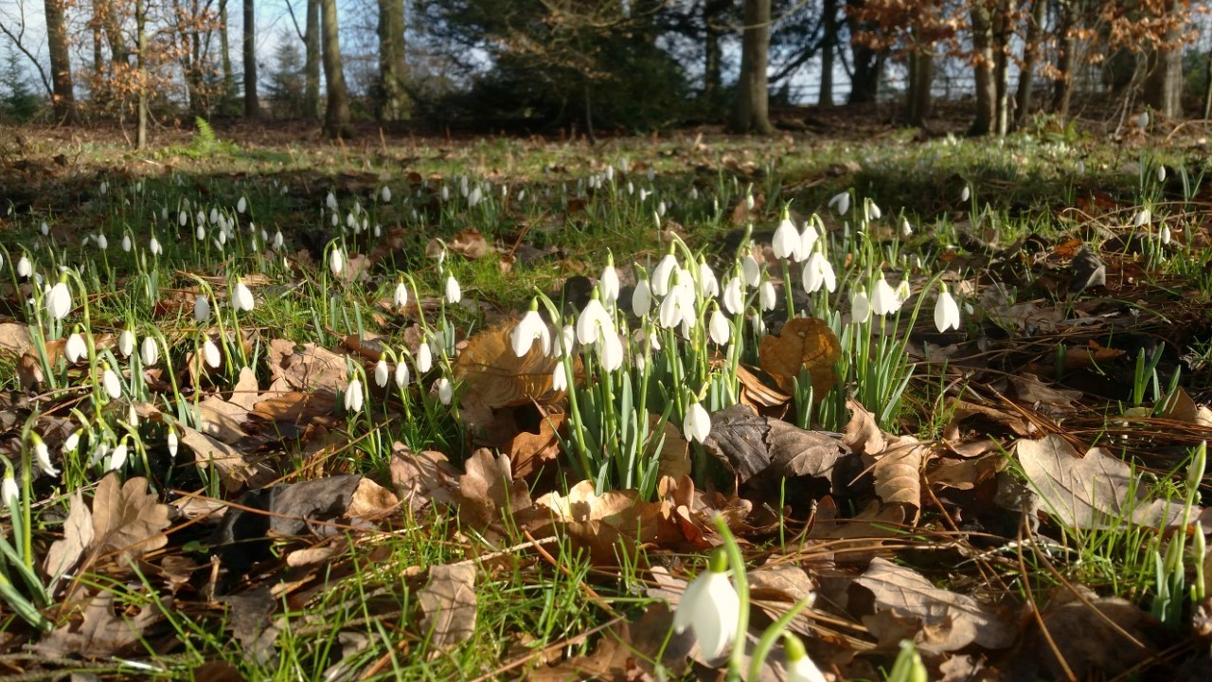
Knowledge Is Power Using Research to Conserve Historic Parks and Gardens
Hodsock Priory, 28th February 2017
Historic Landscape Project
Notes:
Thanks for coming. So pleased to see so many of you, and from such varied backgrounds.
9 CGTs represented today and 6 councils…
With my Notts GT hat on, I’m pleased to see people here from all five E Mids counties, as we’re starting to organise a joint research and recording project for the region. After this day, perhaps you’ll feel inspired to volunteer!
I know it’s always a special effort to get out to rural landscapes like this, but I’m sure you’ll agree it is well worth the effort
Thanks to George Buchanan and his team for looking after us today.
Housekeeping – loos, fire, shoes
Location of lunch

Slide 2
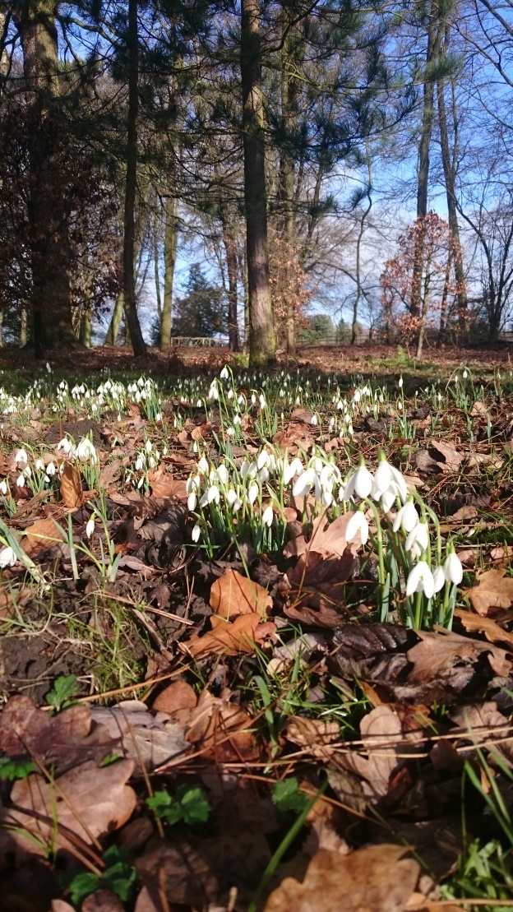
Why are we here?
Celebrate CGT volunteers’ research and recording work
Find out how it’s done
Understand how its importance for conservation grows exponentially, once it is linked to the planning system
Be encouraged to keep going, or inspired to get started!
Notes:
You are here because you have an interest in research
To celebrate the fantastic research work already being done by CGTs across the country.
Much of this published in books / leaflets BUT it is when this research, particularly the understanding of significance, is linked to the planning system, that it becomes invaluable.
to describe the key ways in which you can link your research to the planning system, thereby giving it a massive conservation role, particularly in the protection of undesignated historic landscapes.
encourage you to keep going or inspire you to get started!

Slide 3
Plan for the day
Nuts and bolts of how to undertake a research project – both CGT and District Council
How understanding of a landscape’s significance is key to protecting it
How designation can help to protect parks and gardens in the planning system
How and why to get your research onto the Historic Environment Record and other forums.

Slide 4
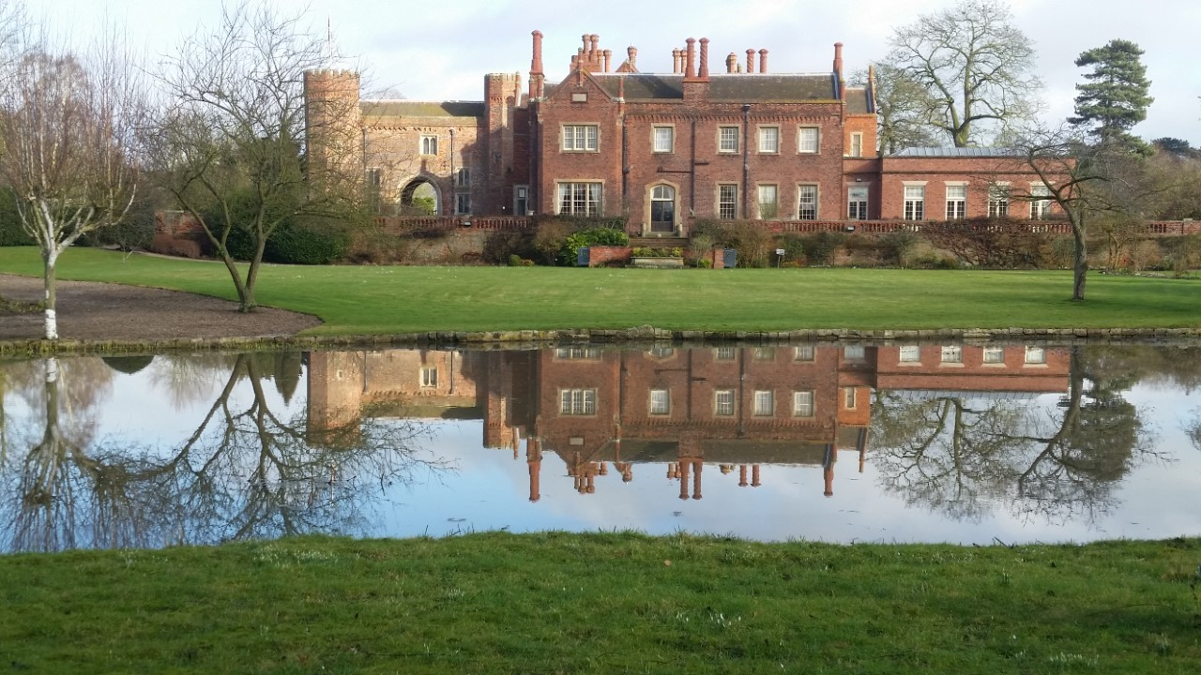
Discover how you can be instrumental in conserving our historic parks and gardens for the future.
Notes:
Introduce Erika, HE’s Heritage at Risk Landscape Architect, East Midlands

