Slide 1
The role of the Gardens Trust in the planning process
Caroline Ikin
Historic Landscape Project Officer
The Gardens Trust

Slide 2
+
=
Research
Conserve
Campaign
Notes:
The Gardens Trust was formed in July 2015 when the Garden History Society merged with the Association of Gardens Trusts. The aims of the Gardens Trust are:
to promote the study of the history of gardens, landscapes and gardening through research and education
to promote the conservation of historic designed landscapes
to campaign for the protection and understanding of landscapes

Slide 3
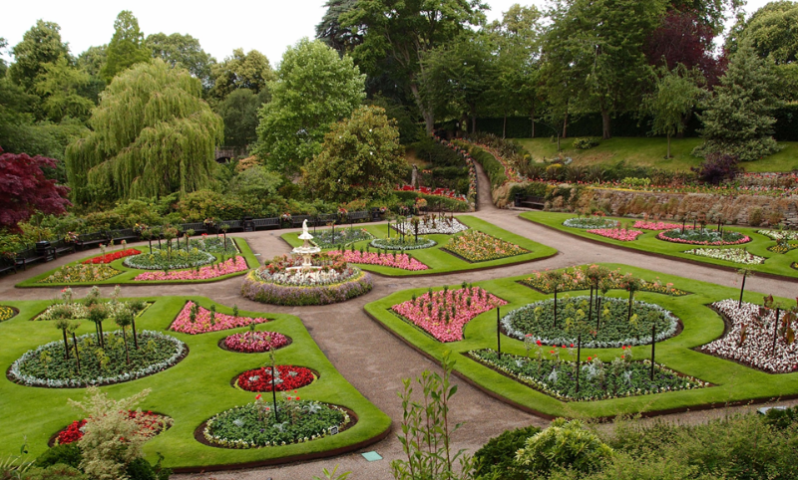
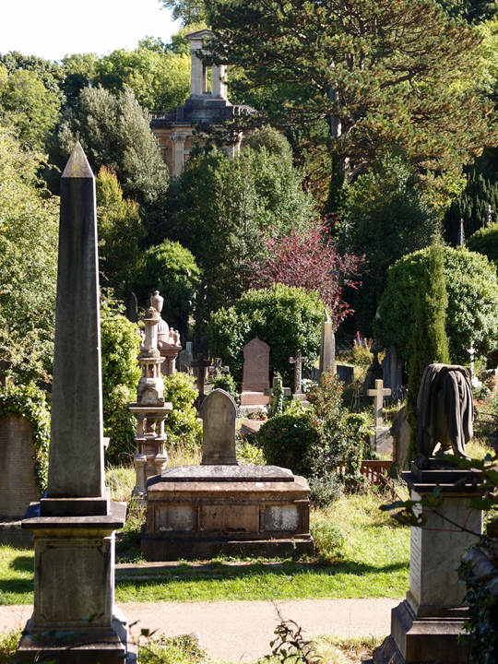
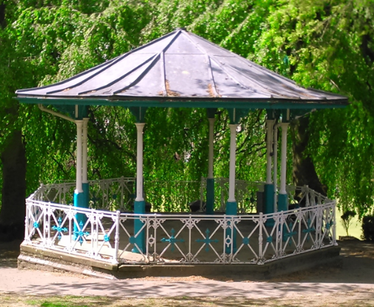
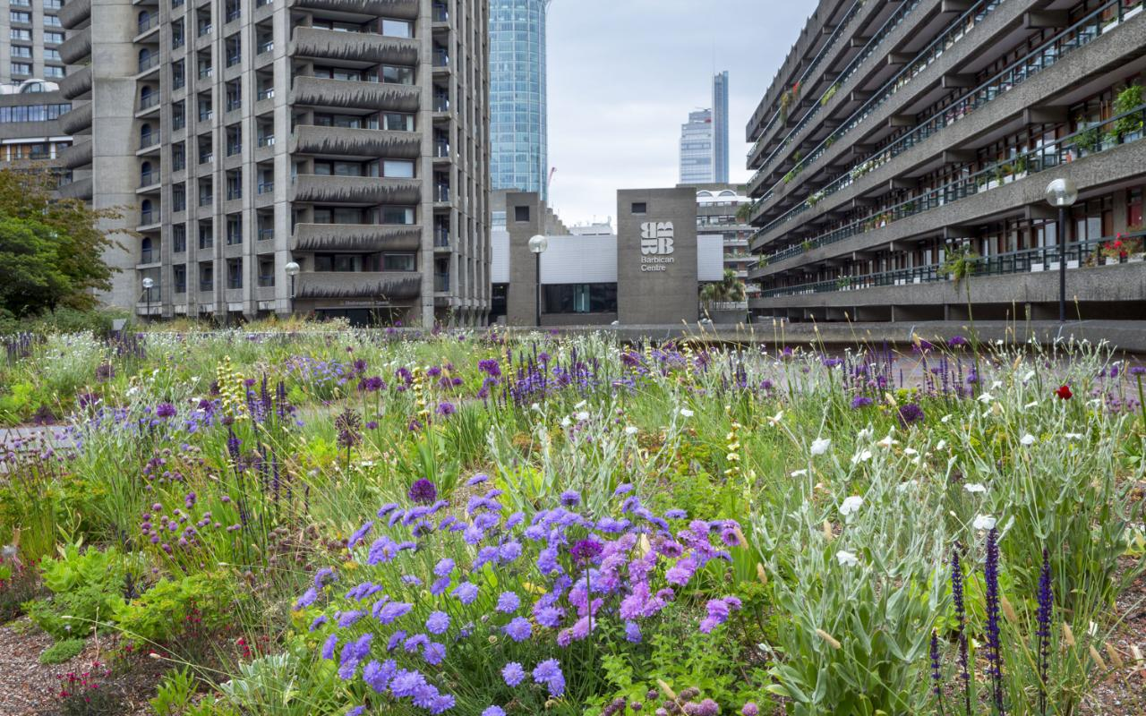
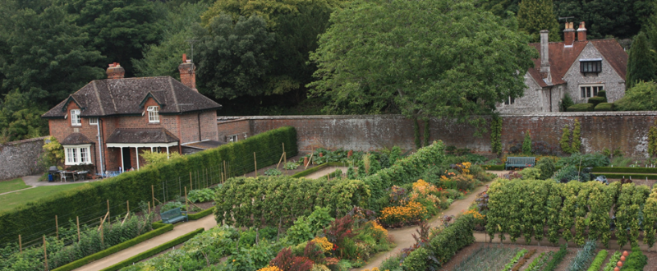
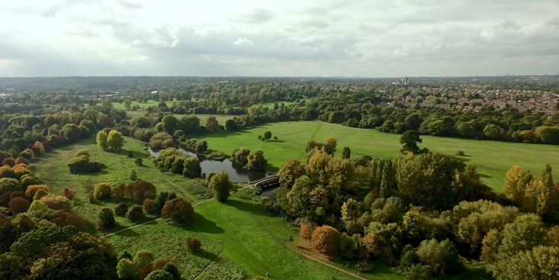
Notes:
Not just gardens – our remit includes parkland, garden squares, public parks, cemeteries, kitchen gardens, playing fields, institutional landscapes, and covers all periods, including modern landscapes. We also work to promote appreciation and involvement in historic designed landscapes and encourage the creation of new gardens and landscapes. We hold lectures and visits and an annual conference, publish a journal and newsletters, as well as our conservation work, which is carried out by a small staff and lots of volunteers.

Slide 4
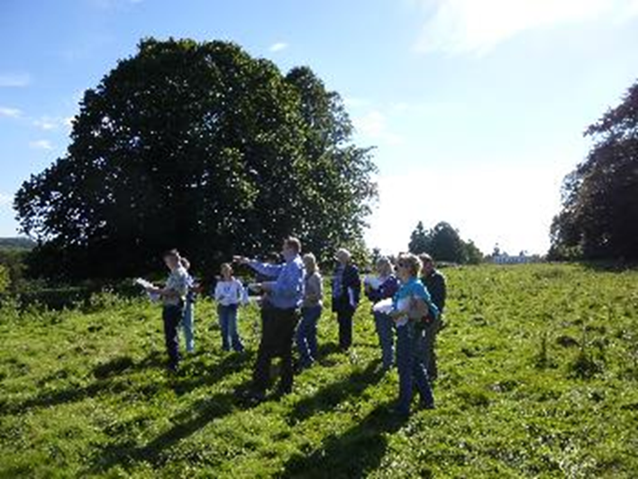
What are County Gardens Trusts?
36 County Gardens Trusts
Autonomous charitable organisations which are all members of the Gardens Trust
Membership varies from 50 to 400+
Research & Recording Groups
Conservation Groups
Education/working with schools
Events and garden visits
Notes:
36 CGTs – one for each county in England – are members of the Gardens Trust, which also has individual members. We also have close links with the Welsh Historic Gardens Trust and Scotland’s Garden and Landscape Heritage. CGTs are involved in a range of activities, but all are individually structured and governed and pursue their own particular interests.

Slide 5
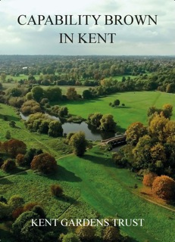
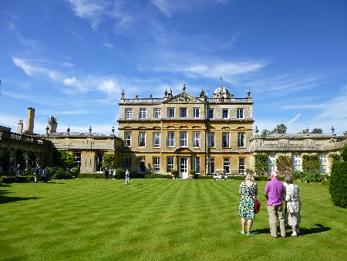
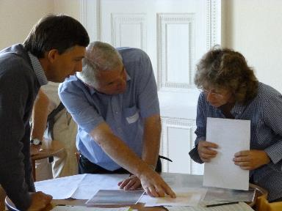
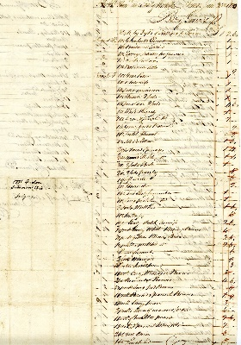
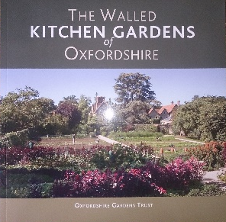
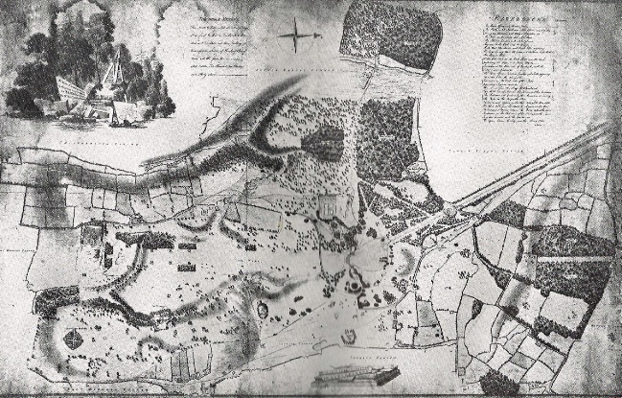
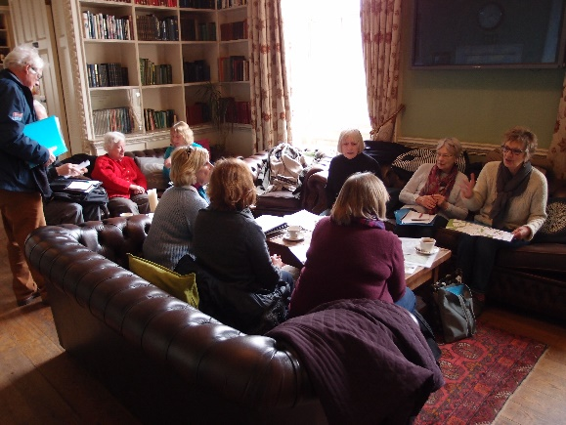
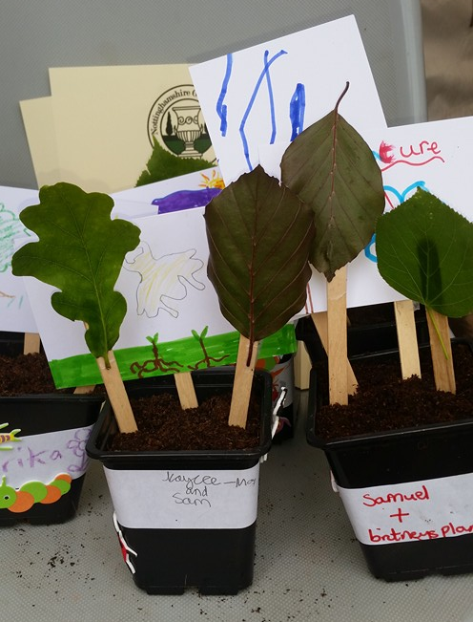
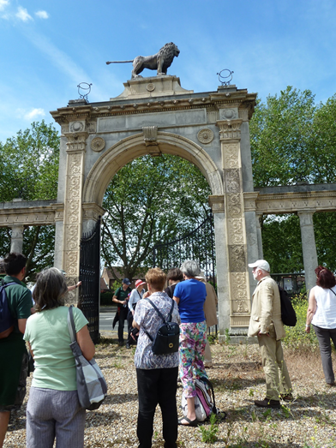
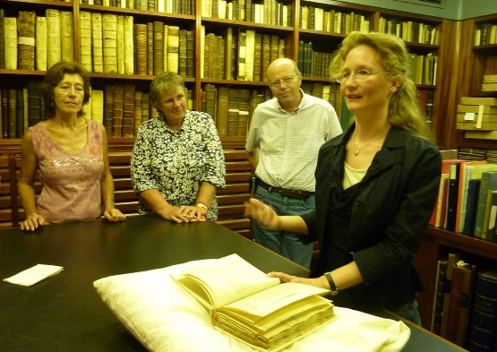
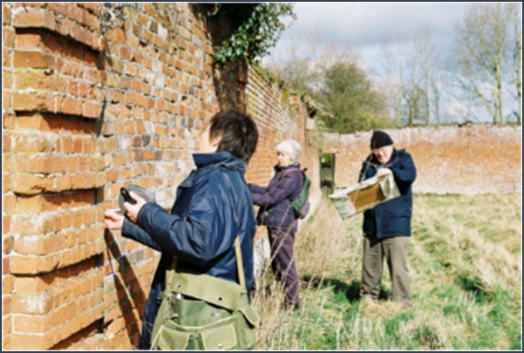
Notes:
Pictures show a selection of the activities CGTs get up to, including visiting landscapes, research and recording (including site surveys, working with archives, training (eg on significance), contributing to local lists, PGUK and HERs), publishing books, articles and newsletters, education (including lecture programmes and working with schools), raising the profile of local landscapes, and undertaking work in the planning system.

Slide 6
Statutory status
The requirement for consultation is set out in Article 18/Schedule 4 of the Town and Country Planning (Development Management Procedure) (England) Order 2015.
Before granting planning permission for development, LPAs are required to consult the Gardens Trust and Historic England.
Historic England in relation to Grades I and II* registered sites
The Gardens Trust in relation to Grades I, II* and II registered sites
Notes:
Statutory consultation requirements have been in place since 1995 in relation to ‘development likely to aﬀect’ registered parks and gardens, passed to the GT from the GHS. LPAs must consult the Gardens Trust on planning applications affecting all sites on the Register of Parks and Gardens. Many CGTs also comment on applications affecting unregistered sites in their local area.

Slide 7
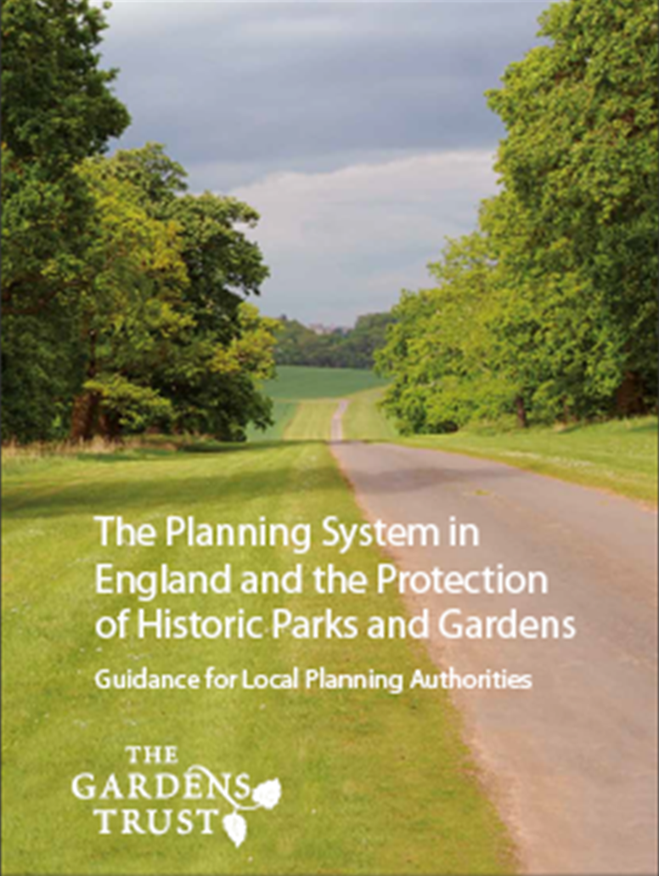
New planning leaflet
Need to introduce the Gardens Trust to local authorities
Need to restate the statutory consultee obligations
Need to ‘introduce’ the County Gardens Trusts and explain their role
New leaflet: ‘The Planning System in England and the Protection of Historic Parks and Gardens’
Distribution to local authorities summer 2016
Notes:
With the formation of The Gardens Trust and the passing of statutory consultee status from the Garden History Society to the Gardens Trust, we feel that it’s time to set out who we are and what our role is in the planning process. The Gardens Trust is about to publish a leaflet which will clarify roles, working relationships, obligations, and the position of historic parks and gardens in the planning system, and will be available to all LPAs and other organisations, such as national and local amenity societies.

Slide 8
How does the Gardens Trust manage the consultation process?
The Gardens Trust receives consultation from local planning authorities on planning applications relating to Grade I, II* and II landscapes.
All applications are logged in the GT Casework Log by the GT Casework Manager and circulated in a weekly list to CGTs
The GT Conservation Officer goes through the weekly list and determines which applications require a response.
The GT turns to CGTs for help – CGTs are not statutory consultees but their local knowledge, research, site visits and advice is invaluable.
A response is written, sometimes by a CGT, sometimes by the GT and sometimes by both.
Notes:
The Gardens Trust (GT) is a statutory consultee. This obliges local planning authorities to consult it on planning applications affecting registered landscapes. The GT conservation team consists of a part-time conservation officer and a part-time Casework Manager and we are supported by members of CGTs to provide local expertise to allow us to respond to planning applications. The consultation process works like this (set out above). The Historic Landscape Project has been set up to increase capacity in CGTs to carry out this work and to facilitate communication between the GT and CGTs, and also to help CGTs build relationships with other organisations such as HE, HEROs, PGUK, other amenity societies and, of course, their local planning authorities.

Slide 9
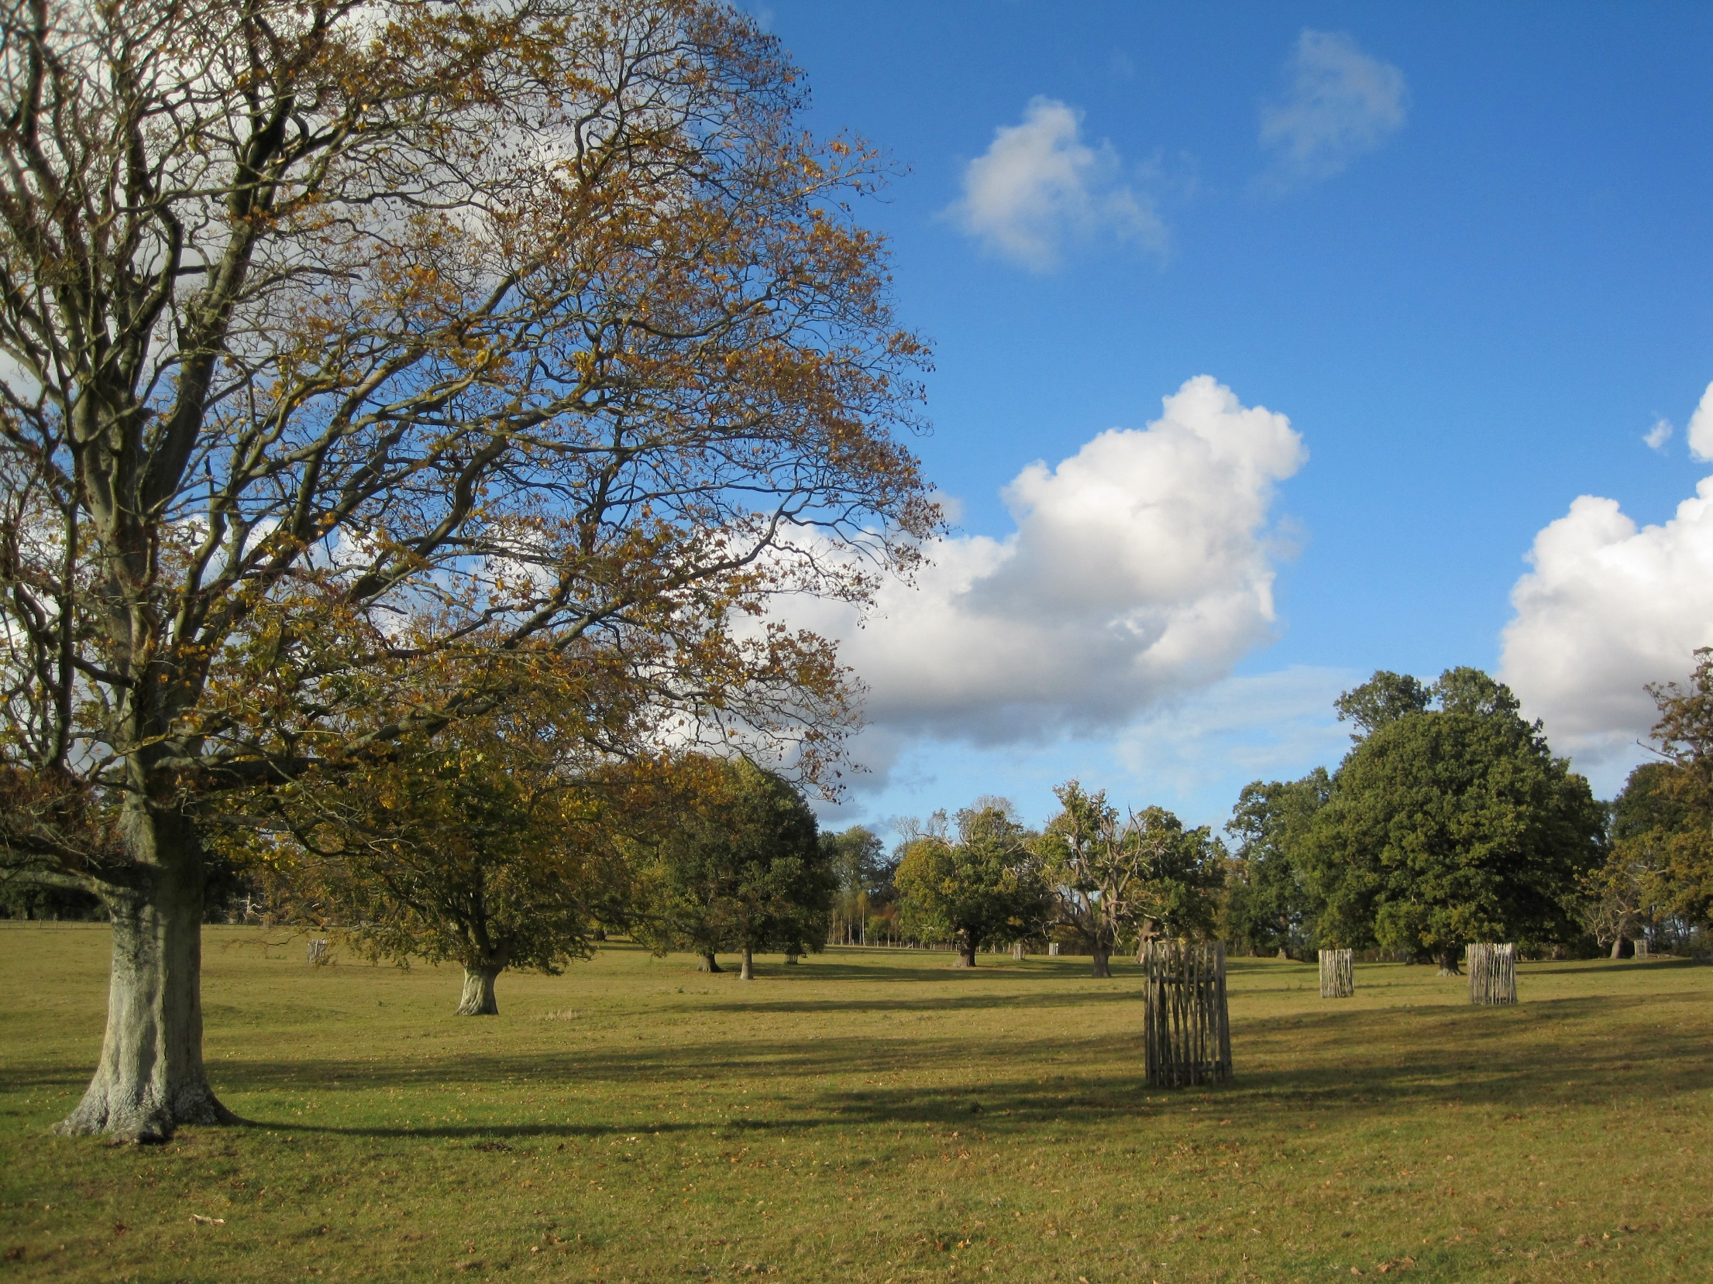
Notes:
Last year, the GT is was consulted on around 1700 applications affecting historic landscapes in England, which we suspect is probably rather less than we should have been, and we hope that the planning leaflet will help to ensure the GT is more widely and consistently consulted. We also collate information on the outcome of planning applications, which is added to the Casework Log and gives a more complete picture of the conservation of historic designed landscapes, and demonstrates the impact of our work in the sector.

