Slide 1
KENT GARDENS TRUST
RESEARCH GROUP

Slide 2
What we have achieved
How we went about it
Problems – only a few

Slide 3
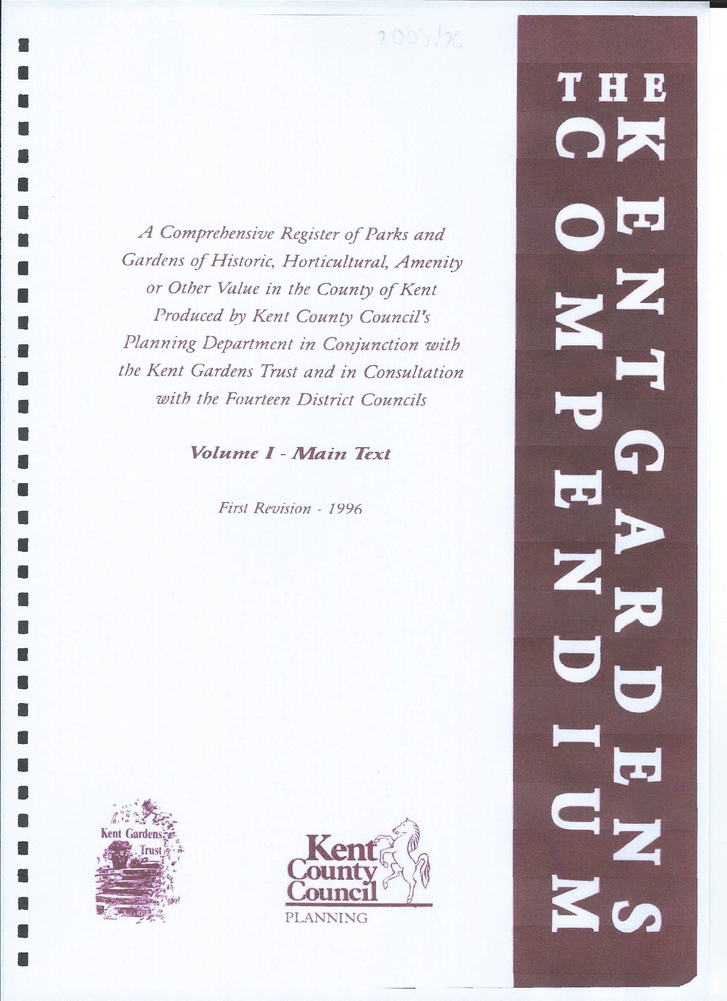
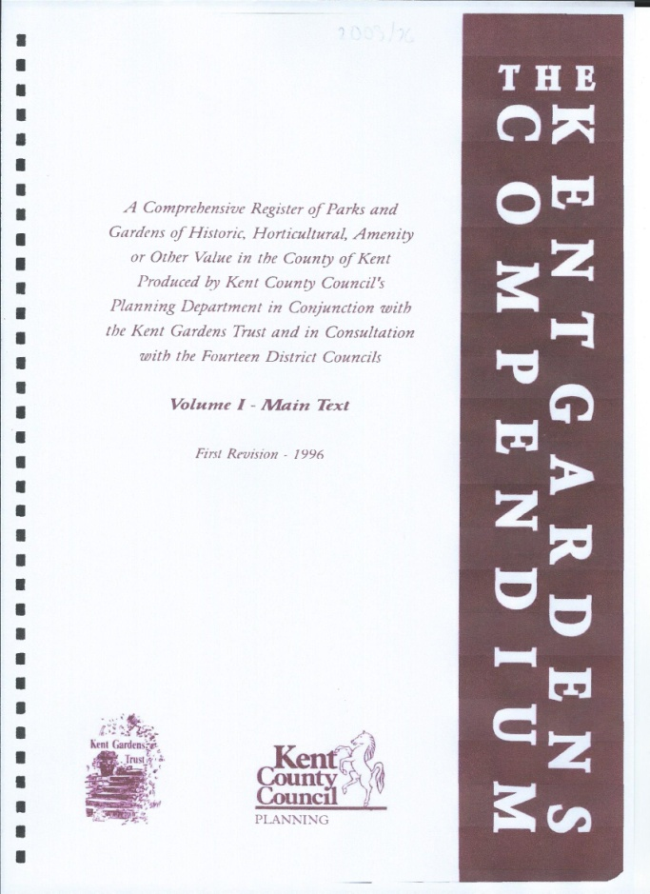
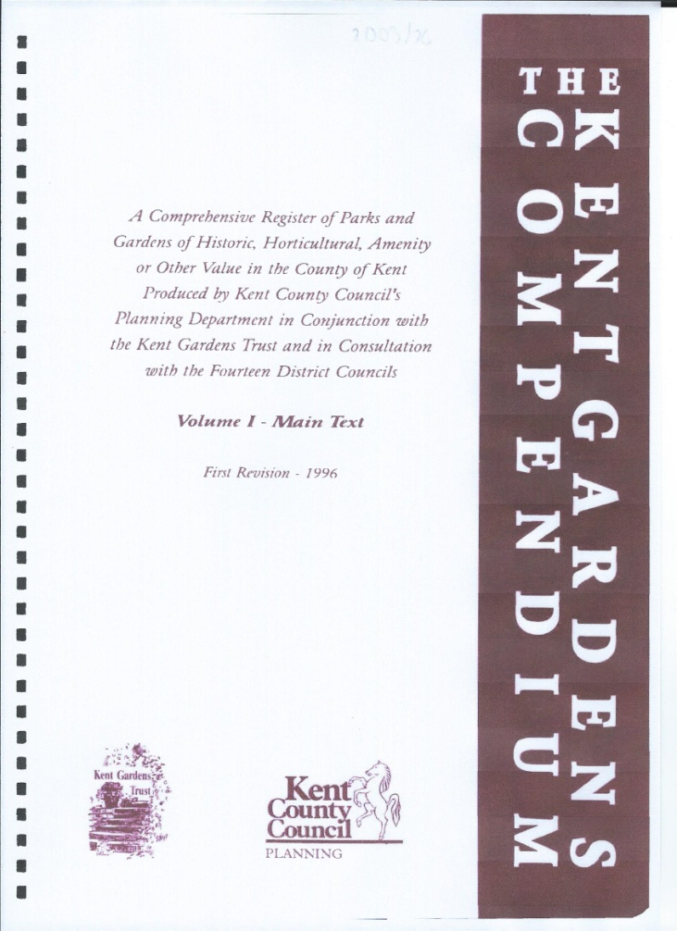
The Kent Garden Compendium
Commenced in 1988 and revised in 1996 in conjunction with Kent County Council.
3 volumes.

Slide 4
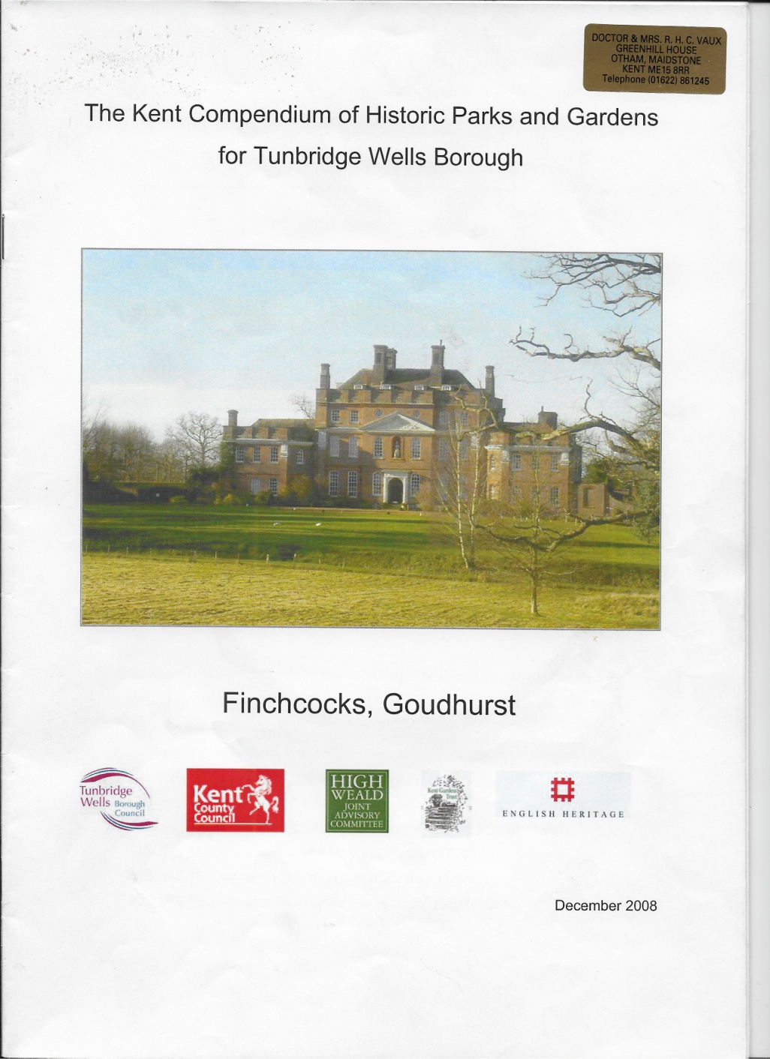
In 2008 it was decided to
carry out a further revision
Tunbridge Wells (27)
Sevenoaks (20)
Medway (27)
And now Dover
Extra sites in Margate
and Lamberhurst

Slide 5
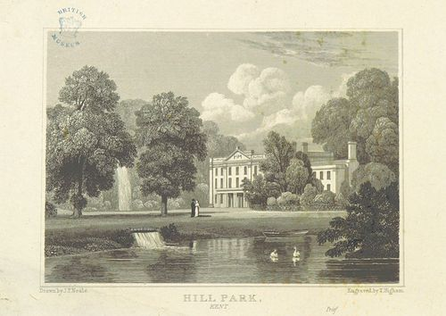
VALENCE. The first Capability Brown site we surveyed
which gave us the idea for the book.

Slide 6
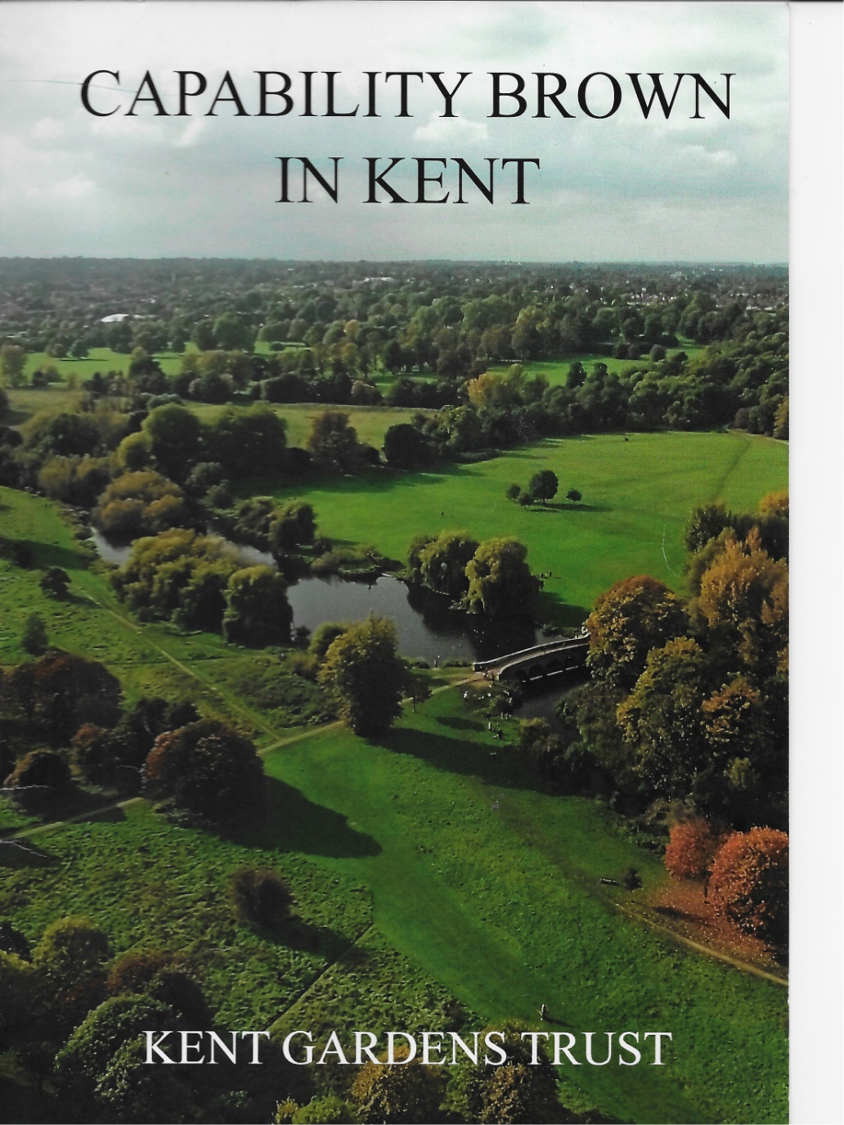
In May 2016 we published
‘Capability Brown in Kent’.
Chilham Castle
Leeds Abbey
Ingress
Valence (Hill Place)
North Cray Place

Slide 7
The reports were laid out in English Heritage format
1. Summary and Statement of Significance
2. Chronology of Historic Development
3. Description of Site
4. References
5. Images

Slide 8
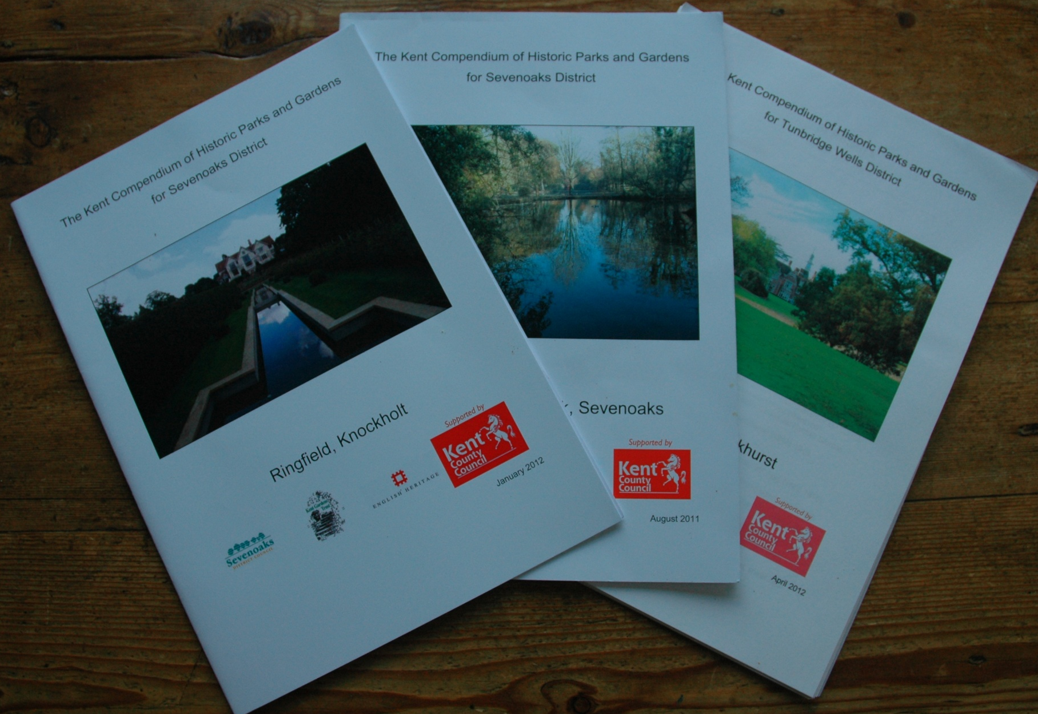
What did we do with the reports?
Published them in paper format
and on KGT website
Nearly all are on the Parks and
Gardens UK data base.
What have they been used for?
1. A source of information which is available to everyone
Planning permission
3. Grant applications
4. Local listing
5. Basis of other publications eg Medway booklet

Slide 9
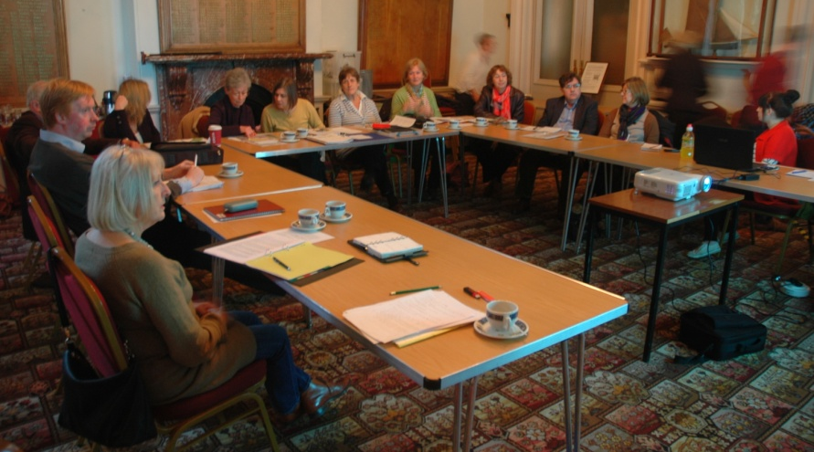
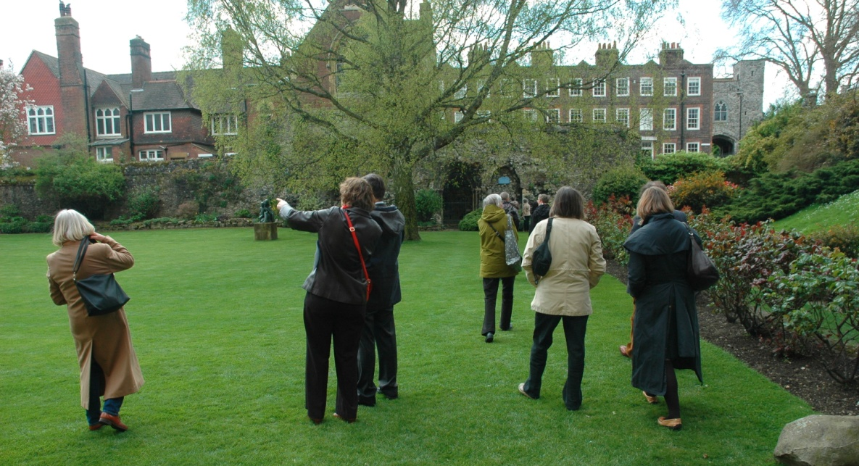
How did we go about it?
1. Initial enthusiasm of Tunbridge Wells BC, Kent CC and KGT and our trainers
2. Spreading the word and recruiting volunteers
3. Training . Formal sessions, example and mentoring.
4. Into action.
Part of the cloister gardens
at Rochester Cathedral

Slide 10
Kent HER packs. Maps, listing, aerial photos, previous compendium entry
Collecting information. Owners, Internet, local societies, record offices
Visiting the site. Walking, recording and photographing
Collating info and writing drafts
Editing
Final draft
Compilation into pdf file with images by Kent HER
Publish. Paper and on line
Entry on Parks and Gardens UK website

Slide 11
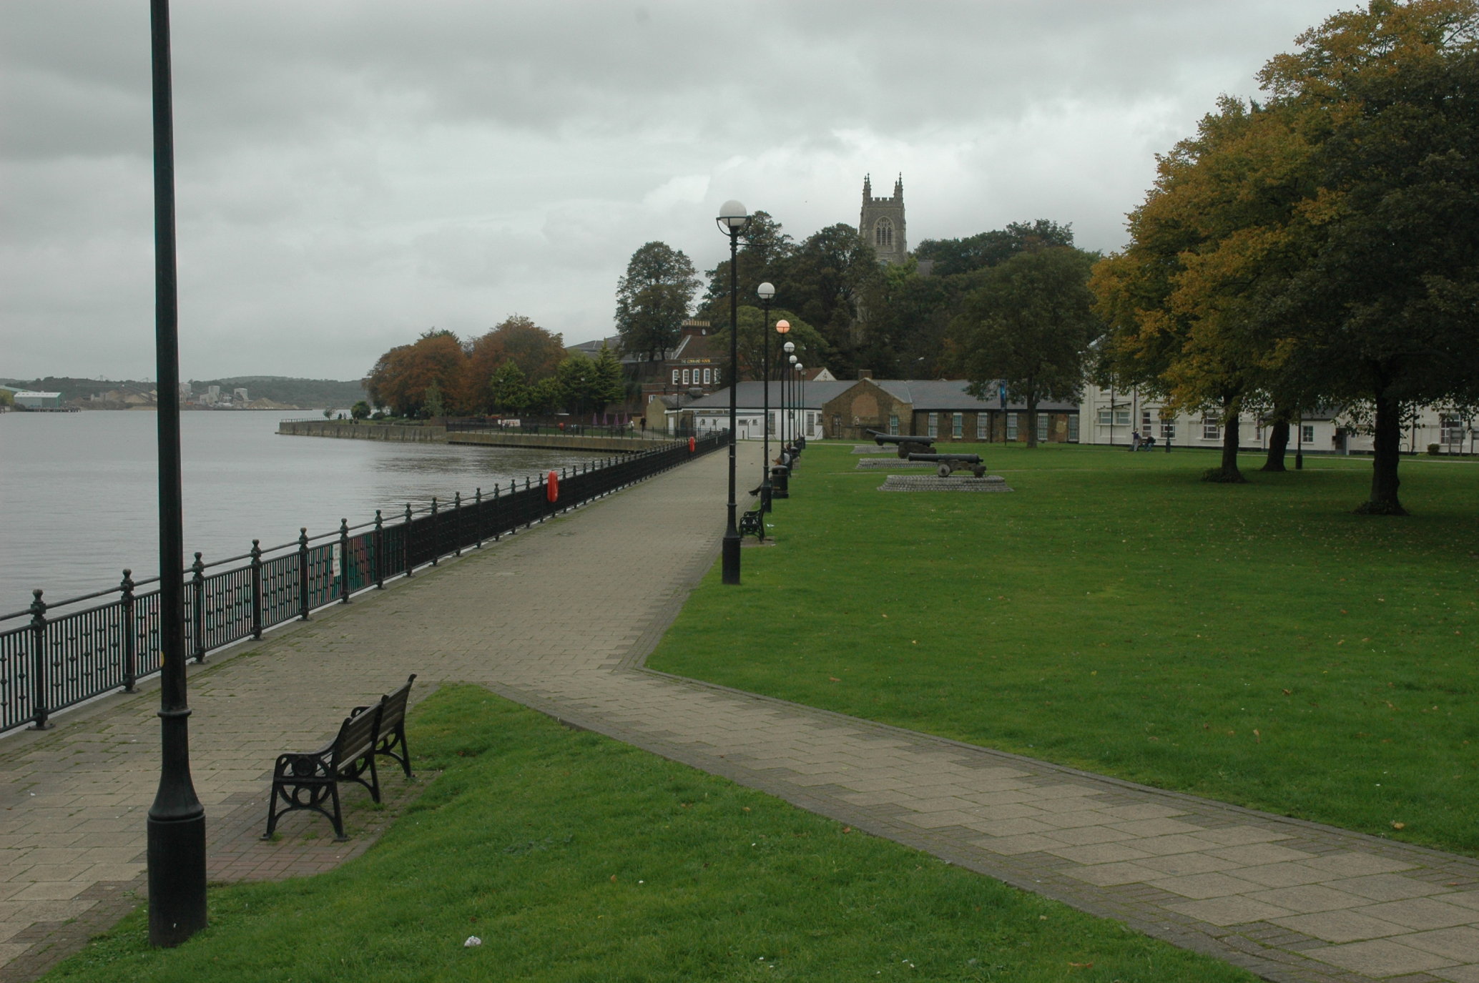

Slide 12
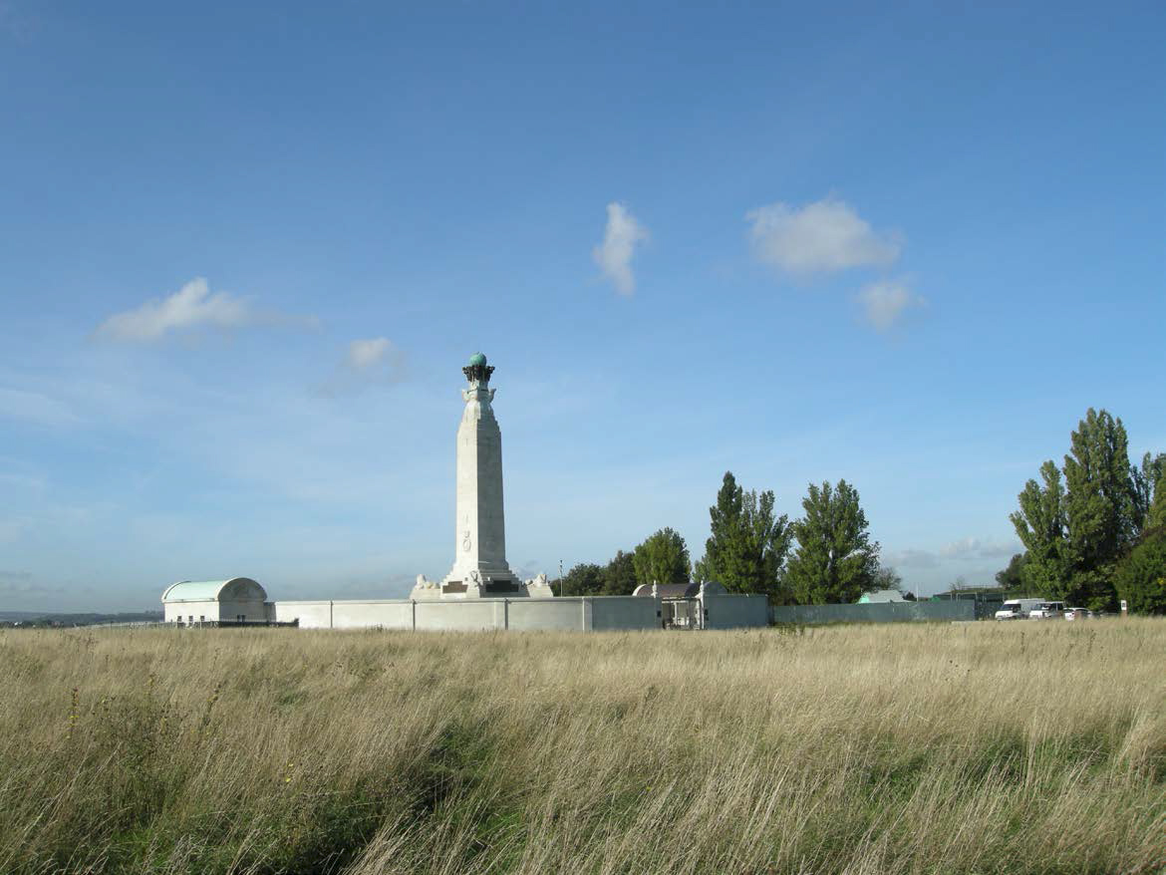

Slide 13
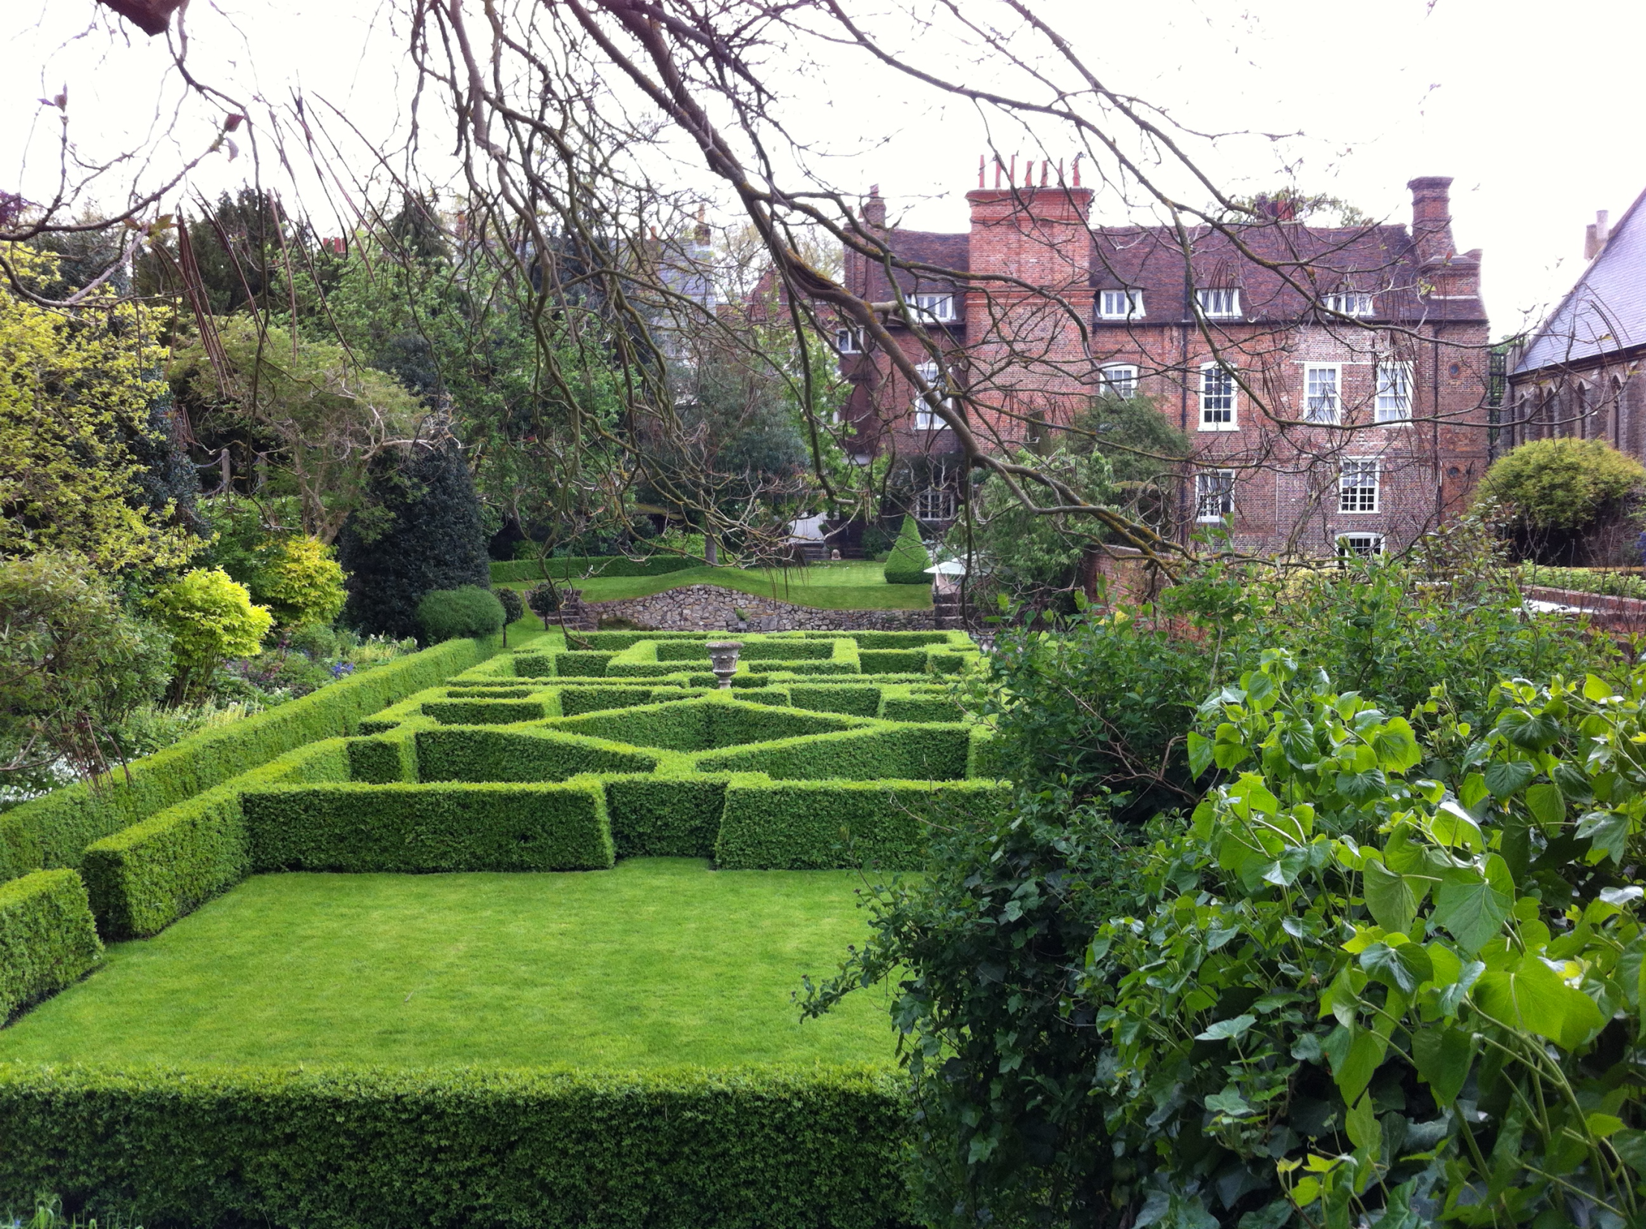

Slide 14
PROBLEMS
Finance
Owner consent
Copyright
Communication with local authorities
Volunteers

Slide 15
FINANCE
Needed for?
Running study days
Paying editor
Publishing - including website
Volunteers expenses
Where from?
Grants and donations
KGT funds
The time given by volunteers

Slide 16
FUNDING OF REPORTS
from
English Heritage
Kent County Council
Tunbridge Wells Borough Council
High Weald Advisory Committee
Sevenoaks District Council
Medway Council
Dover District Council
Thanet District Council
FUNDING OF BOOK
from
Historic Houses Association
Kent Archaeological Society
Rochester Bridge Trust
John Swire 1989 Charitable Trust
Roger de Haan Charitable Trust
Stanley Smith (UK) Horticultural Trust

Slide 17
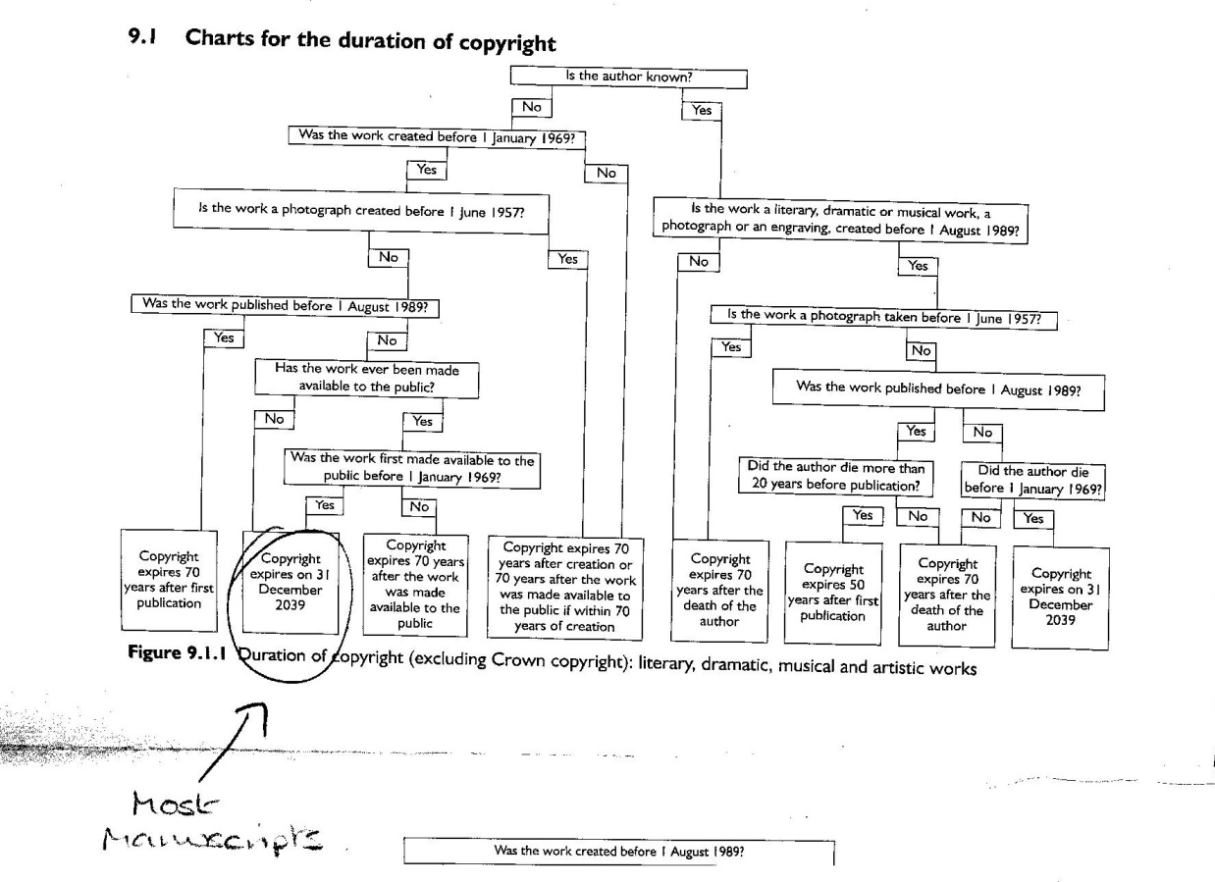
Dear
Kent Gardens Trust Historic Gardens Research Project
Name of Garden:
We are very grateful to you for allowing us to have access to your garden for the purposes of our research project. We hope that you will find the results interesting.
The purpose of the project is to discover more about the historic parks and gardens in Kent and record our findings in order to provide the best possible protection for them in future years. This will involve writing up our research and publishing it in hard copy which will be available to local planning authorities and to researchers in libraries. It will also be accessible on line on your local authority website.
We would like to include photographs and other images of your garden in our report and would be most grateful if you could give your permission for this by selecting Yes or No in answer to the statements below.
I agree that Kent Gardens Trust may take photographs of the garden and include them in their report
Yes/No I agree that the maps, plans, paintings, drawings and other images listed on the attached sheet which are owned by me/us may be photographed and included in the report
Yes/No
Kent Gardens Trust may wish to include the report on your garden on their website and submit the information we have obtained including some images to the Parks & Gardens UK database and website. This will increase wider understanding and appreciation of the history of parks and gardens.
Please indicate if you agree to this.
I agree to the report on our garden being included on the Kent Gardens Trust website
Yes/No I agree that Kent Gardens Trust may submit the report to be included on the Parks & Gardens UK database and website
Yes/No
The Parks & Gardens UK database is a free source of information about historic parks, gardens and green spaces in the UK. For more information please visit its website: www.parksandgardens.ac.uk
Signed
Date
LETTER OF CONSENT

Slide 18
COPY RIGHT FLOW CHART

Slide 19
Communication with local authorities
Some more enthusiastic than others
Those you are dealing with change jobs
Volunteers
Integrating new volunteers – mentoring
Very occasionally one gives up but another takes over

Slide 20
But almost everyone finds the whole process of being a garden detective
is addictive
and above all fun
(even the writing up)

