Slide 1
R and R in Sussex
Where we had got to with researching and recording our county parks and gardens:
In past years we’ve worked towards a pan-Sussex gazetteer: a basic list of sites plus more detailed reports. Have achieved latter on a significant number in West Sussex.
BUT:
Difficult to establish a realisable plan of how to achieve complete county long-term
process was perceived as long, slow, unwieldy and insufficiently focussed to attract new volunteers

Slide 2
Practical reasons why:
hugely variable skills and time - from experienced and new volunteers
limited relevant skills available to train new volunteers
Council members running R and R - differing views on what we should be aiming for and how
Changes in personnel/attitude/support levels of LPAs to working in partnership with CGTs; in particular attitudes of HER staff
Changes in approach by national government – e.g. HE’s guidance on local listing doc in 2013 (?); more LPAs considering local listing - so a formal ‘way-in’ for a CGT

Slide 3
Finding a focus
While our West Sussex work will continue (mainly in the hands of one particular volunteer researcher) we decided to trial a new kind of project that would be:
at the other end of the County - new territory
Tightly-focussed on one place and on one LPA
With a purpose: of submitting sites for a local list of heritage assets
Focussed on finding volunteers who are already passionate about their open spaces
Time limited -2/3 years
Funded – to cover volunteer expenses
Resourced with training time from experienced researchers

Slide 4
Why select Hastings? It is/has:
A specific confined urban area so no travel problems
A local library and museum with collections and meeting space
2 SGT members/trustees knew the area - one knew the conservation officer (exploit any contacts you have!)
A range of designed open spaces to provide experience in site survey and using different types of archive material
Sites in public ownership so to access at any time (no issues with private owners)

Slide 5
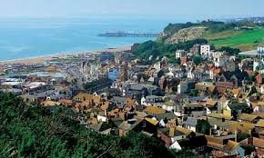

Slide 6
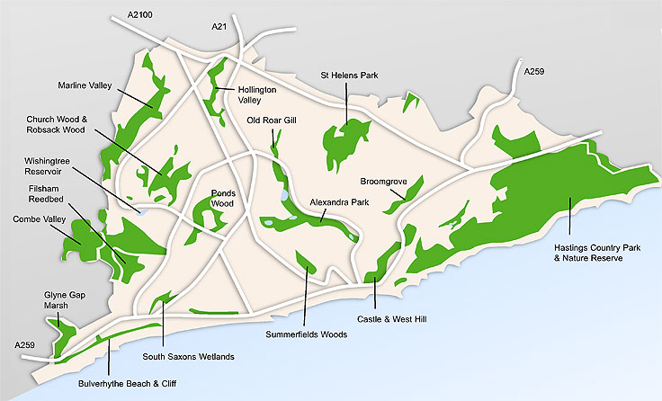

Slide 7
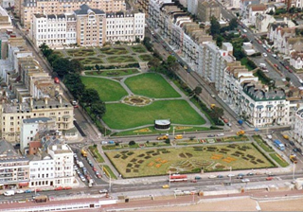

Slide 8
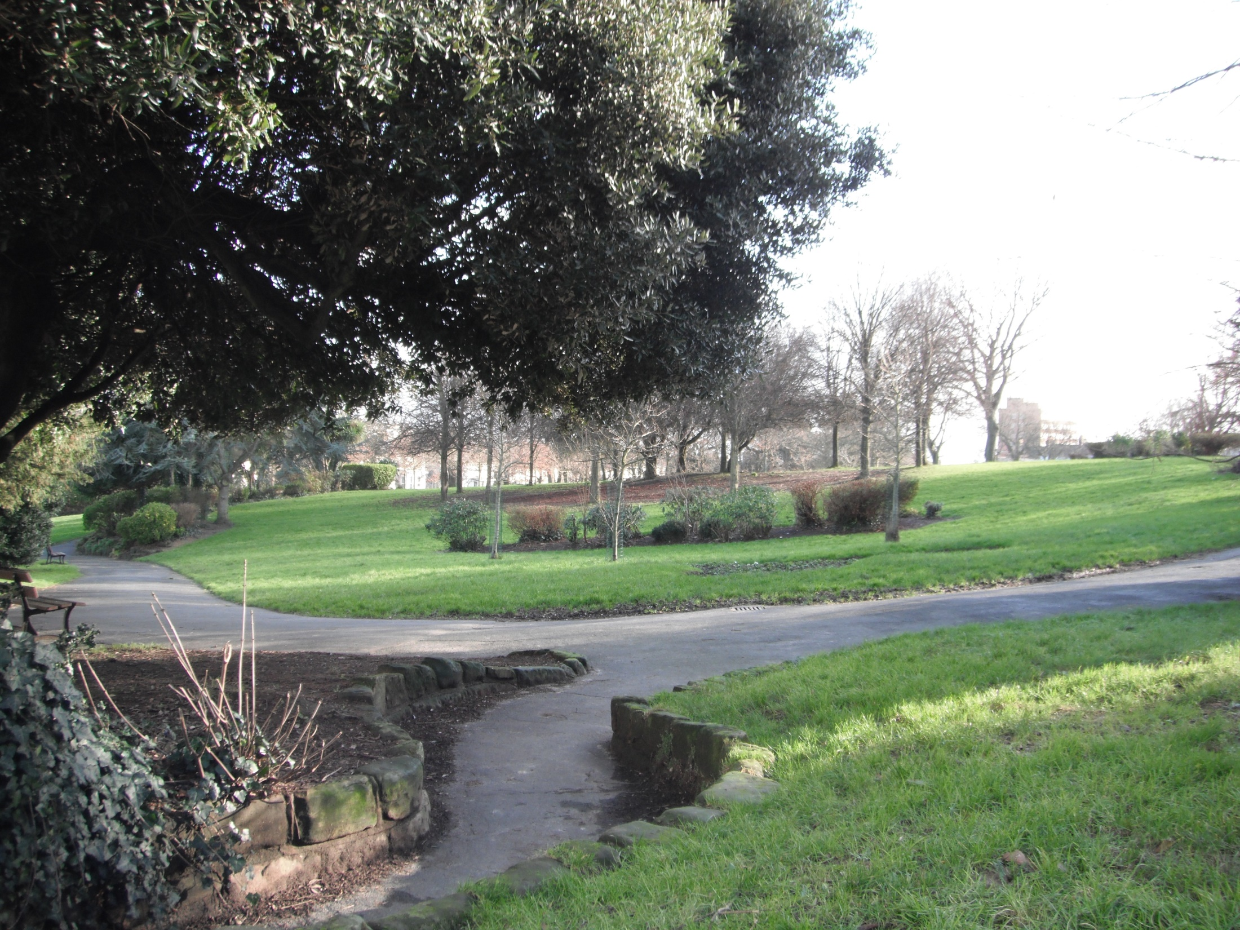

Slide 9
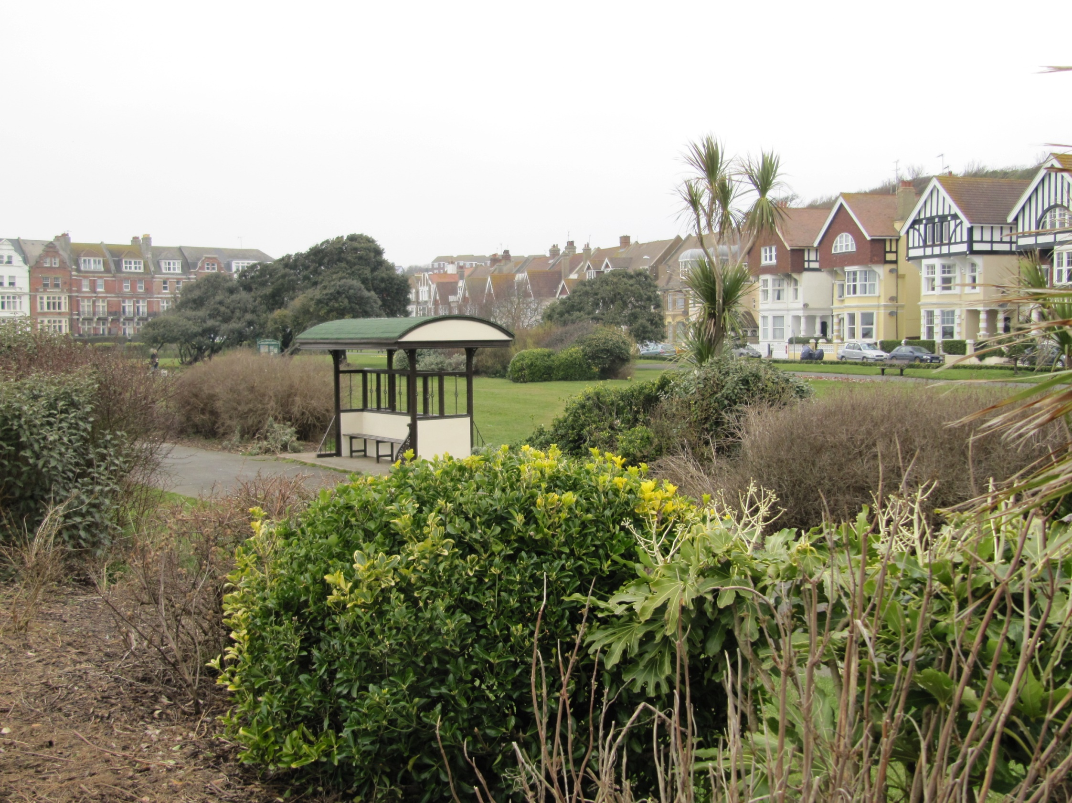

Slide 10
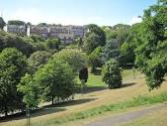

Slide 11
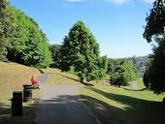
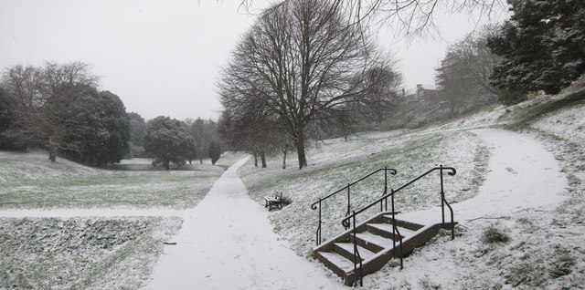

Slide 12
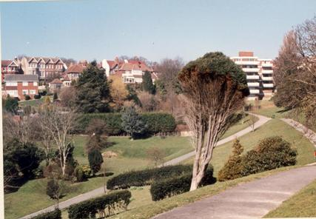
Linton Gardens Photograph c 1990

Slide 13
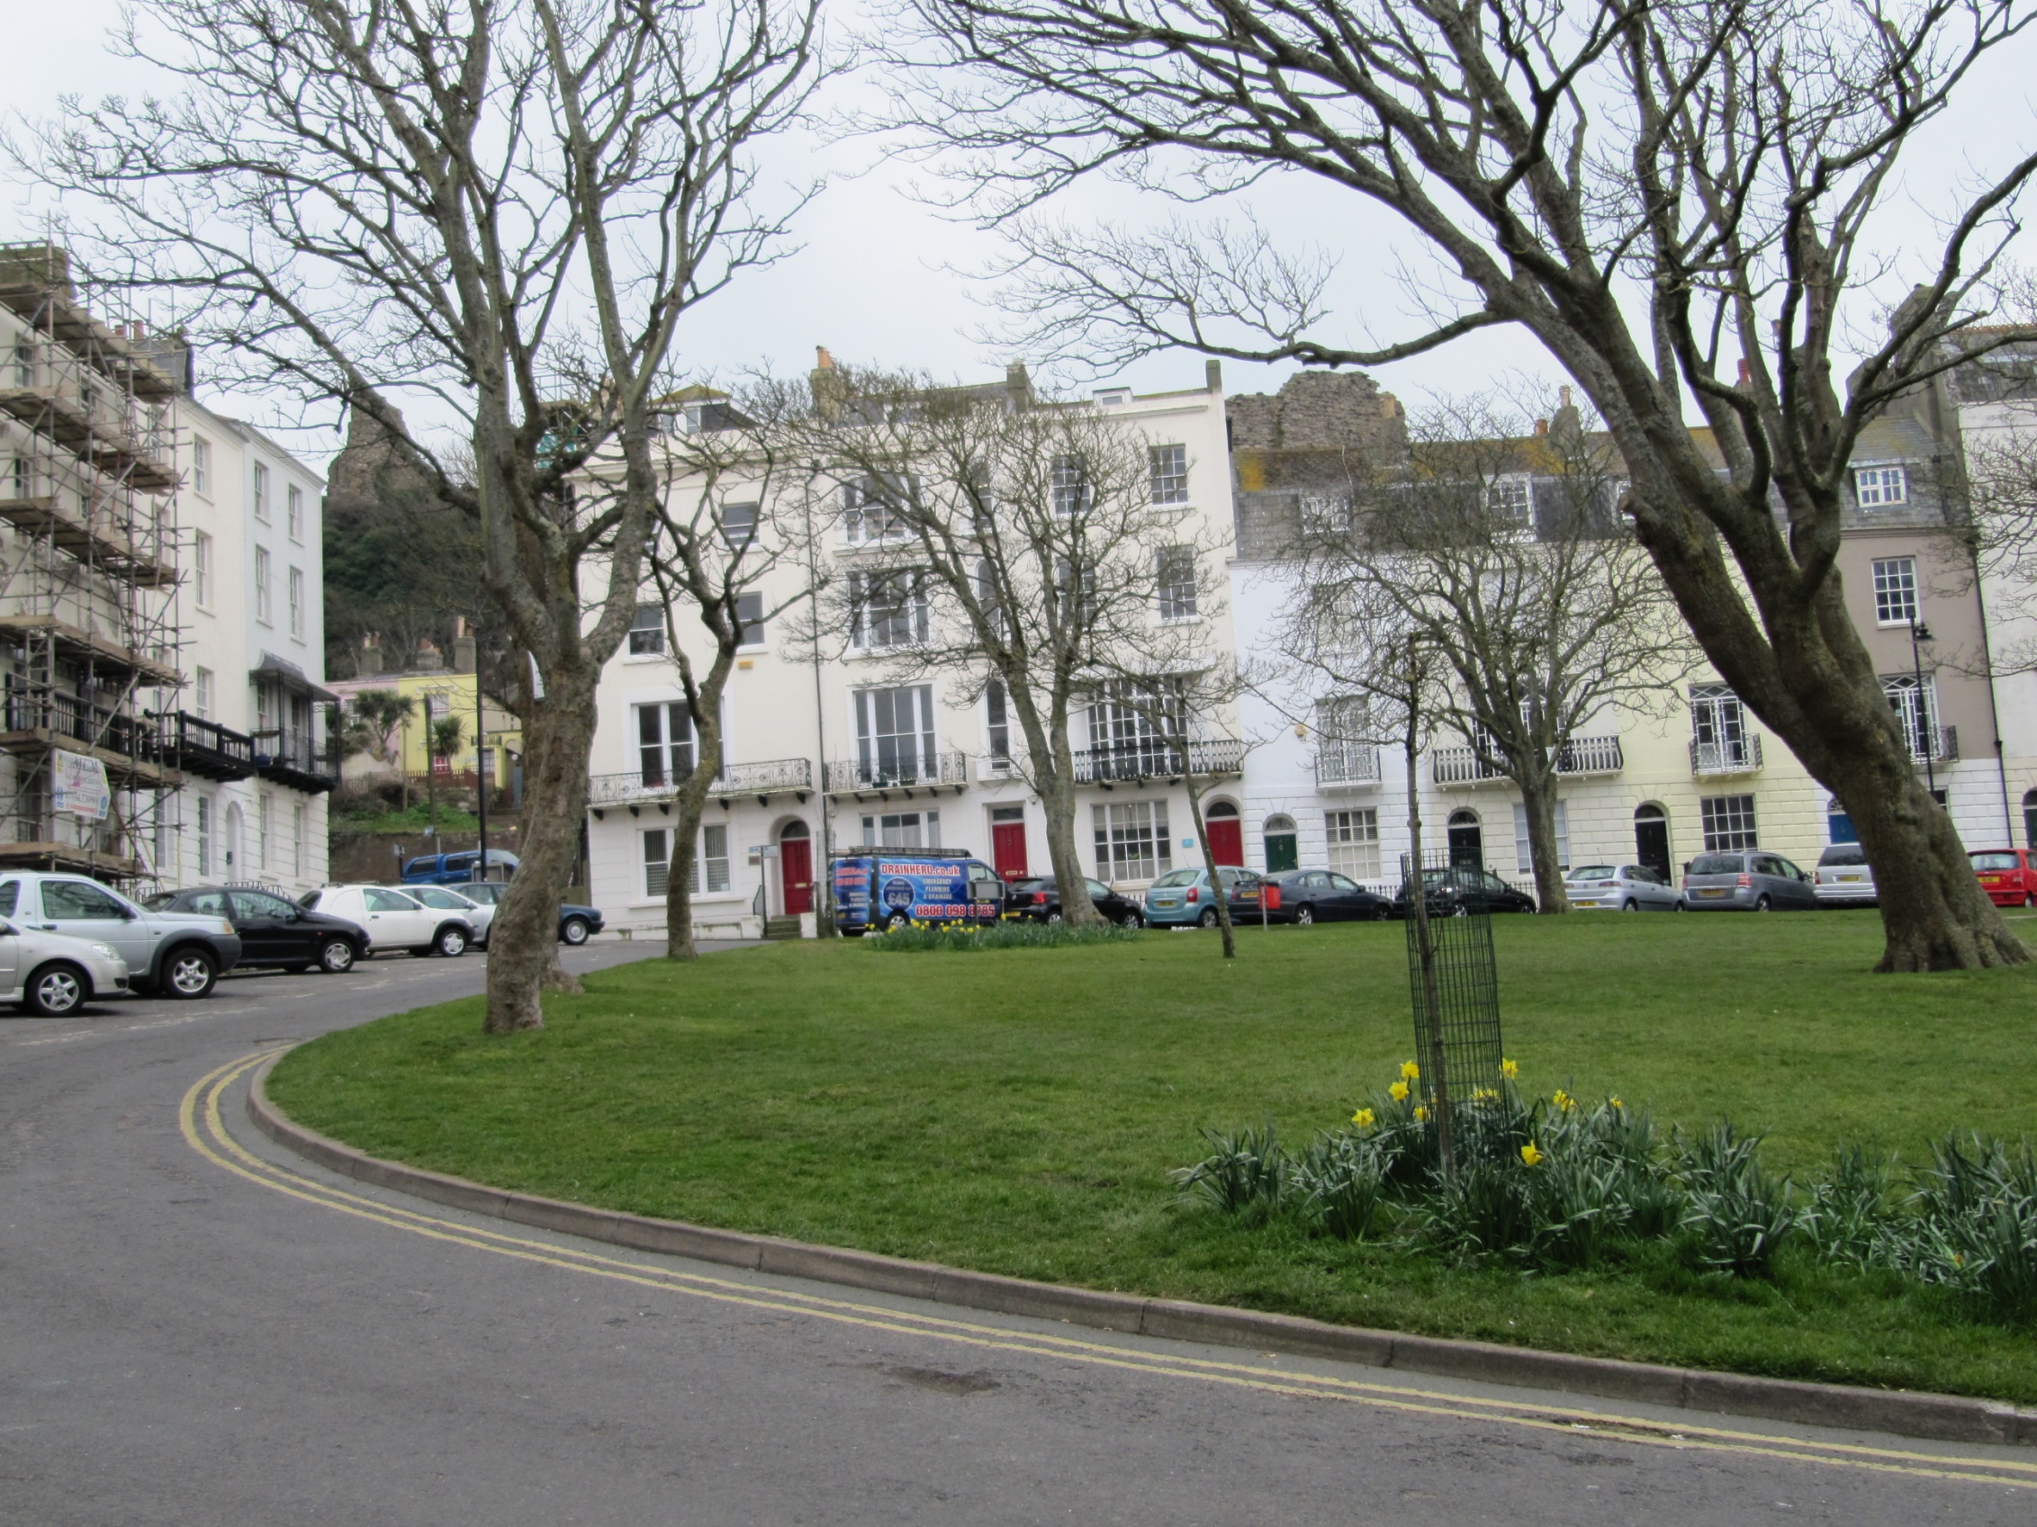

Slide 14
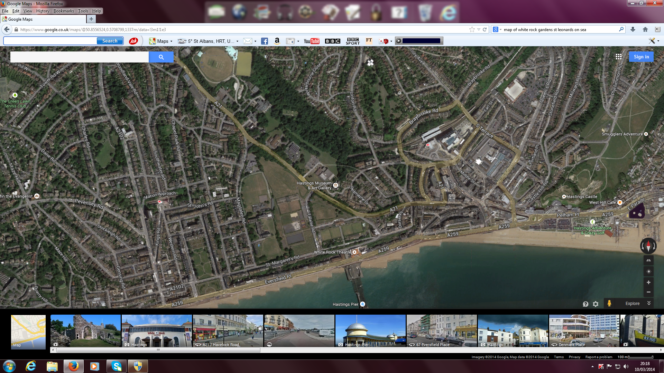

Slide 15
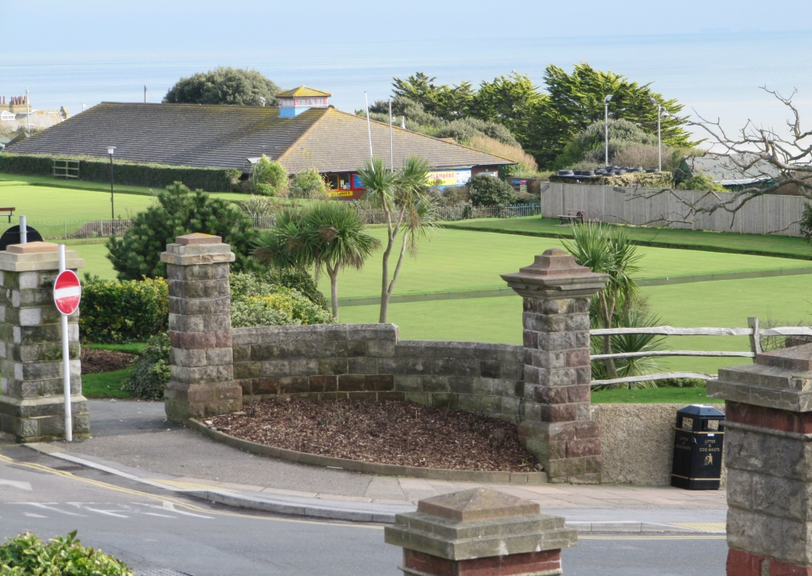
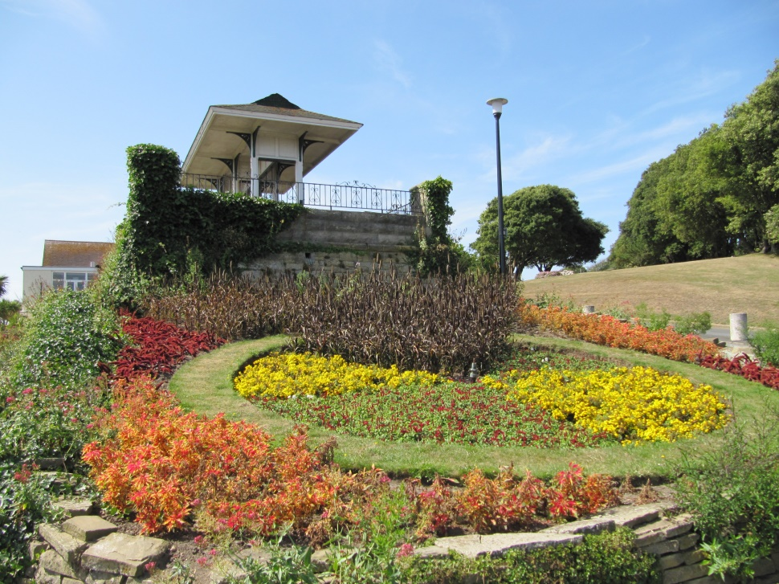
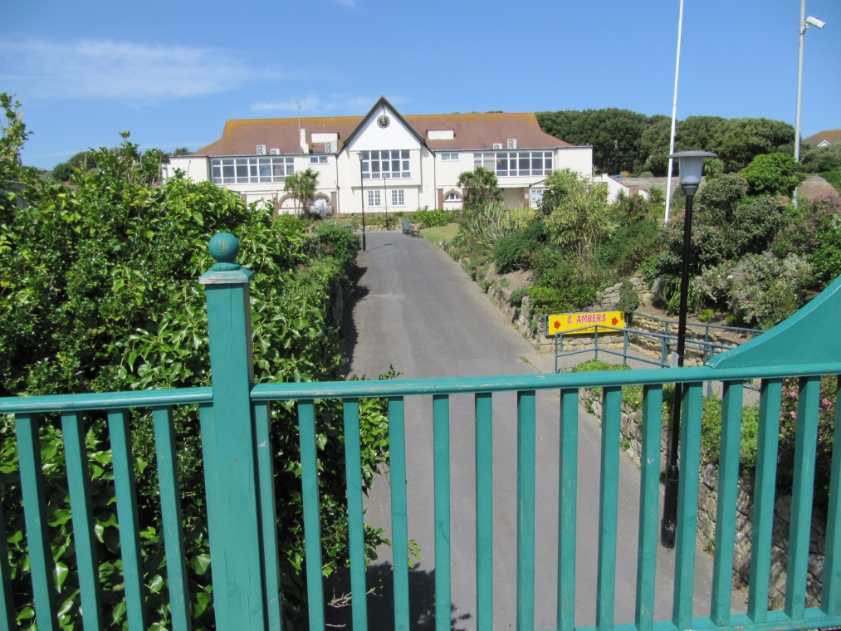
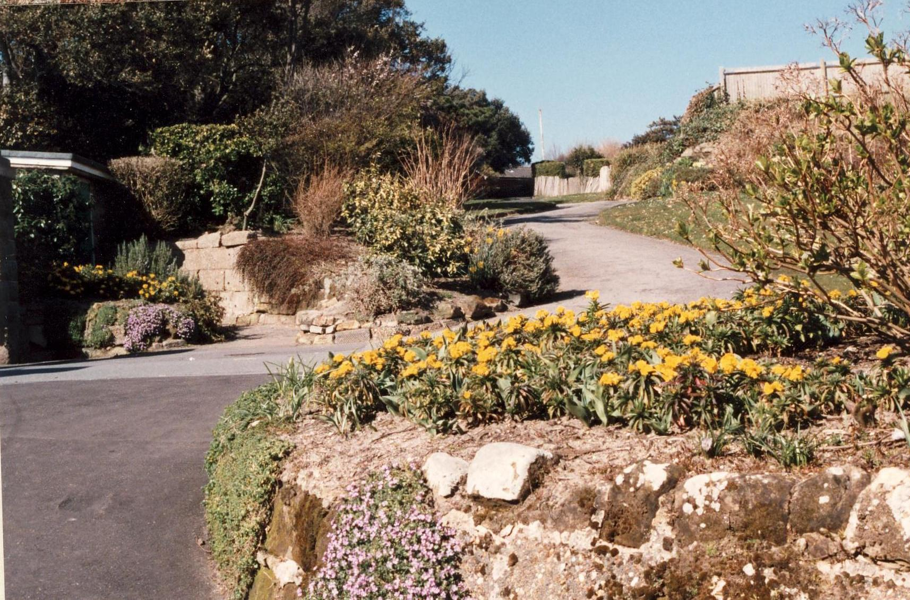

Slide 16
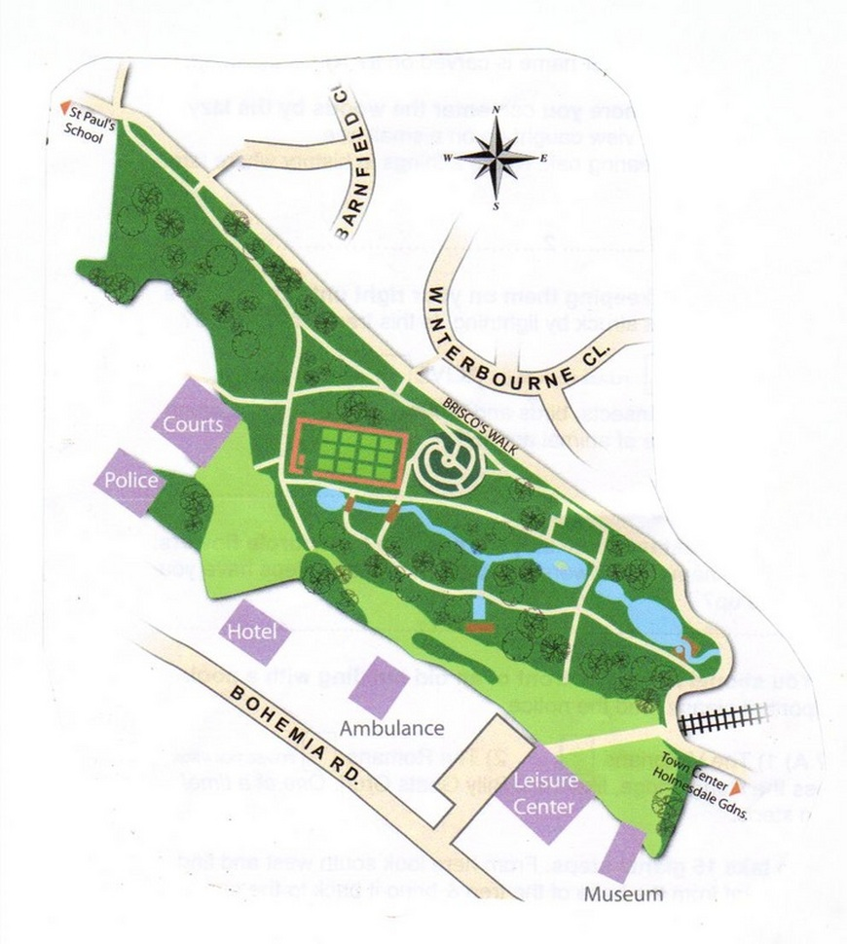
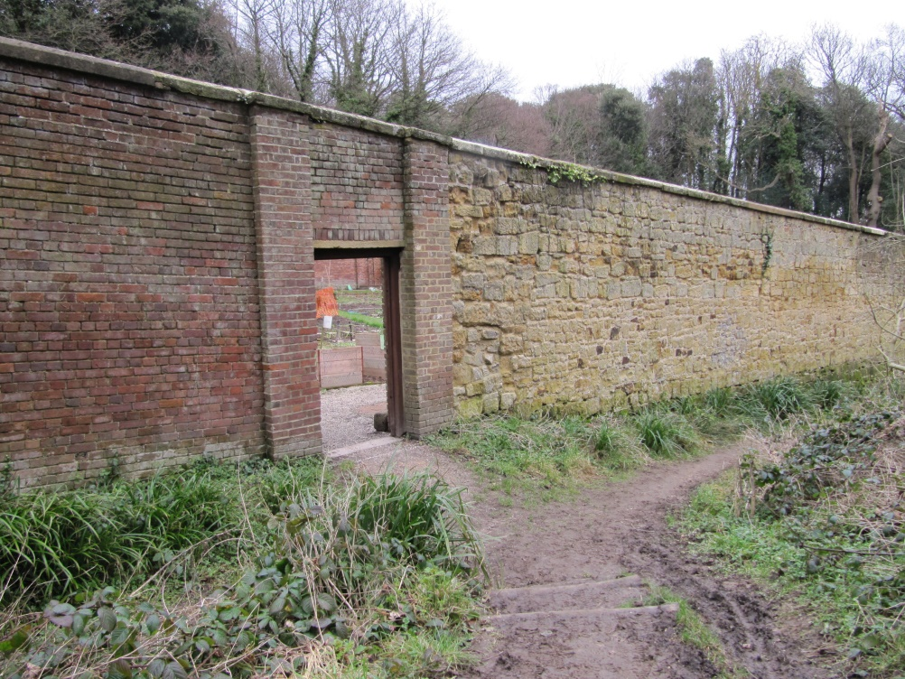
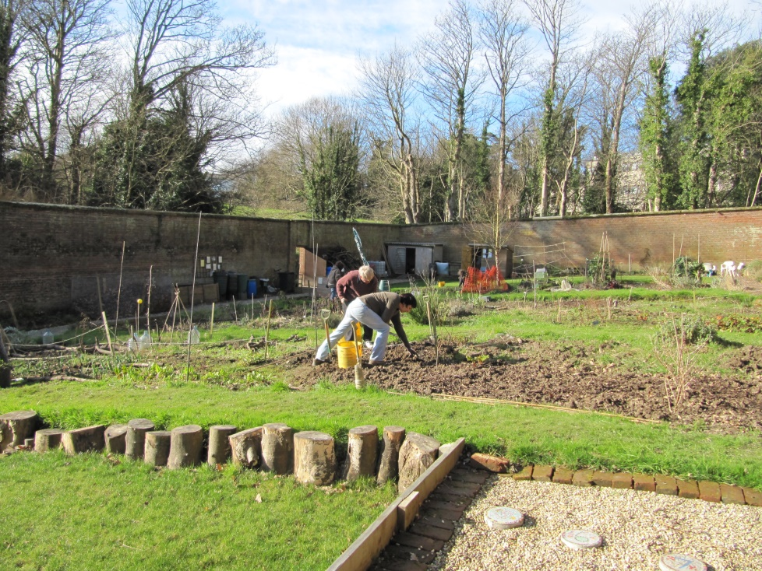
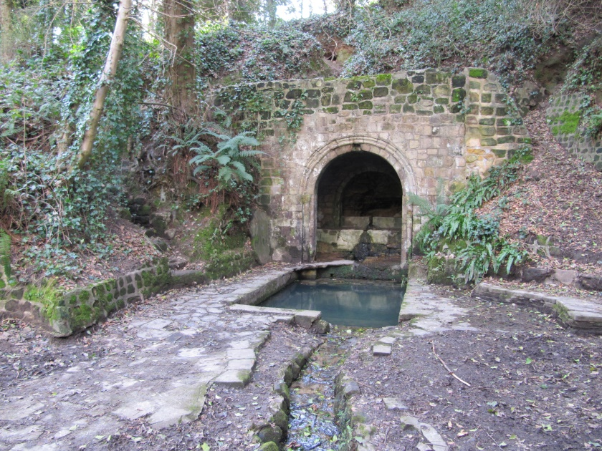

Slide 17
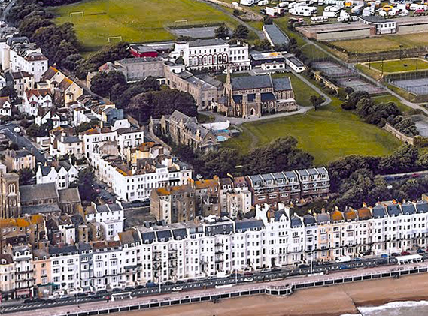
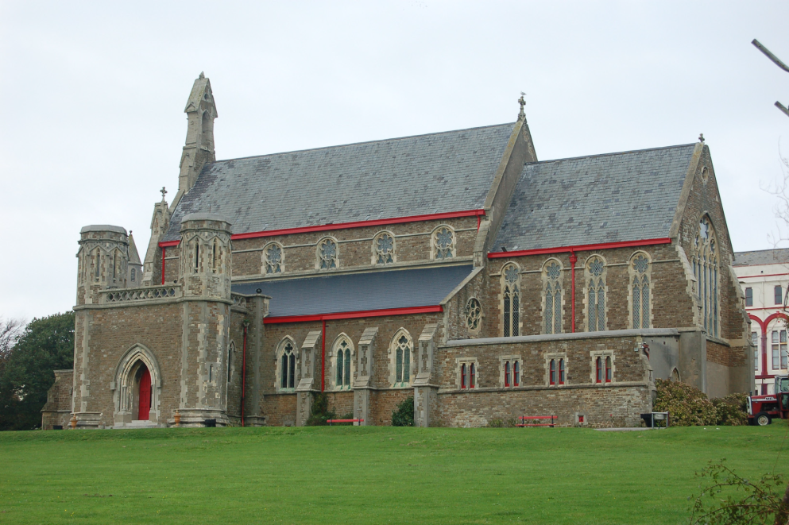
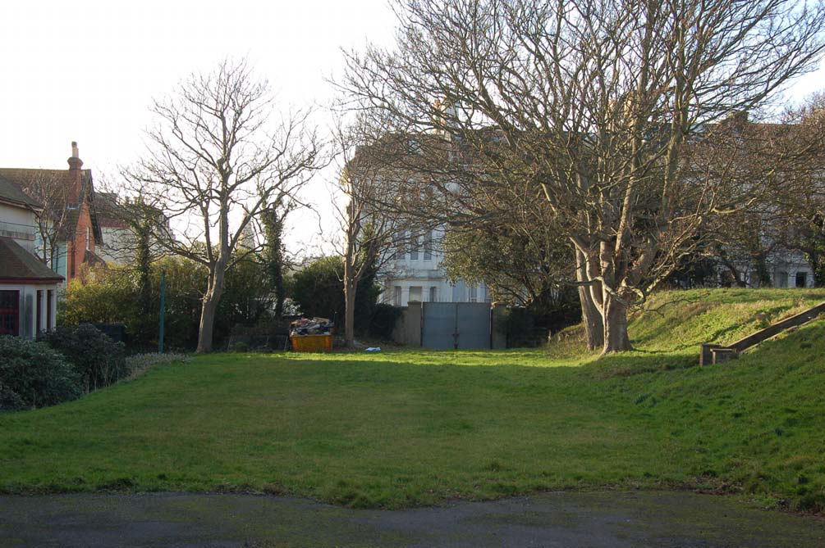
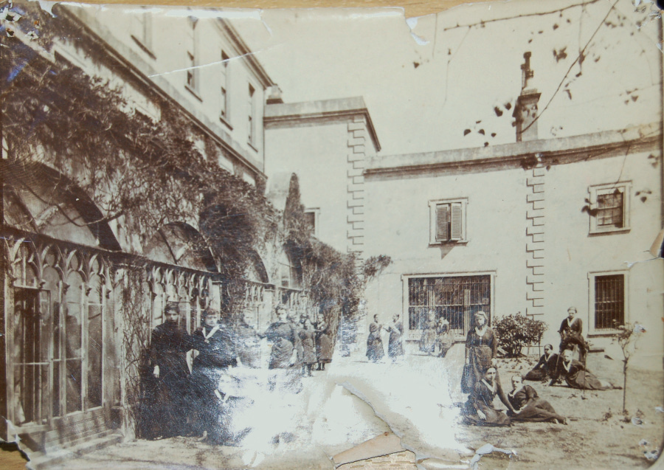

Slide 18
It was: A step in the dark as we didn’t have any volunteers in Hastings! So we:
Approved a budget of £500 to kick-start the project
Met with the East Sussex County Archaeology/HER team to ask for practical support in providing maps and archival information stored on the HER.
Met with the Librarian and Museum curator to check out resources
Contacted HBC departments for material (you would be surprised what turned up!

Slide 19
Took a stand at the Rother and Hastings Family History Fair’s Hastings Day a October 2012 and set up a rolling slide show on site survey and recording with lots of pics of local parks and gardens in the area – took about a dozen expressions of interest
Wrote copy for local newspapers and Sussex archaeological Society newsletter (see article Planning to look after the county’s greatest gardens

Slide 20
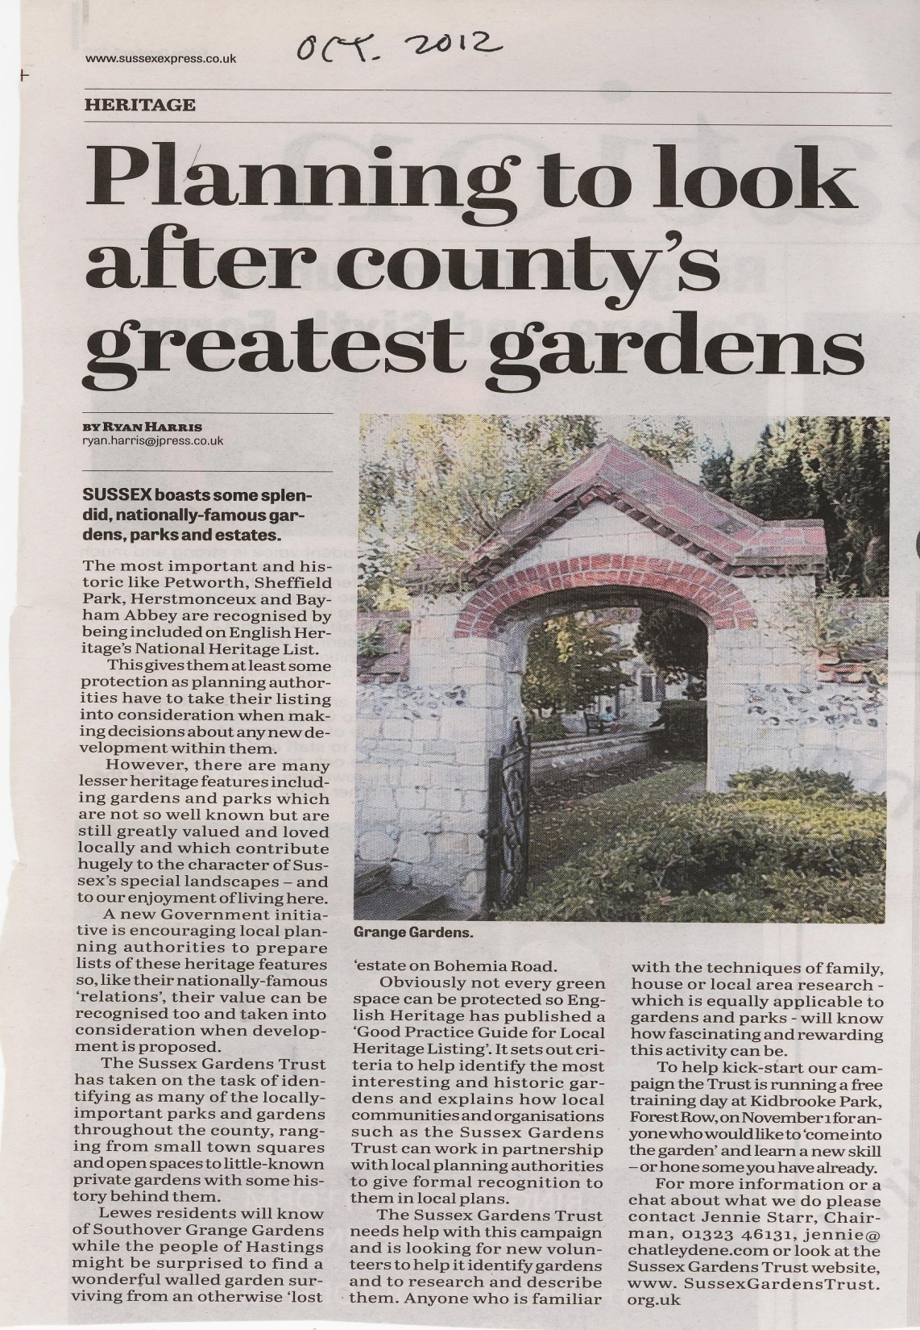

Slide 21
Emailed HBC’s conservation officer and a senior planner in local plans with a detailed project proposal:
“CAN WE HELP YOU WITH YOUR LOCAL LIST OF PARKS AND GARDENS AS HERITAGE ASSETS?
This summarized what we could offer and, importantly, highlighted our skills and experience and our willingness to take the lead. We received a supportive reply from HBC. It turned out that HBC had just started thinking about a local listing project - so ask around your LPAs – a door may be ajar!

Slide 22
Held a workshop (November 2012) in East Sussex for all SGT members on a general introduction to site survey and recording; specifically to identify any who would like to work in the Hastings area. We used much of the HLP early training material;
Invited HBC planning and conservation staff to our workshop as a good CPD opportunity - they didn’t attend!); suggested a follow up workshop in Hastings. HBC responded with offer to host inaugural workshop in the town hall.

Slide 23
First Hastings-based workshop: we invited:
The 7 contacts we made at Family History day
The 3 HER staff at East Sussex County Council
The Hastings librarian and the Museum curator
Experienced volunteers from Kent CGT
HLP staff member
4 SGT Council members – Chairman and R and R group
A local author/researcher on local history

Slide 24

We advertised the workshop:
In the Hastings on-line Times (Hastings & St. Leonards on-line community newspaper) and got front page billing!
To The Old Hastings Preservation Society
To The Hastings Museum local history group
To various Park Friends groups

Slide 25
The full day programme comprised presentations by:
HER staff on the role of the HER
Librarian and Museum curator on their collections
Kent GT volunteers for experience of a similar project
HBC Planning and conservation staff on the role/importance of local heritage assets in local planning system
SGT on concept of local listing, selection criteria, significance, introduction to writing up research and survey
Round up and open discussion on next steps:
Main Q’s: Is there enough interest for a project? If so: how do people like to work - in pairs/ groups/as individuals?
How shall we keep in touch/co-ordinate volunteers within Hastings: How should we select sites? Criteria to be used ? Are there sites that are priorities in Hastings?

Slide 26
11 potential new volunteers attended including 3 from the Museum’s local history group, 1 from the OHPS and several who had heard about it from contacts in HBC or from friends.
We recorded a list of all attendees with a note on experience, knowledge. Need now to capture their attention and tempt them to get stuck in – no guarantee that any of them would stay.
HBC presented us with its own agenda for sites we should look at – it included 3 of their major potential development sites…!
So, what next?

Slide 27
Cunning plan:
Sessions to be regular and be hands-on/activity-based
Volunteers have to do something new at each.
We plan each session together (new vols and experienced SGT ‘trainers’) at the previous one so volunteers feel they have ‘control’ and are not pressurised

Slide 28
1st post-launch session March; Library hosted us: 12 turned up!
Volunteers worked to enlarge ‘the list’ using local knowledge and enthusiasm for particular sites;
Volunteers introduced to criteria for assessing potential of a site for local listing;
Hands-on element: noisy ‘discussion’ on sites/values; list whittled down to manageable number.
Next session planned – Wellington Square: how to do a simple site survey; Invitation and some ‘homework’ (look at maps and postcards in library) sent out 2 weeks in advance.

Slide 29
2nd session: April:
Wellington Square; 10 turned up;
1 ½ hrs. on site looking at/making notes on orientation, topography, views in/out, details of its layout and planting.
Indoor session: short description composed – done verbally, as a group, with leader writing up on flip chart.
** Volunteers often lack confidence to write something – hence starting with verbal description.
Tea and CAKES

Slide 30
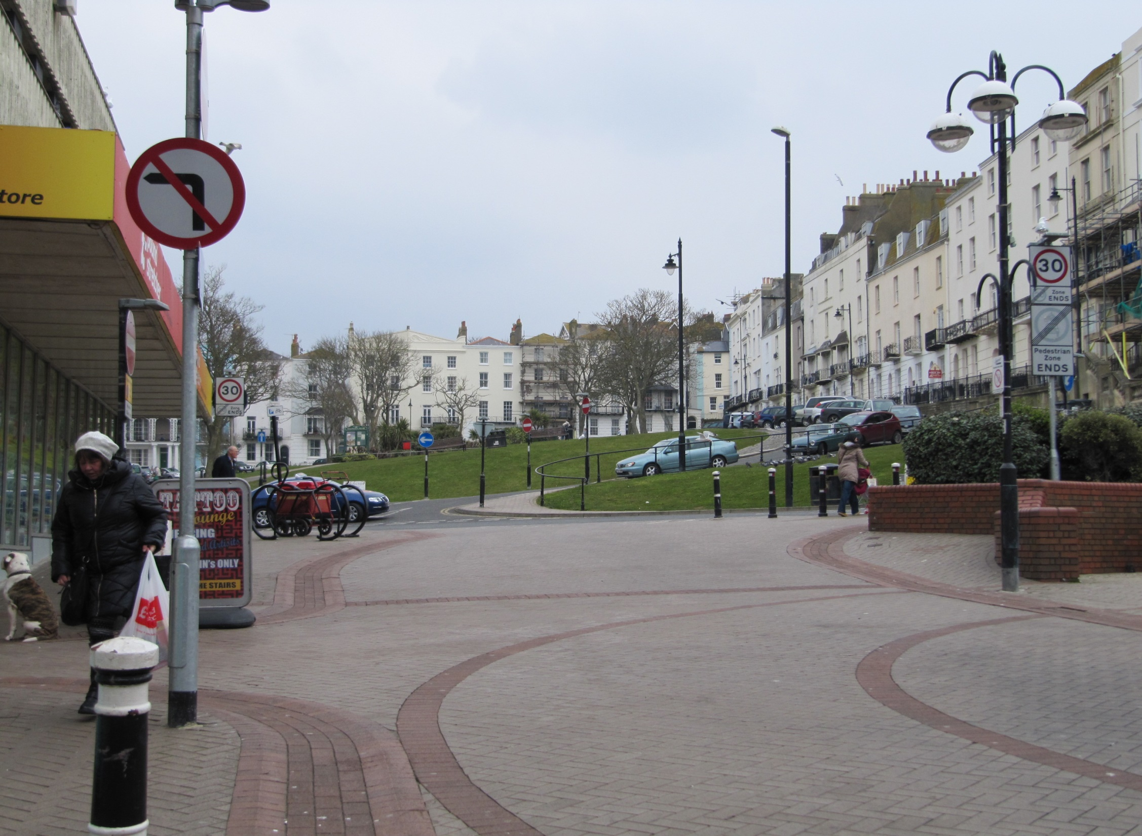

Slide 31
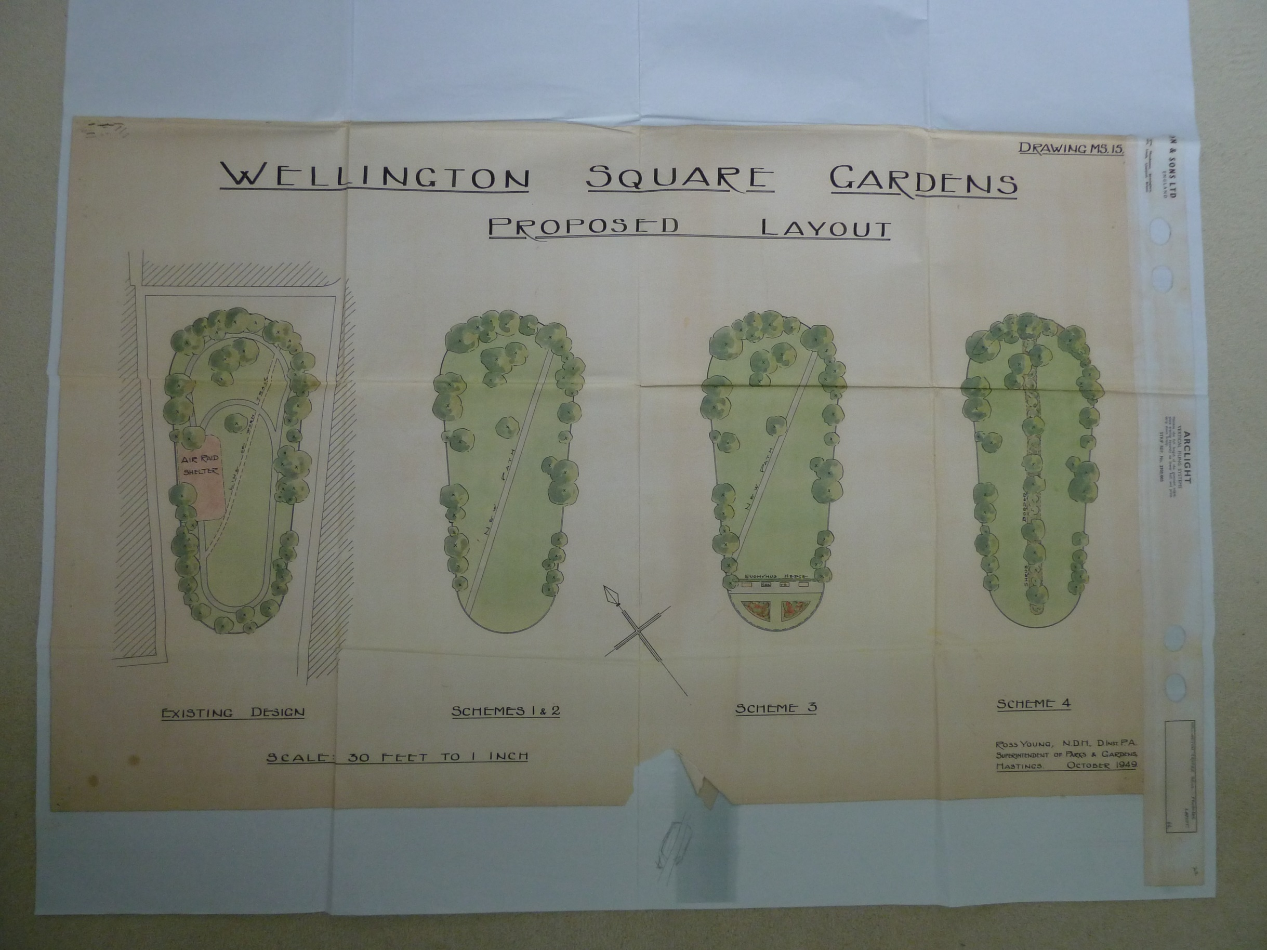
Proposed layouts for Square 1947
Hastings Parks and Recreation dept.

Slide 32
3rd session: June:
Volunteers beginning to ‘take ownership’ of sites and to start and explore sources alone.
Session held at Museum to look at ref sources; Local history group members able to help us navigate collections
4th session: August - held at Museum; group stabilizing at 5/6 volunteers and starting to ‘bond’; individuals gave feedback on what they had found; advice and critique given on individual basis by SGT project leaders

Slide 33
Next 3 years
On-going sessions – group and individual - held bi-monthly
locations and content of sessions planned in advance; SGT trainers available for emailed advice; reports went through several iterations/edts
report writing skills developed by group and individual sessions with help from SGT trainers
Site - based sessions for a volunteer to present his/her site to the group, with copies of ref material
Group visits to East Sussex Record Office, Museum collections etc. continued

Slide 34
Outcomes

Slide 35
In 2015 HBC launched its local list initiative and called for site submissions
Hastings Group submitted 4 sites for first Panel in Sept.2016: White Rock, Holy Child Convent, Wellington Square and the Bohemia Estate land.
Wellington Square and the older, more historic half of White Rock were accepted and have now been endorsed through public consultation. The Convent was adequately protected through listing status;
More information was asked for on the Bohemia land. This site and Linton Gardens were recommended for inclusion in December 2016 and are out to public consultation.
We will submit all our other sites in due course

Slide 36
Extract from HBC’s web page on local heritage assets list :
“The panel has recommended three assets to take through the Council approval process and as such consultation will run from Friday 6 January to Friday 3 February 2016”.
The assets currently being consulted are the following:
Bohemia Estate
Linton Gardens
Wellington Square

Slide 37
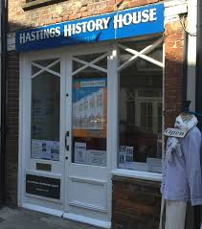
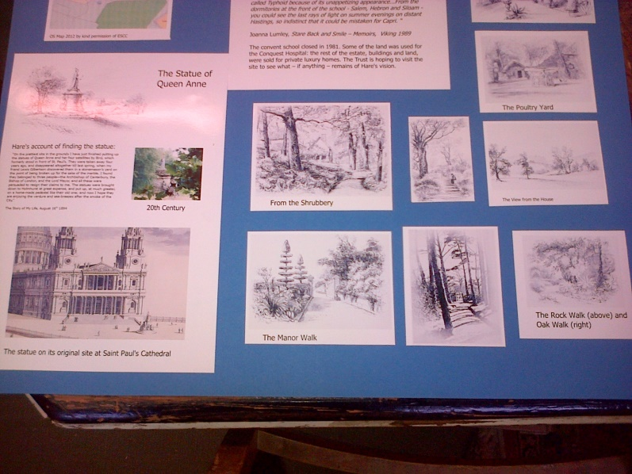
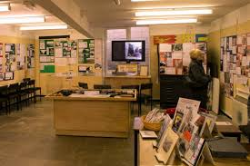
The Old Hastings Preservation Society invited the volunteer group to produce a small exhibition of its researches for spring 2016.

Slide 38
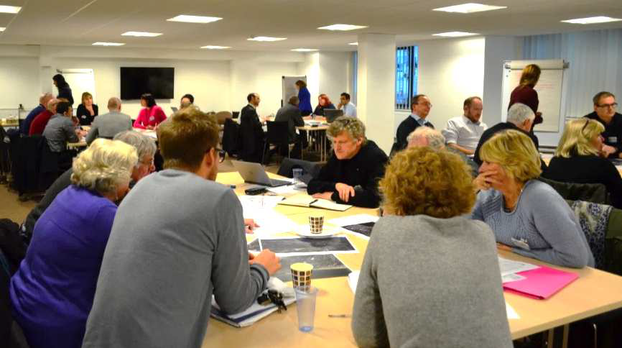
WHITE ROCK DEVELOPMENT PLAN
SGT group Invited to take part in series of Stakeholder Workshops - November 2015 /16
“ In order to gather ideas [Hastings Borough Council] hosted a full day consultation workshop at the end of November 2015 and again in November 2016. The workshop, run by the Council's appointed consultants Bilfinger GVA, was attended by a number of key stakeholders and partners with an interest in the Town Centre and White Rock area”. New exciting experience for volunteers!

Slide 39
what we learned/what next?
Small is beautiful
Choose a discrete project with a clear aim/outcome
Local listing is a good one; though not top(!) it is on LPAs agendas and has Historic England support
Use all/any of your personal/CGT contacts in LPAs if you want to do a local listing project
Be prepared to invest time in mentoring and support e.g. practising visual site surveys, writing descriptions, reading maps etc.

Slide 40
Next project: Building on Hastings’ success we are:
Rolling out a ‘Seaside Parks and Gardens’ research and recording project across Sussex’s coastal towns.
We will use the same techniques for finding, mentoring and training new volunteers
We will use the success in Hastings to make our pitch to LPAs
We will aim for a publication!

Slide 41
