Slide 1
A Tour of Yorkshire’s Hidden Gardens:
A Yorkshire Gardens Trust Instagram collaboration with The Gardens Trust
April/May 2023
Gail Falkingham, YGT
Audience Development Showcase
21 May 24
Notes:
This presentation is about A Tour of Yorkshire’s Hidden Gardens, which was a YGT Instagram collaboration with The GT in April and May 2023.

Slide 2
@YorkshireGardensTrust
Set up a new Instagram account for YGT in May 2022
The GT Yorkshire Weekend held in North Yorkshire in September 2022
Site visits to 5 historic designed landscapes around Richmondshire
Delegates handbook with articles on the history of each site
Took photographs and videos of the sites visited (no idea of collab at this stage)
Did not post on Instagram straight away due to period of mourning following death of the Queen
Notes:
In May 22, I set up a new Instagram site for YGT & was keen to post a variety of content.
The Gardens Trust Yorks Weekend event that I attended in Sept 22 seemed the ideal opportunity.
We visited 5 historic designed landscapes around Richmondshire
And delegates received a handbook with articles on the history of each site written by members of YGT who had arranged the visits
I took photos & videos of the sites we visited, even tho’ no idea of the collab at that stage
But I didn’t post anything on Insta straight away, due to period of mourning for Queen shortly after the event

Slide 3
@YorkshireGardensTrust @TheGardensTrust
Previous collaboration success made me keen to try others (reel with 17.5k views)
Online social media session for CGTs with Frankie led to the idea of a YGT/TheGT collab
Combined approach: weekly Instagram post with a carousel of up to 10 images, or video reel
Posted at 5pm on Thursdays for 5 weeks across April-May 2023
Published a related blog each week on YGT website (using delegates handbook article)
Posted Instagram stories with links to the blogs
Notes:
I’d had previous collab success after posting a reel I’d made of a modern garden designed by a local garden designer who has several thousand followers. I approached him at the event to ask if he’d like to collaborate & as a result that reel has had 17.5k views – way beyond any reach we’ve achieved before or since!
So, I was keen to try more collabs, & after attending an online soc med session…

Slide 4
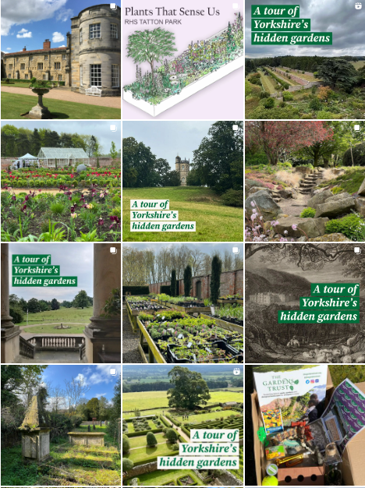
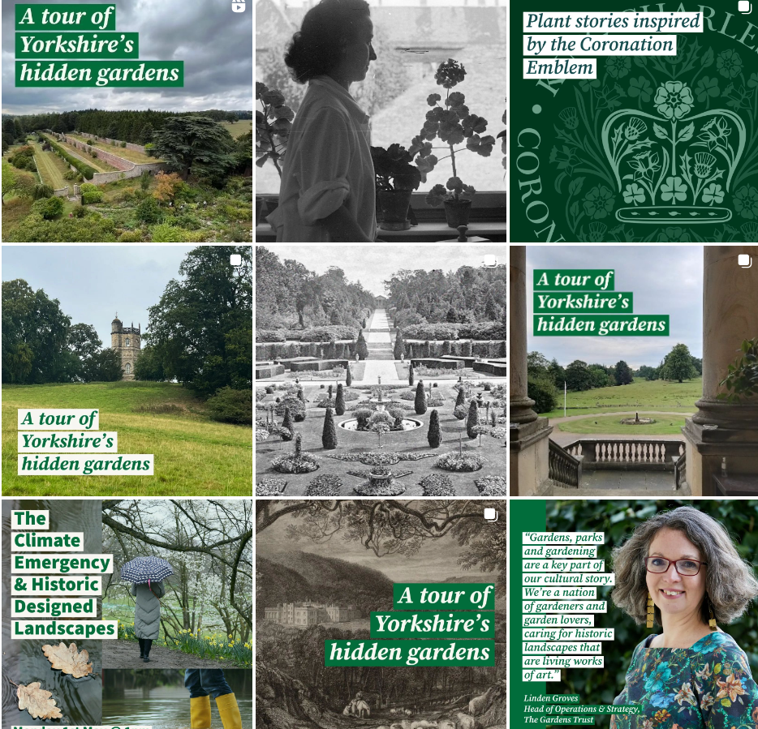
Notes:
Here are some screen shots of the Inst profile pages – on left that’s ours from Yorks GT on right The GT
Frankie had very kindly created these header images for us for each of the 5 sites, each one with the distinctive branding of Yorks Hidden Gdns
The collaboration involved Yorks GT posting on Insta and inviting The GT to collaborate. AT the GT end, they receive the invitation & click accept, so then exactly the same post appears simultaneously on each account profile, so that it reaches both audiences – so you hope to get double the reach than if you post alone

Slide 5
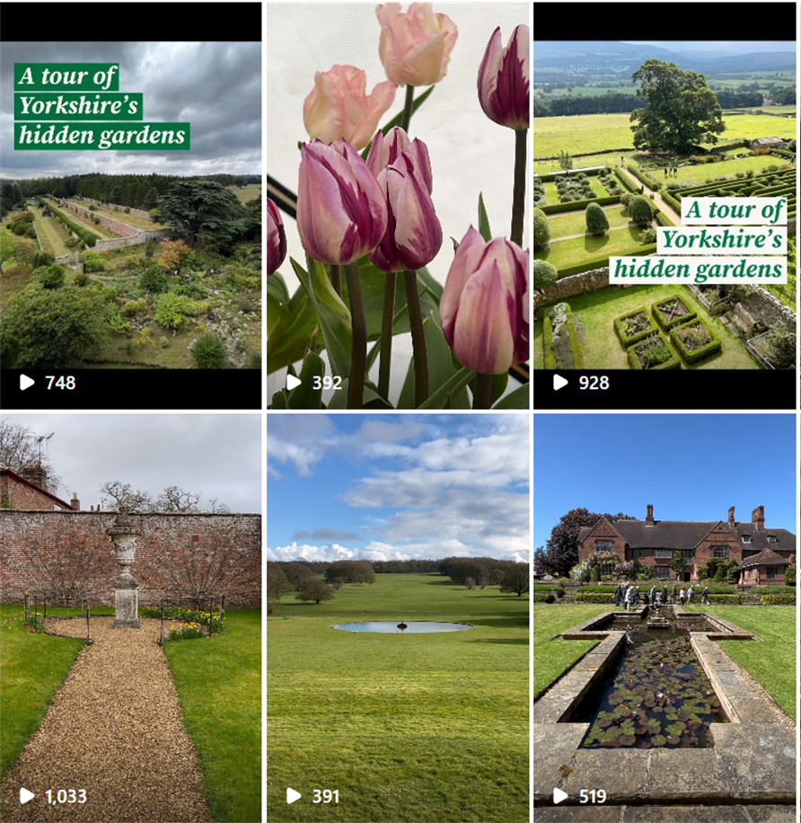
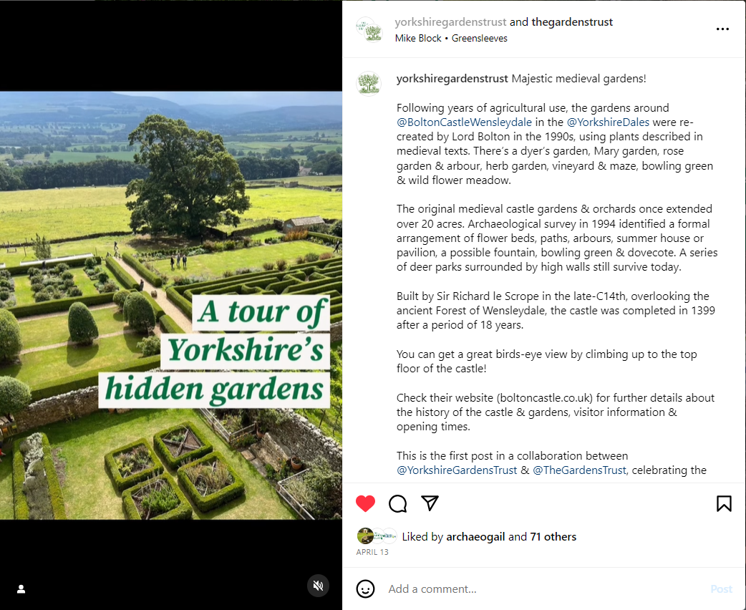
Notes:
When I osted the videos as reel, that works in exactly the same way & you can see the same Tour of Yorks Hidden Gdns branding.
On the right there, you can see the post caption – a bit of text with information about the event, the collab & some site history
In this instance, on the right, this video was of the recreated medieval gardens at Bolton Castle in Wensleydale, so we tagged them in and mentioned their website
However, most of the sites are privately owned, so before posting, we ensured we had liaised with each site owner, so they knew what we were doing & we had their consent to use the images
.

Slide 6
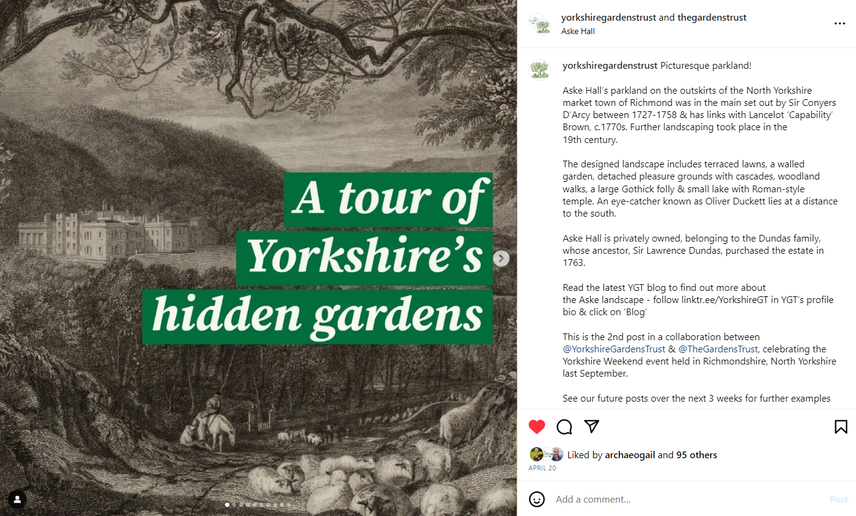
Notes:
& in some of the carousel posts, we interleaved images of historic maps or engravings, so we made sure we had consent from the relevant people to post those.
Here, for example, is an engraving of Aske Hall, near Richmond

Slide 7
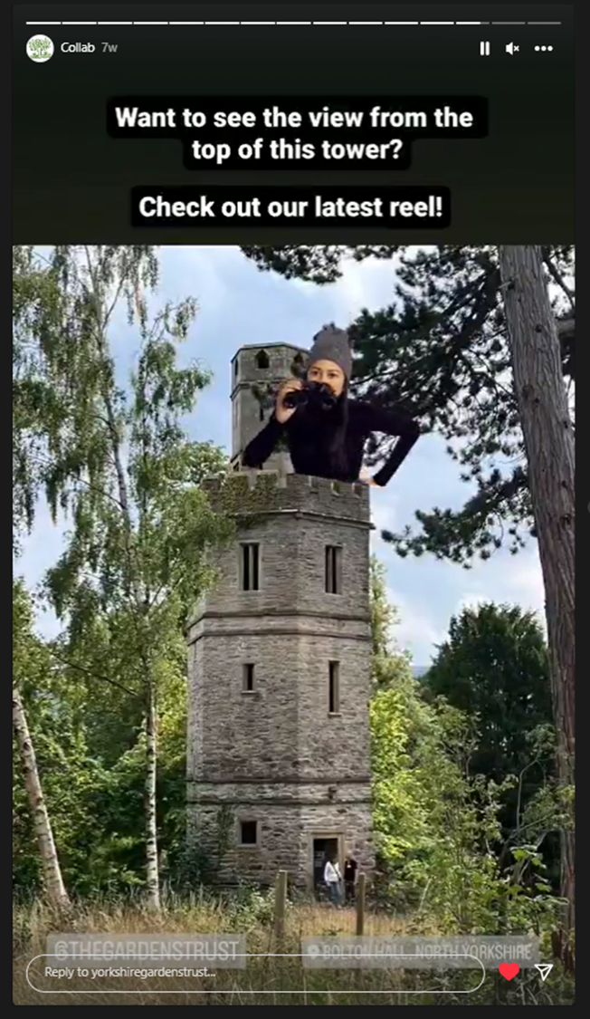
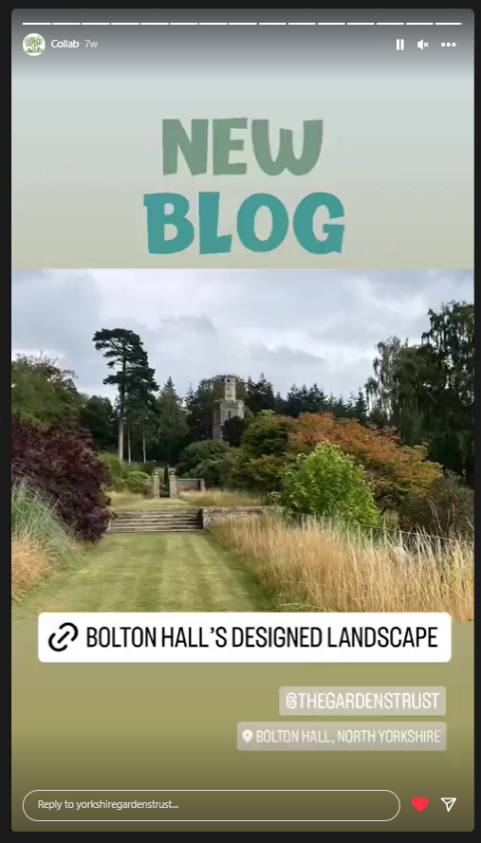
Notes:
We also posted Instagram stories, which last for 24 hours.
In these you can place clickable links.
Here you can see a couple of stories I did about the viewing tower at Bolton Hall, on the right there is the link to BH desig landscape which takes the viewer directly to the related blog on the YGT website.
Can also pin the location so people can see where the site is on a map, and tagged in The GT so they can share the story by reposting on their account too.

Slide 8
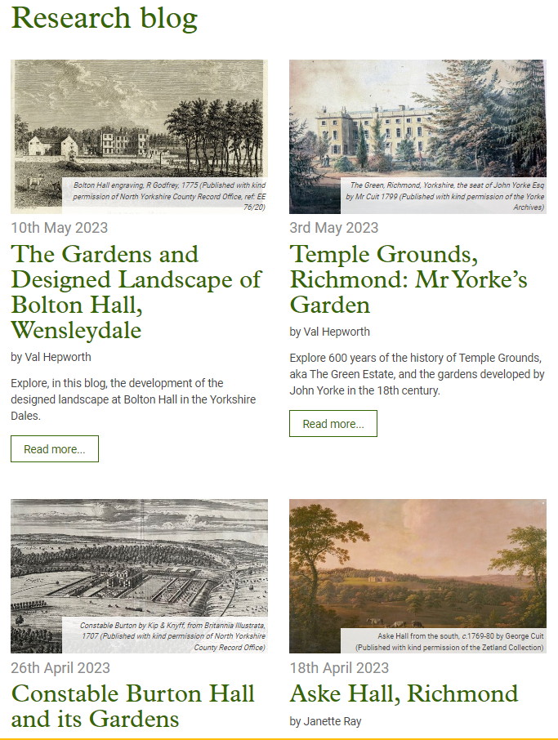
Related blogs on YGT website
https://www.yorkshiregardenstrust.org.uk/research/blog
Four blogs to complement each Instagram post, with historical information about each designed landscape
Notes:
I mentioned the related blogs on the YGT website – these complemented each Inst post & were released at the same time.
They contain the detailed historical information about each designed landscape that appeared in the delegate handbook given to everyone who attended the Yorkshire Weekend event in Sept 22.
So we were reposting info that was already available – so it could reach a much wider audience than just the 50 or so people who attended the Yorkshire Weekend event.

Slide 9
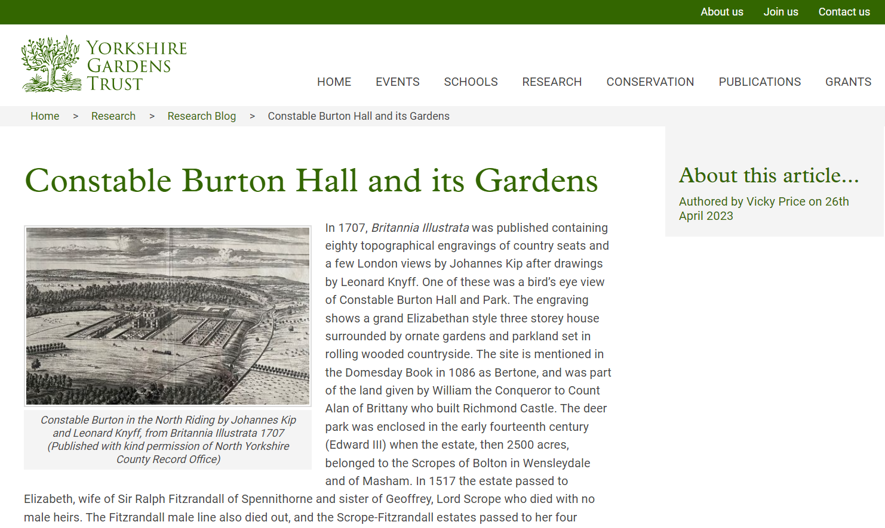
Notes:
This shows you a screenshot of one of the blogs – Constable Burton Hall & its gardens. One of few sites that had their own social media presence, their own Insta site, so we could tag them in and they were aware of what we were doing, and when.

Slide 10
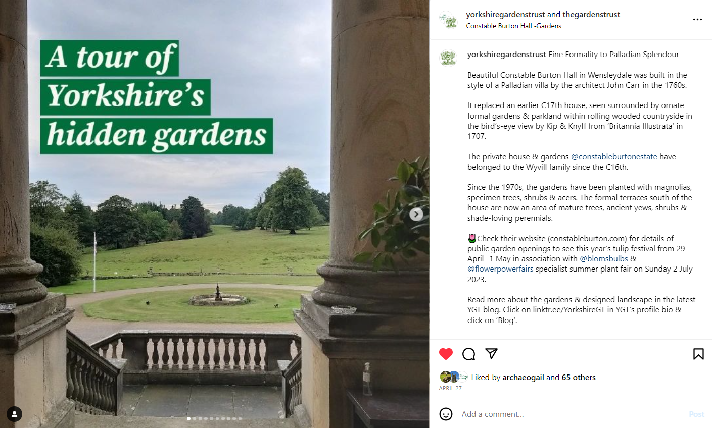
Notes:
So we tagged them into the caption of our post on the CB estate

Slide 11
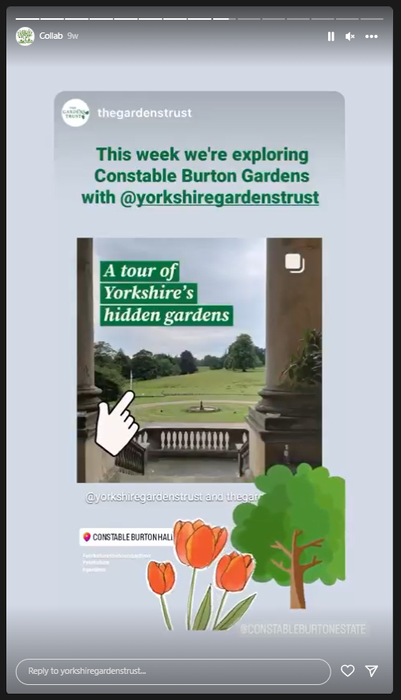
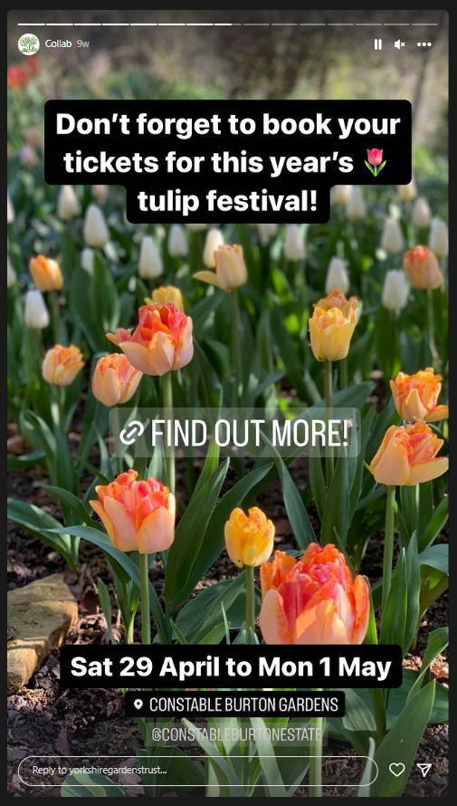
Notes:
And we timed the post to coincide with the CB annual spring tulip festival, so we could publicise their event.
They kindly provided us with some beautiful images of their tulips for us to use.
We also promoted the event through our stories, we tagged them in so they could reshare our posts on their Instagram – increasing the audience yet further
We also included a link to their website so people could find out when they could visit, as well as promoting our blog

Slide 12
Benefits for YGT & The Gardens Trust:
Reached 3725 people, 1391 not already followers
A far greater audience than just the 50 people attending the Yorkshire Weekend event and YGT membership
Greater numbers than usual posts for YGT & The GT individually
A more diverse audience in terms of location – beyond Yorkshire across UK, Europe, USA & Canada, & age range – 18 to 65+, largest % = age 35-54
Relationships with site owners – publicity for their sites/events
Convinced fellow YGT members of the benefits of social media!
Notes:
So, wh
We can see from the statistics that we can get from Insta that we reached 3721at benefits to the YGT & the GT?

Slide 13
What advice would I give?
Make use of The GT resource hub, advice & support, online sessions & training
Don’t be afraid to use social media, embrace it!
Don’t be afraid to try something new!
Find others to collaborate with & share posts to increase reach
When you’re out and about, take great photos & videos
Re-purpose material across different platforms – website, social media, newsletters

