Slide 1

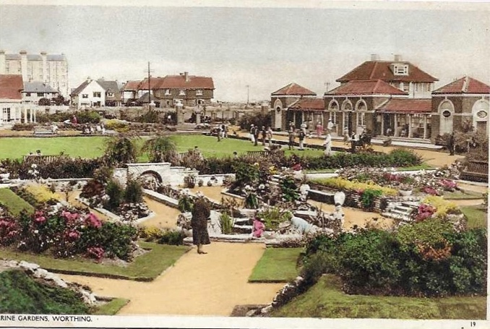
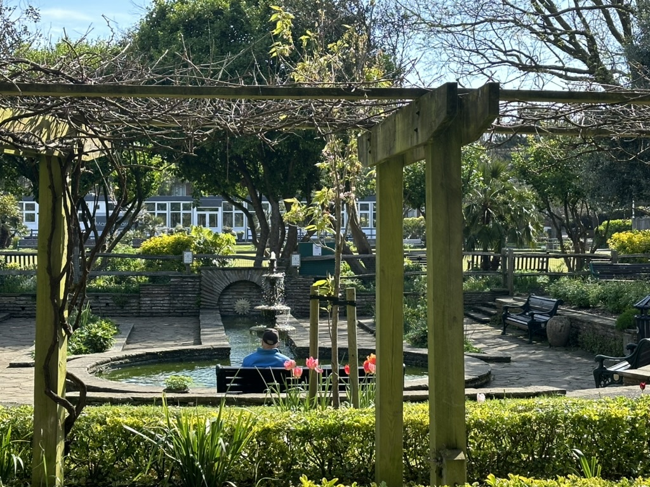
Start a Conversation:
Small Steps in Managing an Oral History Project
Why an oral history project?
Bring a new perspective to our view of the past
Fill the gap in the written history
Document memories and stories from people excluded from traditional records
Record the changing and enduring experience of a public garden in the community
Marine Gardens in Worthing c1930s
April 2024

Slide 2
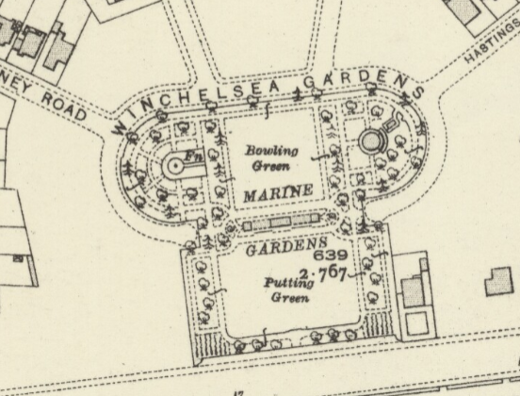
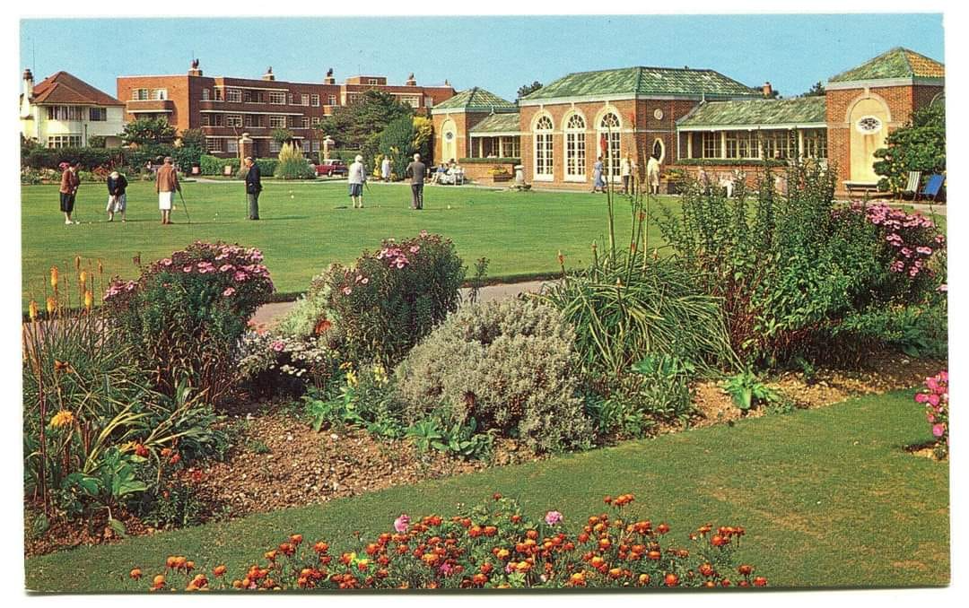
Why this project?
Recruit new volunteers from SGT in a different research process
Engage with community groups and raise awareness of the work of the Trust
Create a template to use in future SGT projects
Preparation:
Joining the Oral History Society – 2 day training session on oral history: interviews, questions, copyright, equipment, legal and ethical issues.
https://www.ohs.org.uk/#

Slide 3
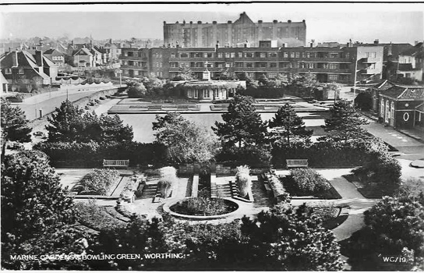

Slide 4
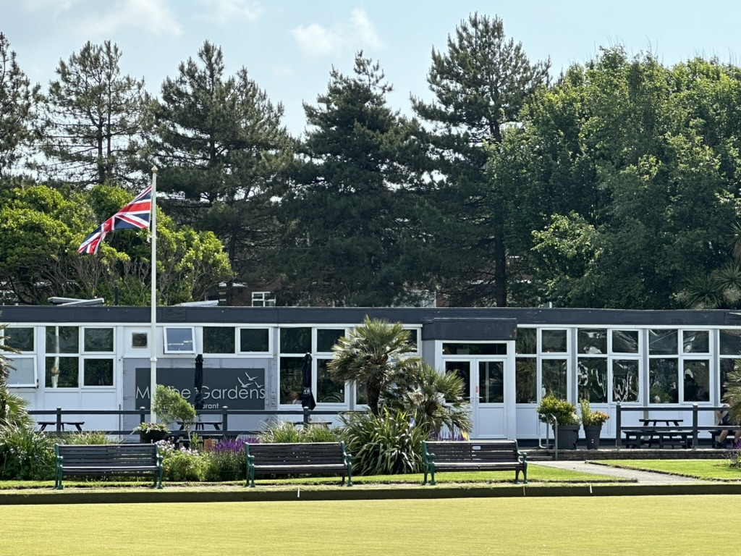
Planning the drop-in activity
Meeting the café owner
Choosing day and time
Inviting the Friends of Marine Gardens
Creating posters and leaflets about the project
Posting on social media
Planning prompt questions

Slide 5

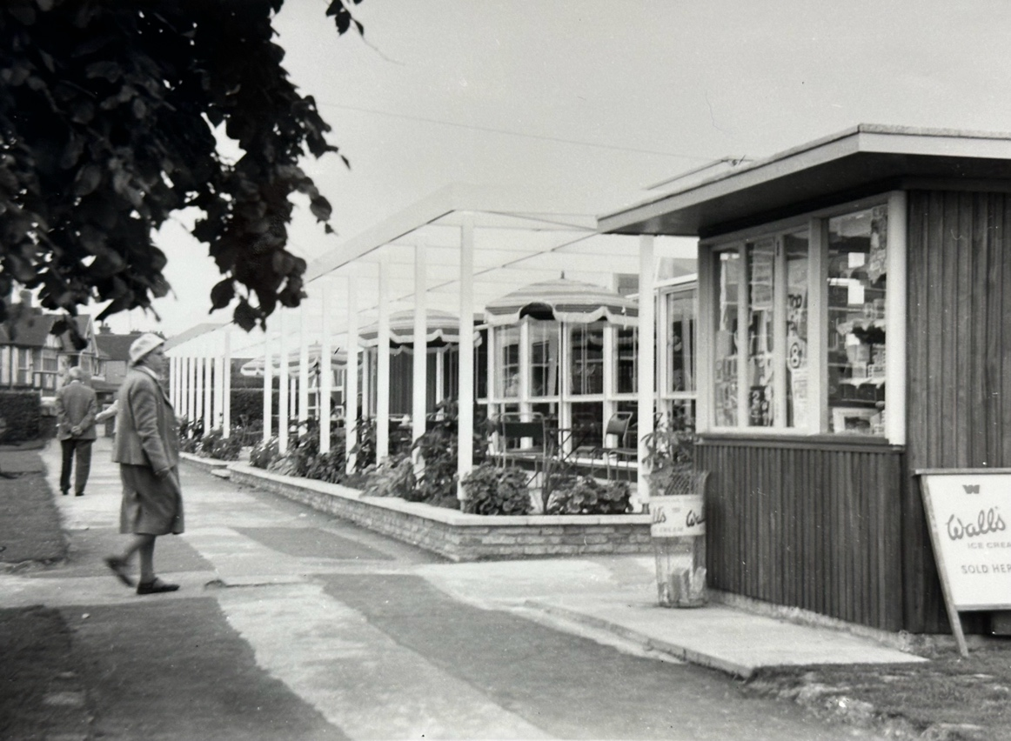
Collecting Memories – from people who worked in the gardens, or in the café
In the 1950s/60s there was a small ice cream kiosk next to the café.
Do you know anyone who might have worked in the kiosk?
We would love to hear their stories of selling ice creams.

Slide 6
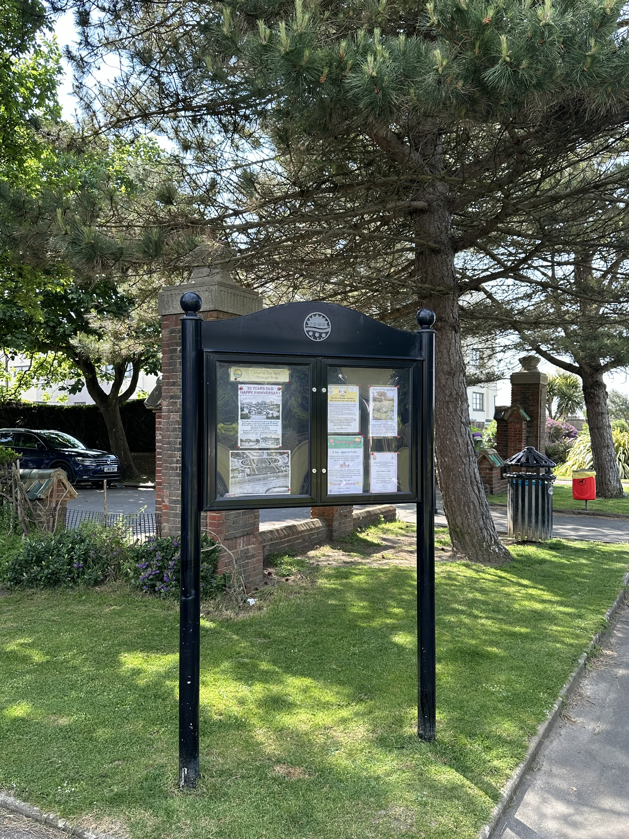
Garden history can be a written story but there is a hidden history …
‘In the late 1950s I worked in the little kiosk to the right of the old café. We sold ice creams and cigarettes and some sweets – Polos. There was only room for one person inside, so I was on my own.
My older sister worked there also, before me, though my younger sister did not

Slide 7
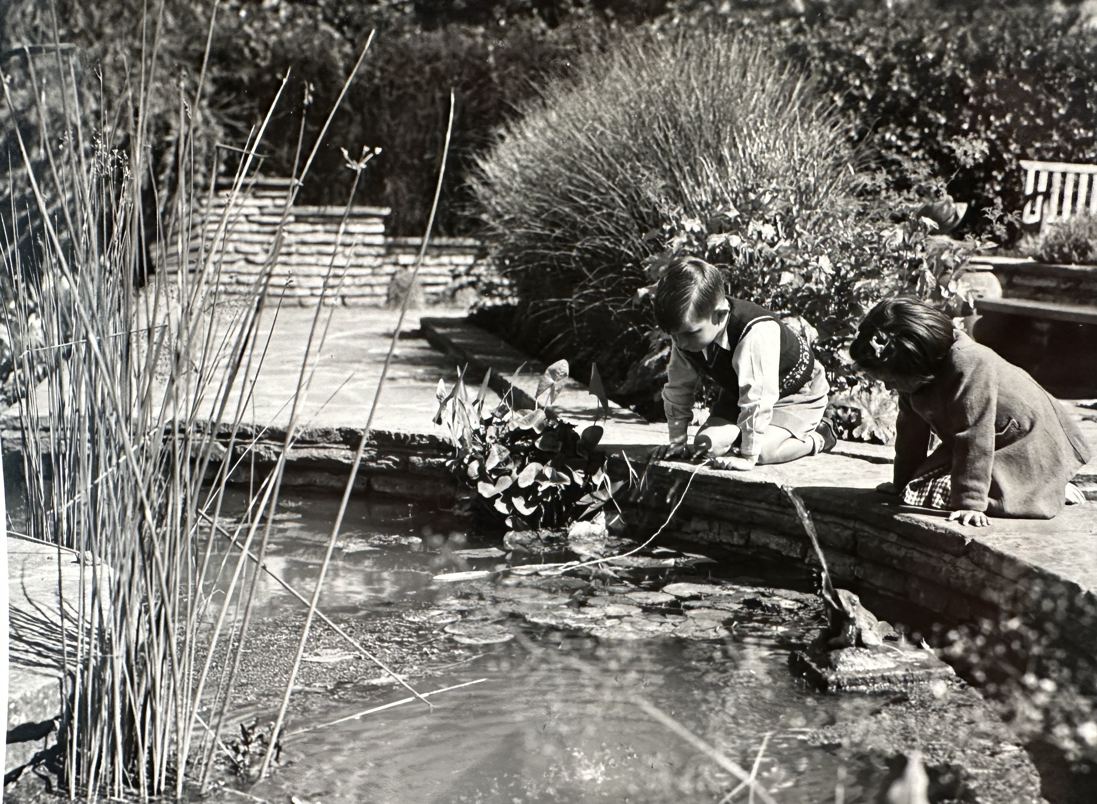
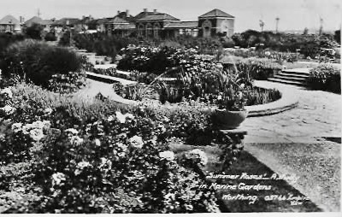
What went well
What we learned
What next
Engaging with the volunteers:
New skills – researching garden history differently -and they had a good time!
Establishing a positive relationship with the community group
Reminiscences shared
Fresh insights and perspectives
Useful contacts made
Interviewees not following up
  A template to take the project forward and receive feedback from the SGT research group
Start a conversation!

