Slide 1
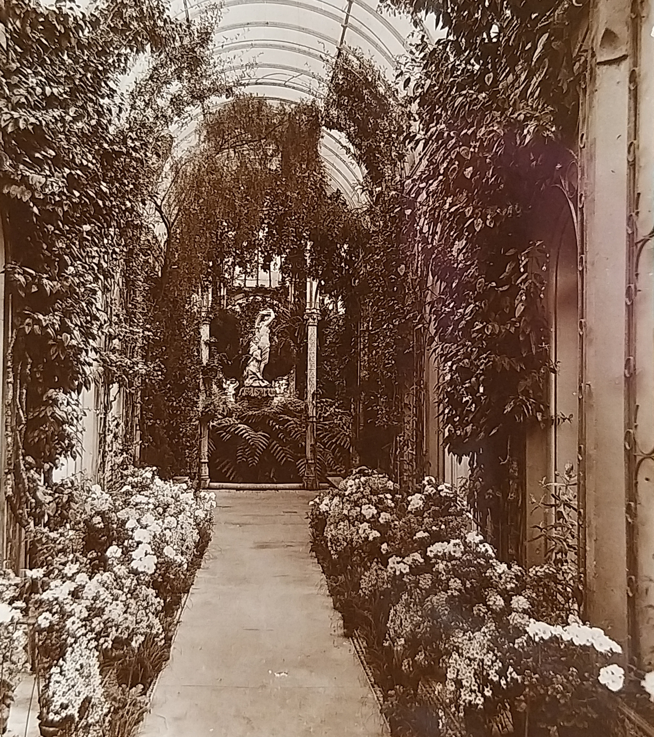
Suffolks Unforgettable Garden Story Protecting Historic Designed Landscapes
Postcard of Somerleyton Hall, Winter Gardens.

Slide 2
The Project
Suffolk’s Unforgettable Garden Story was a successful Gardens Trust and Suffolk Gardens Trust project funded by Historic England.
We recruited volunteers and trained them to research and record historic landscapes.
The project helped tell the stories of more than 20 Suffolk parks and gardens through detailed research reports compiled by volunteers.

Slide 3
Aims
Compile a list of significant but non-designated landscapes that are not already included on Historic England’s Register of Parks and Gardens.
Research these sites and submit the information to the National Heritage List for England, as well as Historic Environment Records and other local lists.

Slide 4
Volunteers
Drawing on local knowledge and expertise to help ensure that these landscapes at risk are better understood and protected.
Championing the importance of diversity in the green spaces we value.
Building a legacy for continued research and protection.

Slide 5
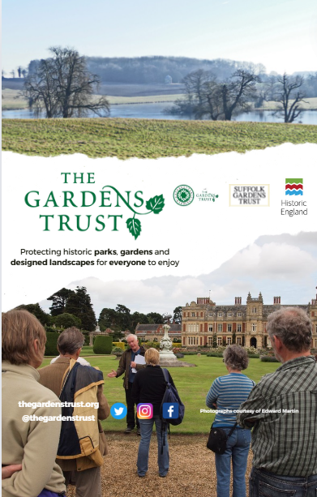
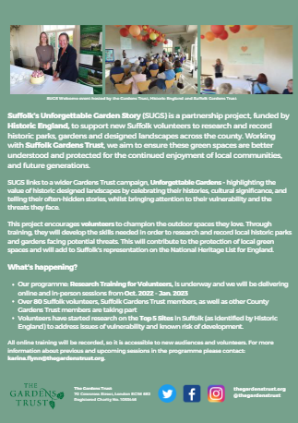
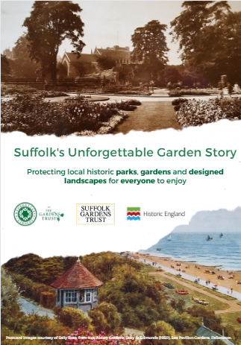
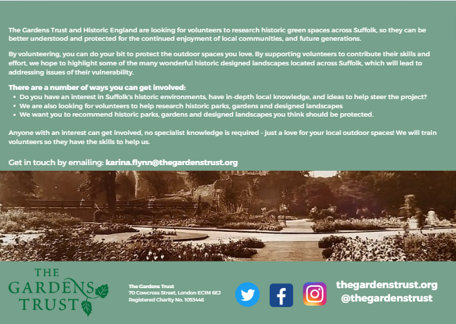

Slide 6
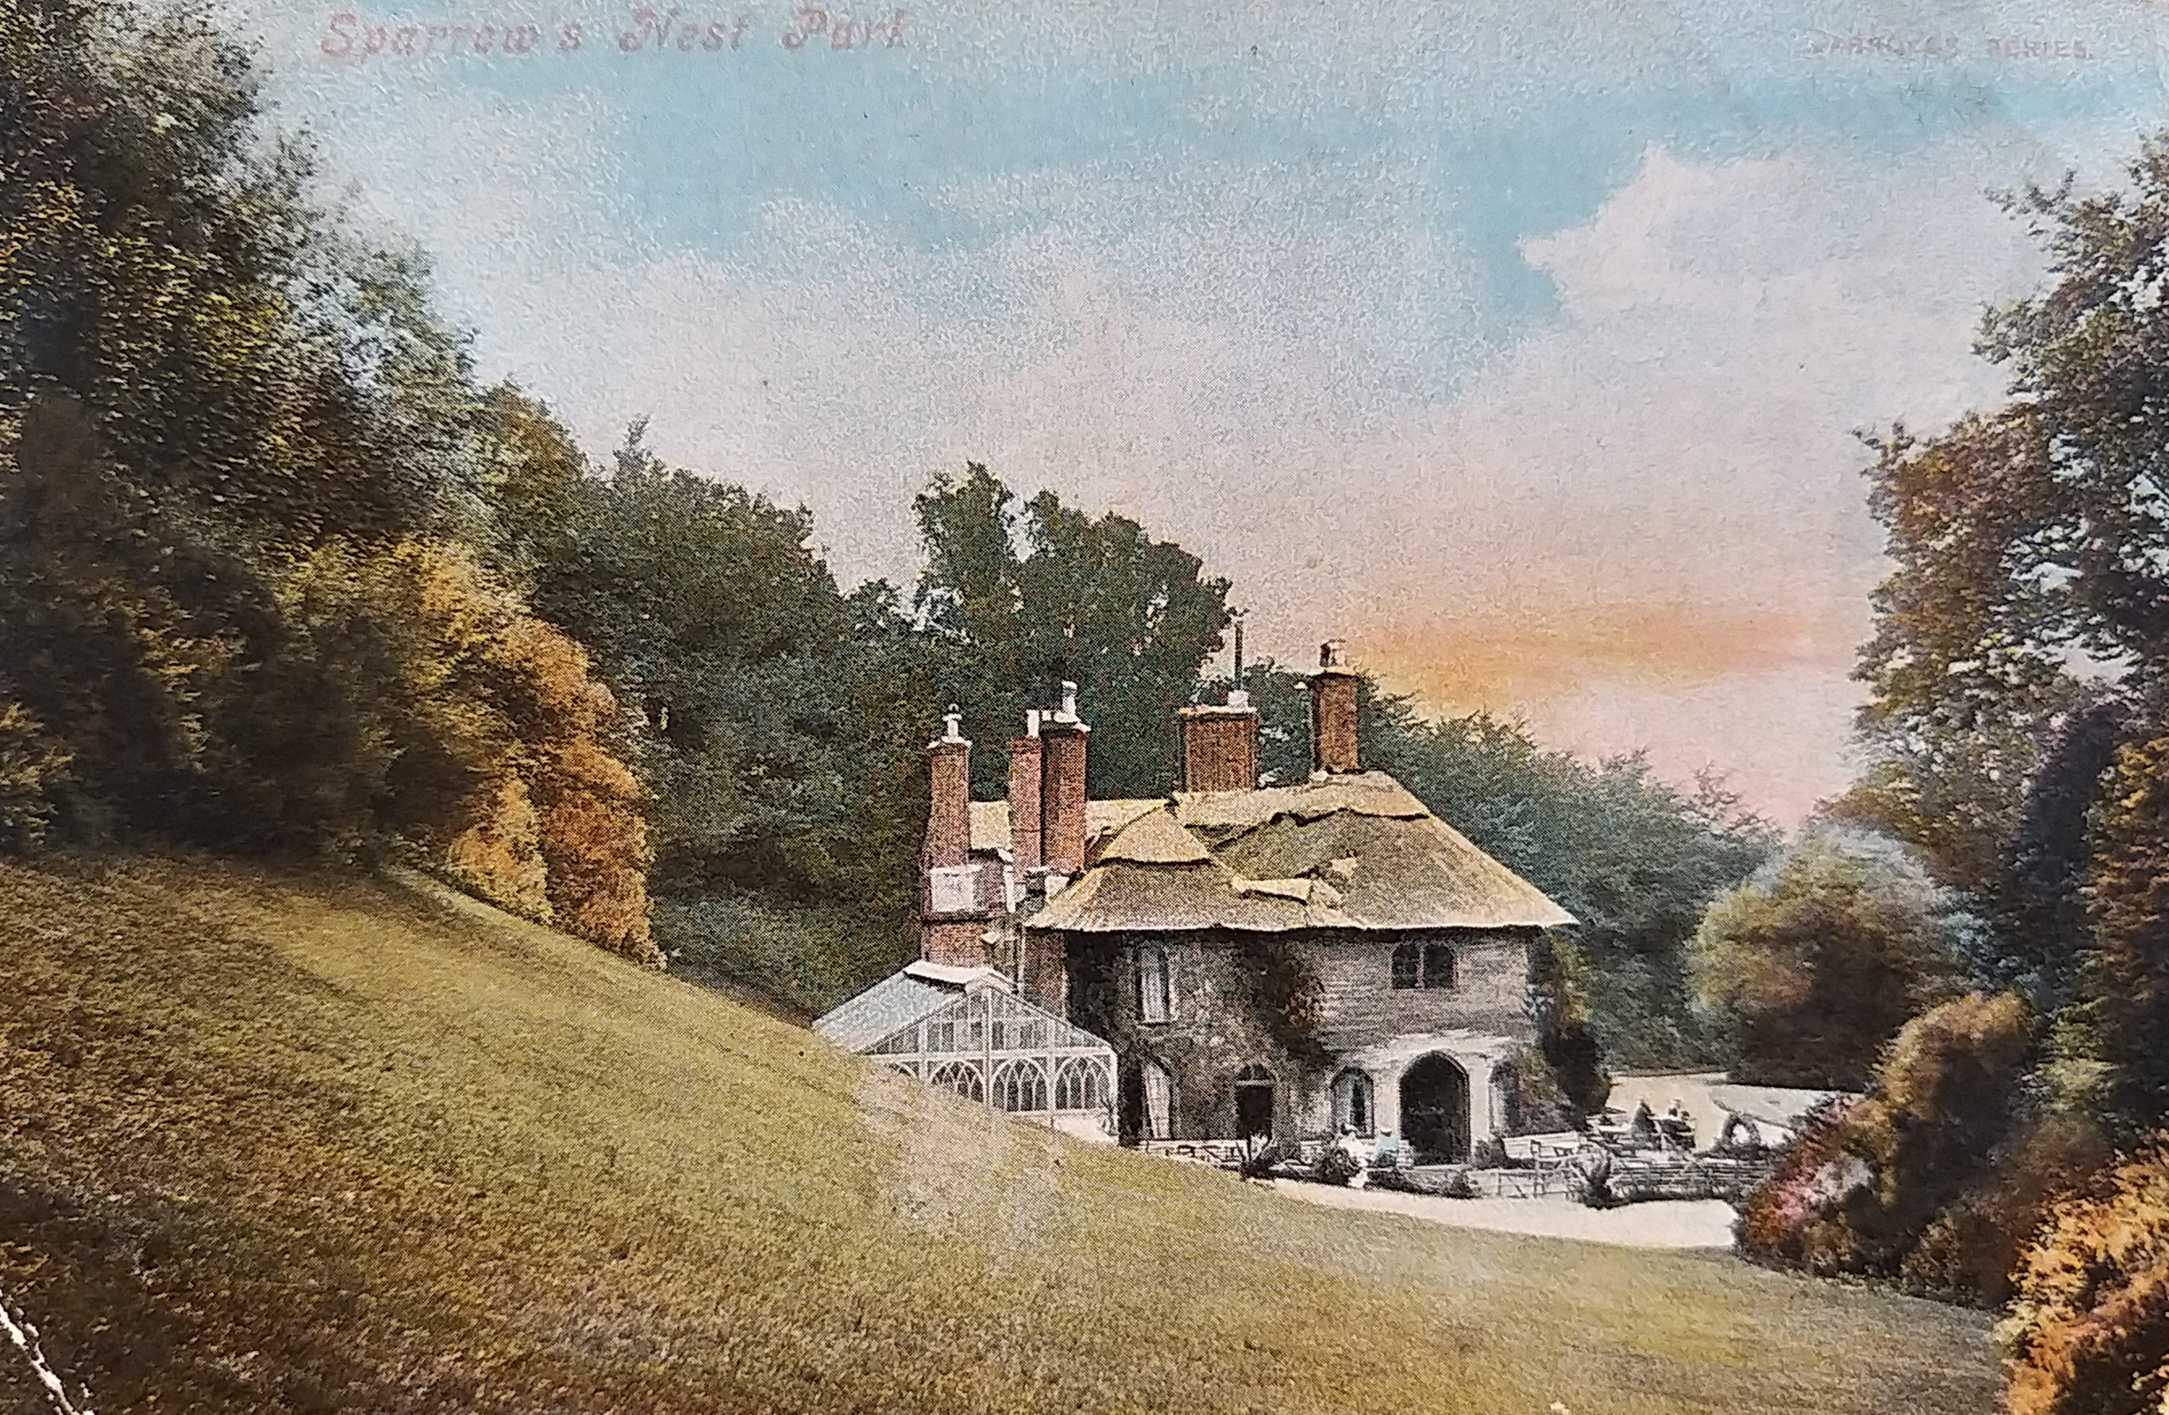
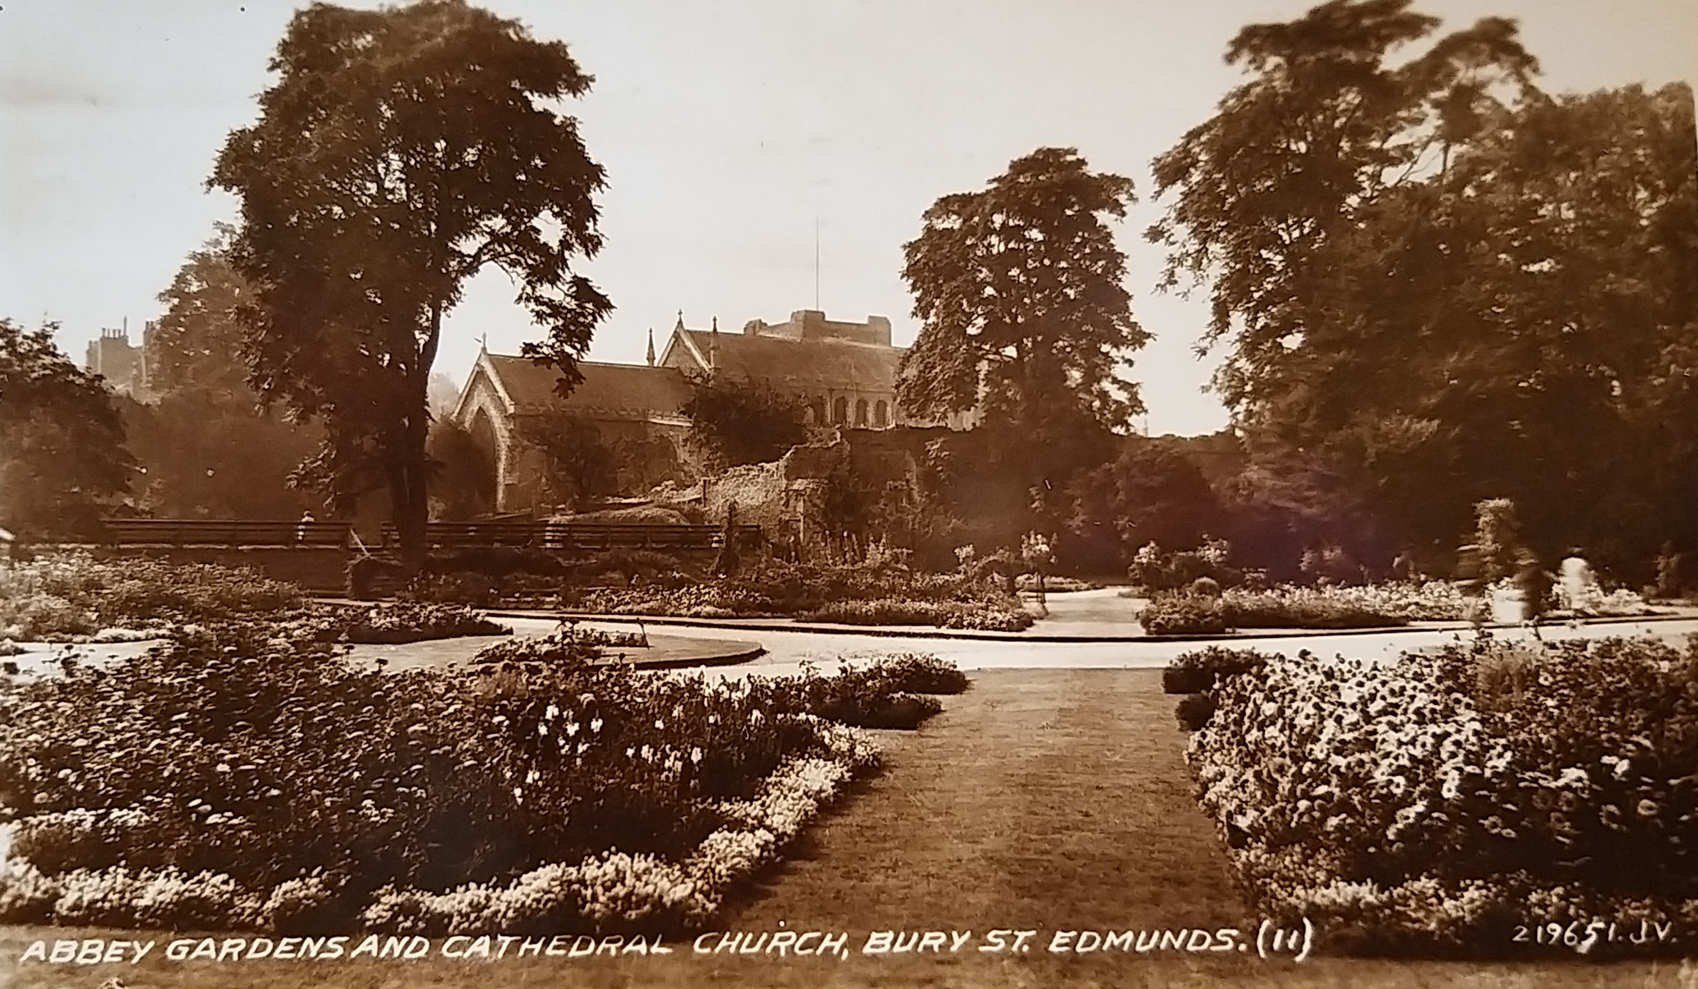

Slide 7
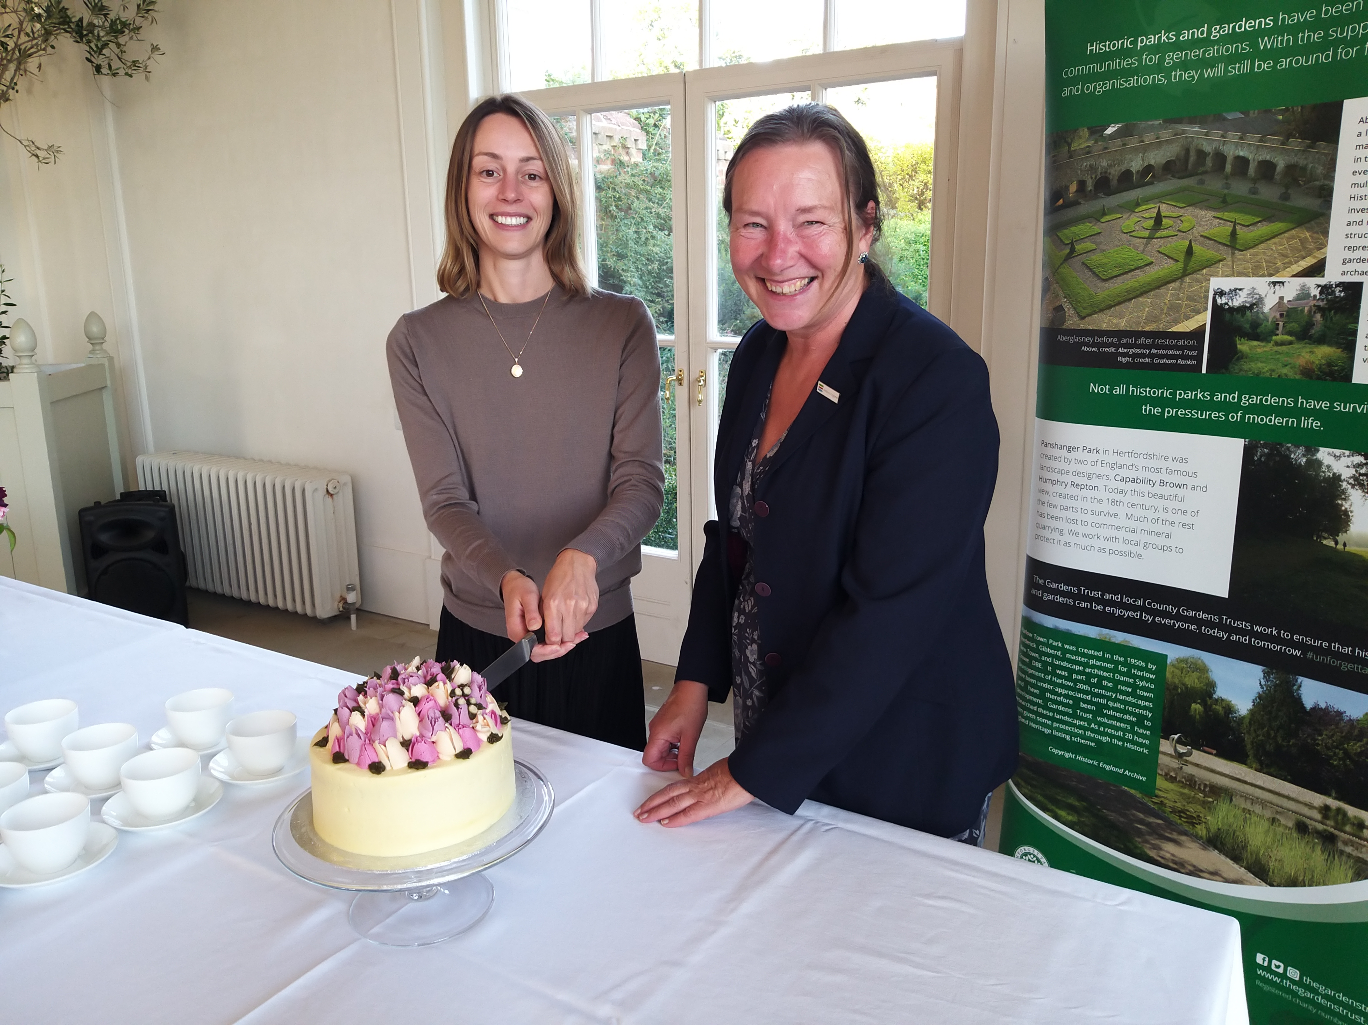
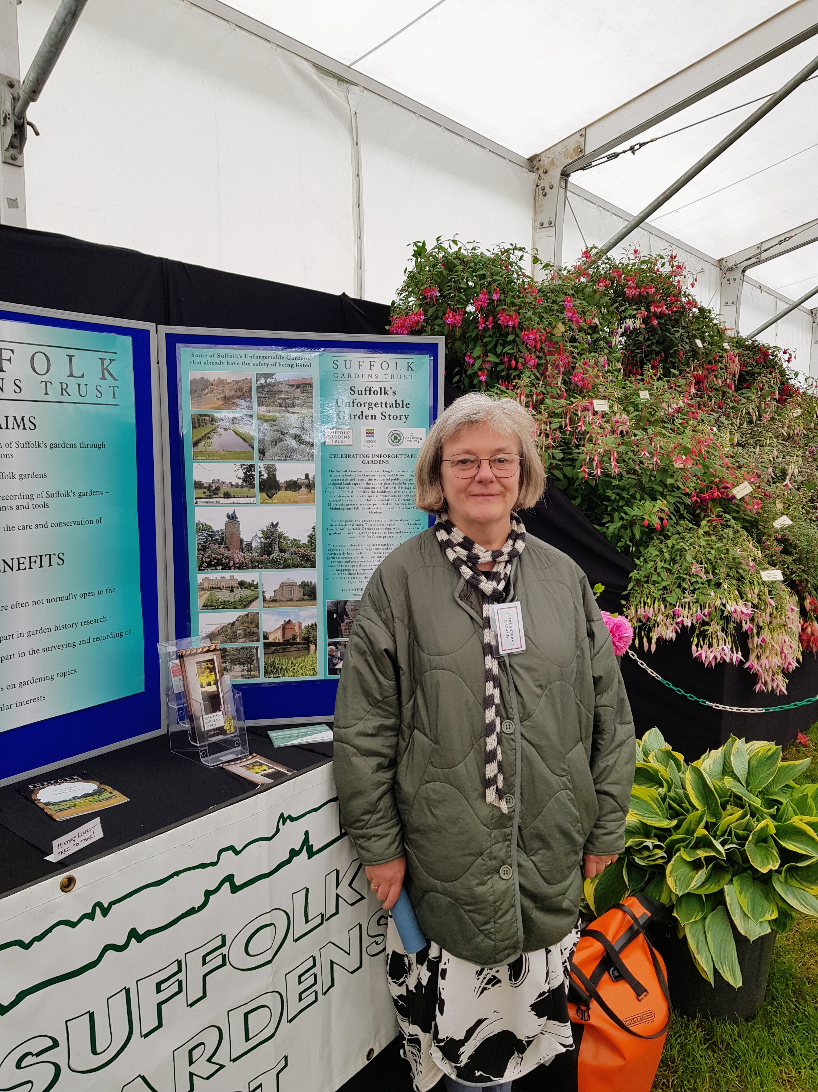
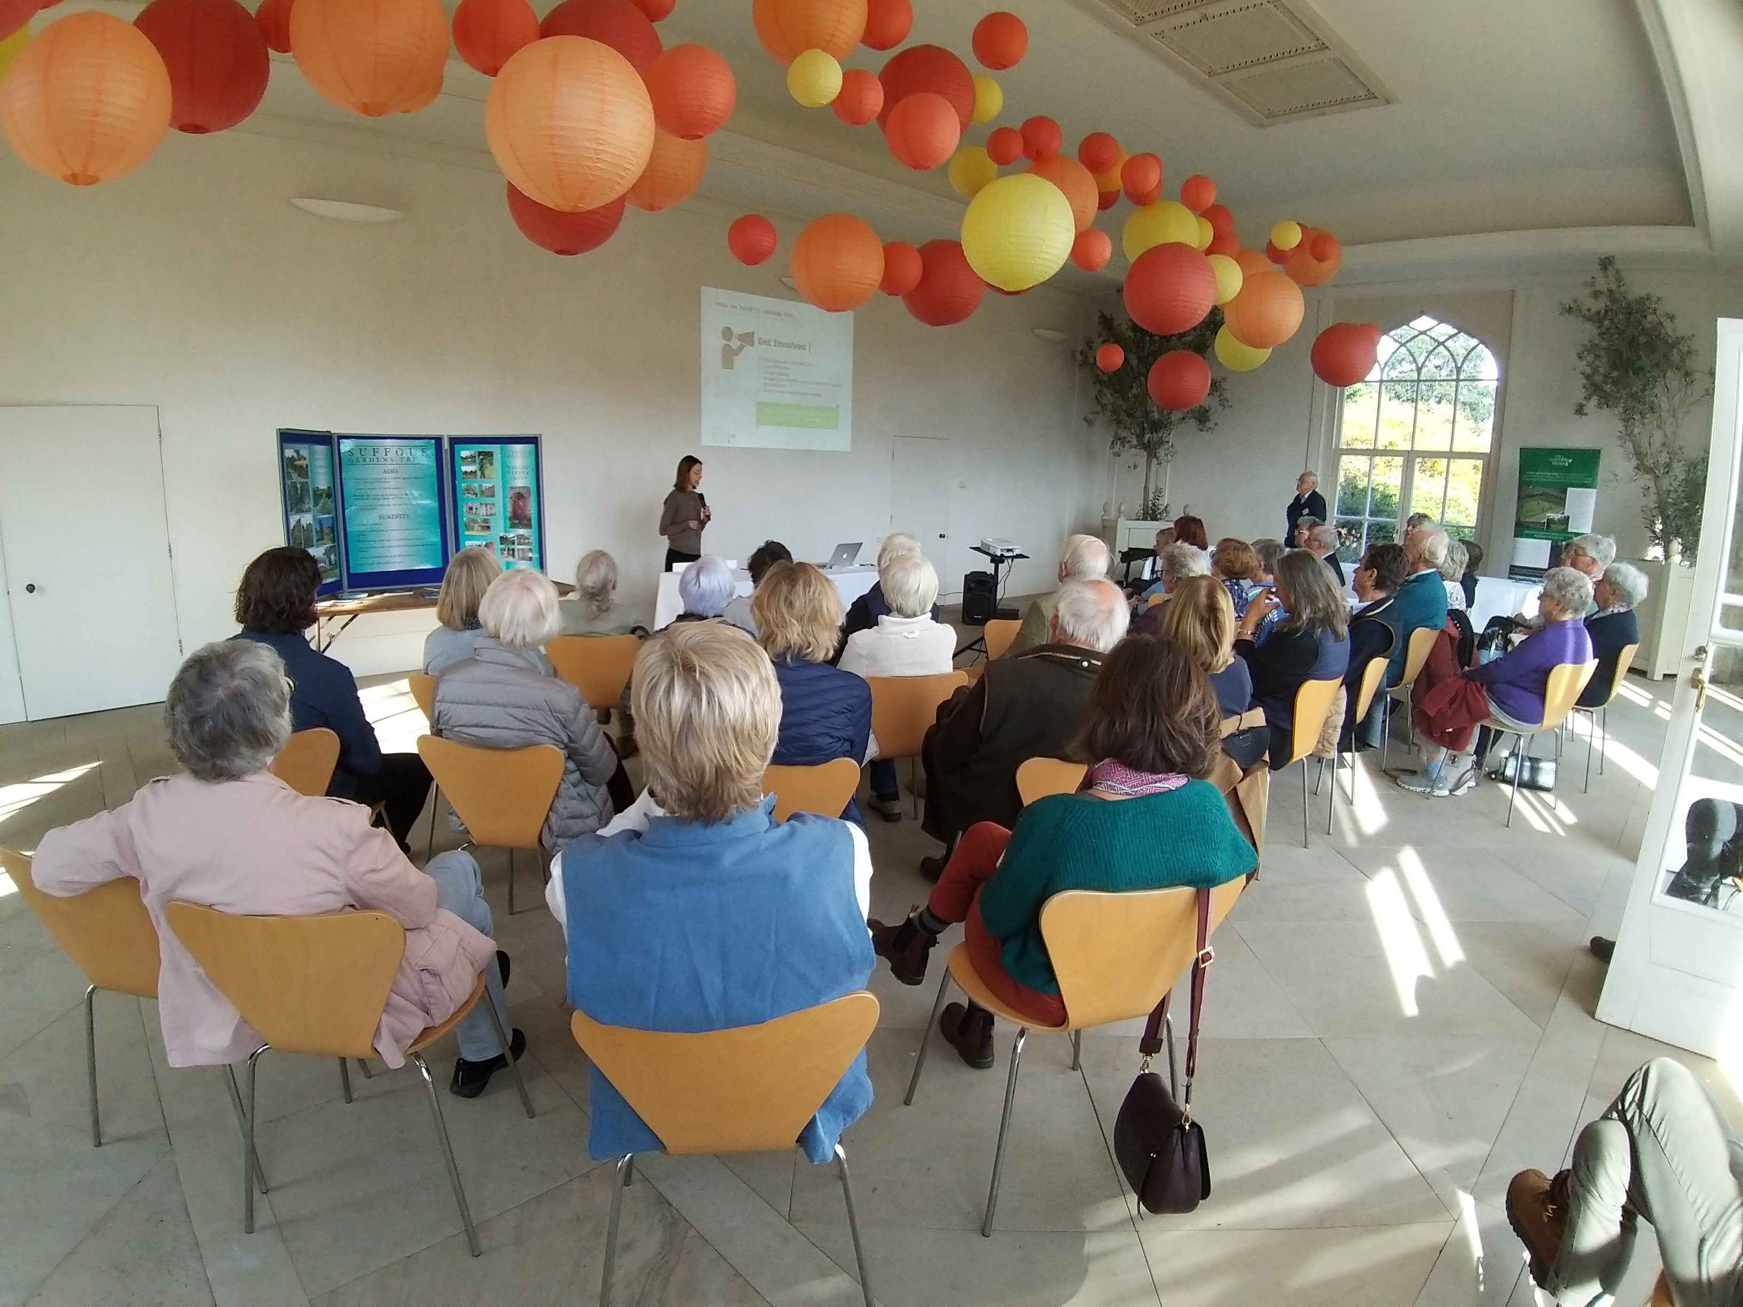

Slide 9
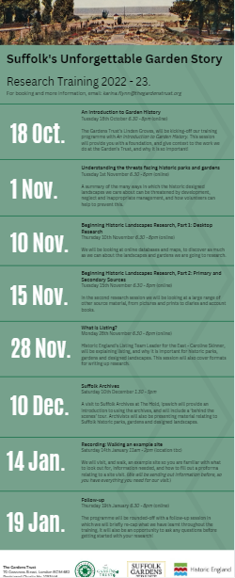
Research Training: online & in-person
An introduction to Garden History
Understanding the threats facing historic parks and gardens
Beginning Historic Landscapes Research, Part 1: Desktop Research
Beginning Historic Landscapes Research, Part 2: Primary and Secondary Resources
What's Listing?
Suffolk Archives
Recording: Walking an example site

Slide 10
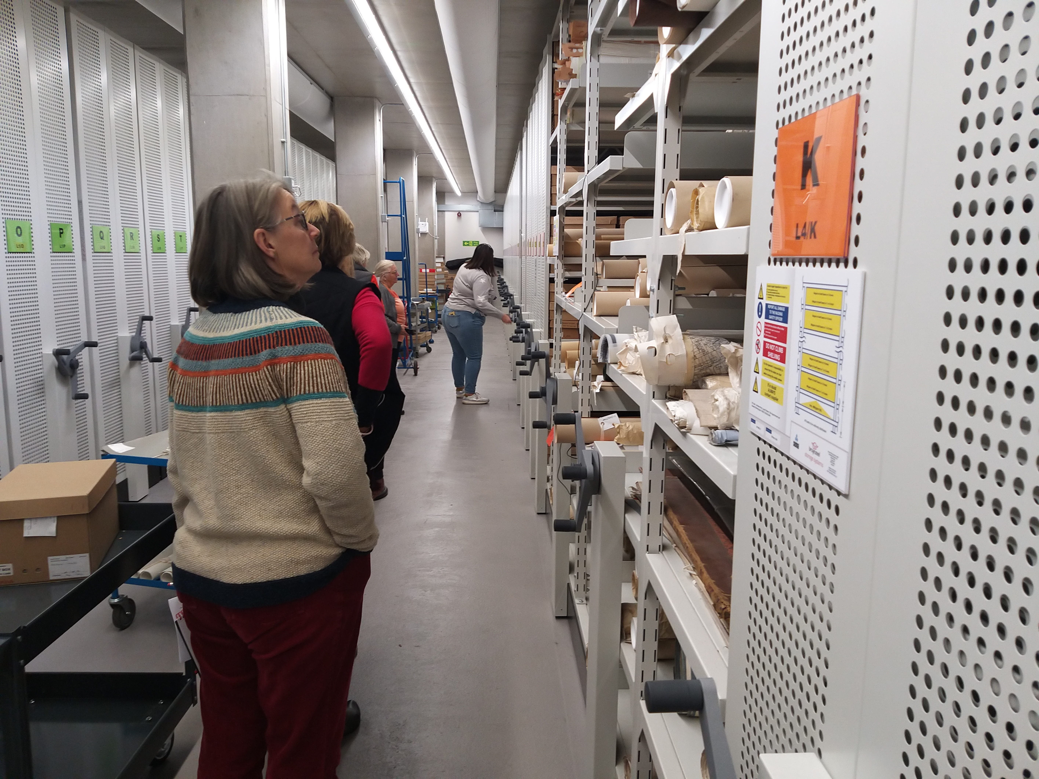
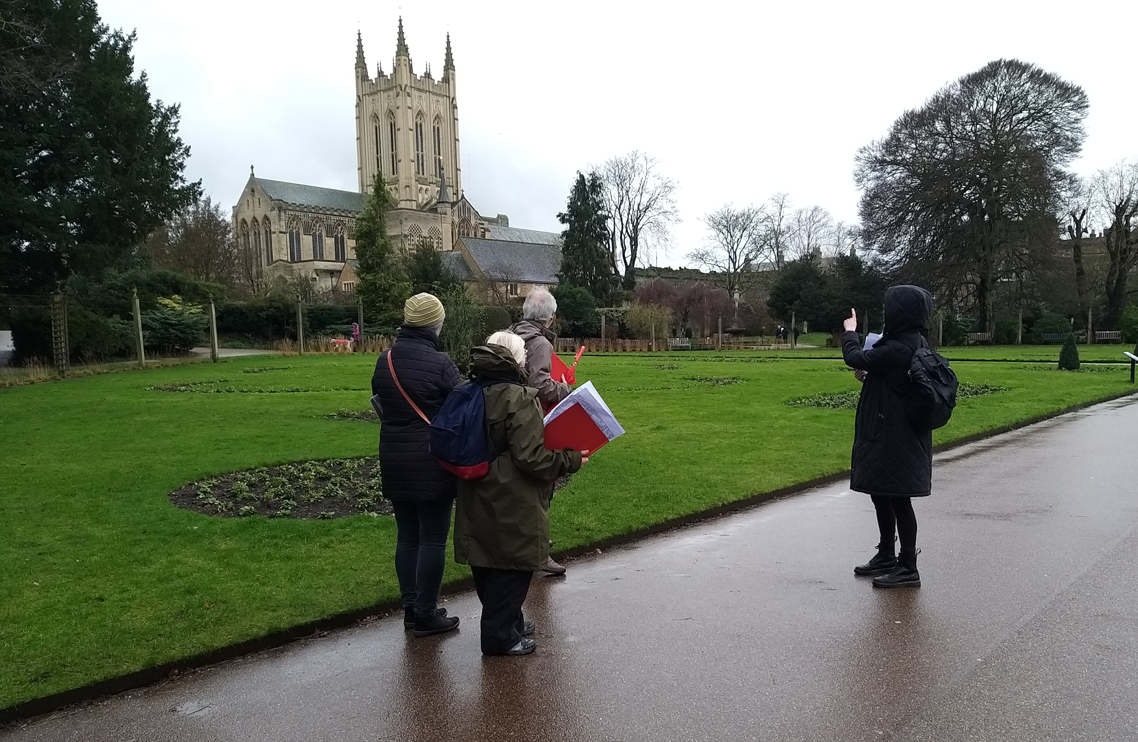

Slide 11
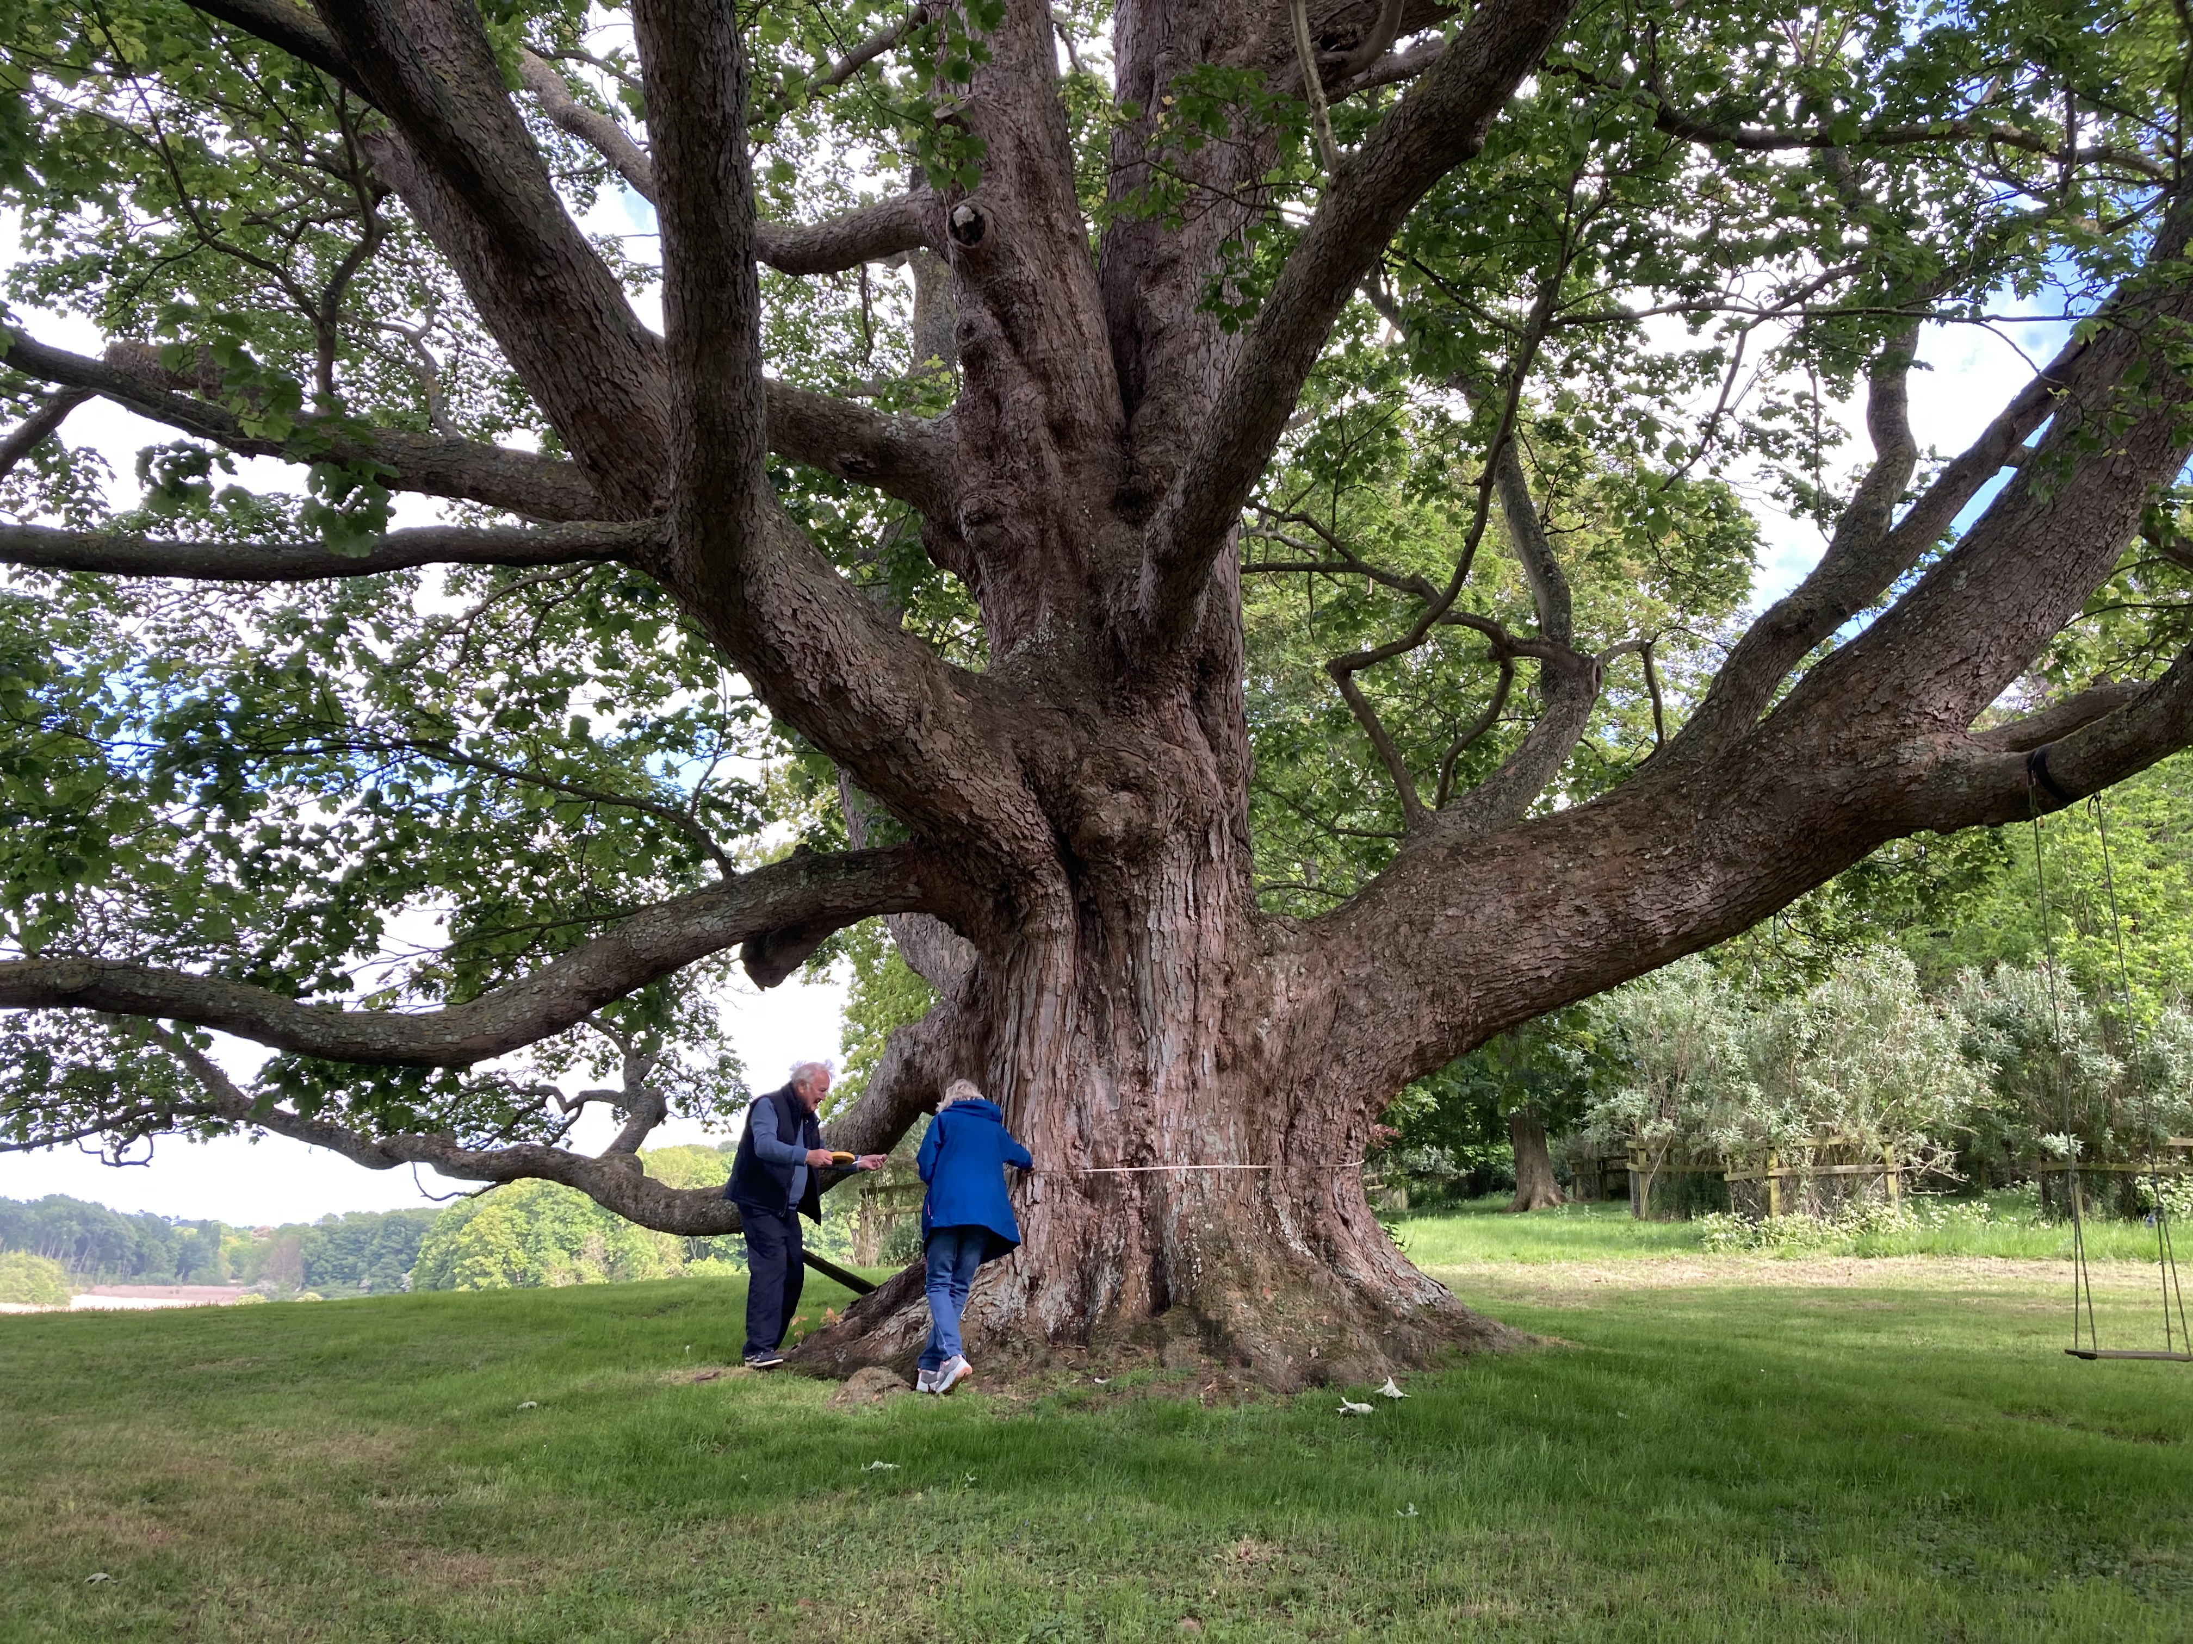
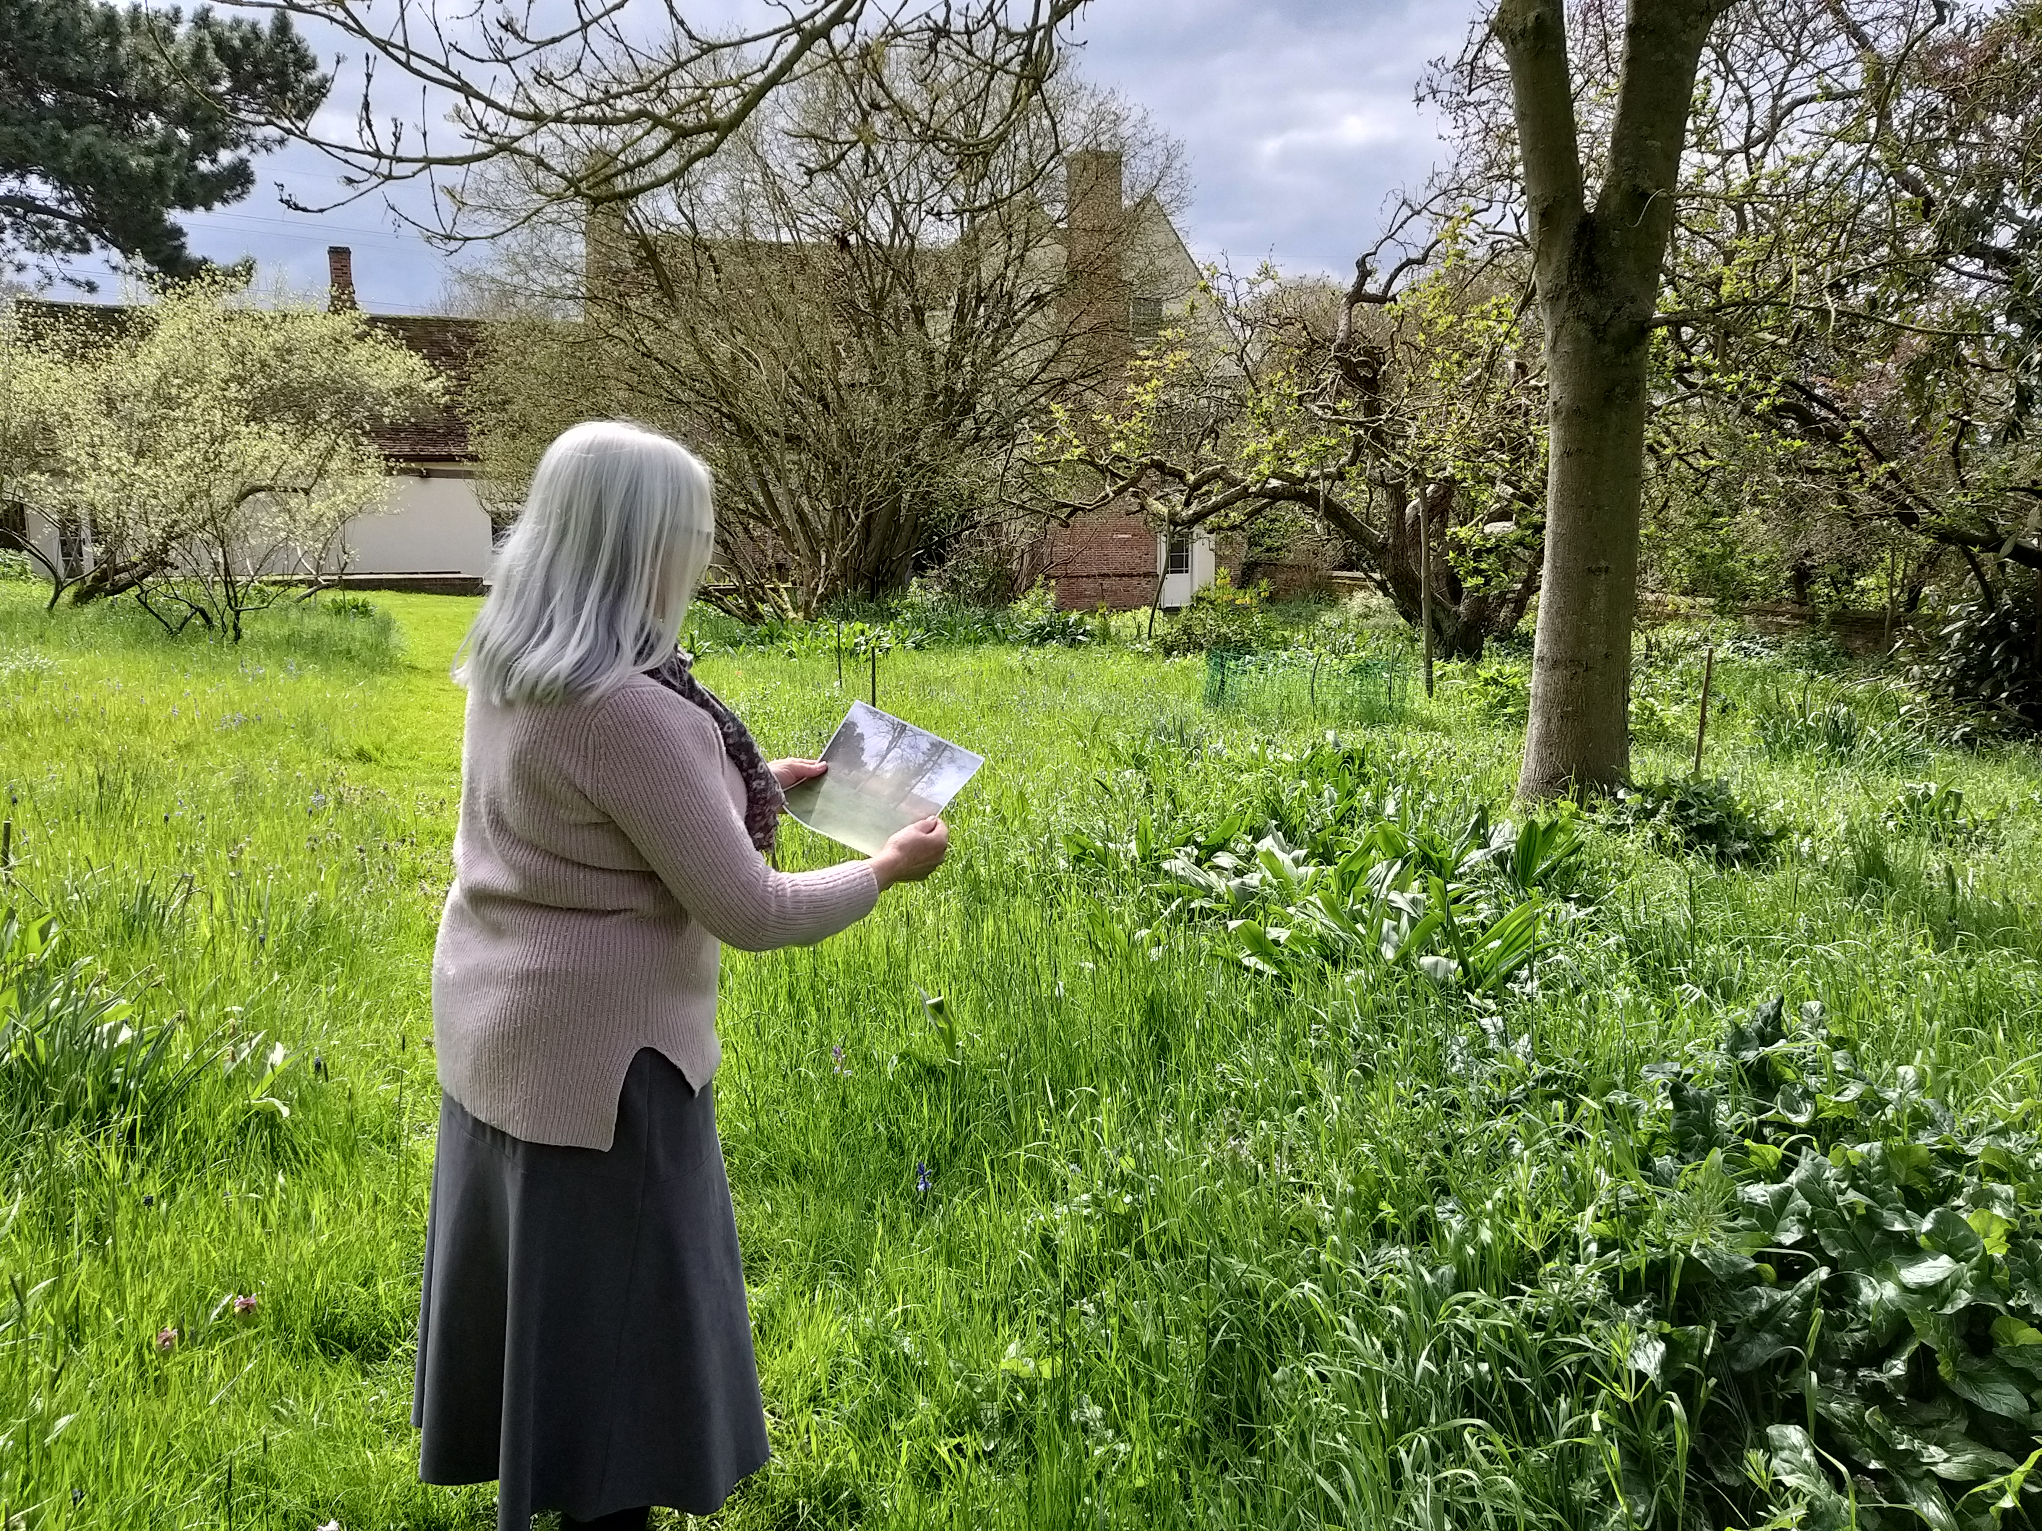
Site visits

Slide 12
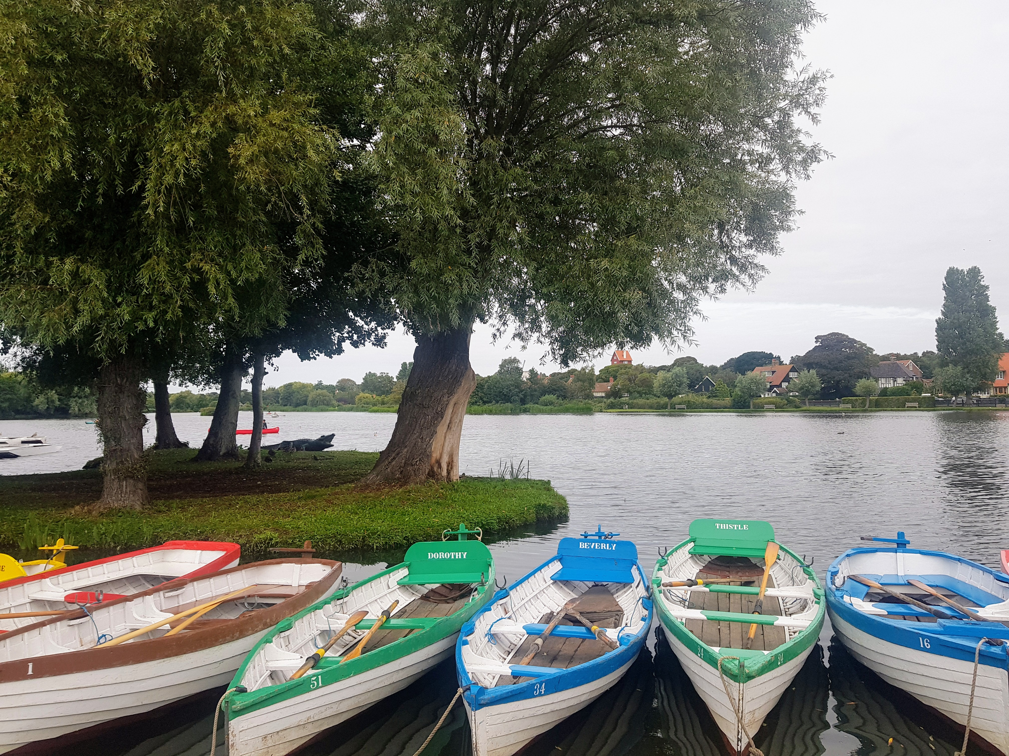
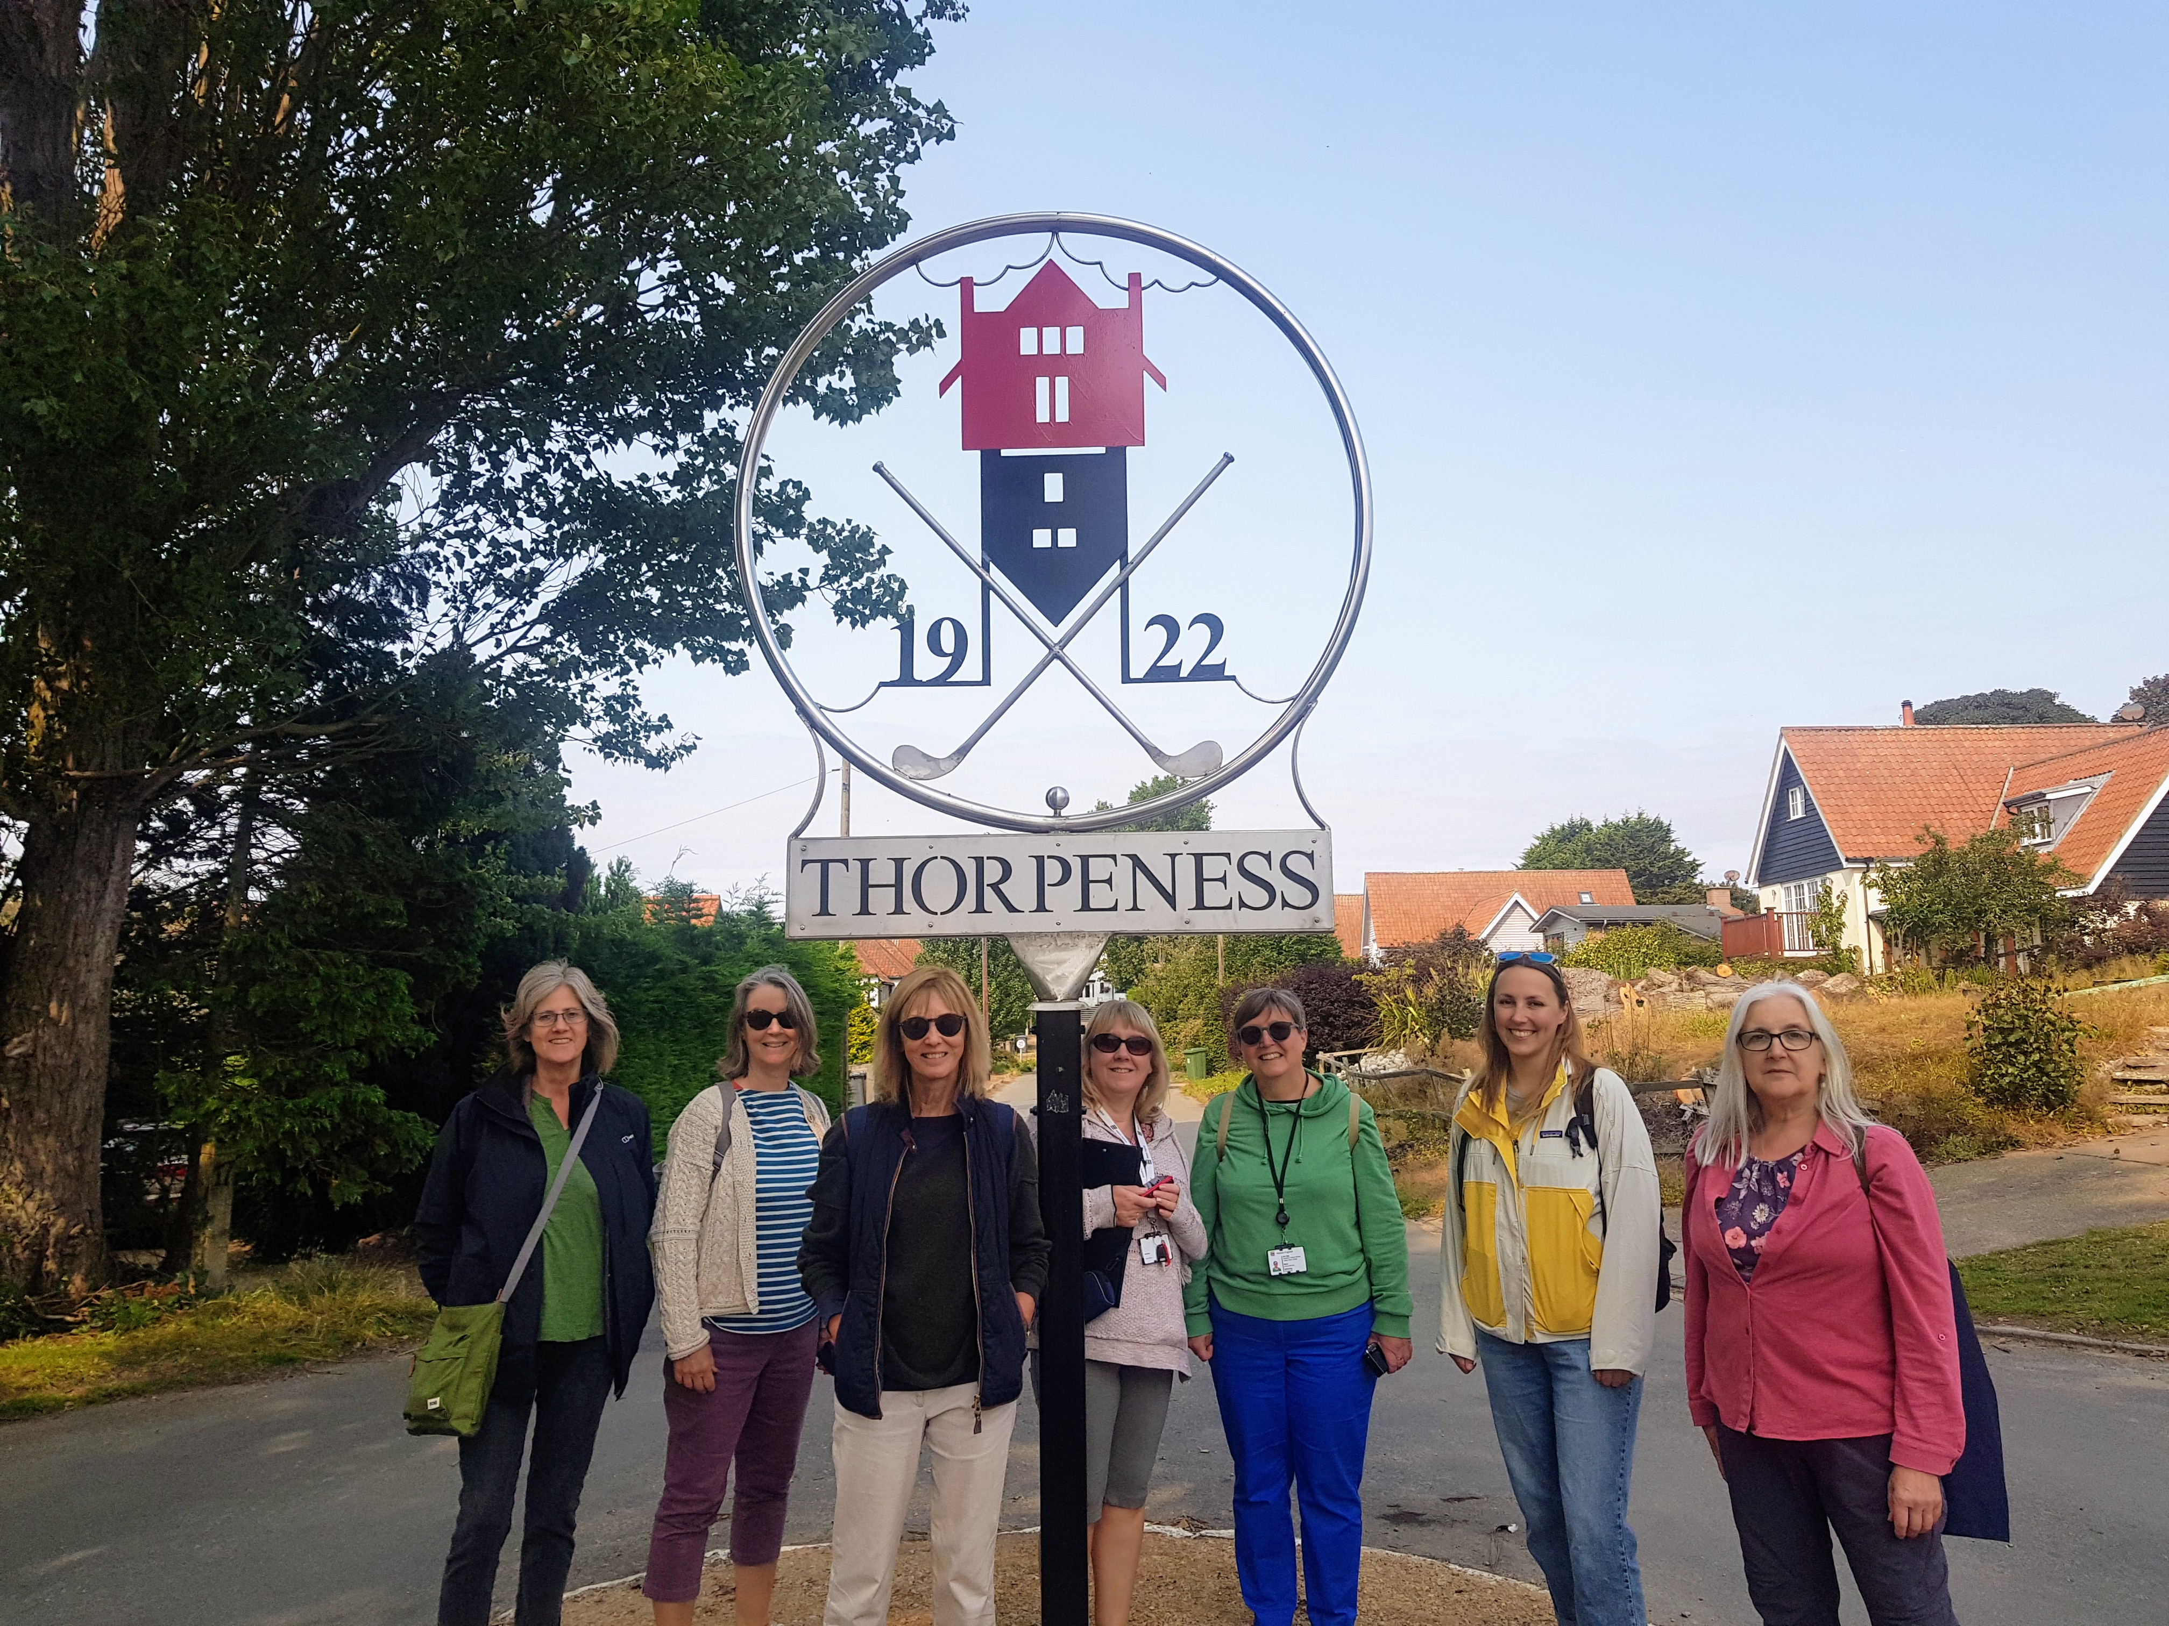

Slide 13
Outcomes
7 new sites on Historic England's National Heritage List for England.
The newly protected parks and gardens include:
Abbot’s Hall in Stowmarket – the pleasure grounds of an early 18th century house;
Thorpeness Meare – the vibrant and adventurous landscape of Britain’s first purpose-built holiday village;
Crow’s Hall – an early country house landscape with stunning views;
Staverton Park – once owned by royalty
the Walled Garden at the Royal Hospital School in Holbrook – featuring a distinctive ‘crinkle-crankle’ wall.

Slide 14
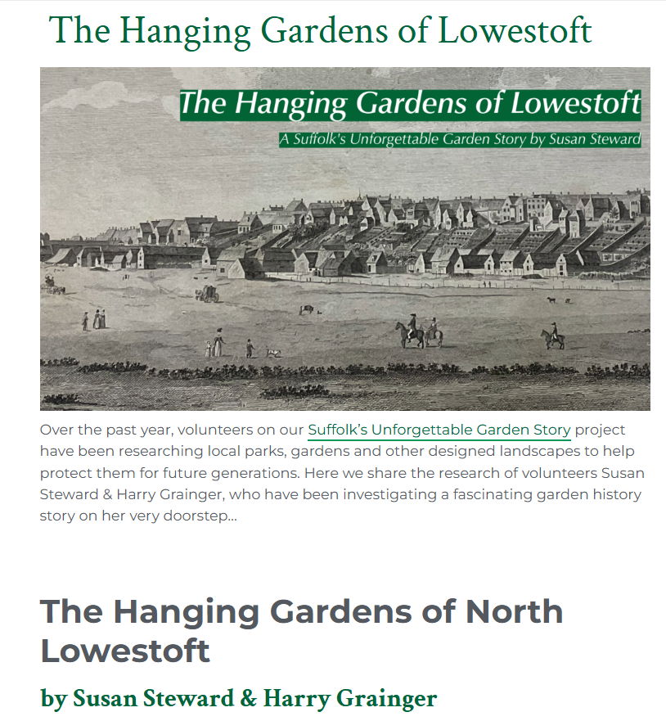
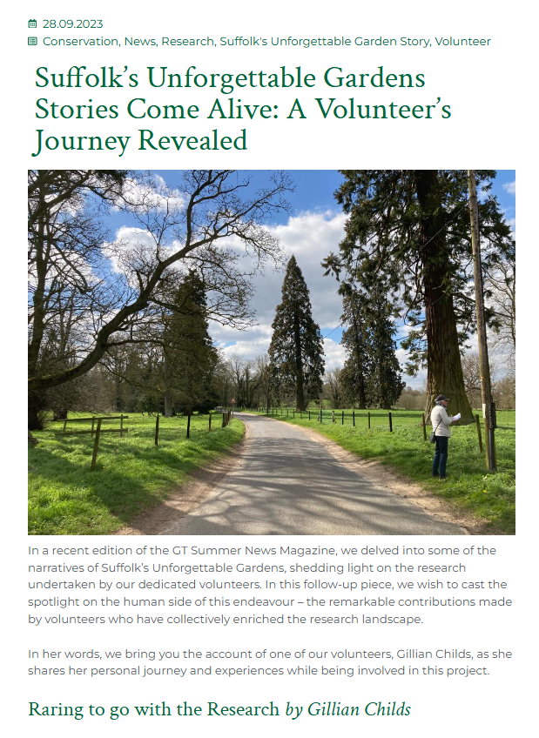
Legacy

Slide 15
The Suffolk Gardens Trust Website
Suffolkgardenstrust.org
Registered parks & gardens
Memorable parks & gardens

Slide 16
