Slide 1
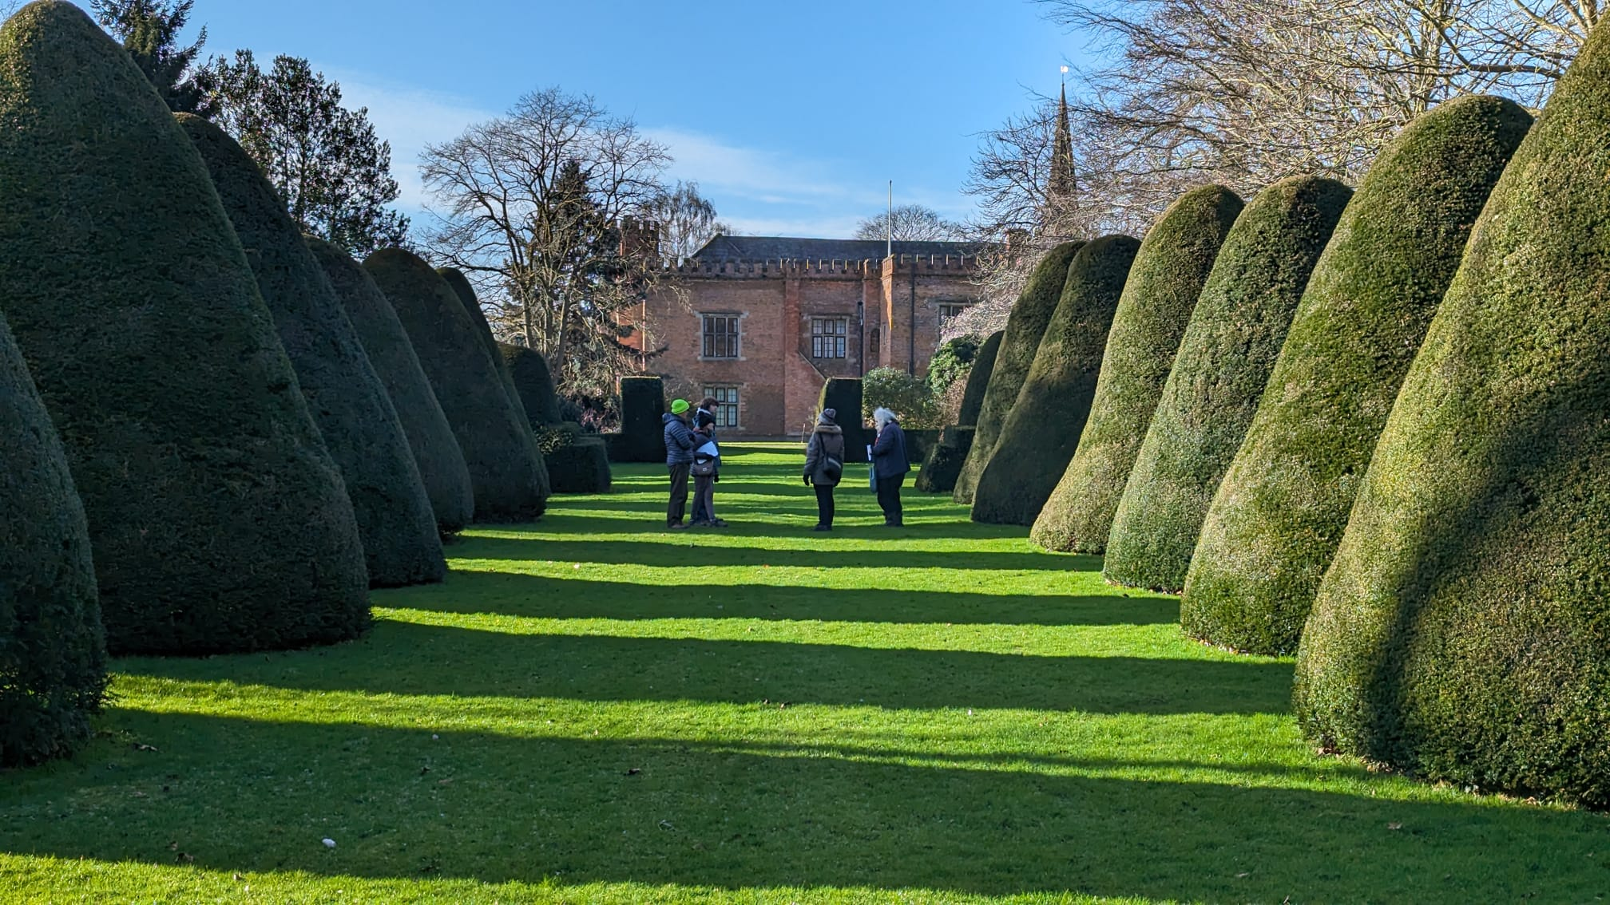
Nottinghamshire’s Garden Story
Tamsin McMillan
GT Volunteer Support Officer
thegardenstrust.org
Find us: @thegardenstrust
Notes:
Hello everyone, I’m Tamsin McMillan. Gardens Trust Volunteer Support Officer
I’m sorry I can’t be with you today but hope you have a wonderful and inspiring day
I’m going to tell you about Nottinghamshire’s Garden Story, which is one of three regional activities we ran as part of a two-year Gardens Trust project called Volunteers Save Space!, part-funded by Historic England.
The aim of VSS was to support and train the County Gardens Trusts; to share knowledge and enjoyment of historic parks and gardens with new people; and to encourage active participation in conservation.

Slide 2
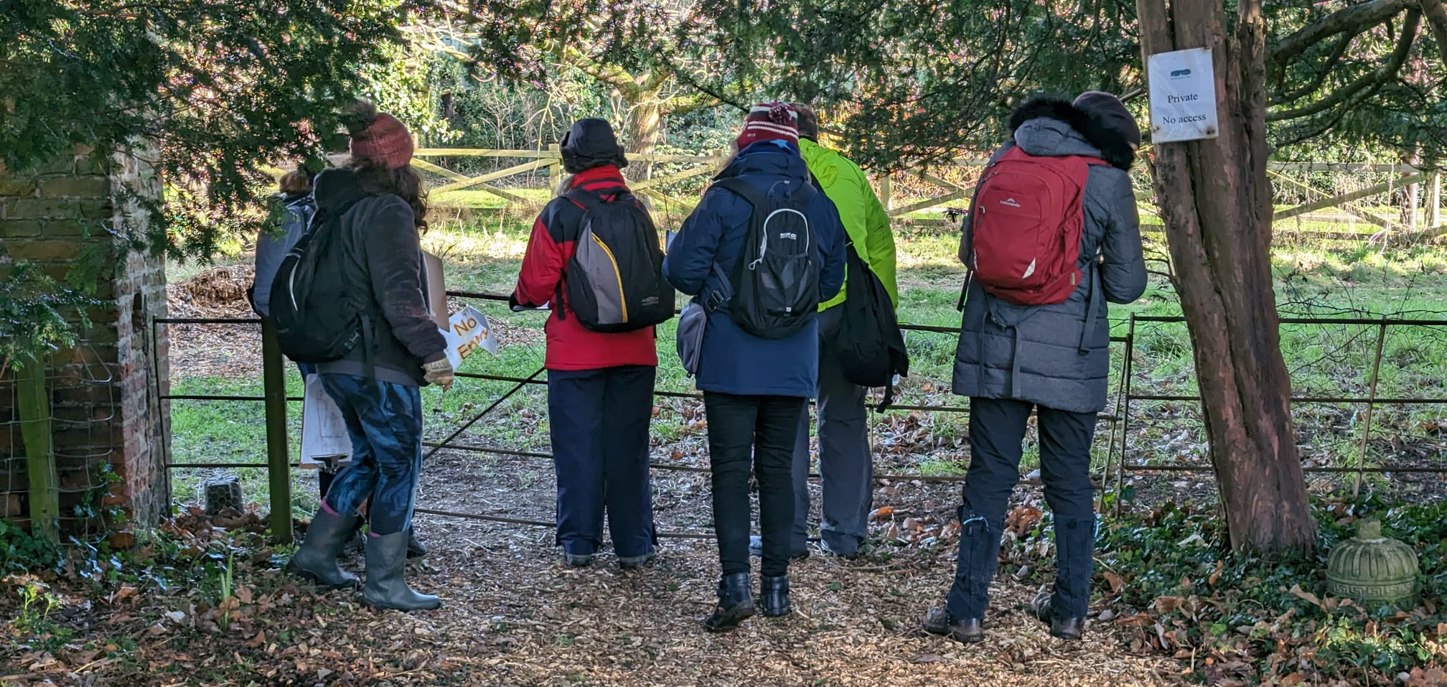
Aims
Share historic designed landscapes with new people
Train 10-20 new volunteers
Research 4-8 non-designated sites
Promote and boost Notts GT
Share the learning
thegardenstrust.org
Find us: @thegardenstrust
Notes:
The Notts project was very much inspired by Suffolk’s Unforgettable Gardens Story and re-used or adapted many of the learning materials.
It was intended to be a sort of mini-version, which could be repeated, as a whole or in part, by other CGTs in their own counties, using the webinar recordings.
The specific aims for the Notts project were:
To help more people to understand, enjoy and treasure historic designed landscapes
to train new volunteers to research and record non-designated sites
To add to the historic record
To raise awareness of Notts GT – the youngest and smallest of all the county gardens trusts
And to share the learning widely, to encourage others to do something similar

Slide 3
Timetable
Choosing recruitment sites
spring
Promotion
Spring-summer
Preparation
early 2023
Recruitment
Aug-Sept
Research
Jan-Feb
Writing up
Feb-March
Training
Nov ‘23- Feb ‘24
Celebrating and sharing
April
thegardenstrust.org
Find us: @thegardenstrust
Notes:
In early 2023, we started project planning, promotion and recruitment of volunteers. This was quite labour intensive, leaving just 4 months for training and 3 months for volunteers to research their landscapes and write up a report.
If time and resources had allowed, it would have been better to run the project over a longer period, allowing us to spread out the training a little more and give longer for the volunteers to get to know their sites. Our project had to fit within VSS, which had to finish at the end of March,

Slide 4
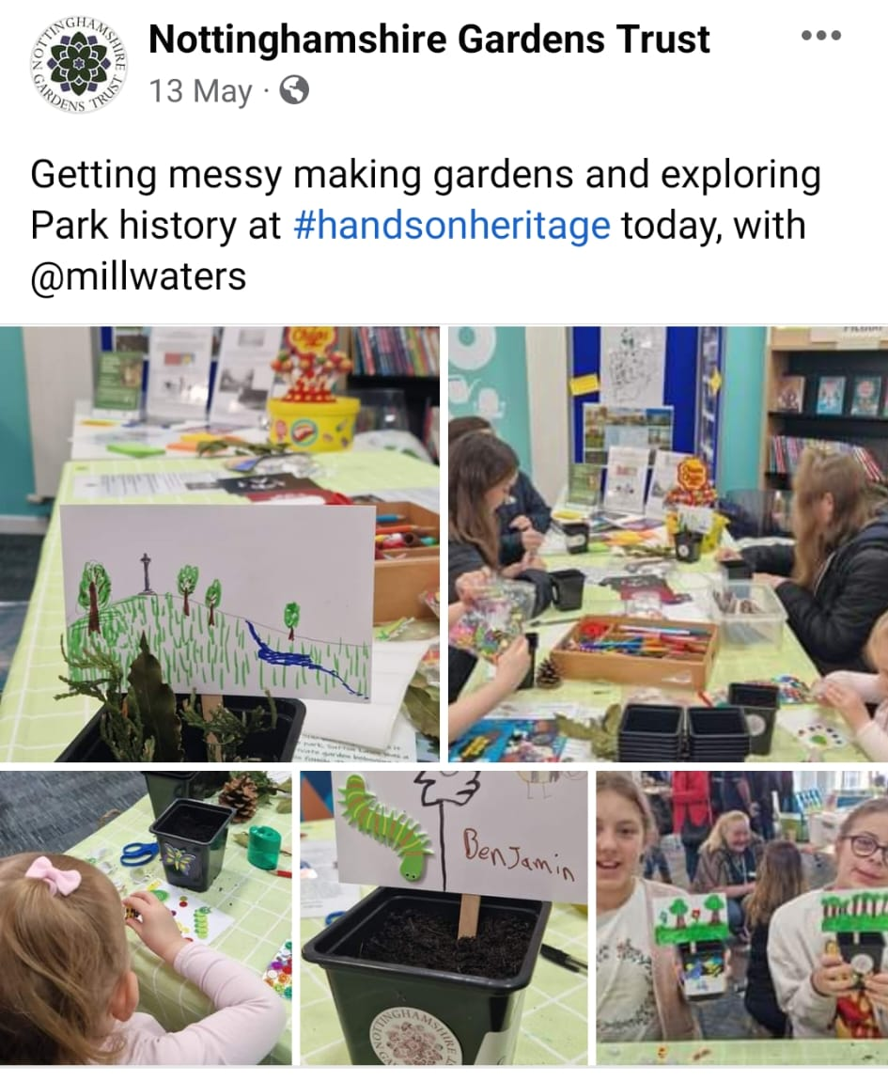
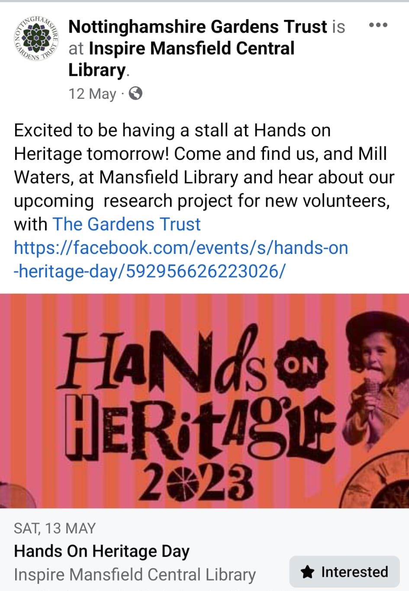
Online promotion
thegardenstrust.org
Find us: @thegardenstrust
Notes:
To try and make contact with as wide an audience as possible, recruitment comprised a mixture of social media posts and pieces in our monthly eBulletin and on the GT website. So here you can see some promotion of our family-friendly recruitment events, as we wanted to get the message across that anyone could take part in this activity, whatever age or background.

Slide 5
Contact with heritage groups
Article in Nottinghamshire Local History Association newsletter
Direct emails to:
All County Gardens Trust main contacts
NGT mailing list
Site owners, managers and Friends groups
Nottingham Centre and North Notts National Trust Supporter Groups
Local history groups
Bromley House Subscription Library
thegardenstrust.org
Find us: @thegardenstrust
Notes:
We also contacted these Notts-based heritage organisations, asking them to share some of our social media and an invitation to a webinar introducing the project.

Slide 6
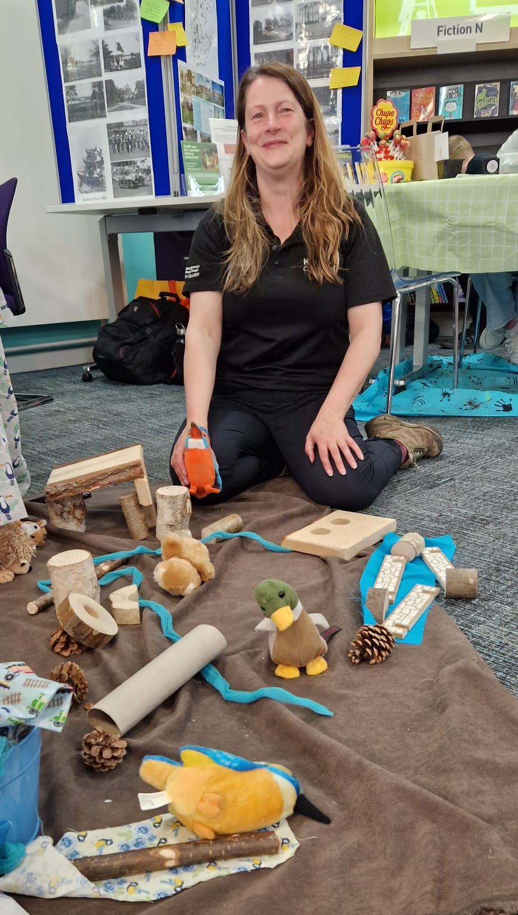
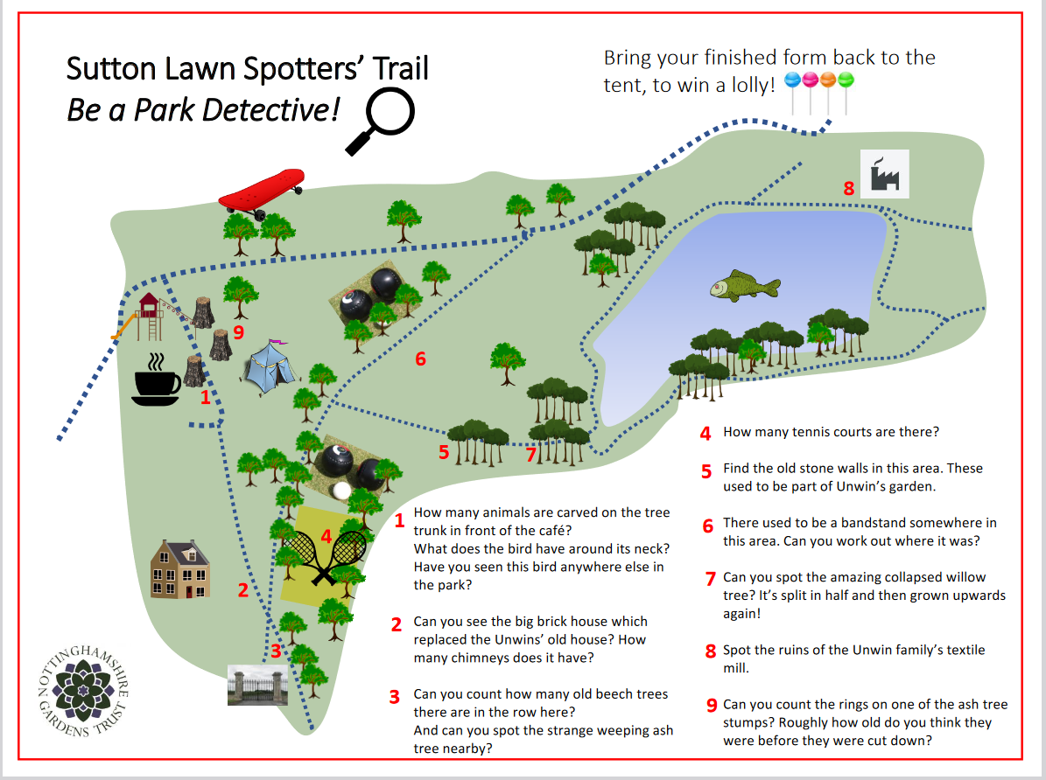
Promotional events
thegardenstrust.org
Find us: @thegardenstrust
Notes:
We identified 3 hub sites at which we carried out some on the ground promotion, to try and reach a more mixed audience –
Ossington Hall, where we met the owner and made contact with a local heritage group
Bestwood Country Park, where we got in touch with the Friends group
And, Sutton Lawn, in Sutton in Ashfield. This became a key hub for us, thanks largely to the enthusiasm and local knowledge of Mill Waters Project Officer, Emma Hancock, and we ran two promotional events in the area – a kid’s activity day at Sutton Lawn and a stall at Hands on Heritage in Mansfield Library. On the left you can see Emma helping us at the latter event. The aim of these was just to tell people about the project and add to our mailing list.
These events included activities for children, making a mini garden in a pot and giving out free Park Detective Spotters’ Trails, to help people discover historic features in the park. These activities attracted quite large numbers and, while the children were busy at our stall, we chatted to the adults who came with them.

Slide 7
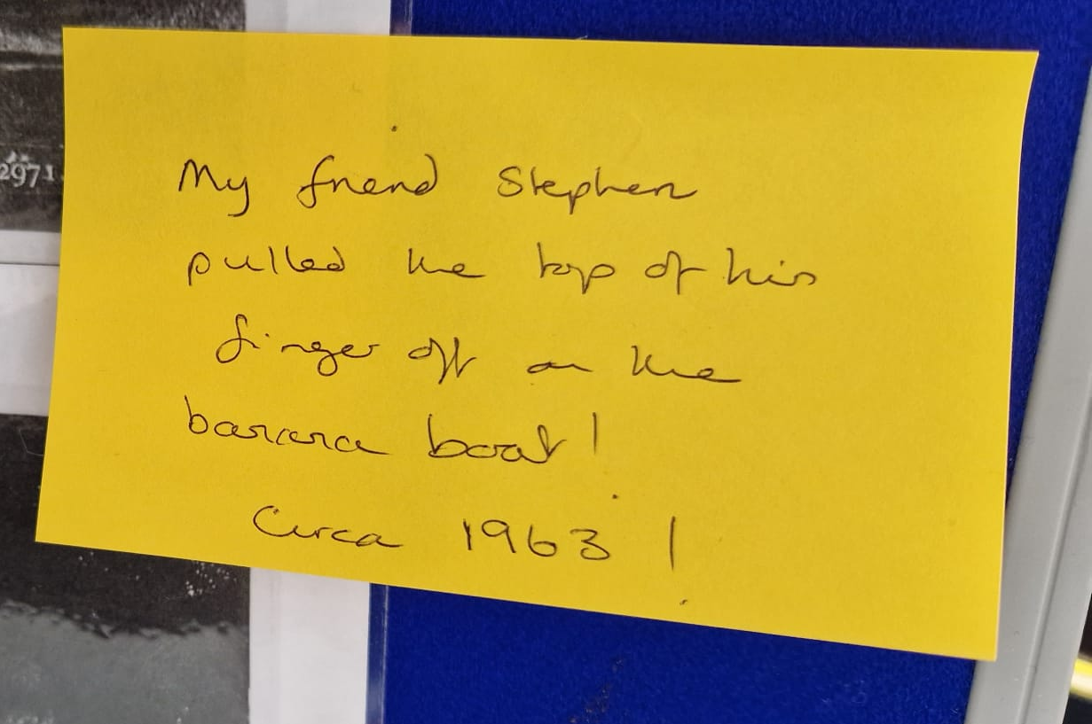
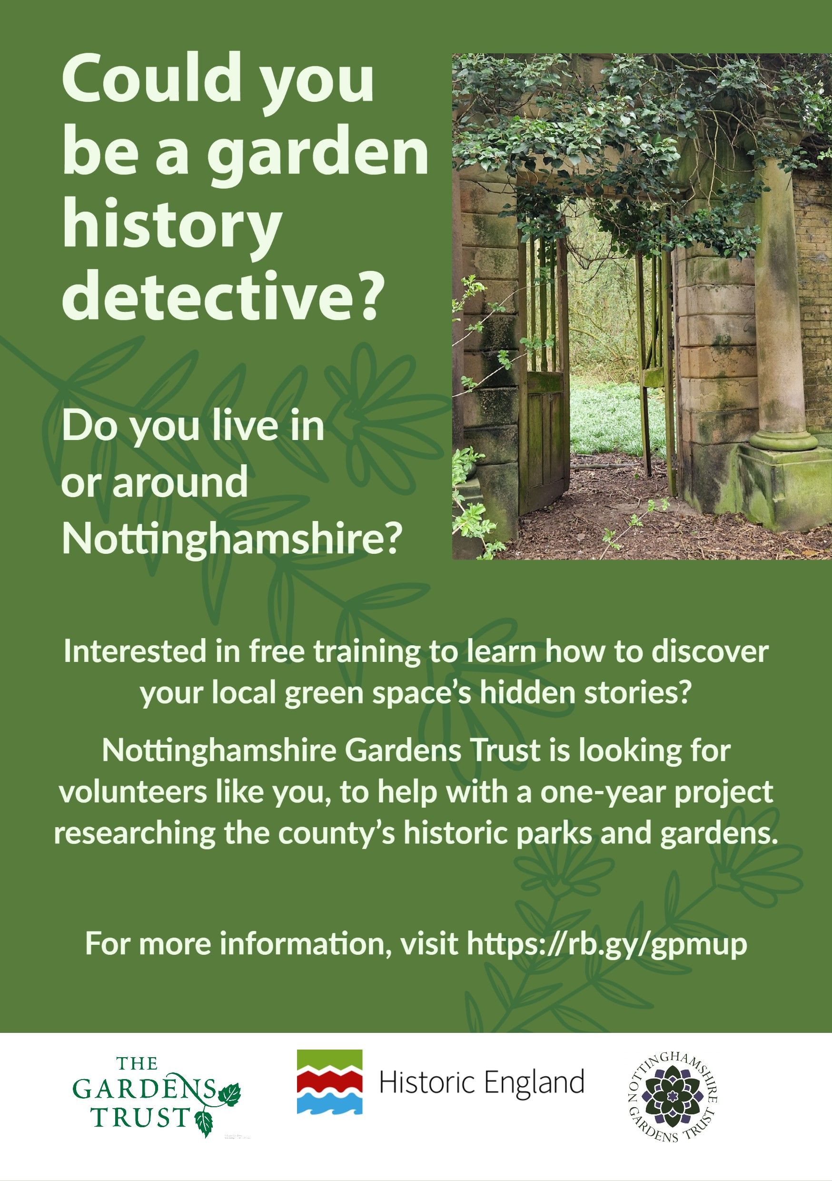
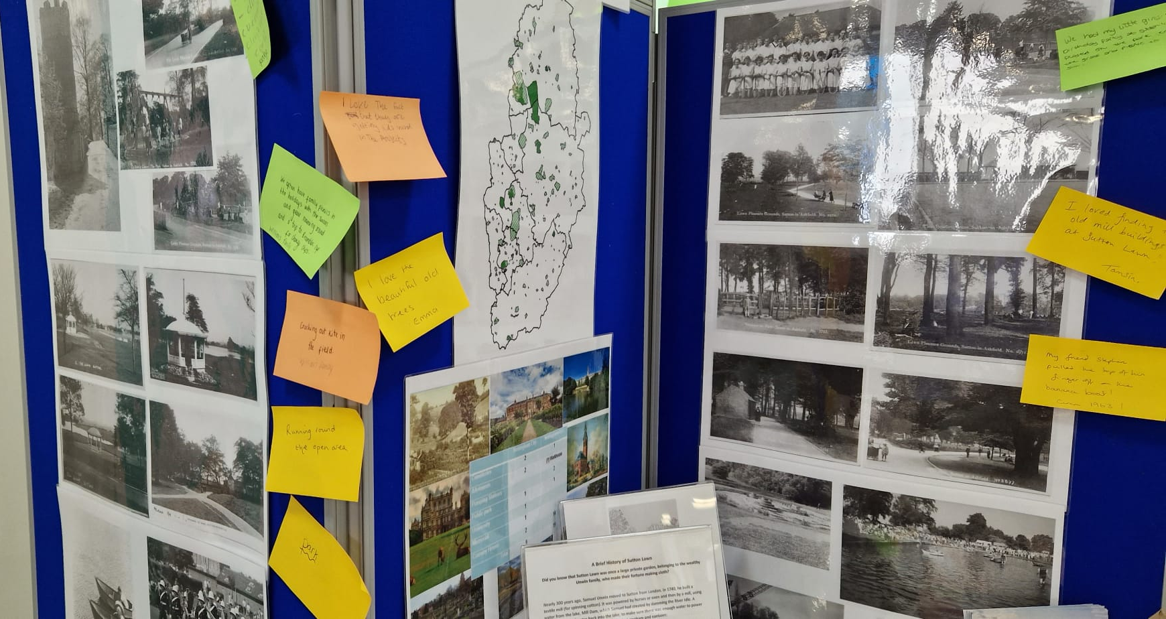
Building Interest
thegardenstrust.org
Find us: @thegardenstrust
Notes:
We wanted to be quite subtle in our messaging, as we didn’t wanted to put people off by announcing an academic-sounding “research project”. Instead, we shared historic images and maps of Sutton Lawn and talked to people about their memories and favourite parts of the site.
We also designed and printed a project flyer, which we gave out to those we talked to and also left some in the library.
Over both events, we talked to around 60 adults, completed the plant pot activity with 59 children, signed up 18 for the project mailing list. So a pretty good result!

Slide 8
Engagement
31 on mailing list:
18 from events
5 who saw promotion
8 partners (site owners/managers/ local organisations/ Friends)
37 attended introductory webinar
17 completed volunteer roles questionnaire
thegardenstrust.org
Find us: @thegardenstrust
Notes:
We ended up with 31 on our project mailing list, including 8 partners . Several of these partners became really important in helping us to promote the project.
After our introductory webinar, we sent out a short survey, asking people how they might like to be involved. 12 respondents said they wanted to contribute directly to the project and others just wanted to follow progress
Only 2 respondents were already experienced in garden history research, which was great, as we really wanted to reach some new people.

Slide 9
Online Training
Garden history
Threats and conservation
Beginning historic landscapes research
Making a site visit
Collecting memories
Sharing research widely
Depositing research reports
Materials on GT Resource Hub https://thegardenstrust.org/conservation/vs-hub/
thegardenstrust.org
Find us: @thegardenstrust
Notes:
Training webinars were held in the evening, so that people who were busy in the day could take part. The training was suitable for absolute beginners. Recordings were put onto YouTube, and you can find these via the GT resource hub.
We covered:
A whistlestop tour of garden history
Threats and conservation of historic parks and gardens
Researching landscapes
Making a site visits
Collecting people’s memories of landscapes
Sharing finished research online and with wide audiences
80-100 people came to the first three, which obviously had wider appeal, and slightly fewer to the others.
Around half of the attendees came from CGTs and the rest from other organisations, or just interested individuals. Again, it was great to welcome some new audiences, including several from abroad.

Slide 10
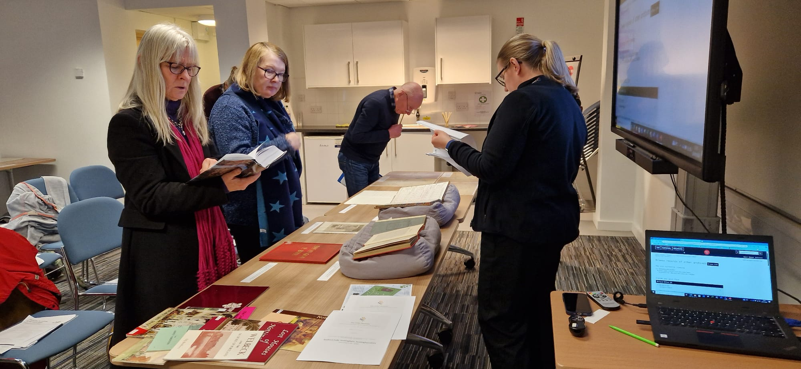
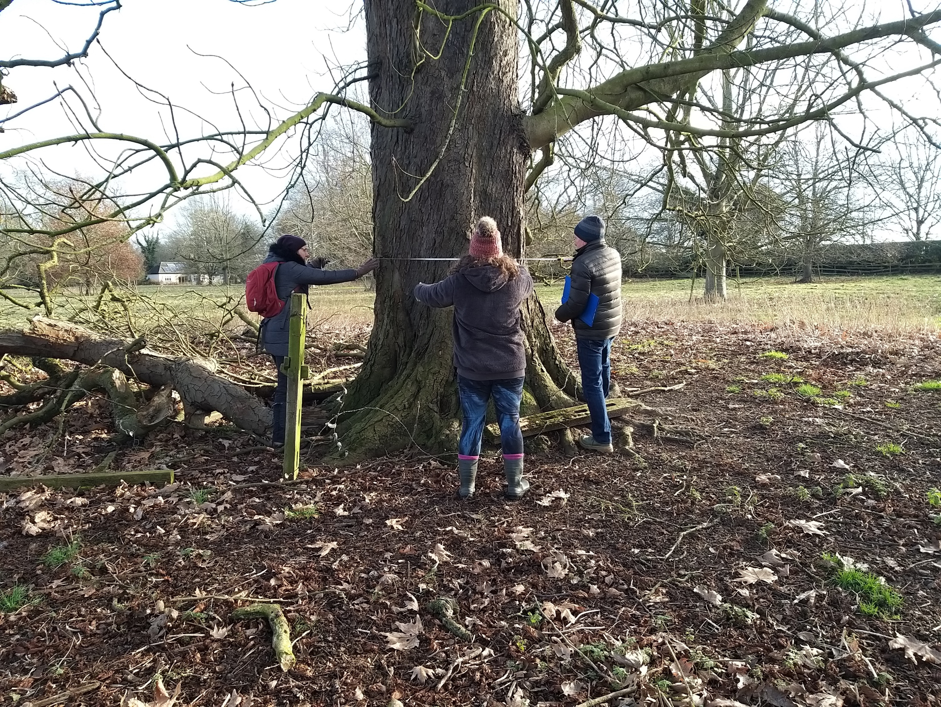
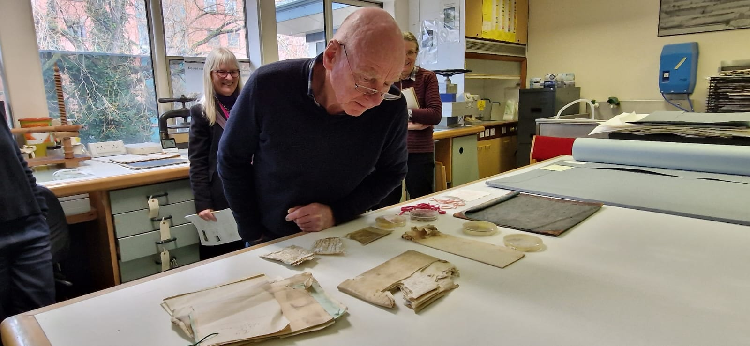
In-person training
For the project volunteers
thegardenstrust.org
Find us: @thegardenstrust
Notes:
We ran two in-person sessions for just the Notts-based volunteers to attend:
A visit to Holme Pierrepont Hall, to practice on-site recording
And a guided tour of Notts archives.
The Holme P session was the first time we all met up in person and it was a really fun and positive day.

Slide 11
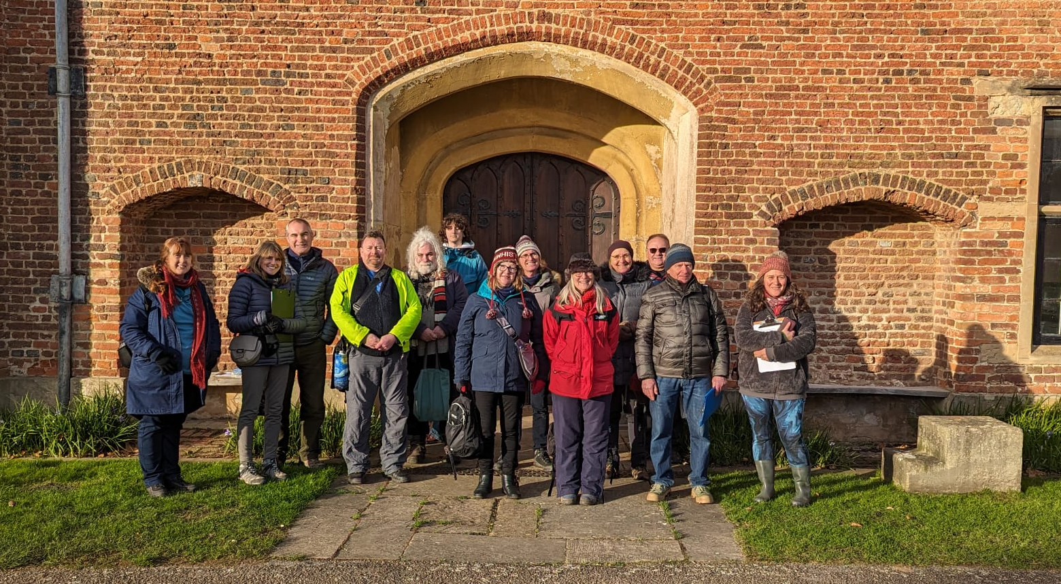
The Volunteers
thegardenstrust.org
Find us: @thegardenstrust
Notes:
We ended up with 9 volunteers. This was an interesting lesson – that you can start by engaging with quite large numbers, but only a small proportion of these will want to join the mailing list; even fewer will have time to come to any training; and fewer still will be able to complete the project.
We’re really grateful, therefore, to those who followed the whole journey, as we recognize what a commitment is it, but we’re also grateful to everyone who engaged with us, however briefly. Hopefully they too will have taken on board a bit of learning about designed landscape heritage and the existence of Notts GT, perhaps sparking an interest for future involvement.
Interestingly, 5 of the 9 had already done some volunteering. This just goes to show what we all know, that if you are a volunteer by nature, then you’re very likely to volunteer at more than one thing (and also very likely to be asked to do so!)
We’ll now have a really quick look at the volunteers and the landscapes they chose to research.

Slide 12
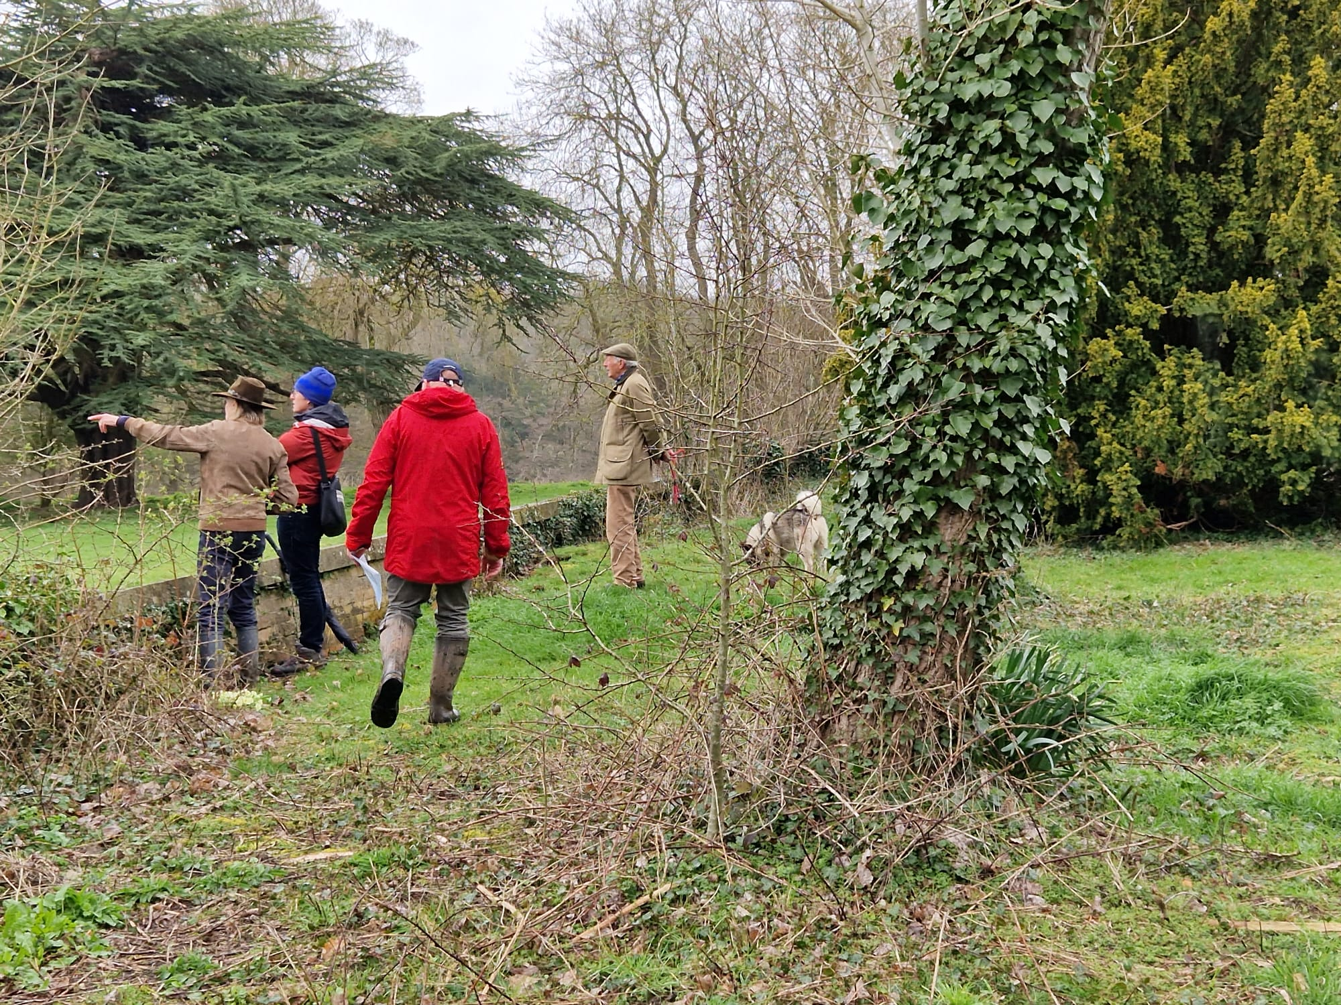
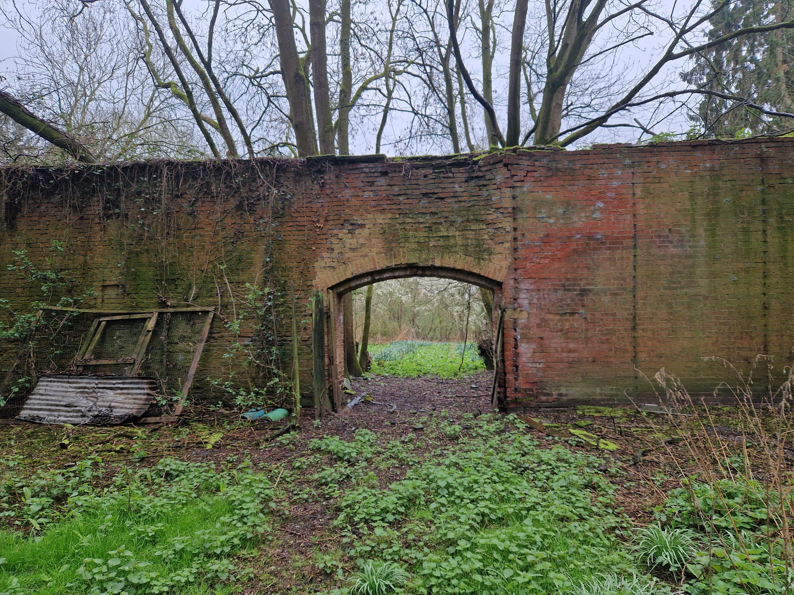
The Landscapes: Ossington Hall
thegardenstrust.org
Find us: @thegardenstrust
Notes:
Liz, a freelance heritage consultant who had also worked as an interpretation volunteer at a NT site, researched Ossington Hall, in rural E Nottinghamshire
Ossington reached its heyday in Victorian times under Evelyn Denison, Speaker of the House of Commons..
Liz has not yet completed her research, but plans to include an interview with the elderly son of the former head gardener.
The link with Ossington has helped NGT to establish three lasting relationships: with the owner; her partner, who owns one of the other sites researched; and with the parish Heritage Group, for whom Liz will be leading a tour of the landscape.

Slide 13
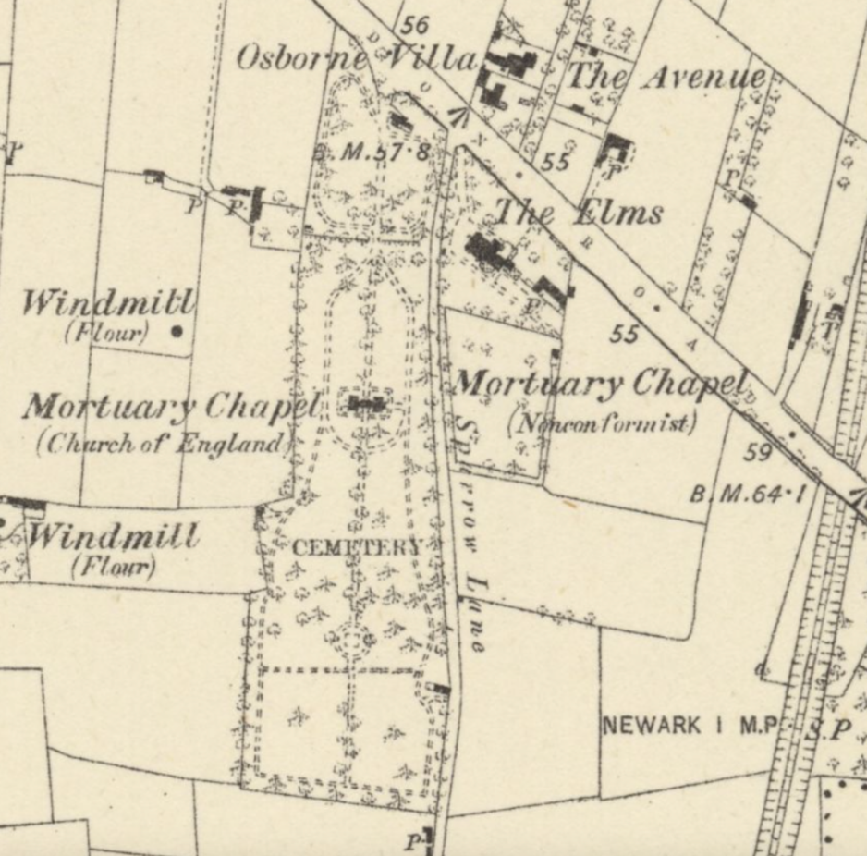
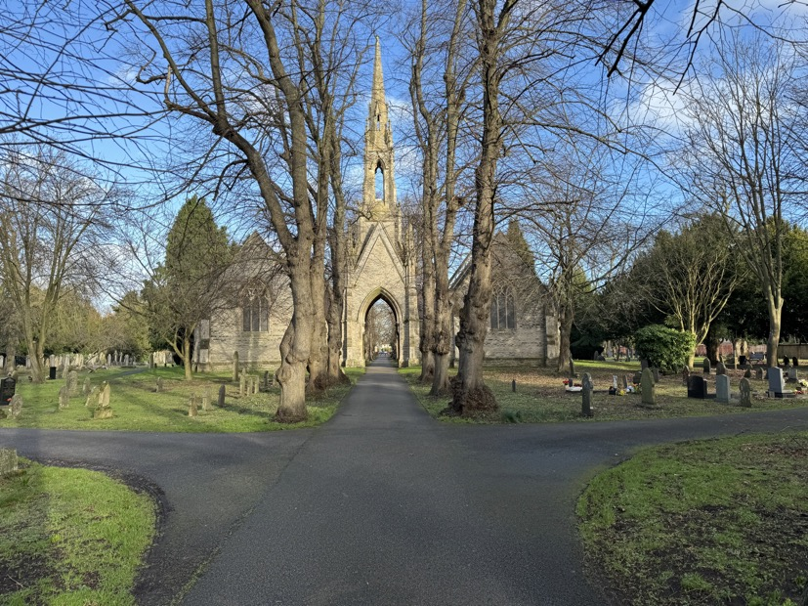
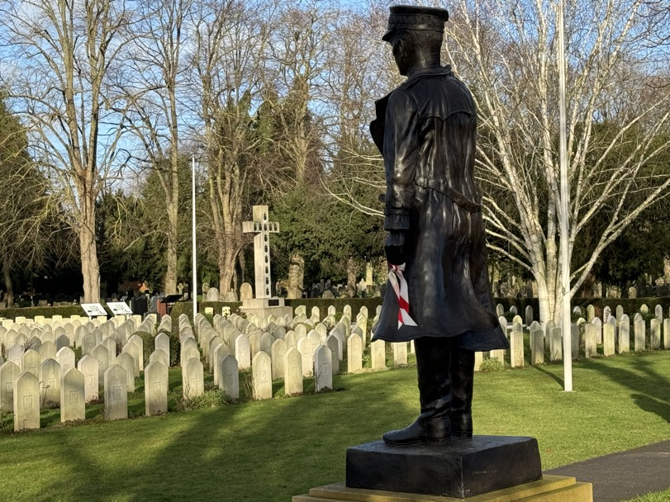
The Landscapes: London Road Cemetery
thegardenstrust.org
Find us: @thegardenstrust
Notes:
Andy is a Notts GT Trustee, with a professional background in landscape heritage. He researched London Road Cemetery in Newark.
The cemetery was started in 1856 and its axial layout has remained largely unaltered. It contains graves of Polish airmen from WWI and II and Andy felt that the Polish story added a particular significance given the concentration of air fields in this locality that were polish flying bases.

Slide 14
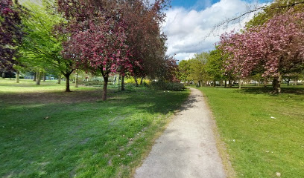
The Landscapes: Clifton Central “Flower” Park
thegardenstrust.org
Find us: @thegardenstrust
Notes:
Ingrid, originally from Sweden, is a businesswoman living in Nottingham
She decided to research her local park, simply because it was only a short walk from her home, and is a public park, with no access issues. Ingrid wanted to keep things as simple as possible for her first research project – in her own words: I don't want to make it too complicated (as that just might be a reason not to do it... and we don't want that)!”
Ingrid is still working on her research, which is fine – we don’t want to put pressure on volunteers to finish quickly as this rather takes away the enjoyment.

Slide 15
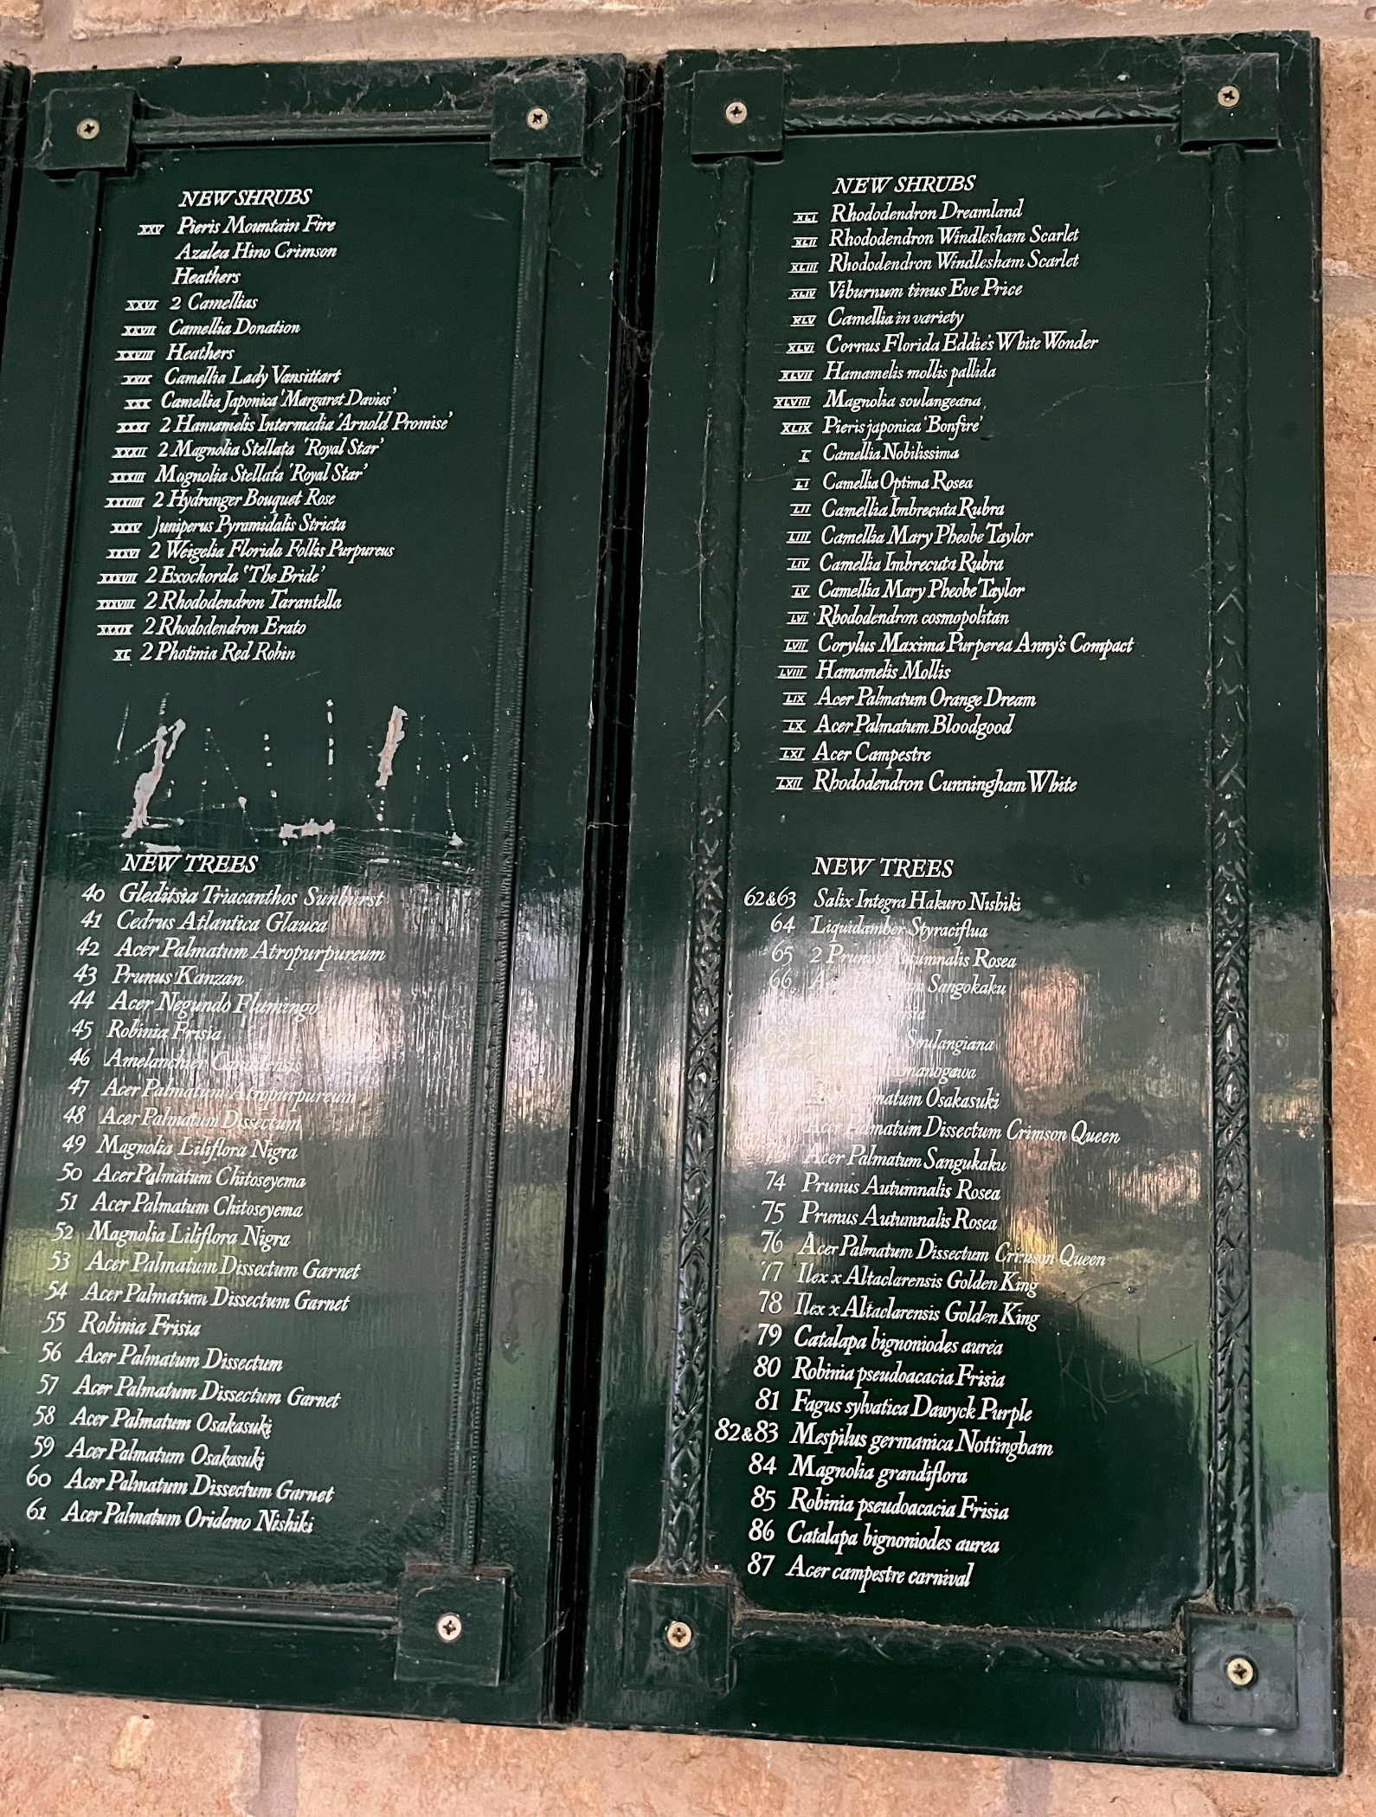
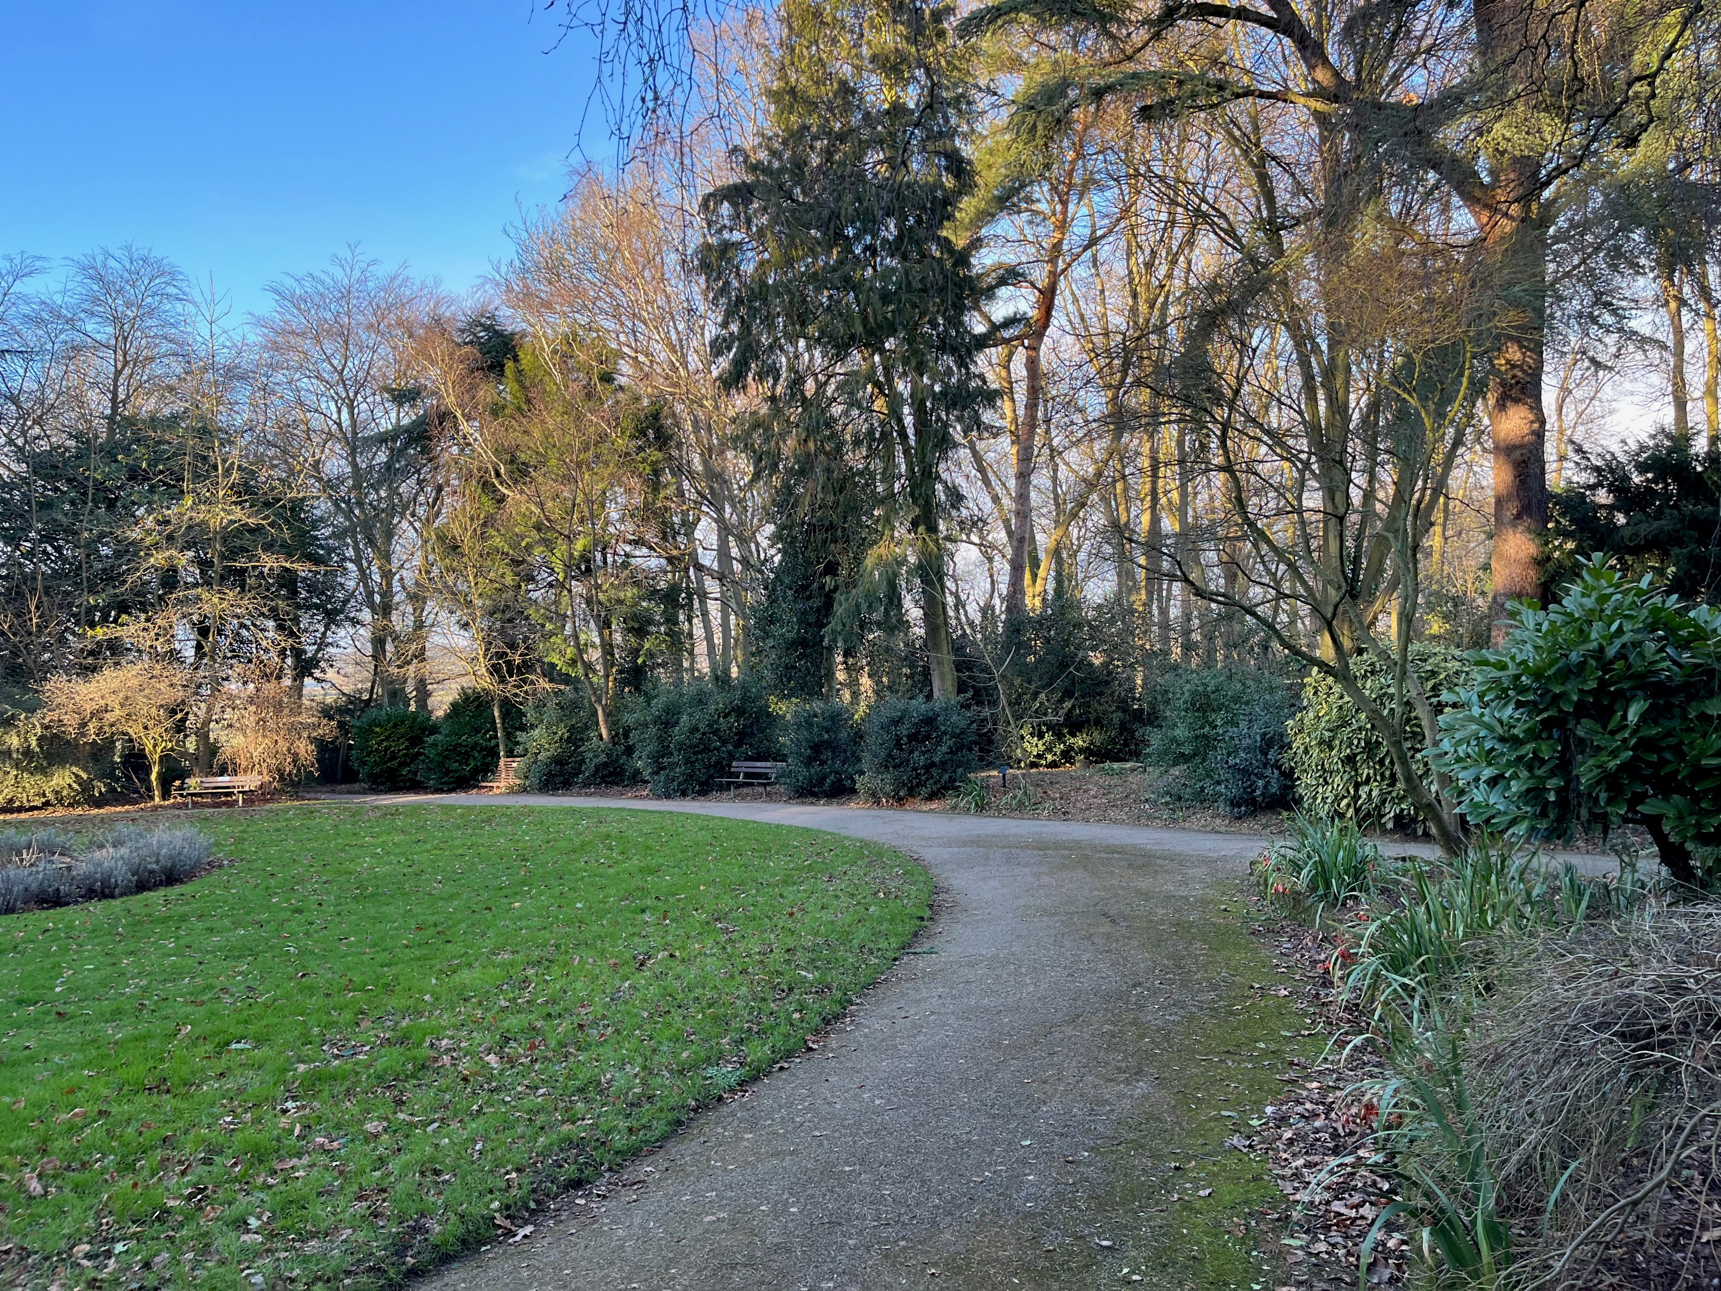
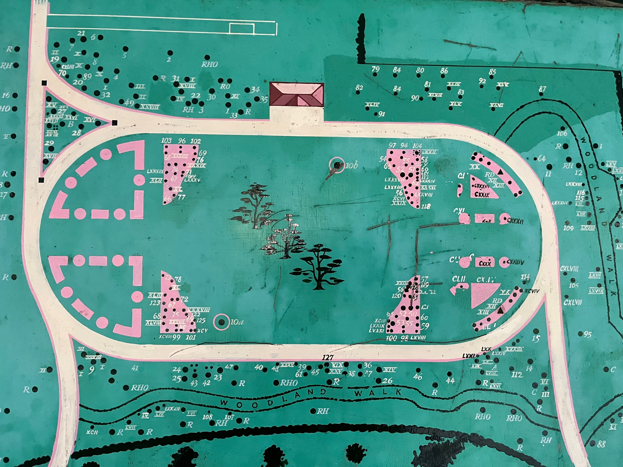
The Landscapes: Rockley Memorial Park
thegardenstrust.org
Find us: @thegardenstrust
Notes:
Andrew, a retired policeman, researched Rockley Memorial Park, a linear landscape along the River Trent, in Radcliffe on Trent. He has a particular interest in golf history and was drawn to Rockley as it had been laid out in memory of accomplished golfer William Rockley, after he was killed at Ypres in 1917. His father, Lisle, created the park and cliff walk and presented the site to the village in 1927.
Andrew was thrilled to find original, wall-mounted planting lists and a planting plan, on display in the park.

Slide 16
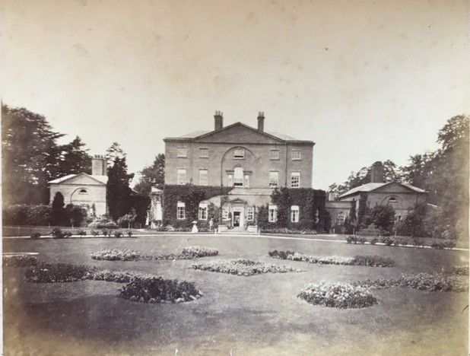
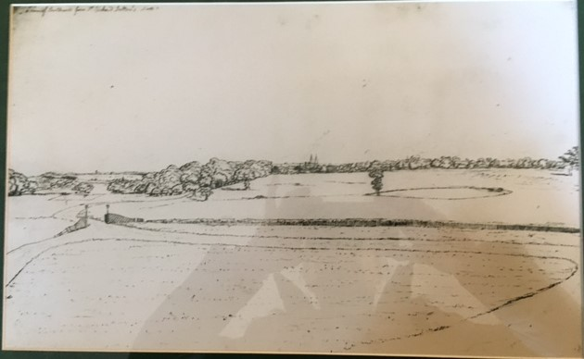
The Landscapes: Norwood Park
thegardenstrust.org
Find us: @thegardenstrust
Notes:
Gill had recently moved to Notts. She had some garden history experience but wanted to become more familiar with using primary source materials.
Gill completed a fantastic report on Norwood Park, an 18th century landscape park, owned by the partner of Ossington’s owner, which made getting access very simple. Gill was delighted to be shown numerous old photos and depictions of the landscape, from the owner’s private collection, such as this 1880s photo and late 18th century sketch.

Slide 17
The Landscapes: Racecourse Rec
thegardenstrust.org
Find us: @thegardenstrust
Notes:
Jo is a retired archivist from Mansfield and her sister, Carolyn, is a Regional Organiser for the Society for the Protection of Ancient Buildings. So both have strong interests in heritage but were new to historic parks and gardens research.
They decided to work together to research the Racecourse Recreation Ground in Mansfield and they uncovered a really interesting mixture of the racecourse’s history and its evolution into a recreation area and allotments.

Slide 18
The Landscapes: Langar Hall
thegardenstrust.org
Find us: @thegardenstrust
Notes:
Nigel, an amateur historian from my own village wrote a fantastic report, bringing together years of his research into the landscape of Langar Hall, a small country house.
The current house, which dates from the early 19th Century, sits within the footprint of a much larger earlier hall. A number of structures dating from the 17th and 18th Centuries remain including boundary walls and gatepiers, ha ha’s, a formal water garden, and an octagonal bowling green (which Nigel identified using this lidar image and earthworks on the ground

Slide 19
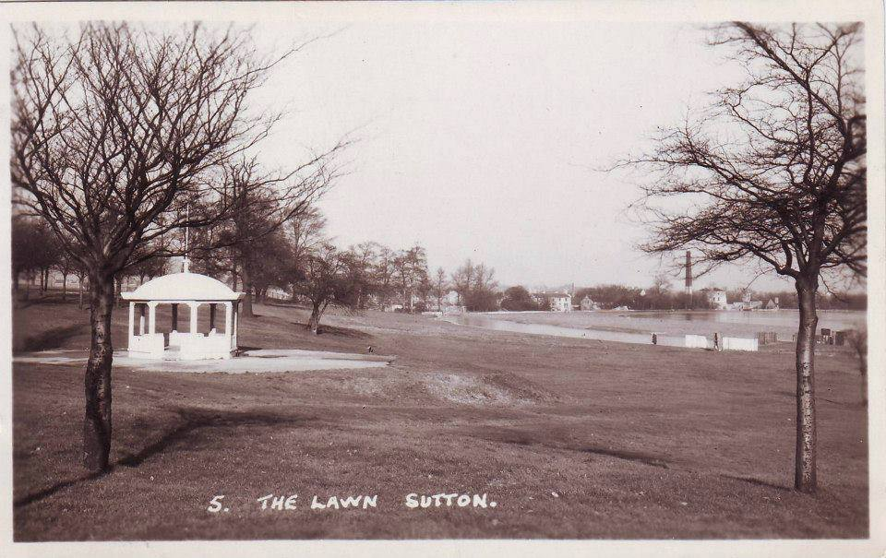
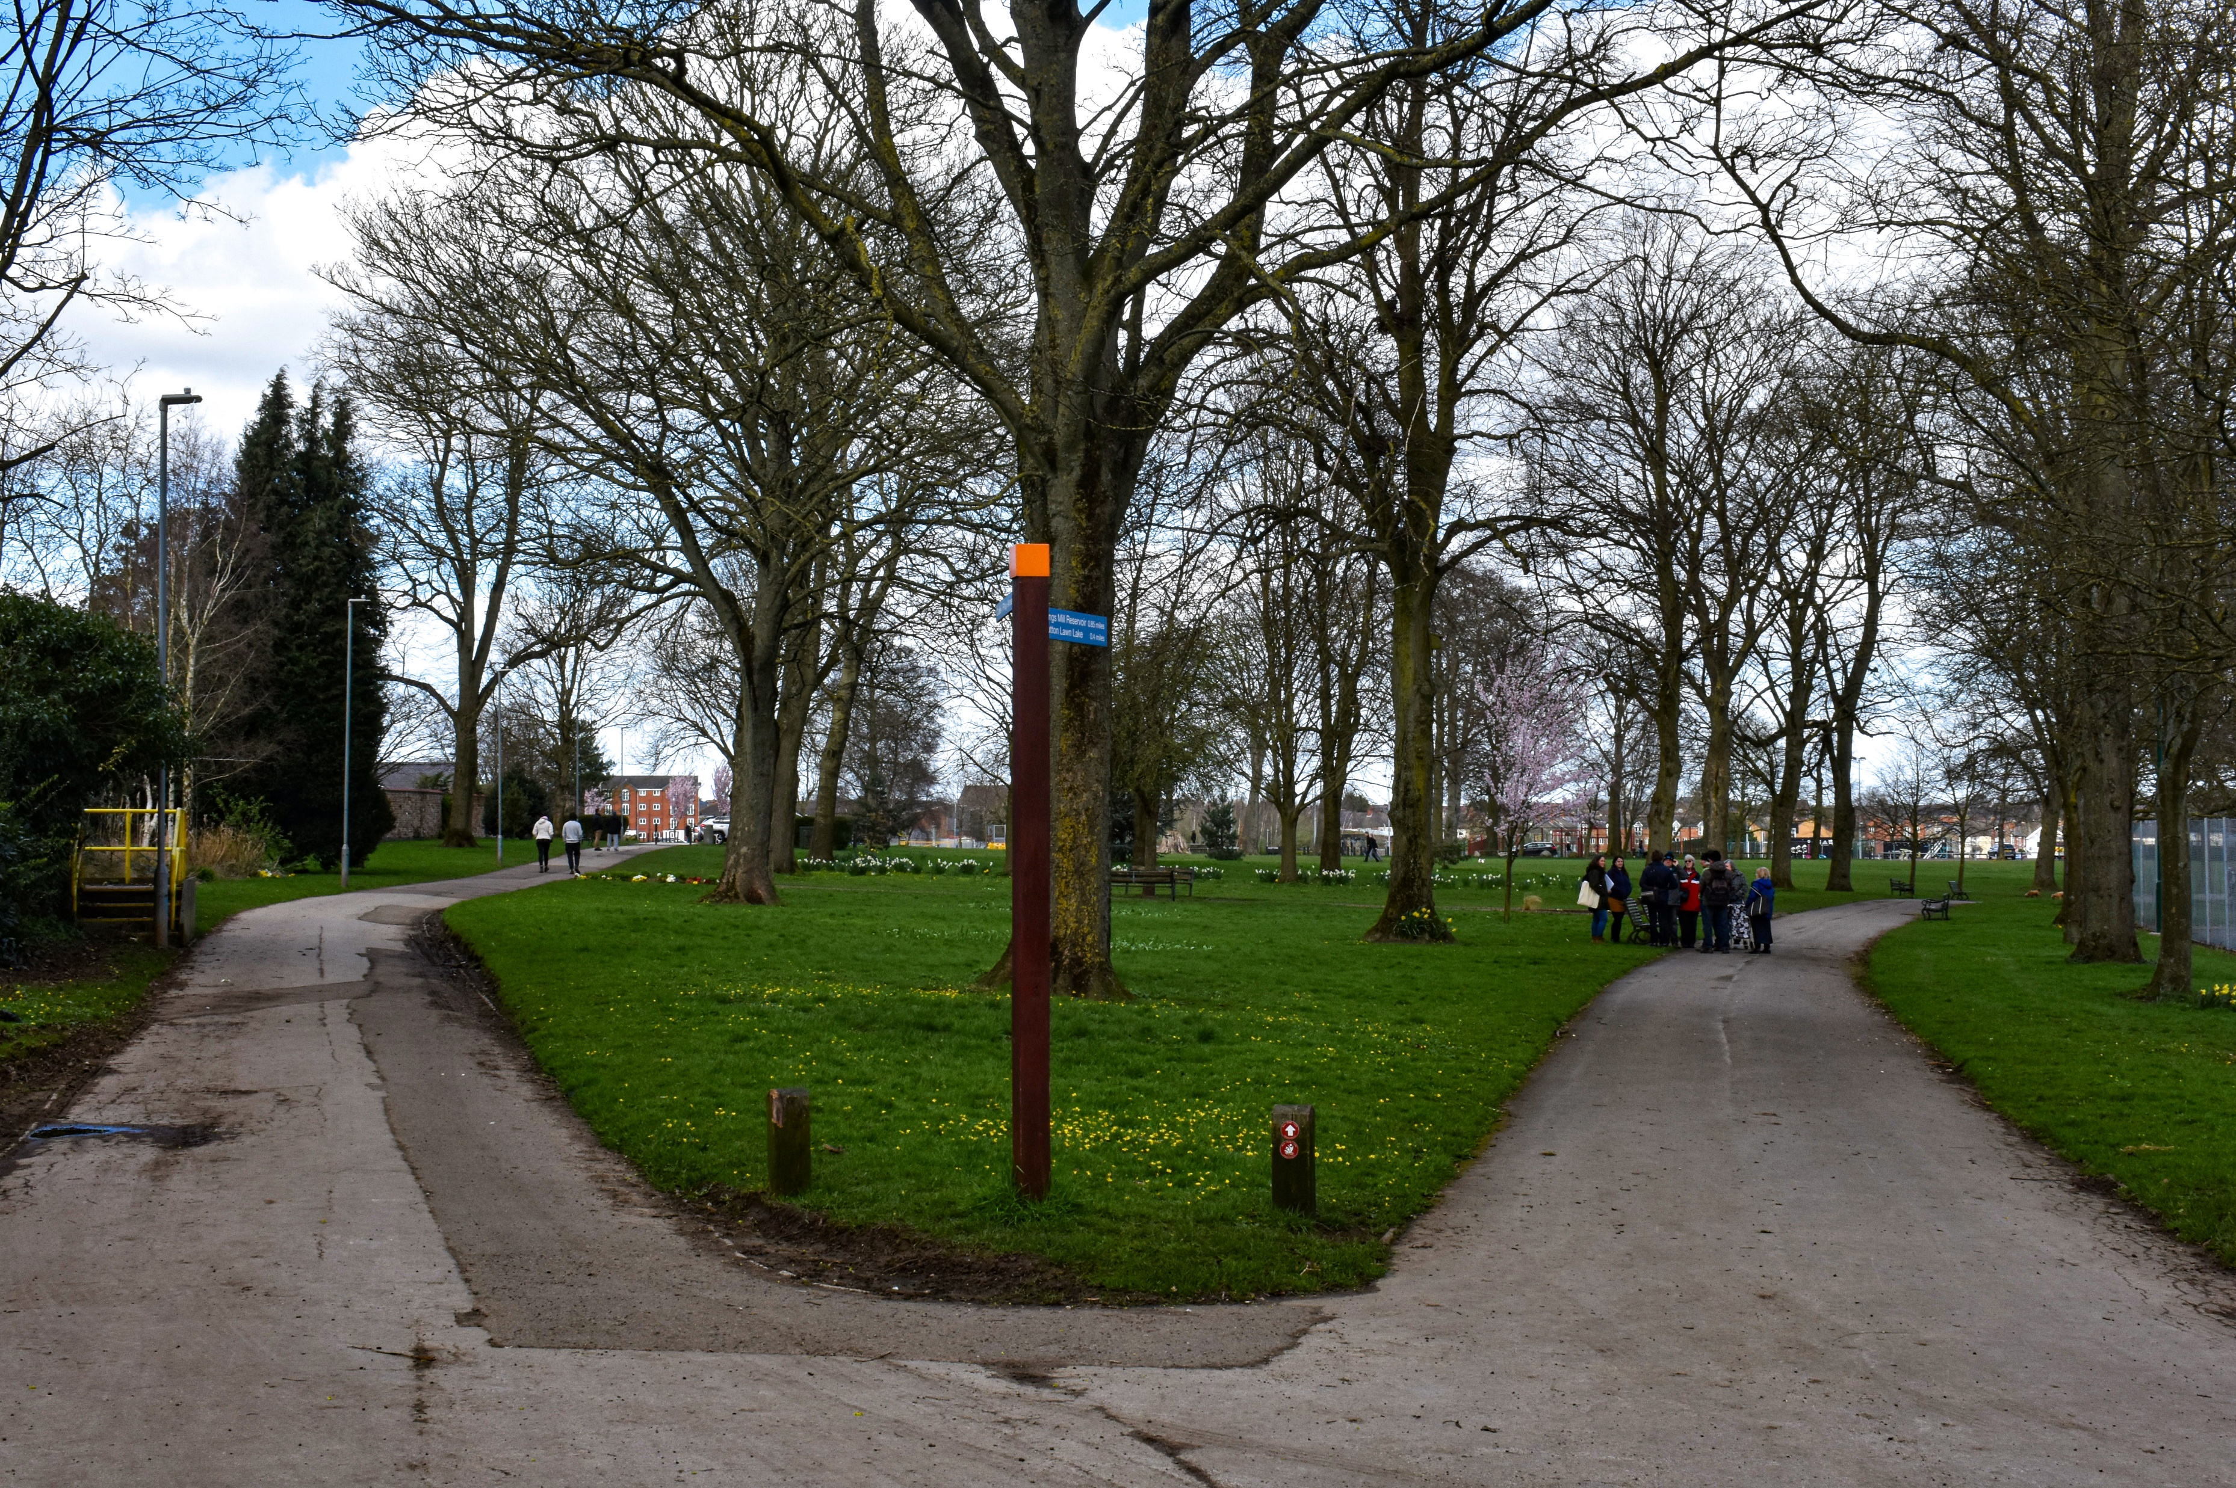
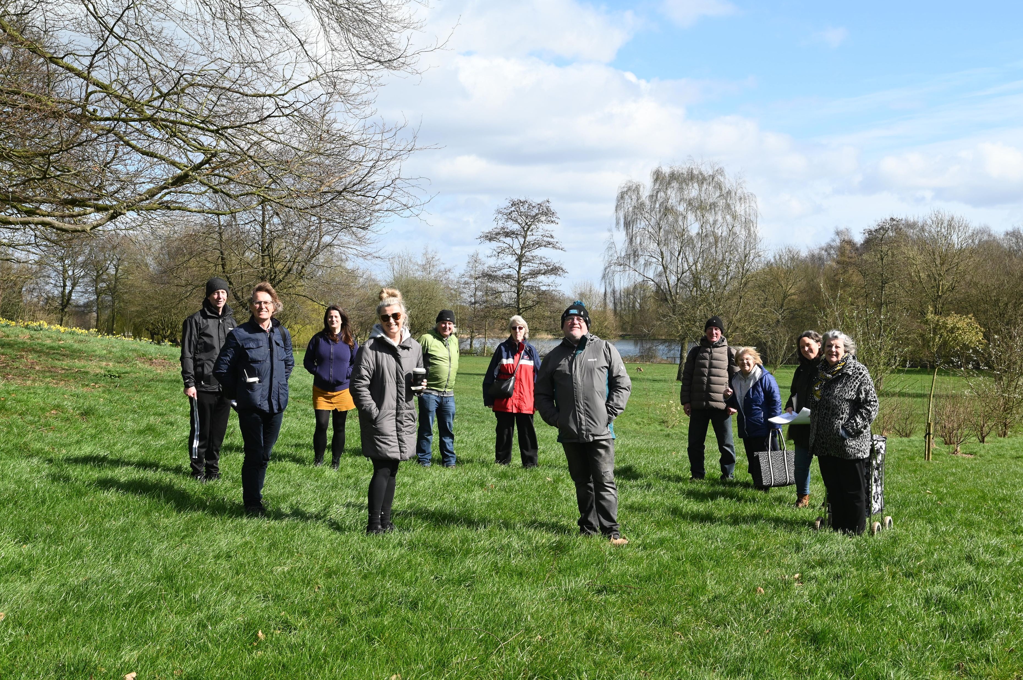
Sutton Lawn
Event for non-researchers
thegardenstrust.org
Find us: @thegardenstrust
Notes:
We were aware that not everyone would want to get involved in full-blown research so, as our mission was to share designed landscape history as widely as possible, we also put on an event for locals near Sutton Lawn.
We made contact with a Memory café group that meets once a week at the local shopping centre. The session was lovely. 10 of the group met us at the café, looked at old images of the park and shared stories and memories over tea and biscuits. Then we walked down to the park together.
A highlight was using photos and maps to find the former location of the bandstand, where one of the women attending had had her wedding pictures taken, several decades ago. Here you can see us all marking the spot.
This simple type of activity is really easy to put on and is so enjoyable for everyone involved.

Slide 20
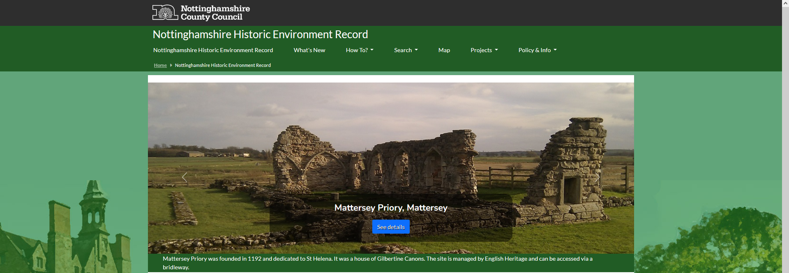
Sharing the research
Historic Environment Record
Local Lists
Parks & Gardens UK
thegardenstrust.org
Find us: @thegardenstrust
Notes:
Only 13% of the historic designed landscapes currently on the Notts HER are Registered, so have top level protection in the planning system. The rest are “non-designated heritage assets” and Planners are required by law to consult HERs, Local Lists and Local Plans to understand how these heritage assets may be affected by development proposals
It’s really important then, to share research on non-designated sites and make their significances clear. The reports from this project are in the process of being added to the Notts HER, Local Lists and Parks and Gardens UK. The Notts HER Manager is really enthusiastic about getting our sites onto the HER, as he feels that designed landscapes are severely under-represented, compared to other heritage assets.

Slide 21
Lessons learned
Everything takes time!
All promotion is valuable
Keep things moving, but don’t rush
Offer varied ways to get involved
Network like crazy!
Online training needs in-person back-up
thegardenstrust.org
Find us: @thegardenstrust
Notes:
So, Lessons learnt – I think the main ones are:
Everything takes time. It takes ages to find volunteers.
All promotion is valuable, even if it doesn’t result in volunteers - we talked to a couple of hundred people about the project, many of whom knew v little about historic landscapes beforehand, so it’s been great for raising awareness.
keep things moving – no big gaps between the stages, e.g. between recruitment and starting training.
Doing the research takes long time. Don’t rush – spoils the fun.
You need to think very broadly about different ways people will want to engage with you about landscapes and offer a range of opportunities
the help of a network is invaluable. Partners can help with promotion, events, finding volunteers, source material and so much more. And if you have a good relationship with them, you should be able to continue this in the long-run
Best session was where we all met up at Holme Pierrepont and got to know each other a bit. It’s worth building in as many informal meet-ups as you can.

Slide 22
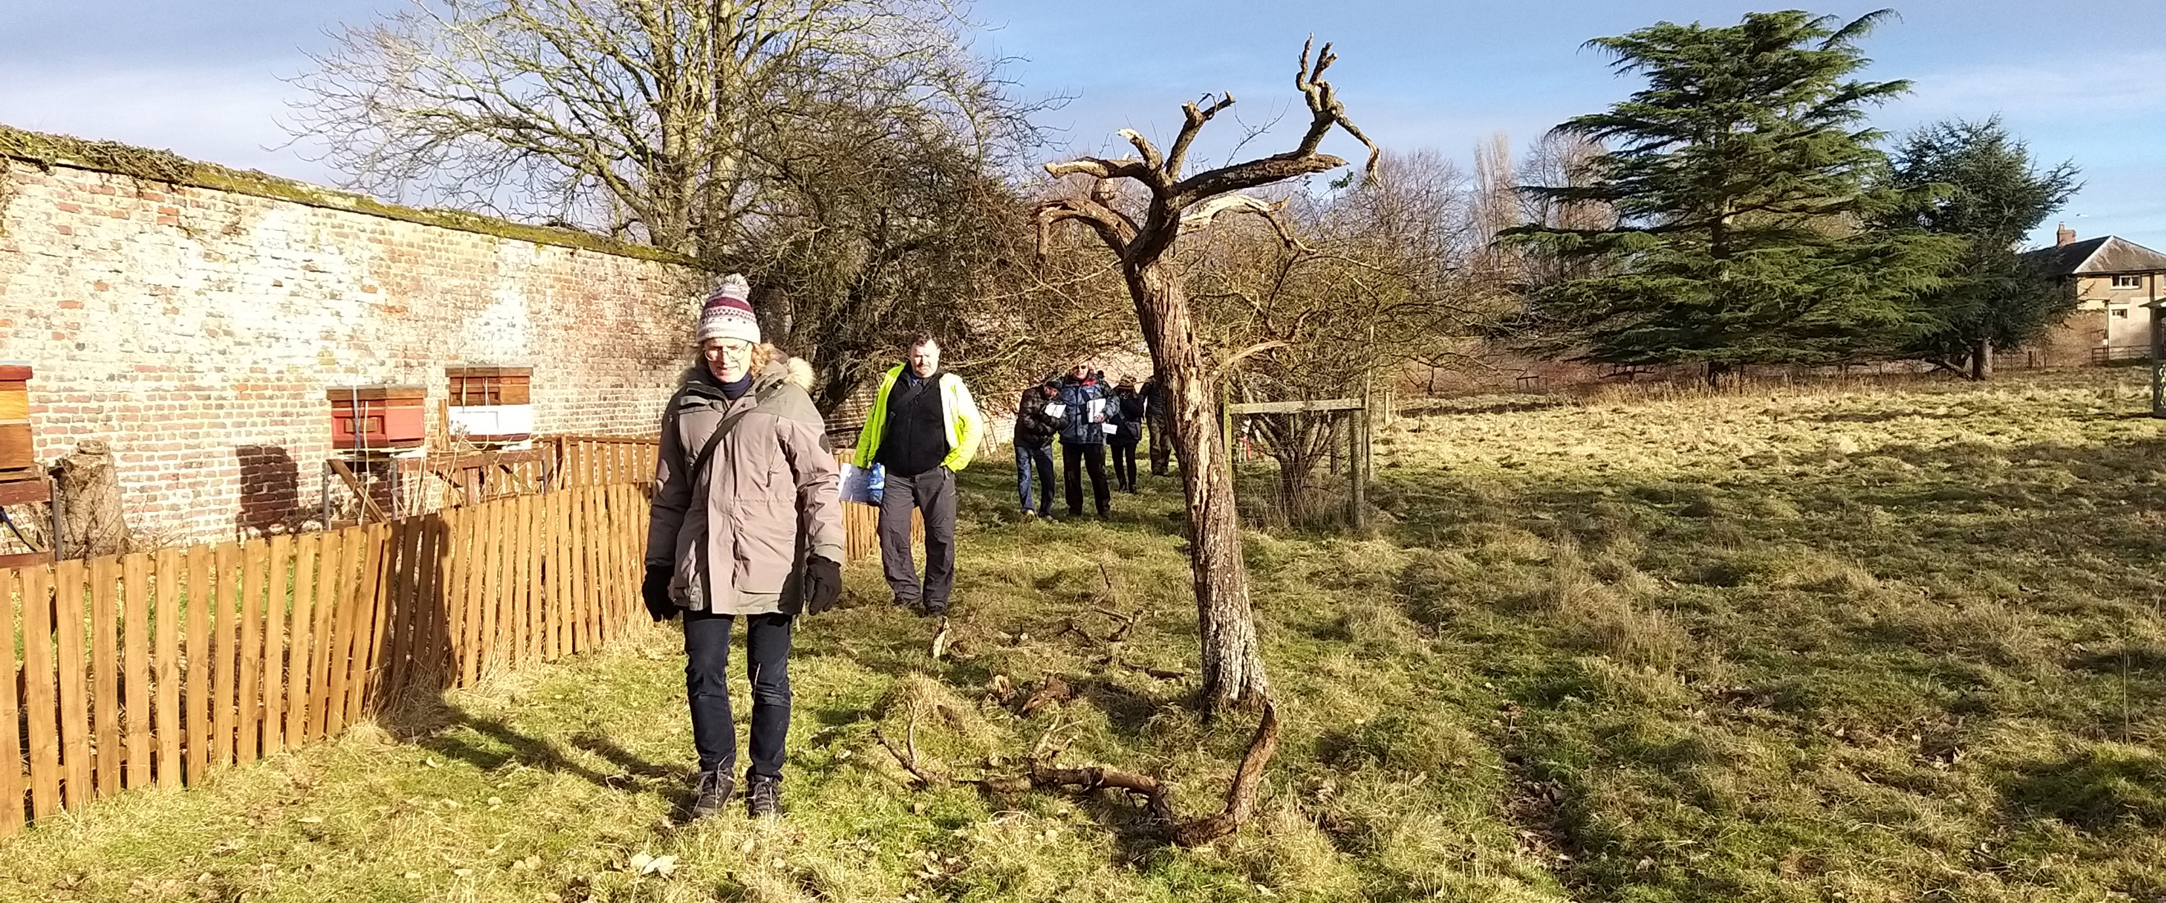
Legacy
Raised awareness of historic landscapes
New, trained researchers, happy to carry on
A big boost for Notts GT
New records on the HER
Future projects and opportunities
Learning materials available to all
thegardenstrust.org
Find us: @thegardenstrust
Notes:
So, what has the project resulted in, and where could it lead?
Notts GT is keen to be welcoming to a wide audience, but it struggles to find supporters. This project has given both it, and the county’s historic record, a considerable boost:
7 non-registered landscapes researched, contributing to the historic record and helping to protect the landscapes from future threats.
7 volunteers, with little or no previous garden history knowledge, have been trained, and 2 with existing skills given a refresher.
Three volunteers have now formed a research group for NGT
Working with Emma at Mill Waters, was so useful in connecting us to local people and organisations at Sutton Lawn. Although we didn’t undertake traditional research there, we have raised understanding of the Lawn as an historic designed landscape and, funding allowing, will be contributing to another local heritage project there
And we also did a lot of light-touch awareness-raising via all the project promotion
We’ve tried to share the learning as widely as possible, and the online sessions have been attended by people from across the UK, as well as several from abroad.
We’re pleased that a handful of CGTs have used the training to help refresh or restart their research groups.
At our end of project celebration, Gill said a lovely thing – when she moved to Notts she hadn’t known anyone, but by taking part in the project and then joining Notts GT, she said she had “found her people”. And that makes it all worthwhile.

Slide 23
A huge thank you
to our fantastic volunteers!
thegardenstrust.org
Find us: @thegardenstrust
Notes:
We only set out with the intention of recruiting and training a small number of volunteers, but we met so many interested and helpful people along the way and heard so many different stories about landscapes. It’s been a truly lovely and inspiring thing.
A huge thank you to our fantastic volunteers!
And to everyone who’s followed the journey. Thanks very much.

