Slide 1
Northamptonshire Gardens Trust
Recipient of
The Gardens Trust
Community Grant
Kelmarsh Hall
And Gardens

Slide 2
Northamptonshire Gardens Trust
Exhibiting at a Garden Fete

Slide 3
Northamptonshire Gardens Trust
Conservation
Castle Ashby Estate

Slide 4
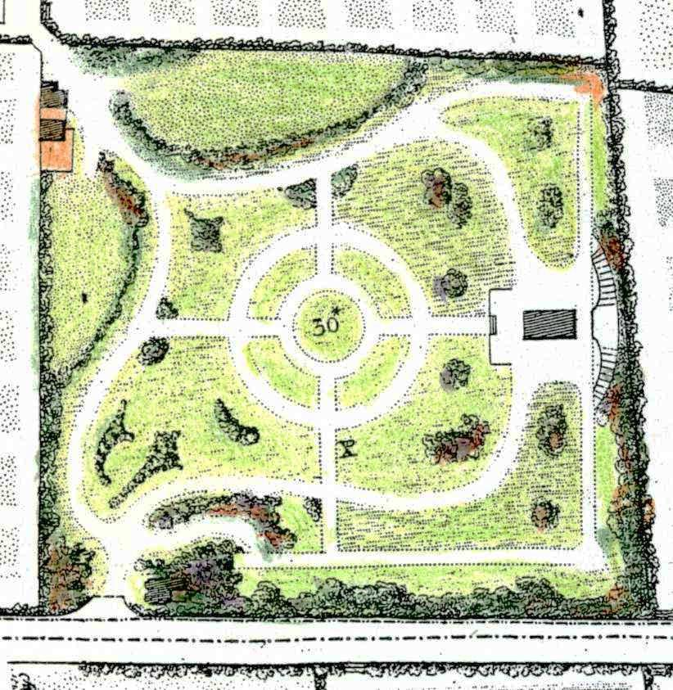
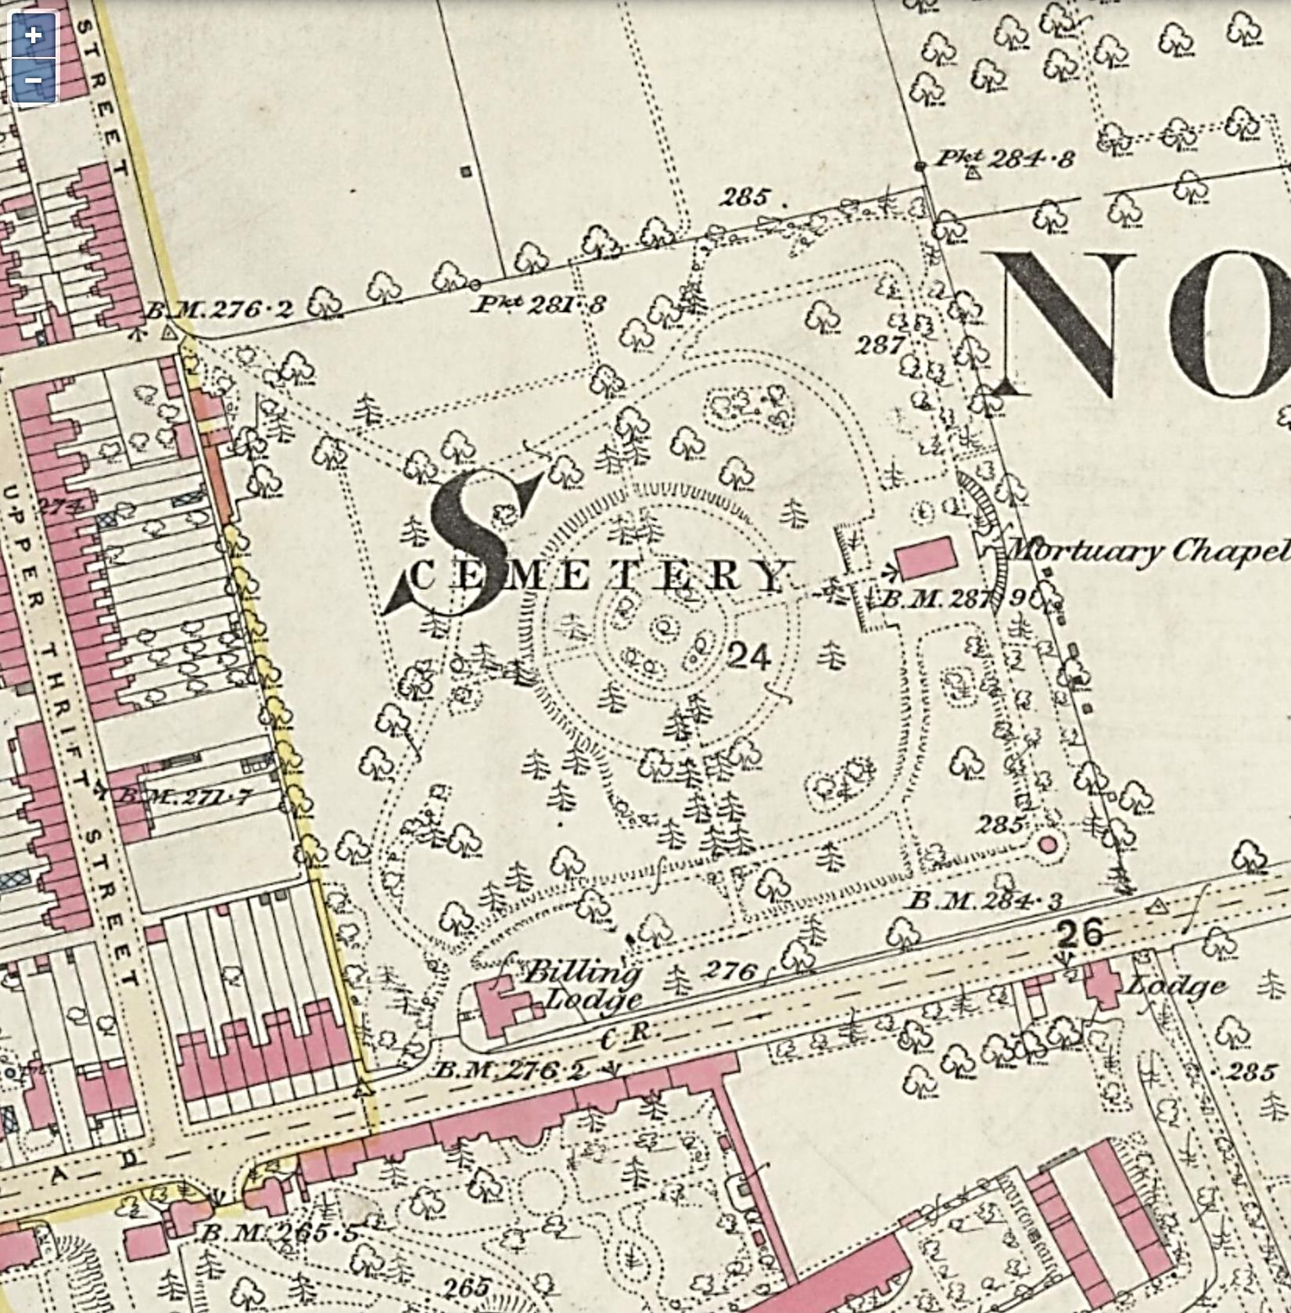
Research: Billing Road Cemetery designed by Robert Marnock
Extract from the 1847 Town Map by Wood and Law
Extract from the 1887 1st Edition Ordnance Survey (25inch map)

Slide 5
Northamptonshire Gardens Trust
Community
Impact!

Slide 6
Northamptonshire Gardens Trust
Billing Road Cemetery
An Open Green Space in an urban area

Slide 7
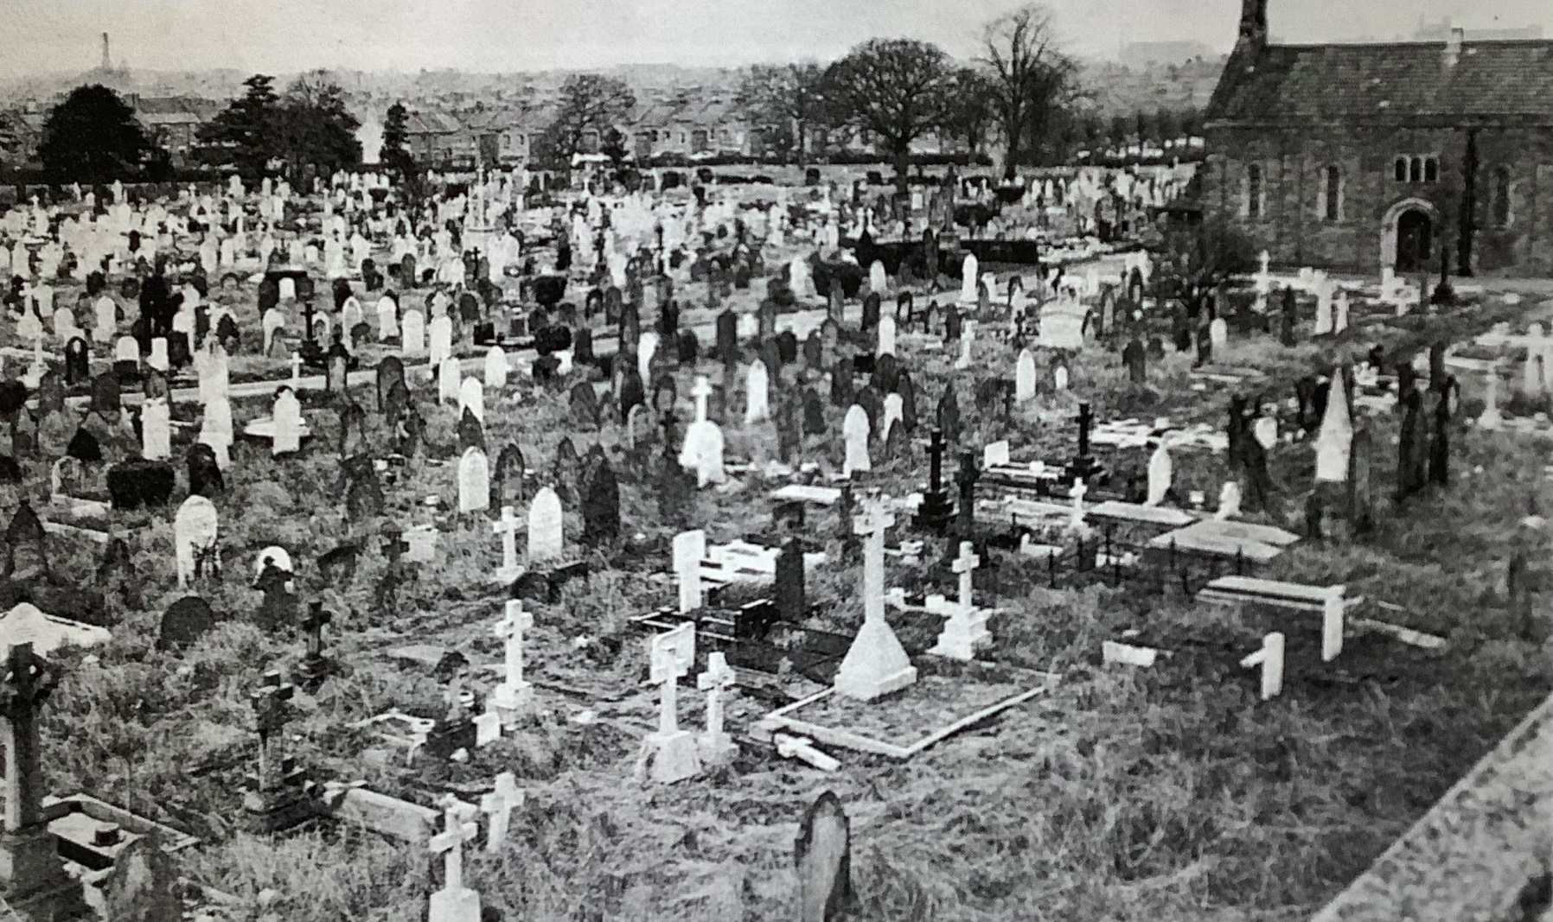
Billing Road Cemetery

Slide 8
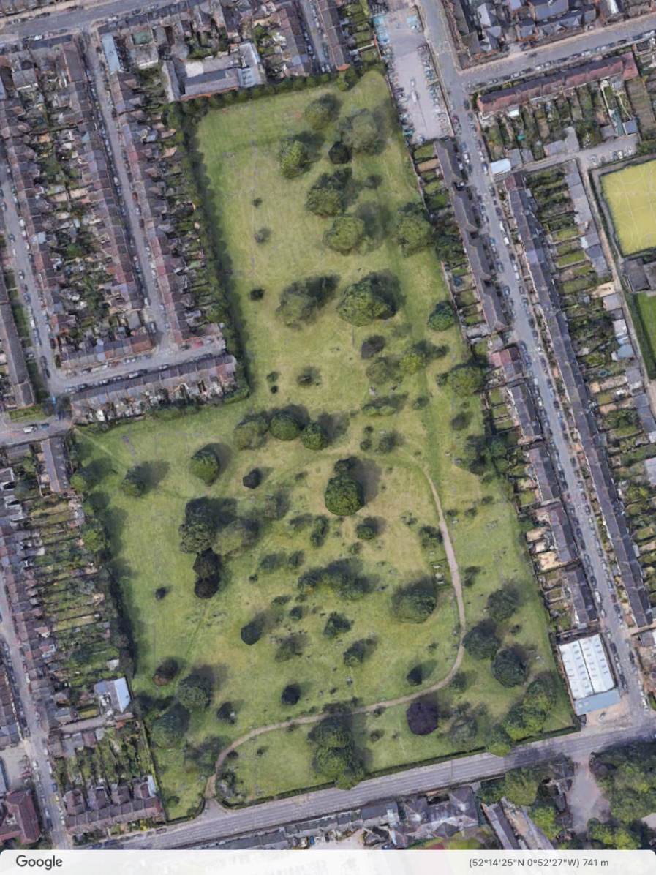
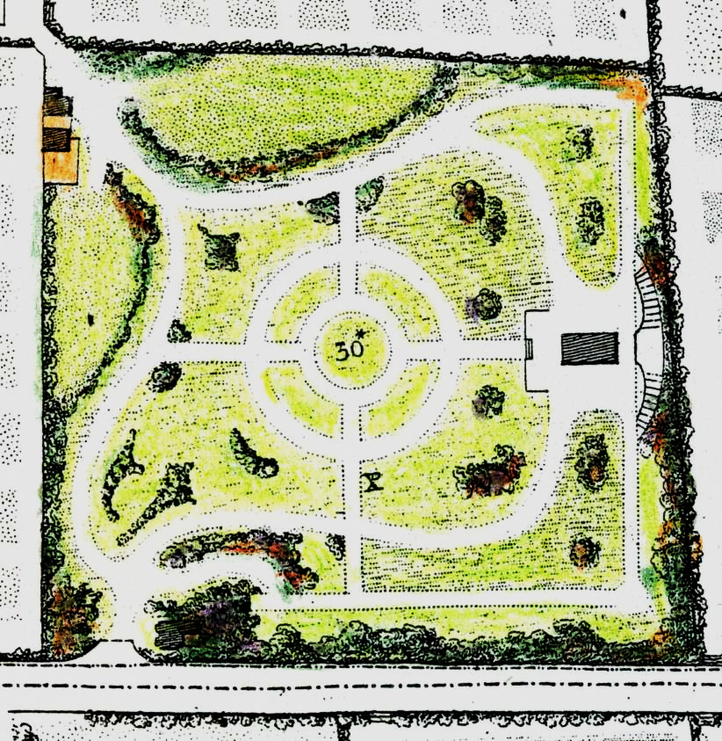
Billing Road Cemetery
A green oasis in a densely populated, culturally diverse, urban area
Satellite imagery from Google Earth 2022

Slide 10
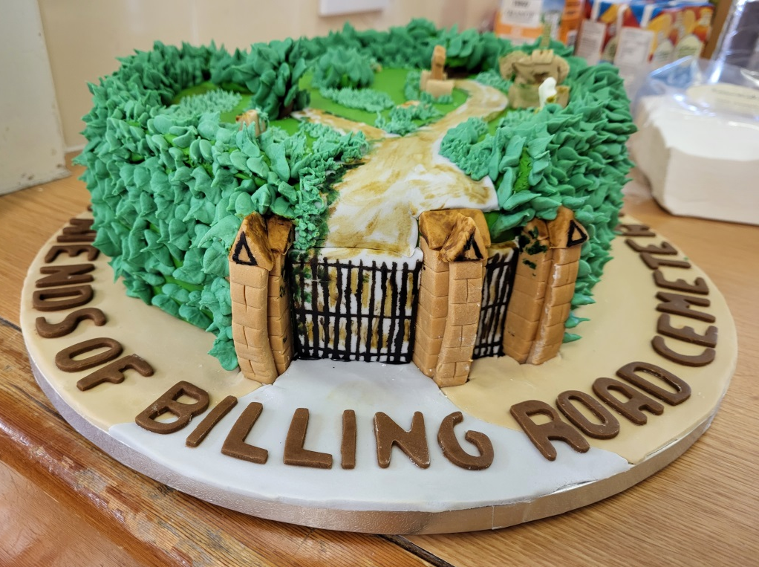
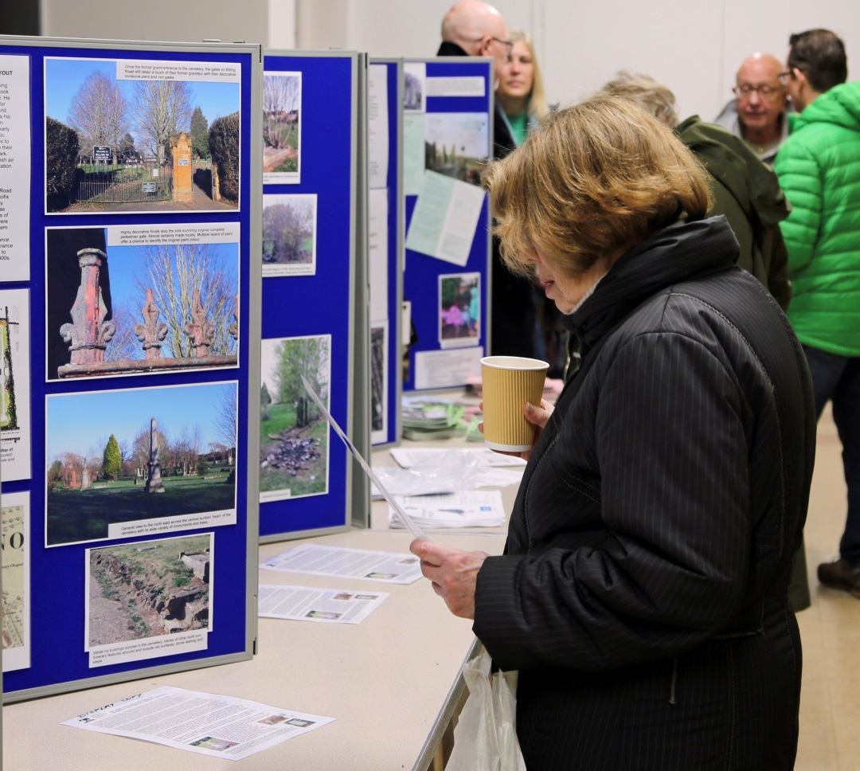
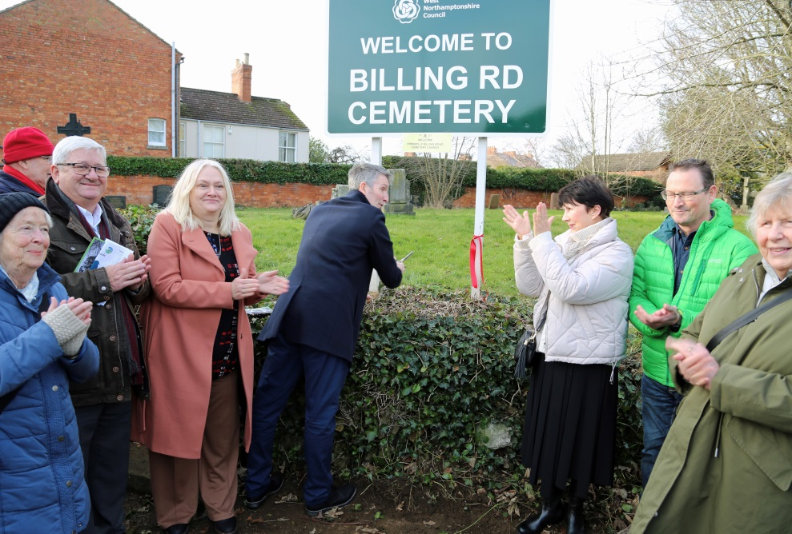
Community Impact
THE LAUNCH!

Slide 11
Community Impact!
Friends of Billing Road Cemetery meet with
West Northants Council
Strategy for Change!

Slide 12
Stakeholder Relationships
West Northants Council
Wildlife Trust
idverde
Family History Society
78 Derngate
Local Businesses
Nothampton Library
Discover Northamptonshire

Slide 13
Community Impact!
Research Group
Recording of Grave stones
Contributing to social history
Stories to be told!

Slide 14
Community Impact !
Enhancing wildlife to create a 'green corridor'
Nest boxes
Bat boxes
Bug hotels
Dead hedges
Sympathetic mowing
Sowing native species
Notes:
PROPOSED CONSERVATION WORK - Chris
Working closely with WNC and it’s contractors (idverde & Veolia) to achieve the best outcomes for the cemetery.
Ecological survey of the cemetery to identify current condition and how this might be improved to enhance its biodiversity value without compromising its function as a disused cemetery.
Tree survey, identification of likely survivals from the original planting plan... Labelling of trees & tree walk.
Survey of surviving built remains to identify their condition and how this might be improved. Removal of self-set trees where possible… surviving pathways….
Eg. Entrance gates, only surviving non-monument-based structures on the site….
Graham’s seasonal photos showing flora……

Slide 15
Community Impact!
Pride and aspiration
Regular Litter-picks
Newsletters
Events
Wildlife Management
Research
Northampton in Bloom
Heritage Open Days

Slide 16
Community Impact!
Volunteers contributing to:
Preserving the past for the future​
Bring people together within and across communities​
Providing a cherished green open space for the enjoyment, and health and wellbeing of all​
Instrumental in helping WNC deliver their strategy

Slide 17
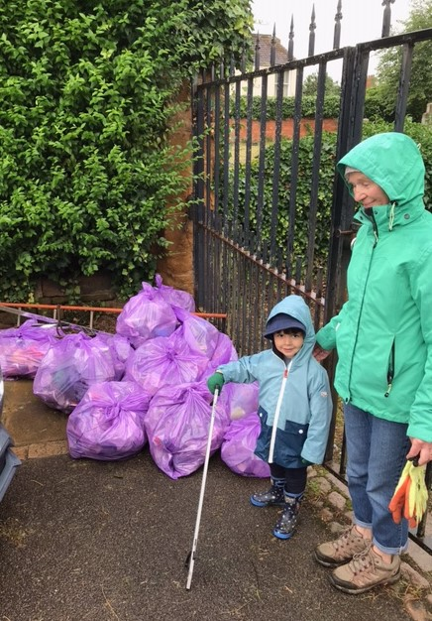
Northamptonshire Gardens Trust
Takes this opportunity to thank
The Gardens Trust
and
The Gentian Trust
for helping us make a difference

