Slide 1
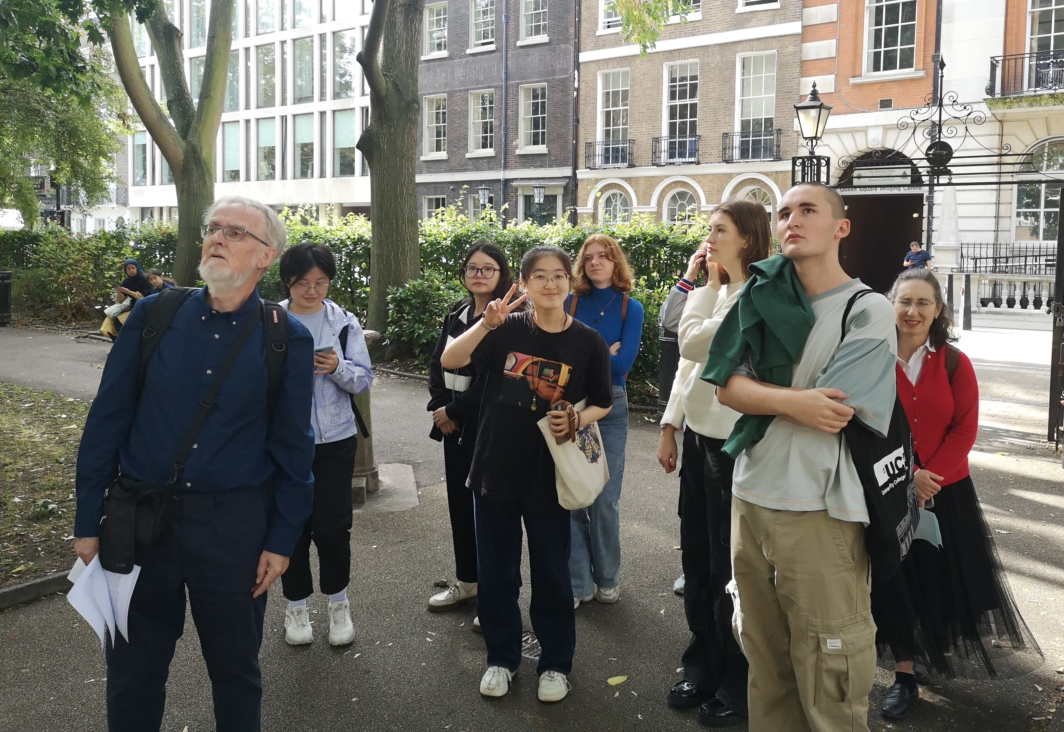
Islington’s Missing Gardens
Pilot micro project engaging young people with garden history
thegardenstrust.org
Find us: @thegardenstrust

Slide 2
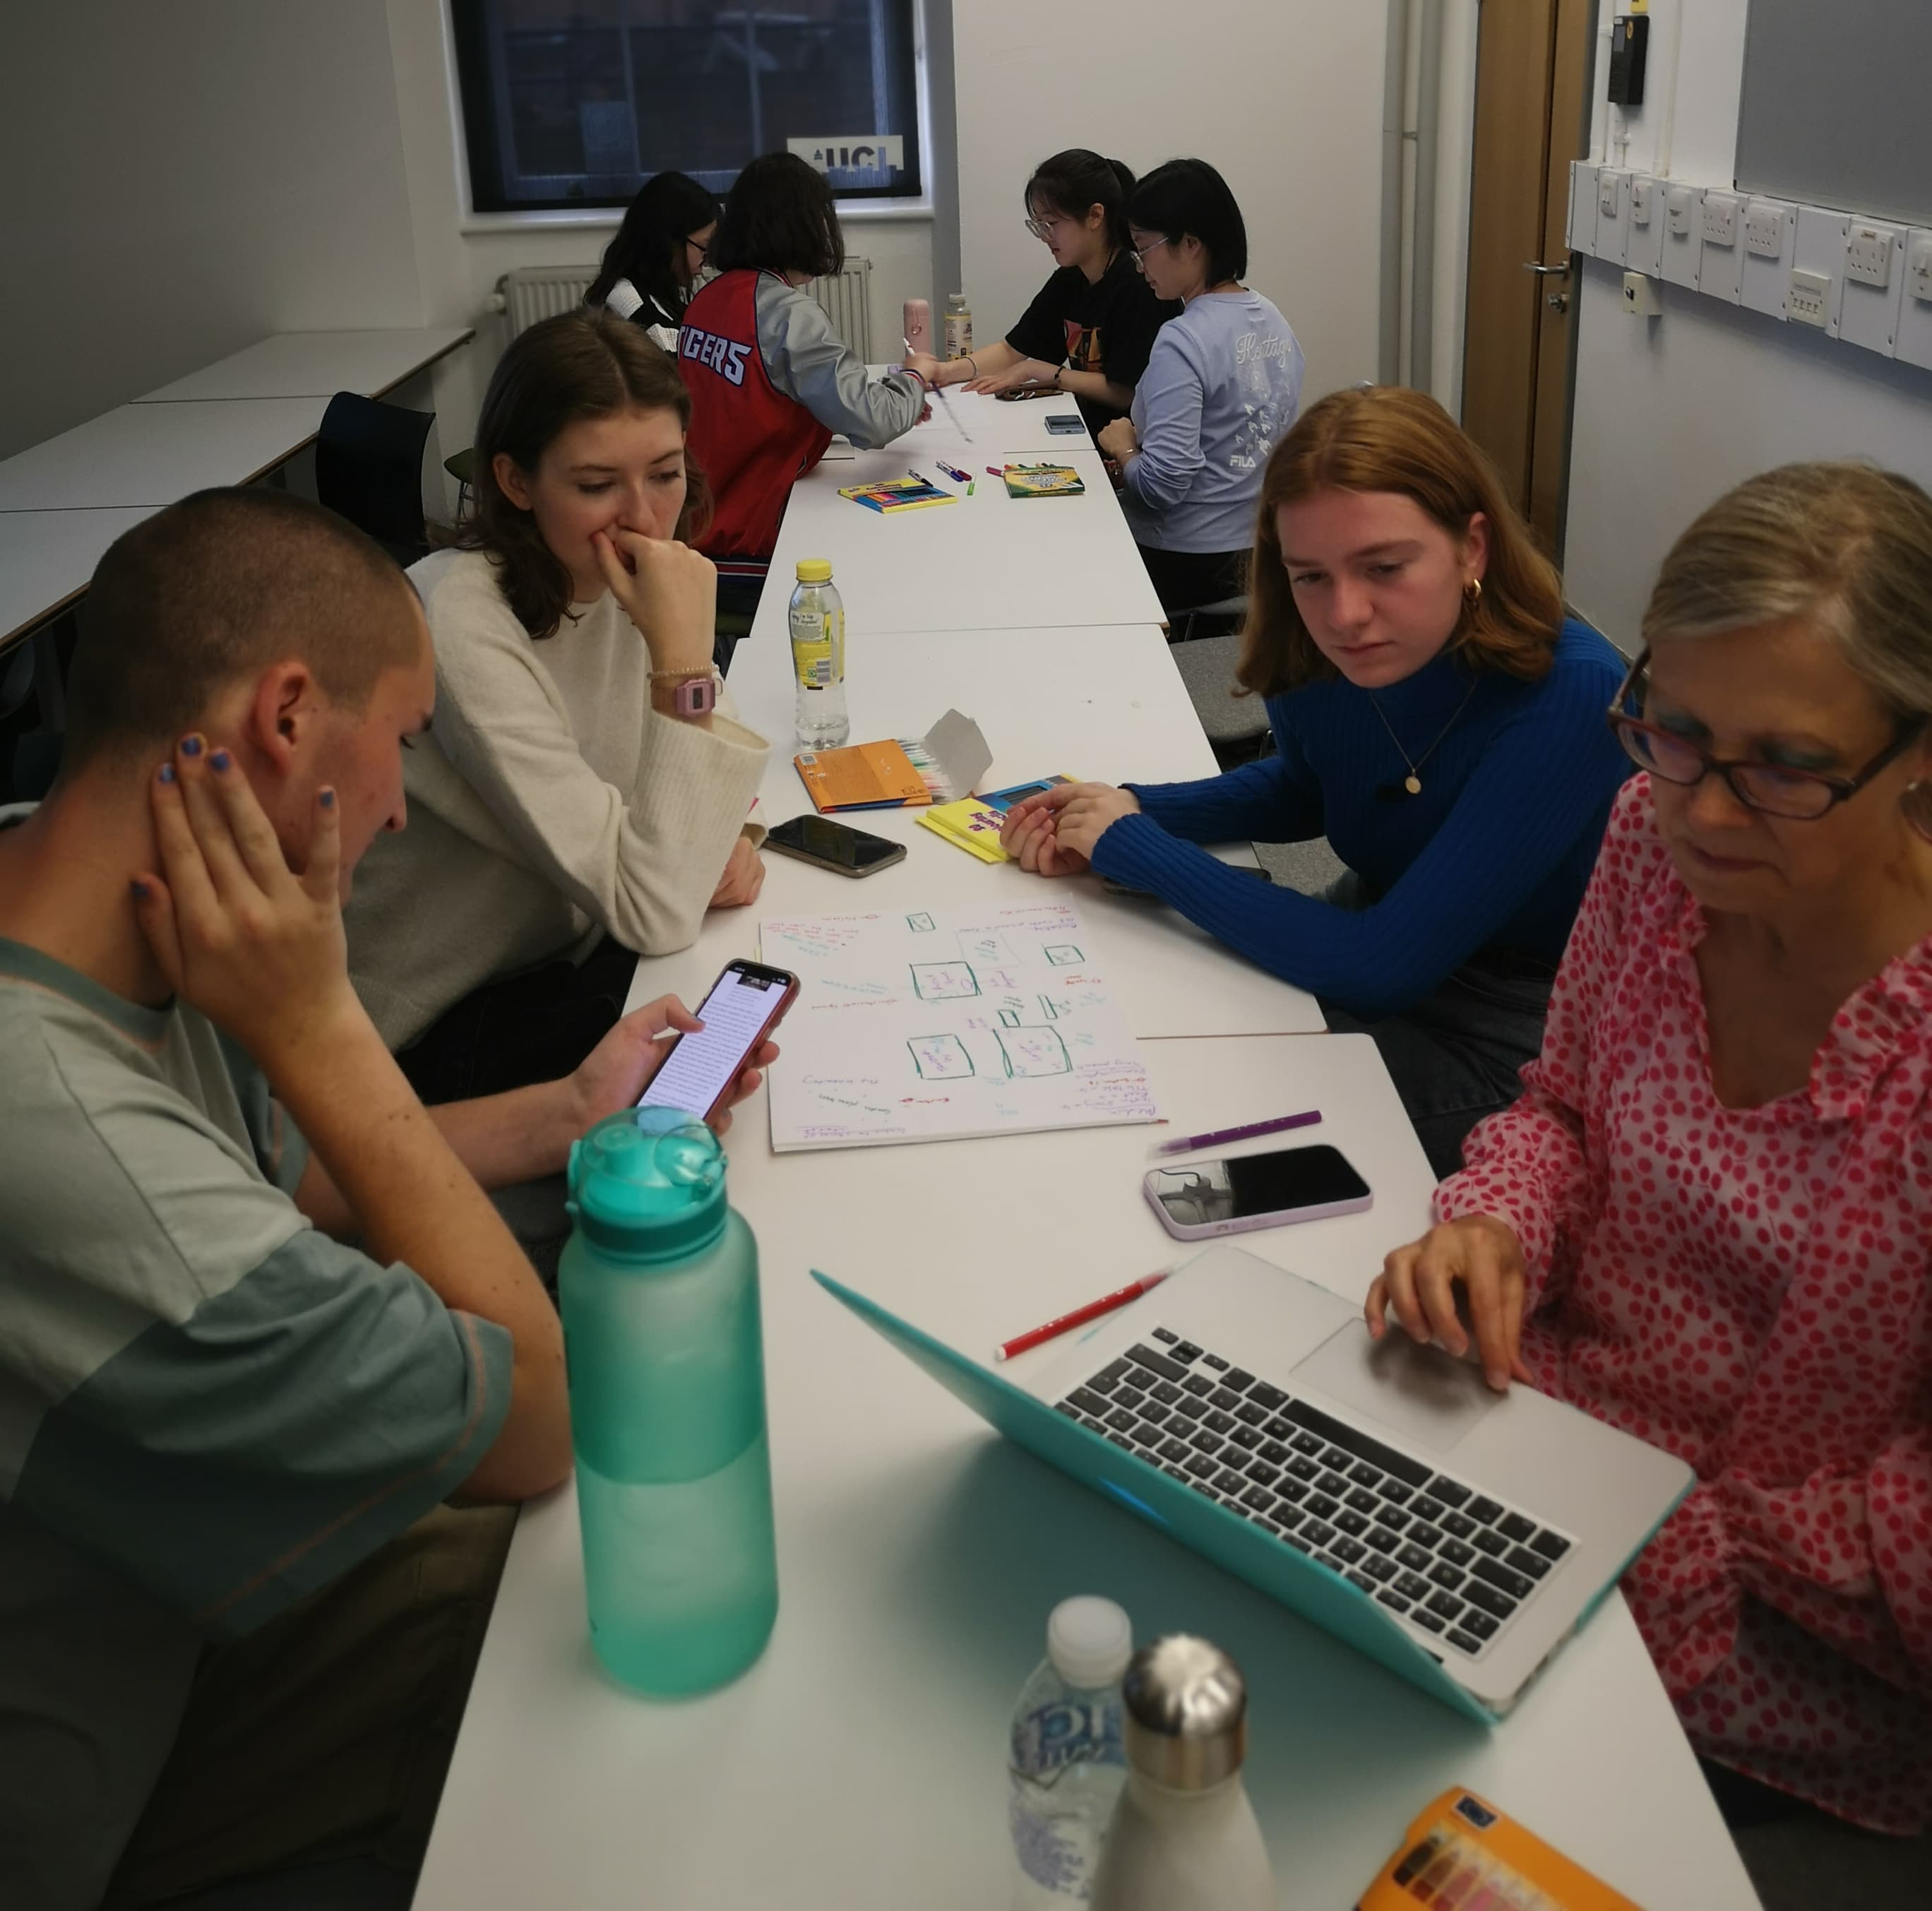
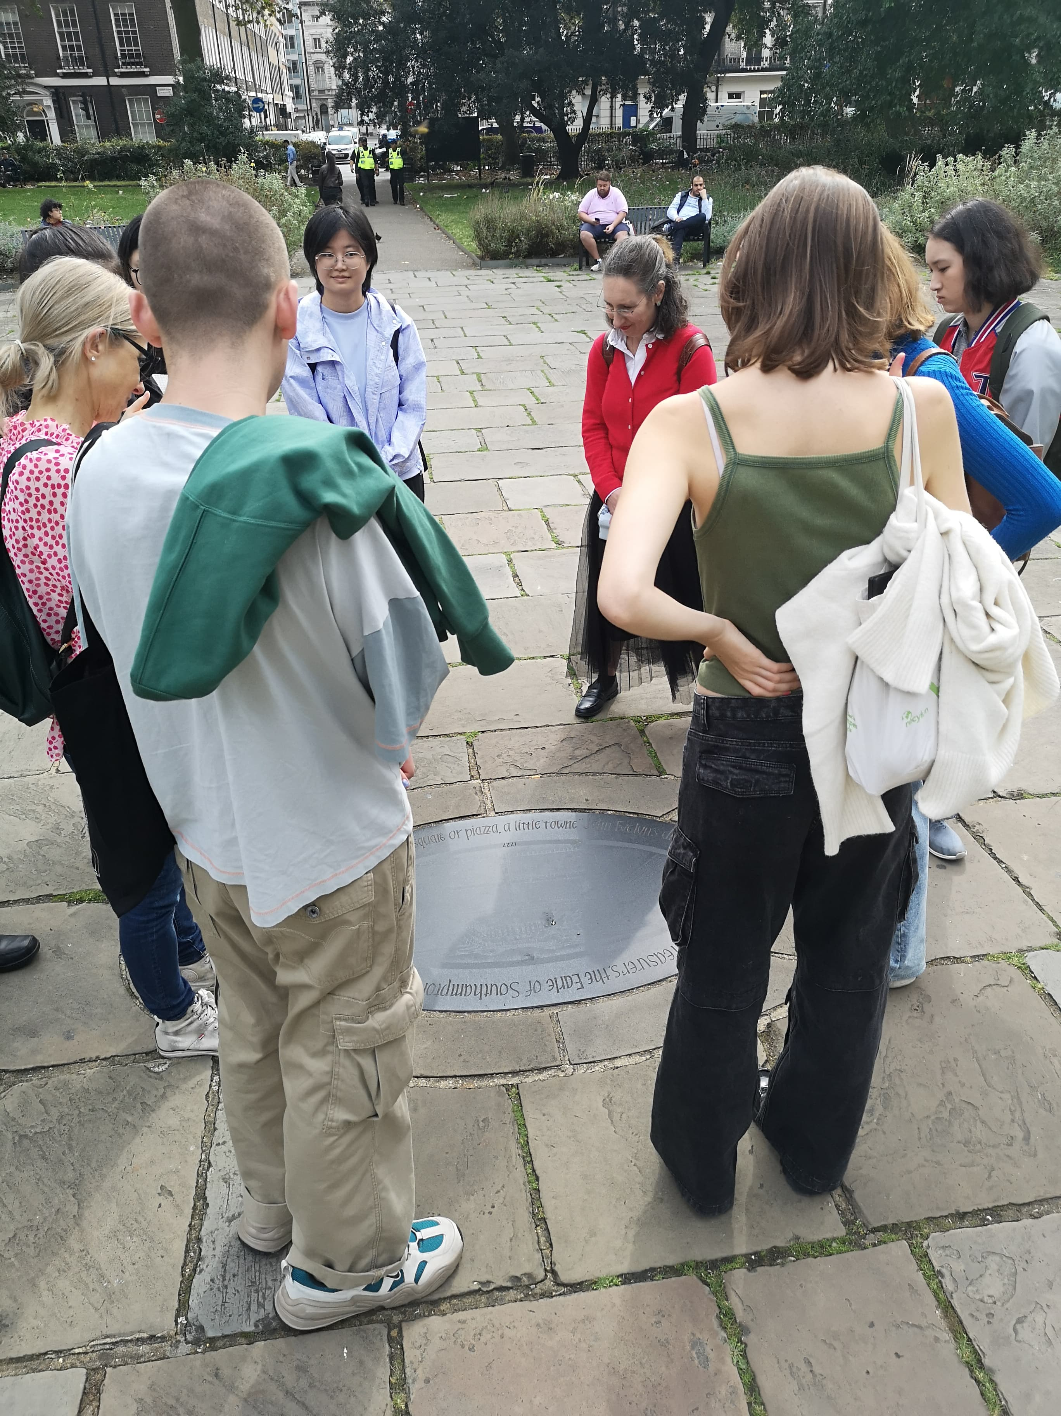
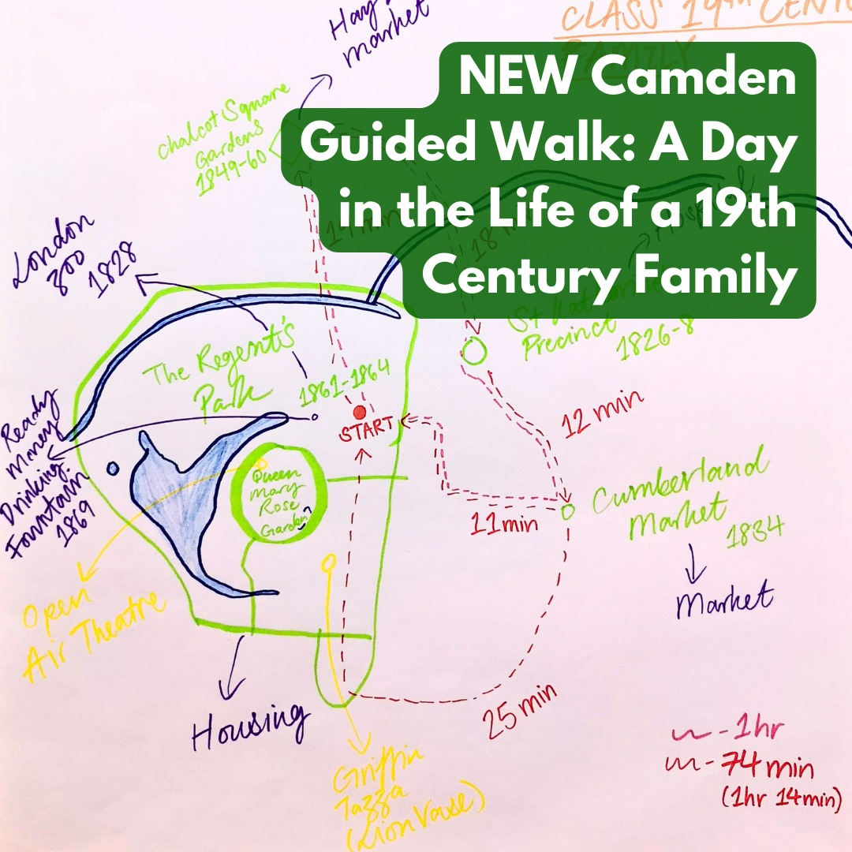
How it started…
Established link with UCL during the Engaging With Our Future project
Hosted a ‘Welcome Day’
Partnered with London Parks & Gardens
8 students created two new guided walks using London’s online inventory
thegardenstrust.org
Find us: @thegardenstrust

Slide 3
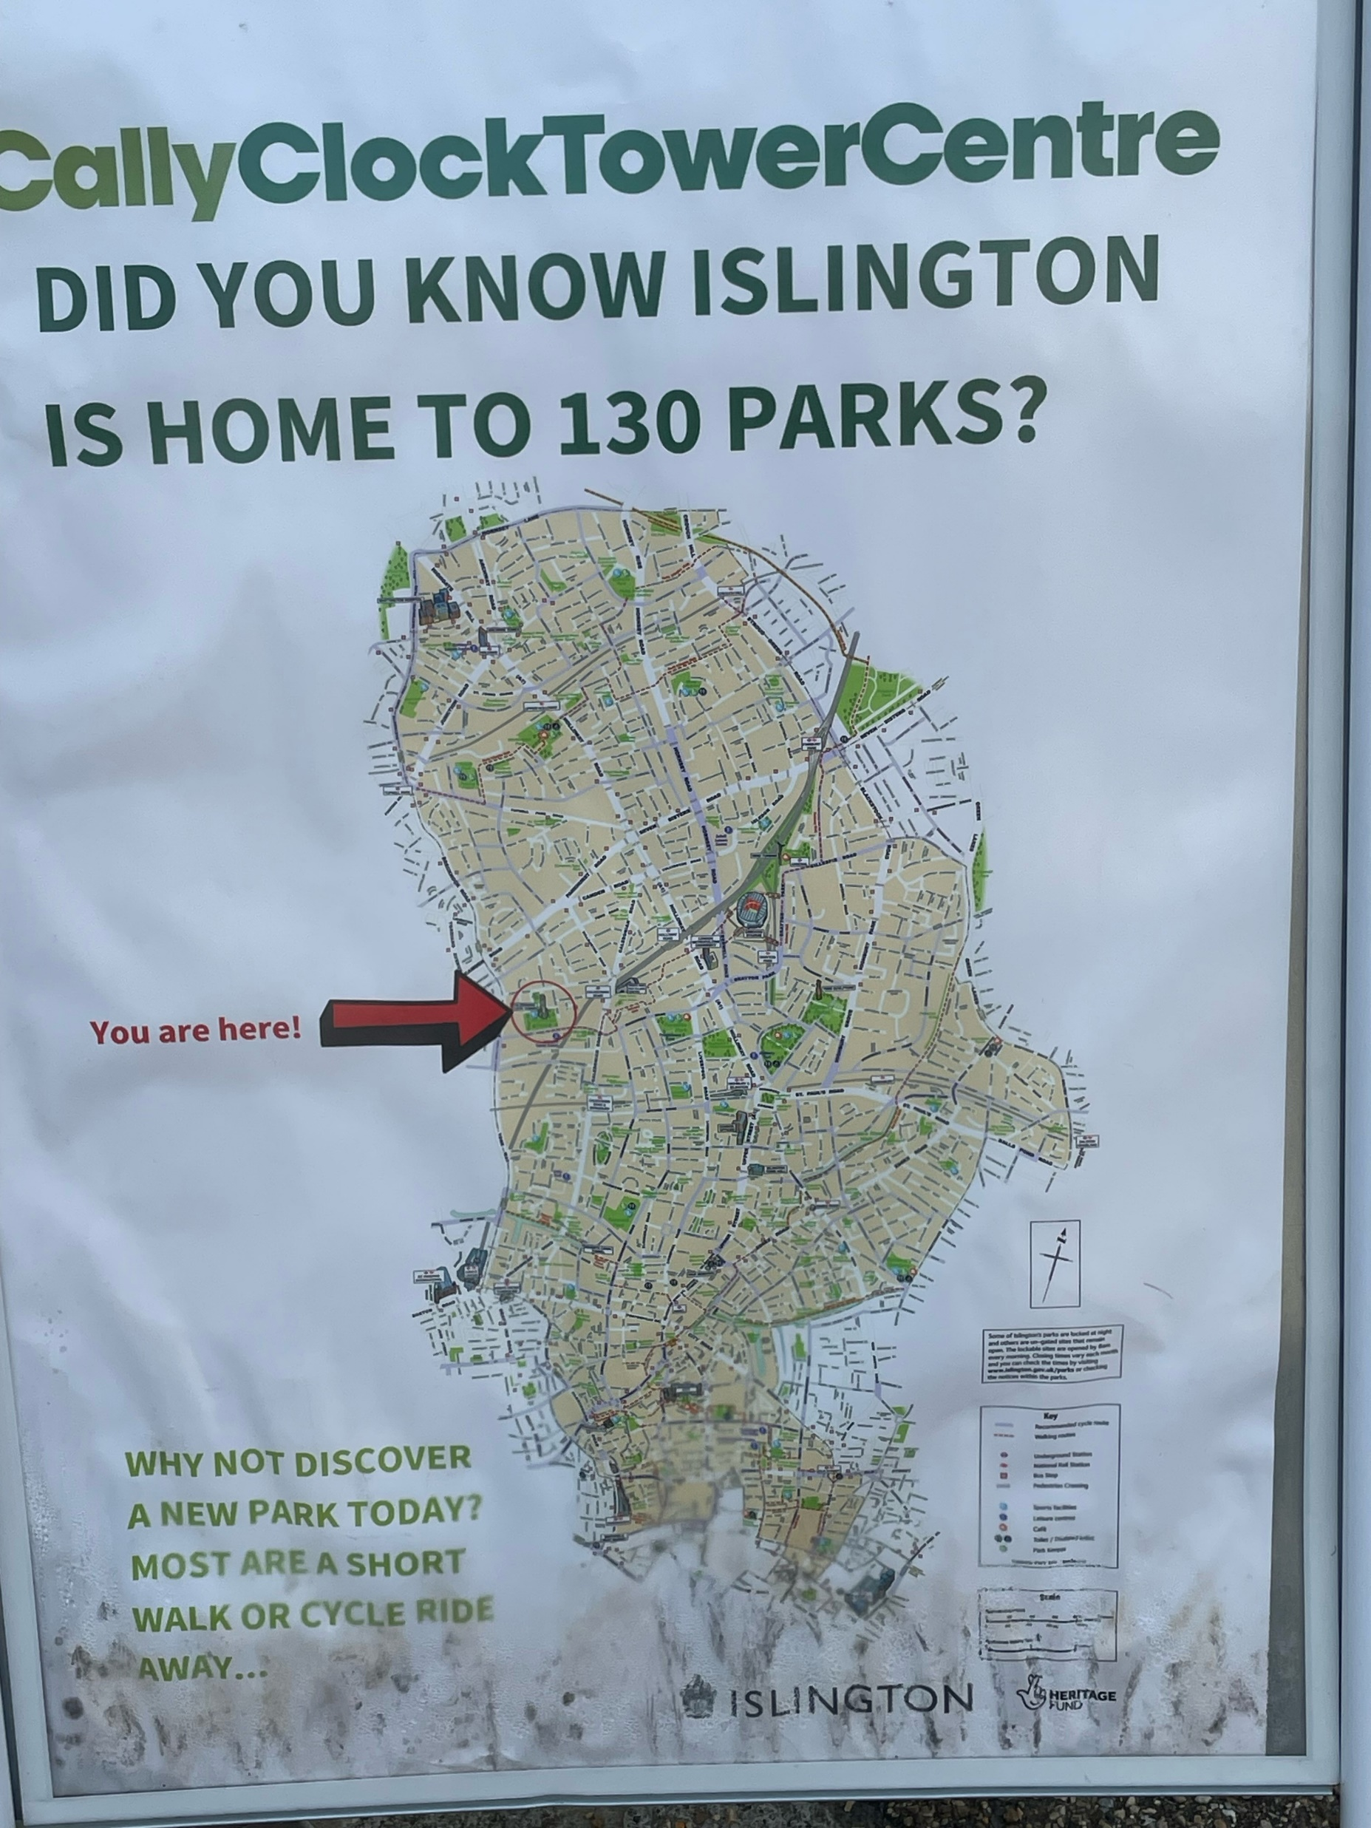
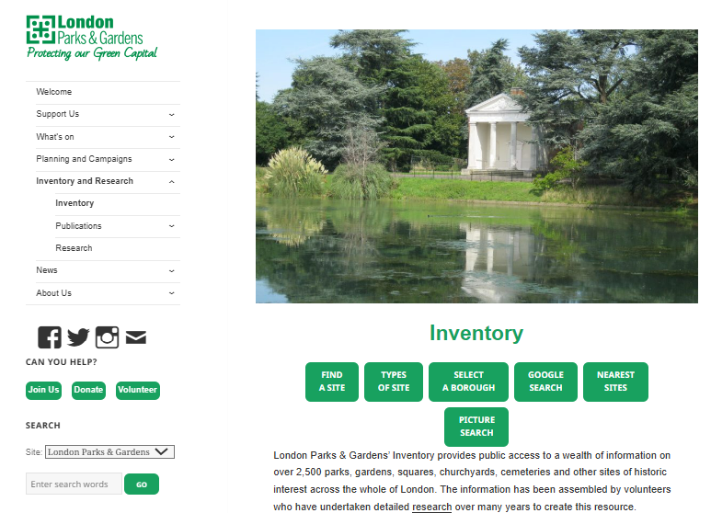
A mystery…
thegardenstrust.org
Find us: @thegardenstrust

Slide 4
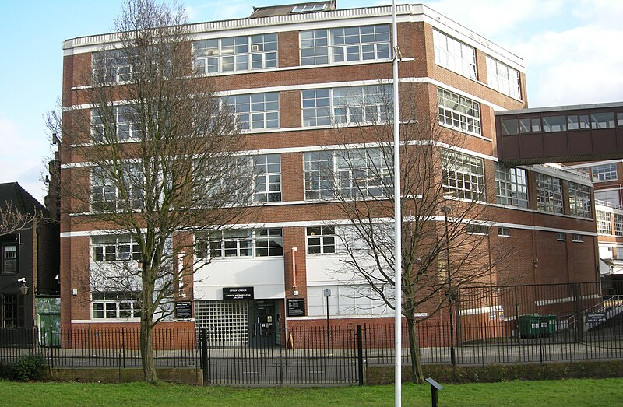
Garden History for beginners
Training in garden history using existing SUGS & VSS resources – on our Resource Hub
Support from London Parks & Gardens
Visit to London Metropolitan Archives
Reporting back to LPG research group
thegardenstrust.org
Find us: @thegardenstrust
By GrindtXX - Own work, CC BY-SA 4.0, via Wikimedia

Slide 5
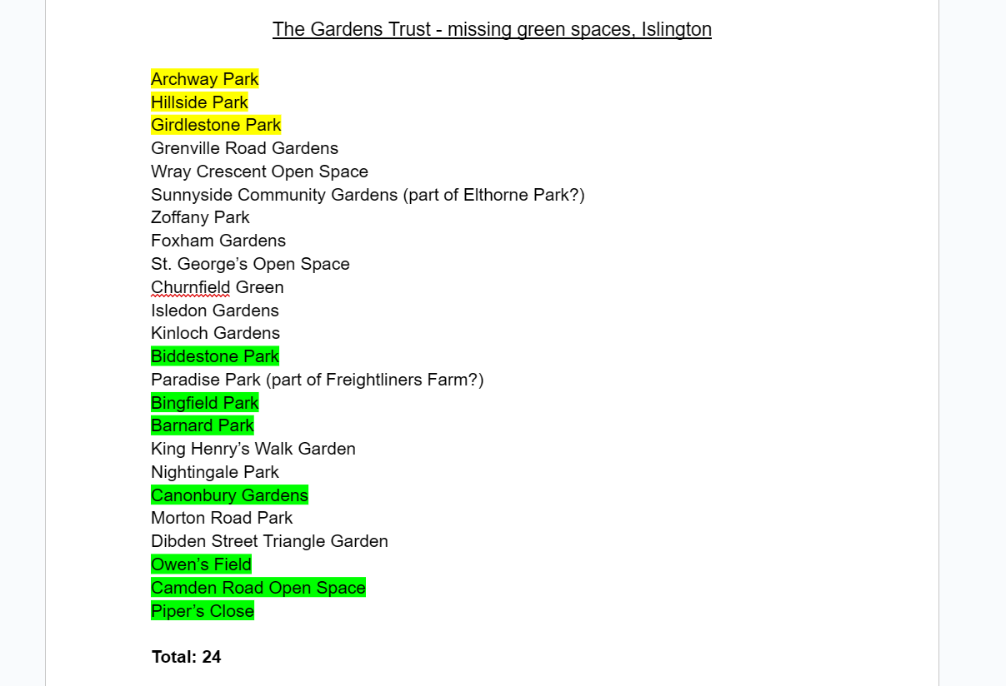
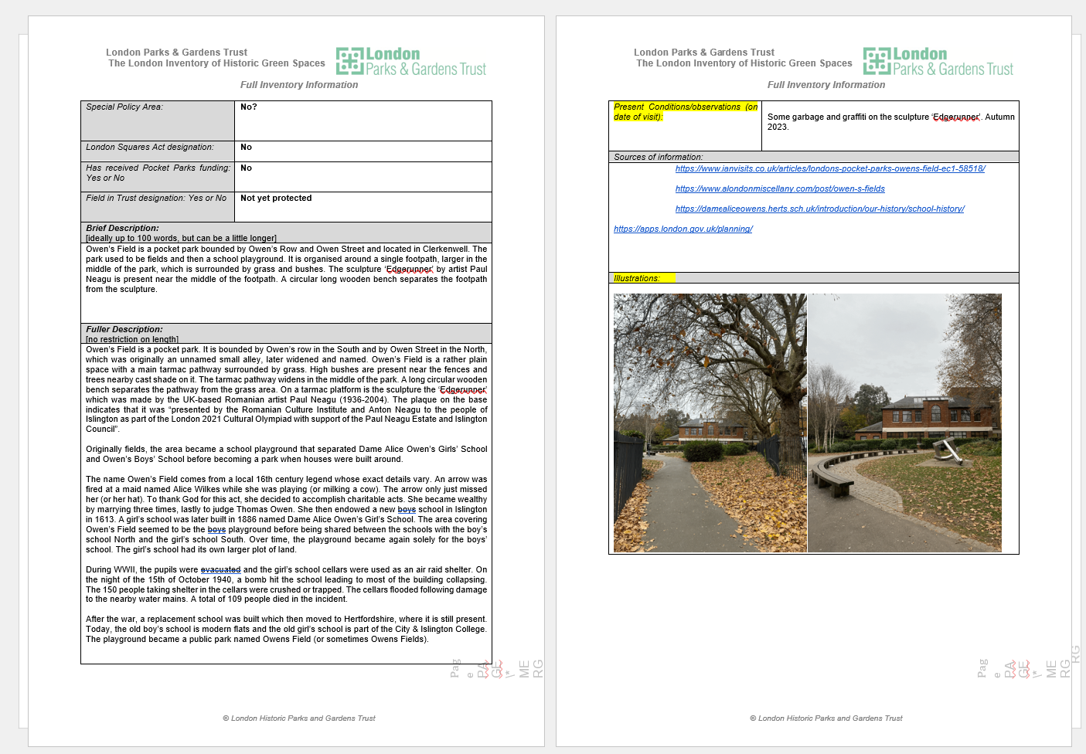
What they’ve found…
Identified over 20 parks and gardens
Completed 10 site visits
Inventory forms for two parks
September – presenting their researched parks to the LPG Research Group
thegardenstrust.org
Find us: @thegardenstrust

Slide 6
Engaging new audiences
“I’ve been really enjoying getting to know more about the history of green spaces in London and why they were created.
I got into it because of how often I use these spaces and how important I think they are for communities.”
Mark
“Volunteering for the Gardens Trust has been an incredible experience! I have discovered new parks and gardens in my city but also learnt about their history while working with amazing people!
I joined to learn more about my area to make it feel more like home while meeting new people.”
Elsa
thegardenstrust.org
Find us: @thegardenstrust

Slide 7
What we’ve learned
Garden History is for everyone!
Anyone can do it with the right training & support
London Parks & Gardens enthusiasm & support has been essential
Energised existing LPG volunteers who want to help
Can we do this elsewhere?
thegardenstrust.org
Find us: @thegardenstrust

