Slide 1
Celebrating Marnock initiative
Image: Gardeners Chronicle 3:6 (1889). Public domain.
Three lessons learnt
Jill Sinclair, 15 July 2024
Notes:
Celebrating Marnock initiative:
Three lessons learnt

Slide 2
Celebrating Marnock
2023 partnership between Sheffield Botanical Gardens and the Gardens Trust
Celebration of Robert Marnock (1800-1889)
Initiated by loan of original editions of his Floricultural Magazine
Image: Floricultural Magazine 1 (1836). Public domain.
Notes:
What the initiative was:
A 2023 partnership between Sheffield Botanical Gardens and the Gardens Trust to celebrate Scottish landscape gardener, horticulturalist and writer Robert Marnock (1800 - 1889), creator and first curator of the Gardens
Started from a long-term loan of complete set of his Floricultural Magazine (published 1836 - 1842)

Slide 3
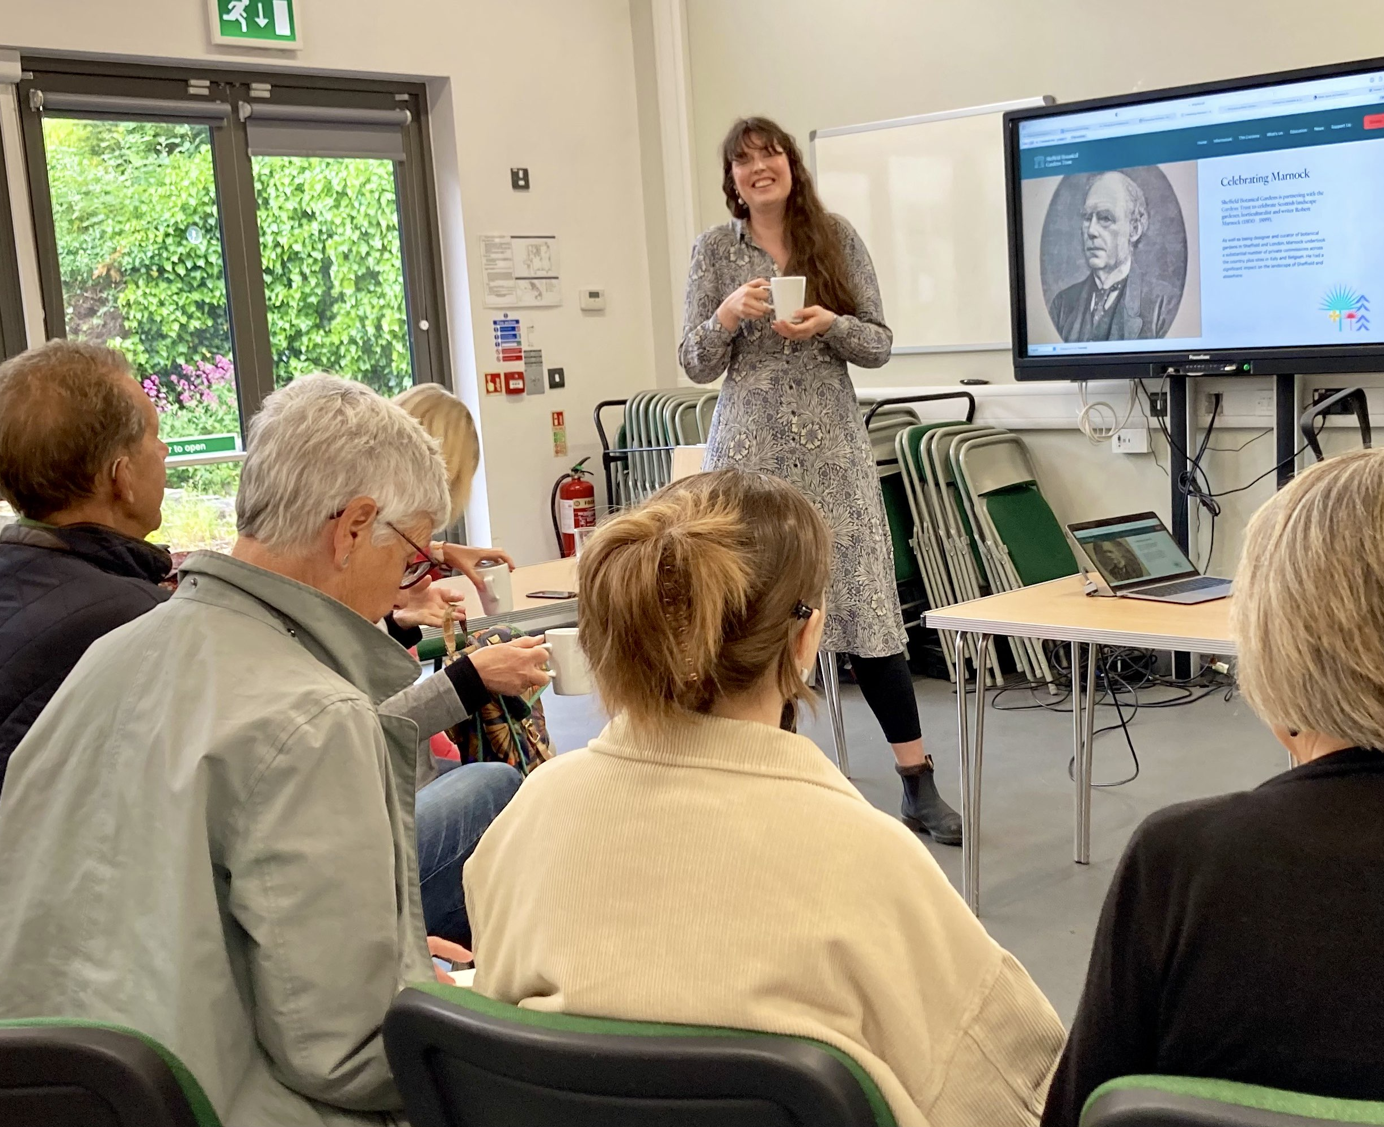
What was it trying to do?
Reach new audiences: raise awareness of Marnock’s name & legacy in Sheffield & more widely,
Recruit volunteers: share & build expert knowledge about Marnock’s life, style & involvement at particular sites.
Image: Volunteer training (c) Jill Sinclair
Notes:
Aims:
• reaching new audiences: Raise awareness of Marnock’s name and legacy in Sheffield and more widely,
• Engagement: recruiting volunteers: To share and build expert knowledge about his life, style and involvement at particular sites.

Slide 4
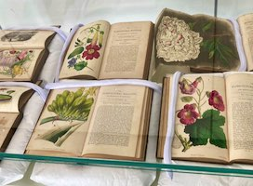
Three planned outcomes
a free exhibition in Sheffield, including the Floricultural Magazine,
a stimulus for volunteers around the country to conduct, collate or share research on Marnock,
a new website to encourage, share and store research on Marnock.
Image: Magazine display (c) Jill Sinclair
Notes:
Objectives
• a free, month-long exhibition on Marnock in Sheffield, including display of original editions of his Floricultural Magazine,
• a stimulus for volunteers around the country to conduct or collate research on Marnock and to find ways to share the information,
• a new website to encourage, share and store research on Marnock, to allow information to be freely and permanently accessible to anyone with an interest in Marnock and, more broadly, Victorian horticulture, gardening and design.

Slide 5
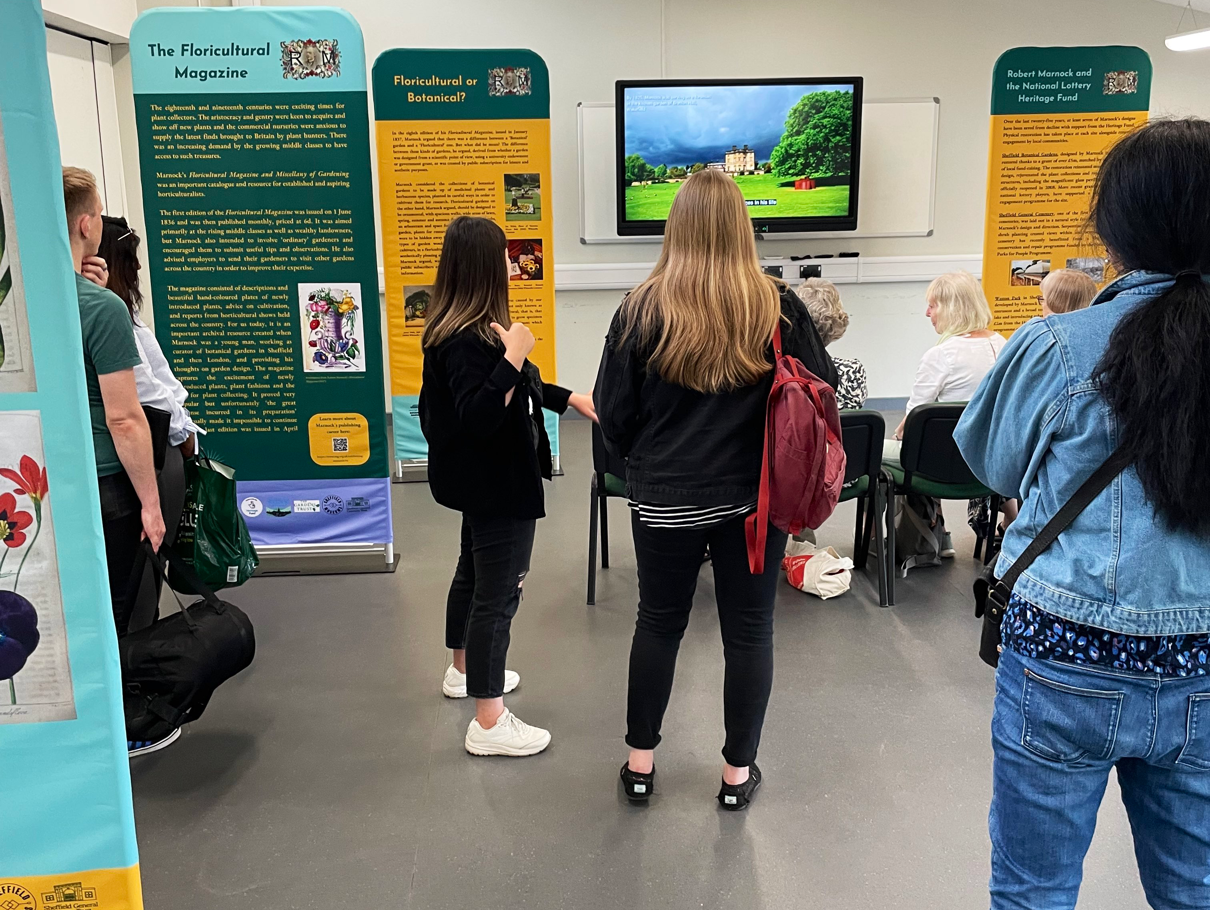
Activities in Sheffield
Image: Exhibition (c) Laura Alston.
Image: Jan Woudstra talk (c) Laura Alston.
Image: Marnock tour (c) Christine Rose.
Notes:
Exhibition with nearly 2,000 visitors, tours, talks, virtual trail, links with other local sites

Slide 6
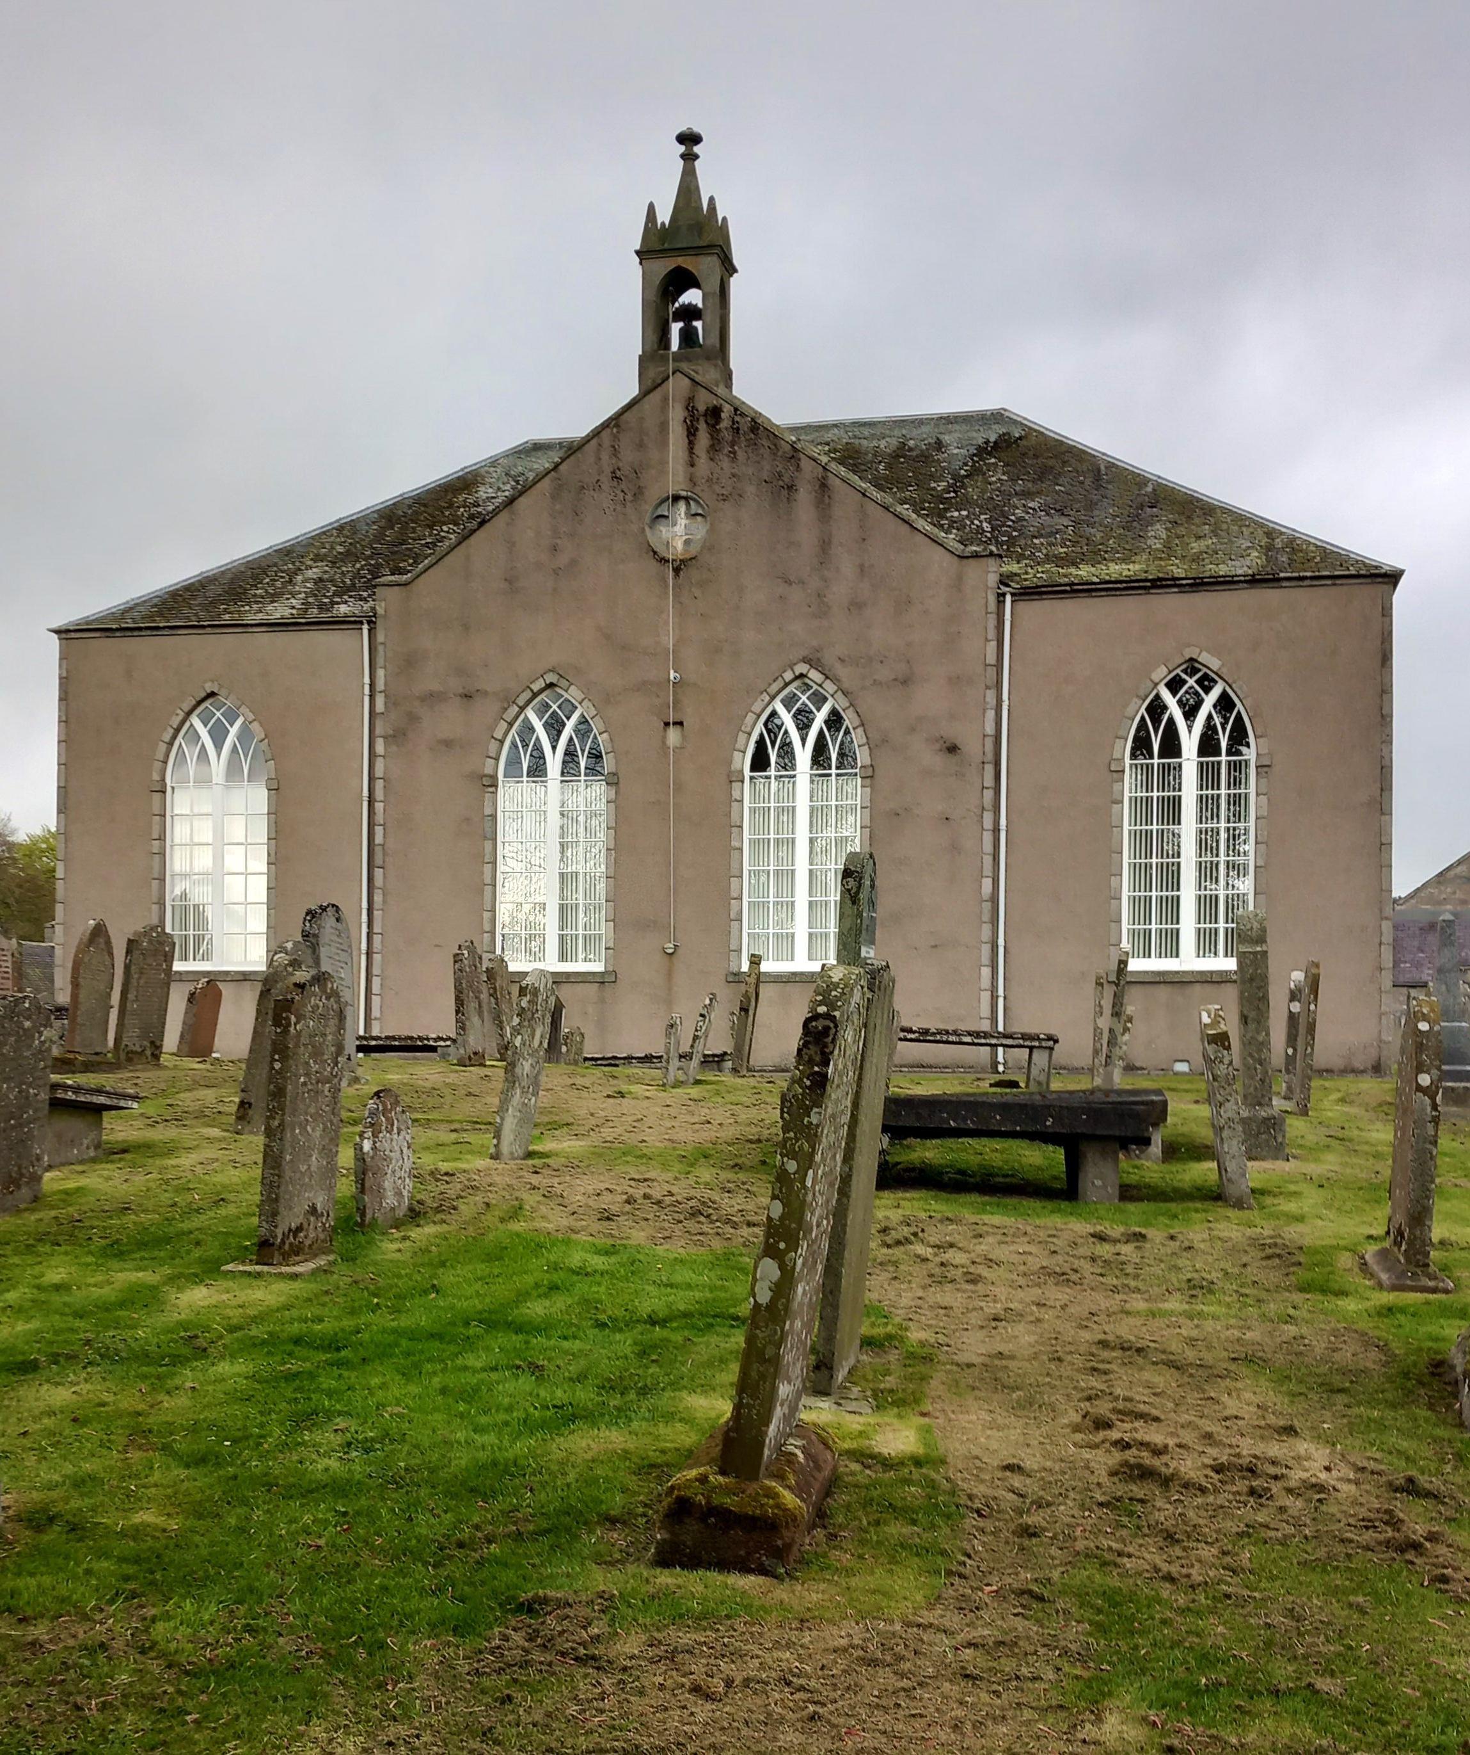
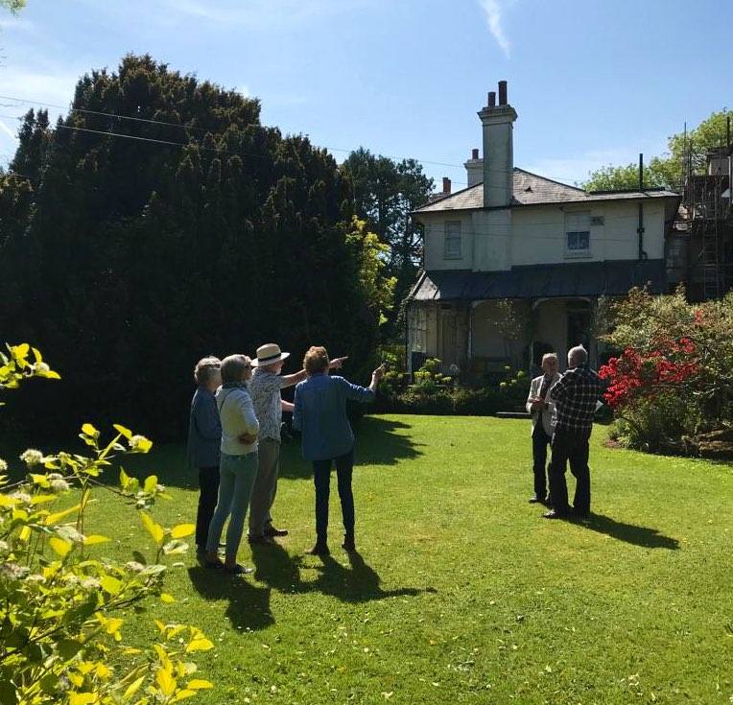
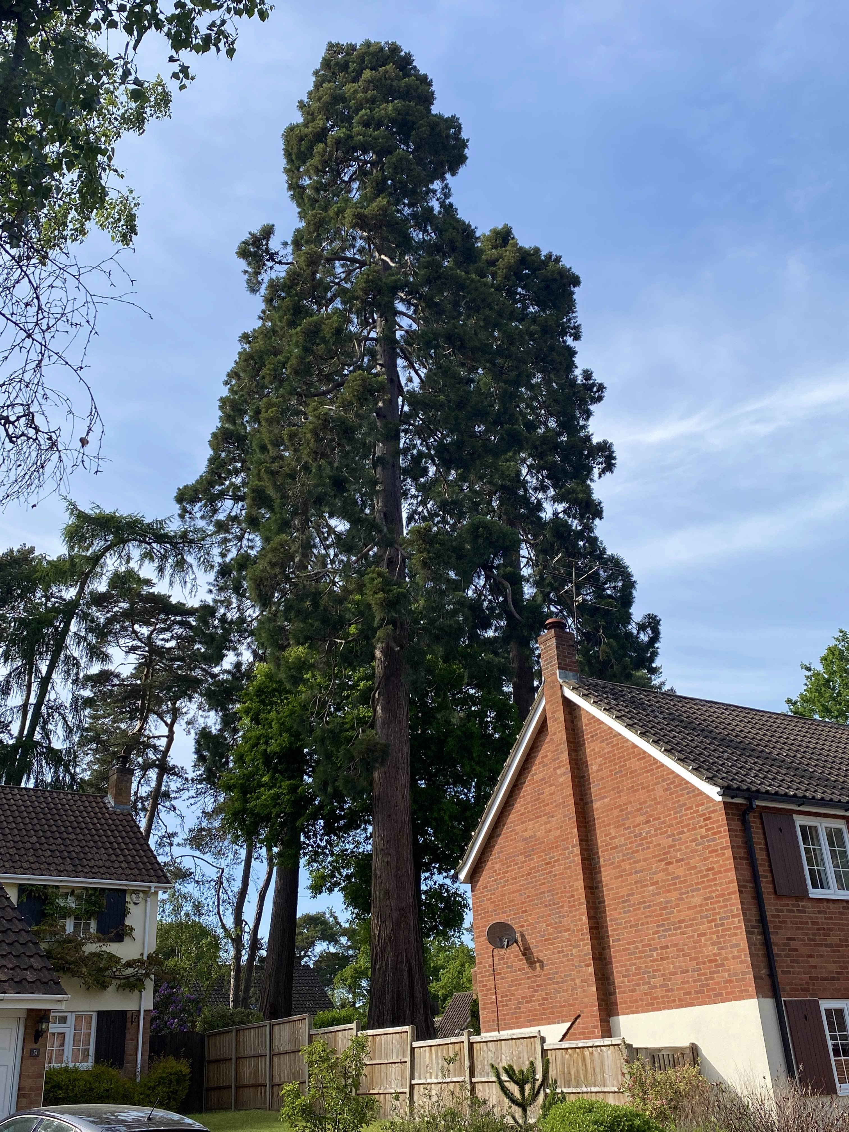
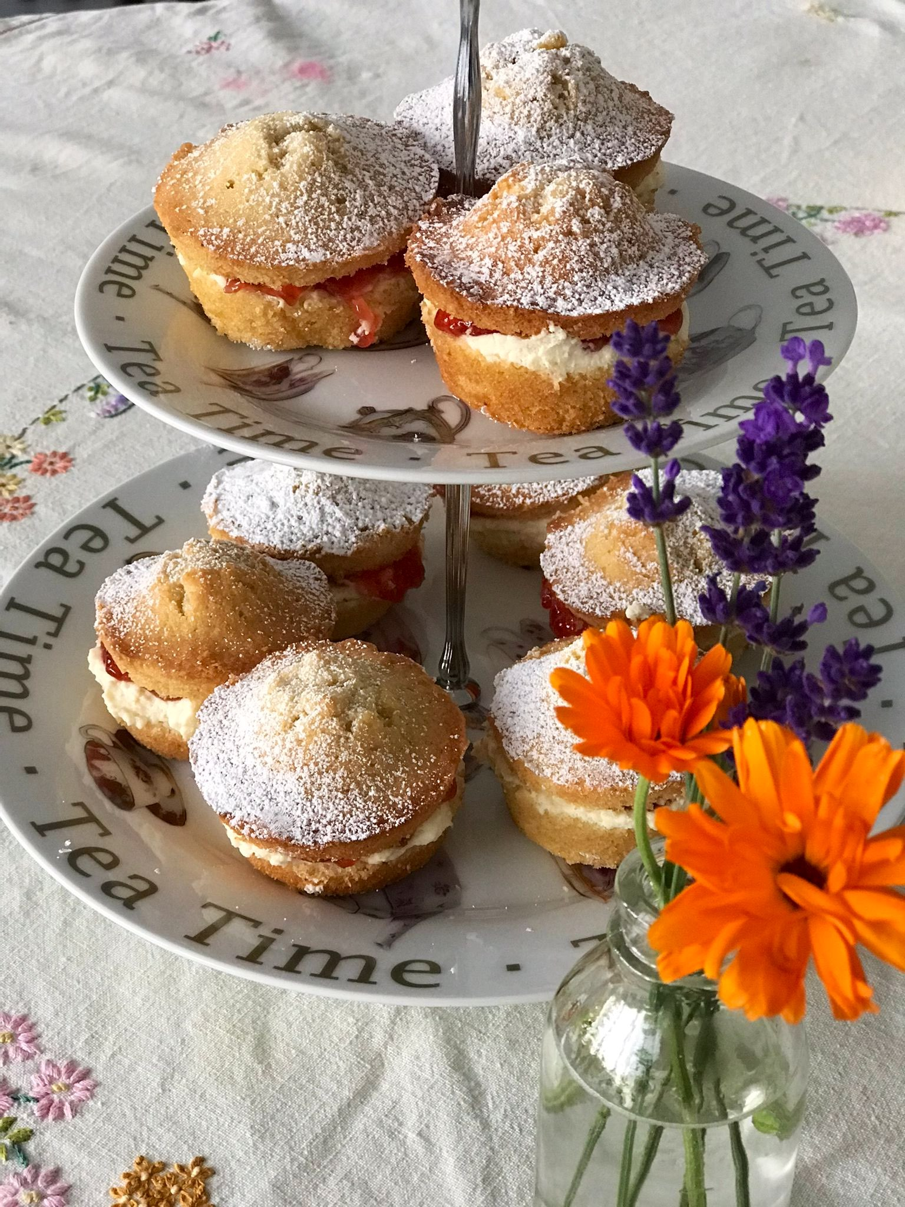
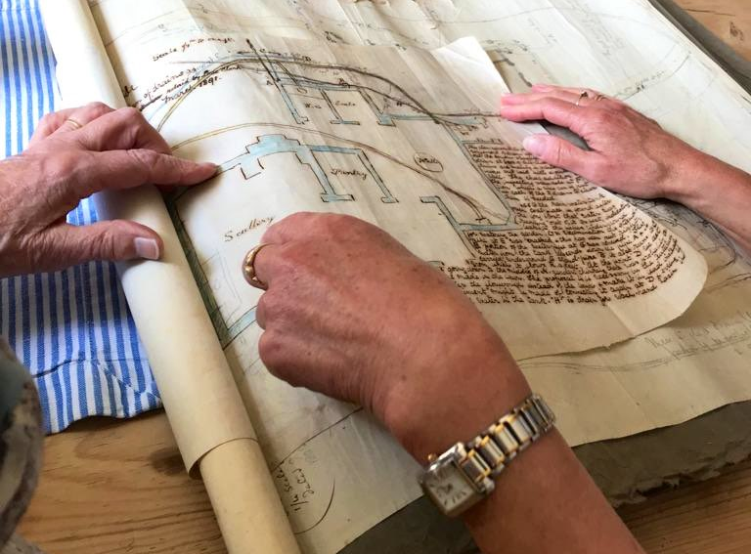
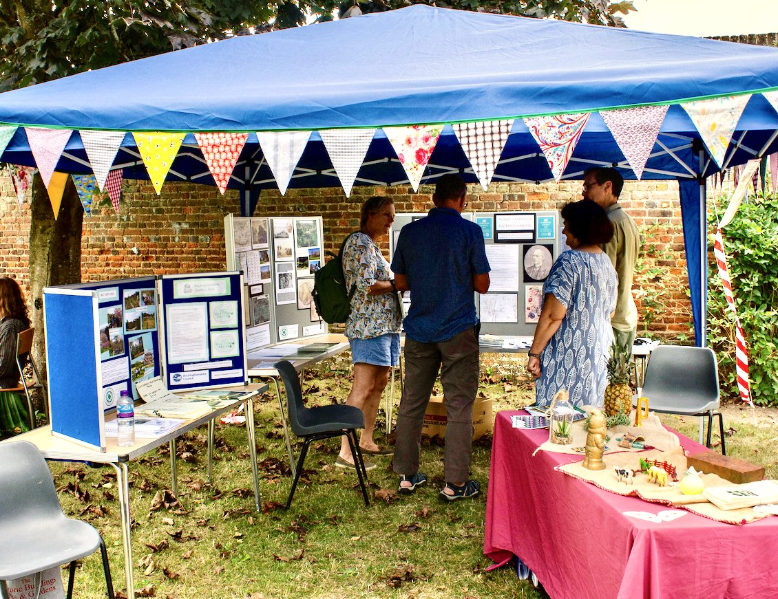
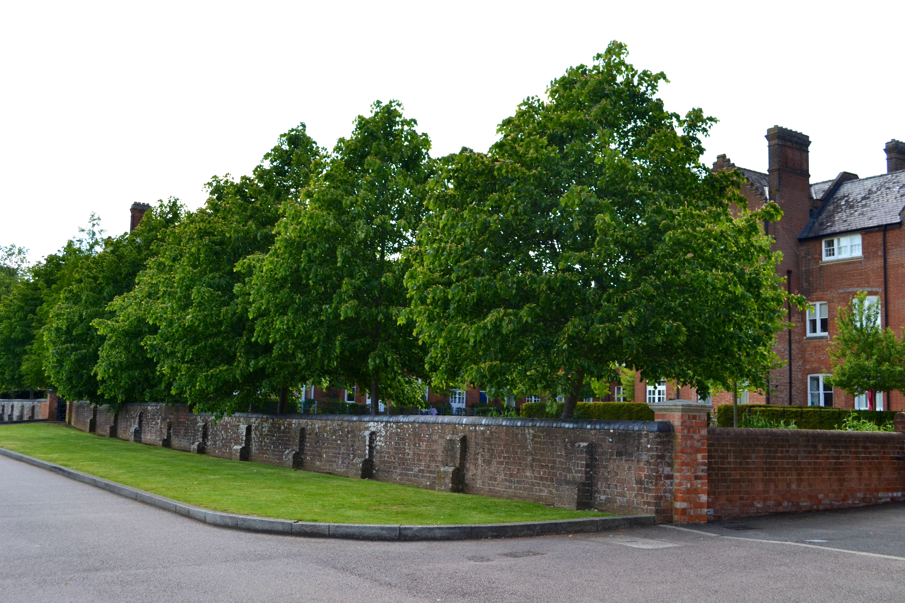
Activities nationally
Images: Skene church (c) Alison McCall; Rusthall visit (c) Clare Kelly; slide from Brent Elliott talk; Grosvenor tour (c) Clare Kelly; Leighton Buzzard Plantation (c) Paul Rabbitts;
Rusthall plans (c) Clare Kelly; Bucks HODs by John O’Dwyer; Fair Mile (c) Bettina Kirkham; Grosvenor picnic (c) Clare Kelly
Notes:
Genealogical research in Aberdeenshire, visits and plan examination Kent, new research and HOD displays in Bucks, site visits and new photography in Berks and Beds, a talk in London, tours and tea in Kent.
New sites identified, new research undertaken, new interpretation offered and planned.

Slide 7
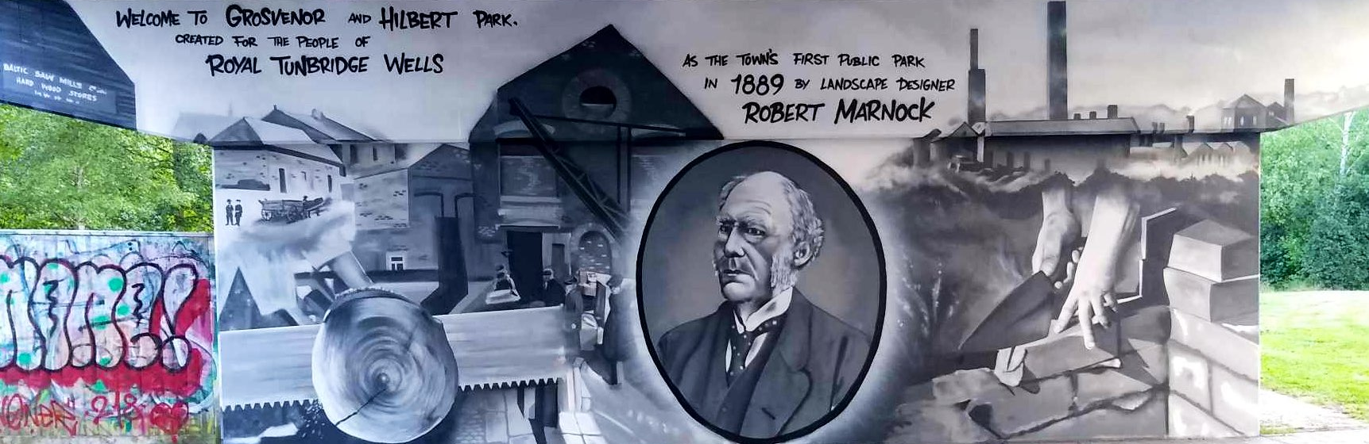
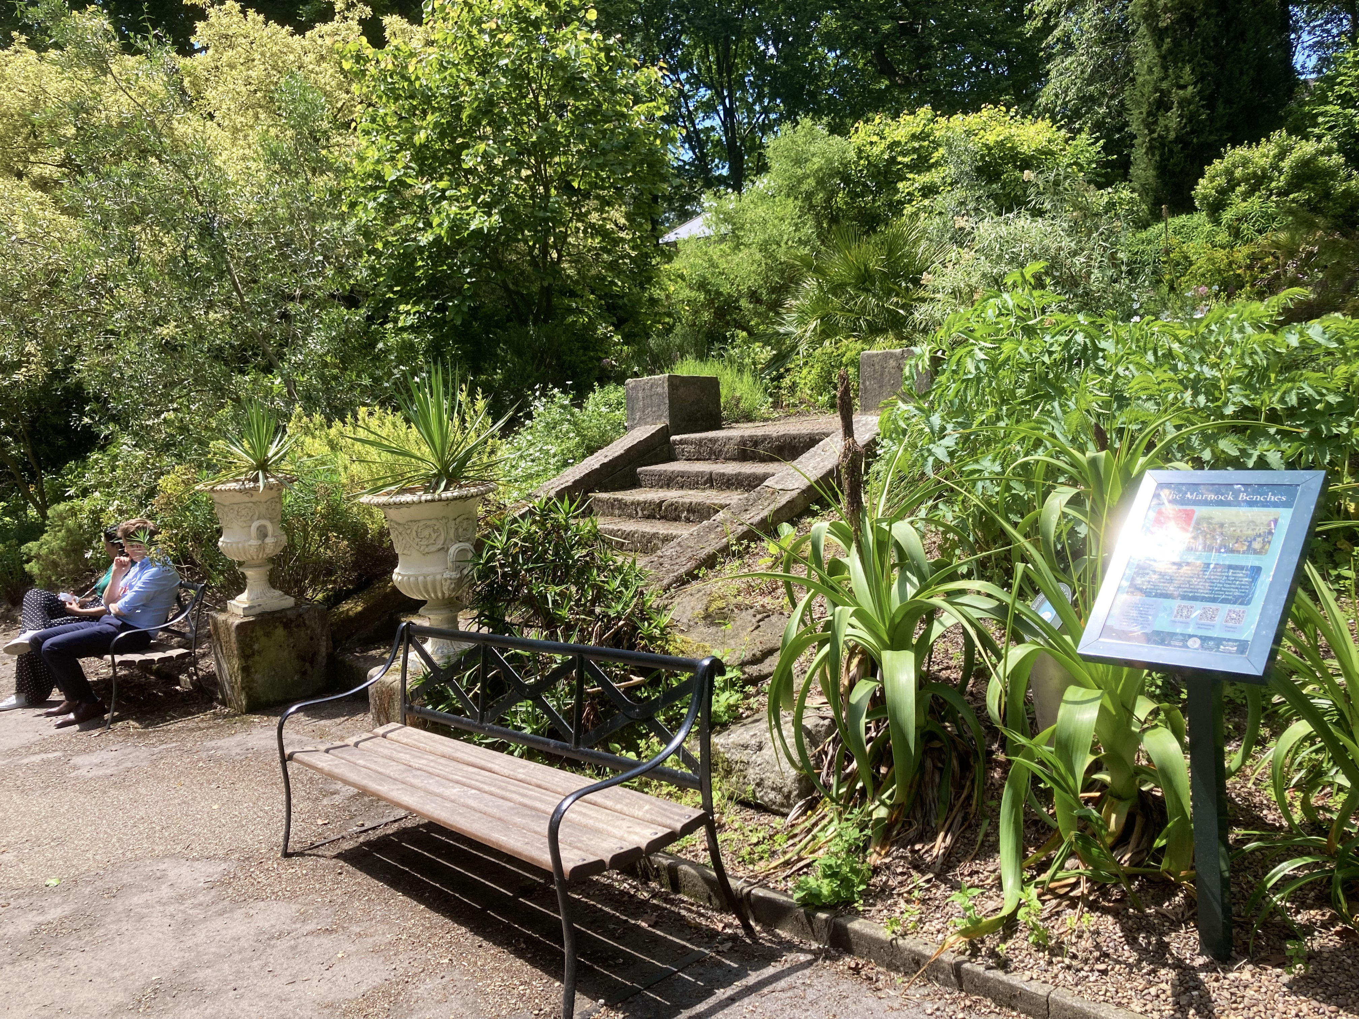
Unusual Activities
Image: Street art (c) Carolyn Gray.
Image: Marnock benches (c) Jill Sinclair.
Image: Filming (c) Laura Alston.
Notes:
Some unusual outcomes - street art on a bridge near Grosvenor and Hilbert Park, Tunbridge Wells (fortuitous public realm art project)
Pair of Marnock-style benches commissioned by Friends of the Botanical Gardens inspired by 1840 image
Snippet on BBC Bargain Hunt

Slide 8
The website
www.sbg.org.uk/celebrating-marnock
Notes:
Website created at no cost and with permanent retention of material
www.sbg.org.uk/celebrating-marnock

Slide 9
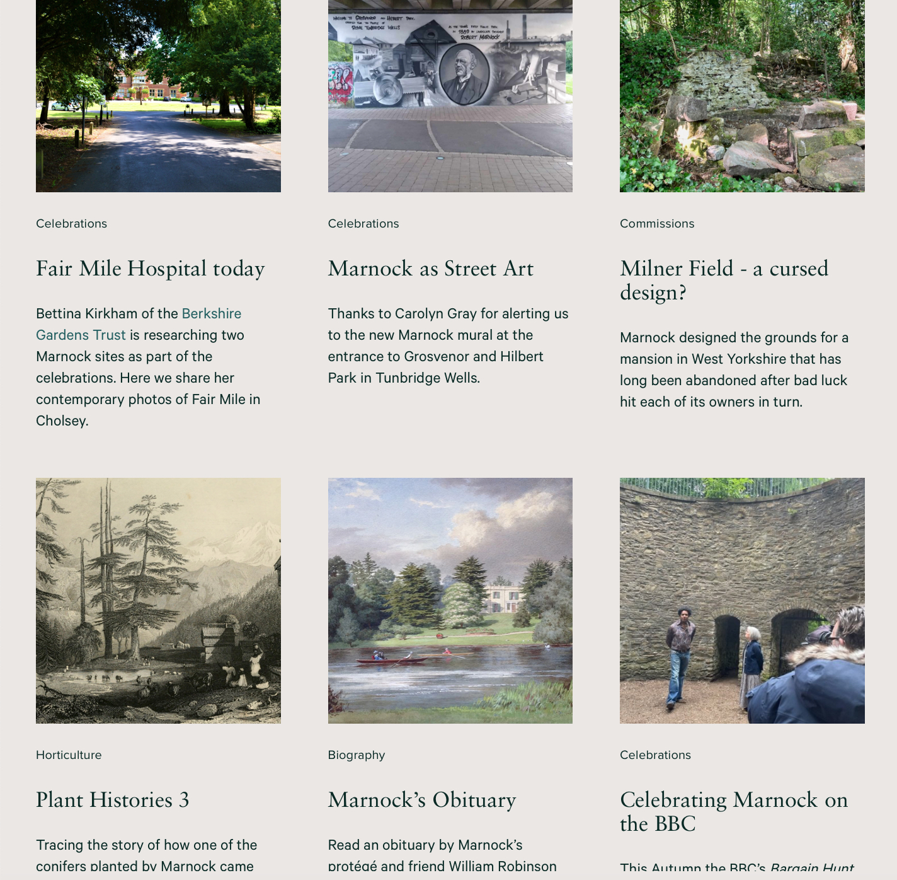
The website
www.sbg.org.uk/celebrating-marnock
Notes:
Website has several dozen blog posts, all written by volunteers

Slide 10
The website
Map of linked sites
Over 60 sites across the country with links to Marnock
Each has images, information and links to sources, many supplied by CGTs
New sites, photos, information or corrections welcome
www.sbg.org.uk/celebrating-marnock/marnock-map
Notes:
And an interactive map with info and images on over 60 sites with links to Marnock

Slide 11
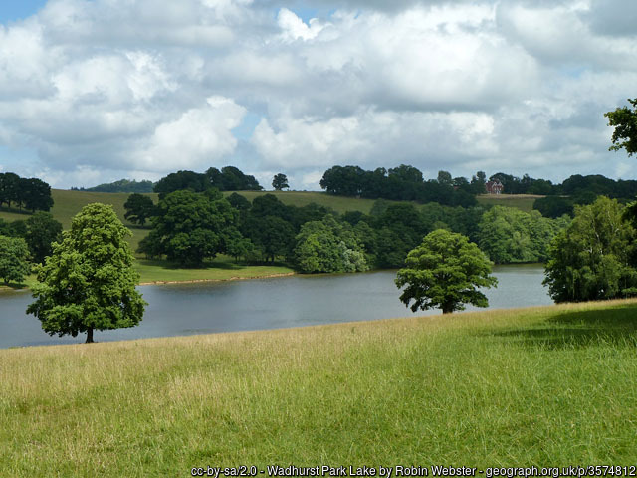
First lesson learnt: time
Notes:
First lesson learnt: time
Image is of Wadhurst Park in Sussex, one of the many sites we did not have time to contact.
Could have planned longer, involved more CGTs, involved more sites, produced more guidance and other material, done more publicity - but in the end we did as much as we could in the time we had.

Slide 12
First lesson learnt: time
“Nobody made a greater mistake than he who did nothing because he could do only a little.”
Notes:
First lesson learnt: time
“Nobody made a greater mistake than he who did nothing because he could do only a little.” Quote by Edmund Burke.
in the end we did lots and made a difference.

Slide 13
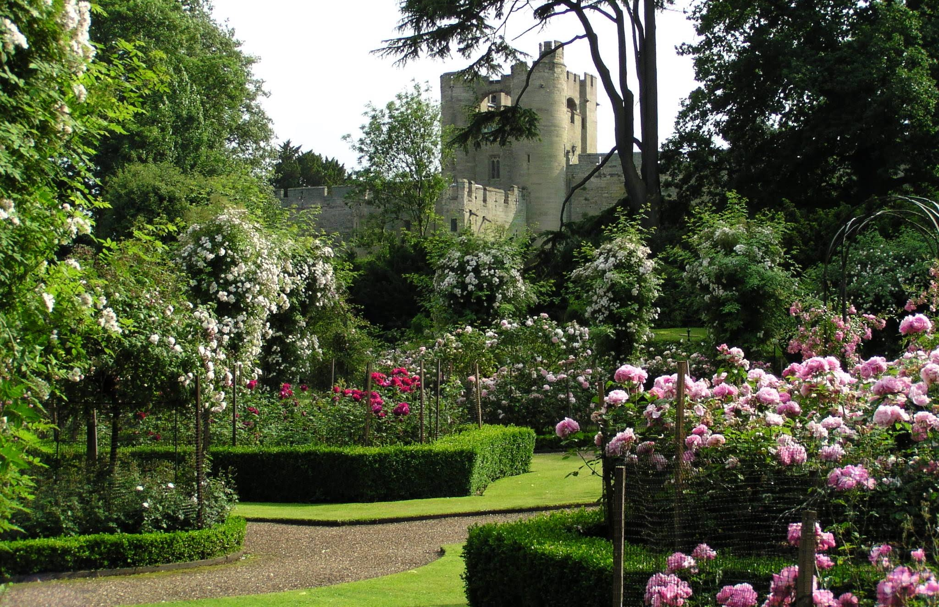
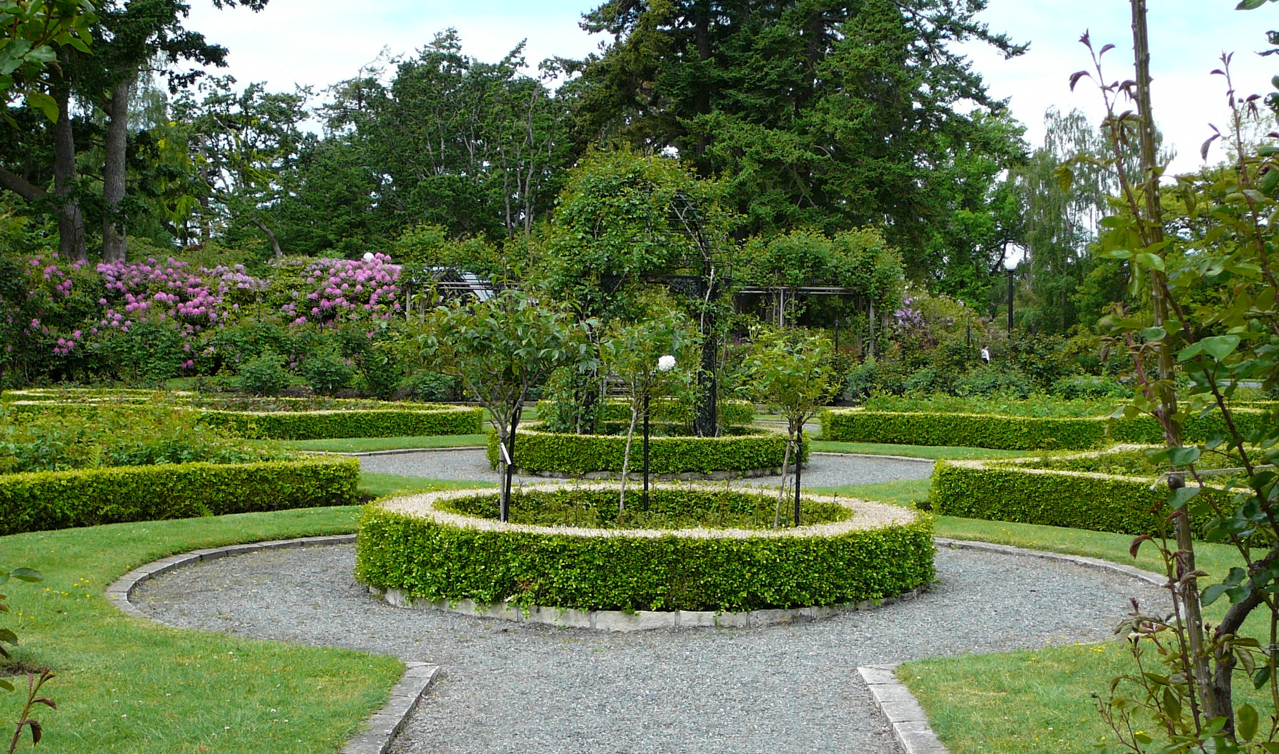
Second lesson learnt: qualities needed
Image: Warwick rose garden (c) Kay Keeton.
Image: Canadian replica rose garden (c) Kay Keeton.
Notes:
Lessons learnt:
Expertise - instills confidence in others, and saves so much time

Slide 14
Second lesson learnt: qualities needed
Two key qualities:
enthusiasm, to bring others on board
Image: Warwick rose garden (c) Kay Keeton.
Image: Canadian replica rose garden (c) Kay Keeton.
Notes:
Lessons learnt:
Enthusiasm - takes over your life, so choose something you love, and brings others on board

Slide 15
Second lesson learnt: qualities needed
Two key qualities:
enthusiasm, to bring others on board
expertise, to instill confidence
Image: Warwick rose garden (c) Kay Keeton.
Image: Canadian replica rose garden (c) Kay Keeton.
Notes:
Lessons learnt:
Enthusiasm - takes over your life, so choose something you love, and brings others on board
Expertise - instills confidence in others, and saves so much time

Slide 16
Third lesson learnt: have a legacy
Notes:
Have a legacy - so project doesn’t just end
The website is a permanent record, the benches an enduring celebration

Slide 17
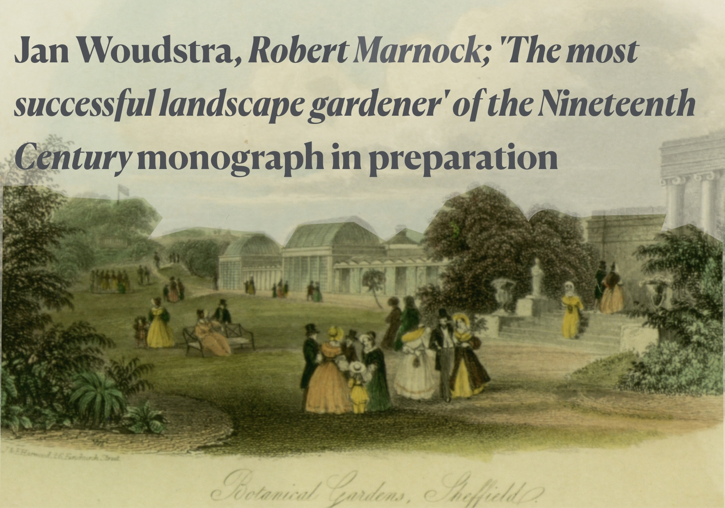
Third lesson learnt: have a legacy
Image: Harwood’s Scenery of Great Britain (1840).
Public domain.
Notes:
Further activities - contacting more sites, updating map etc when book published
and a Missing Pieces project?

Slide 18
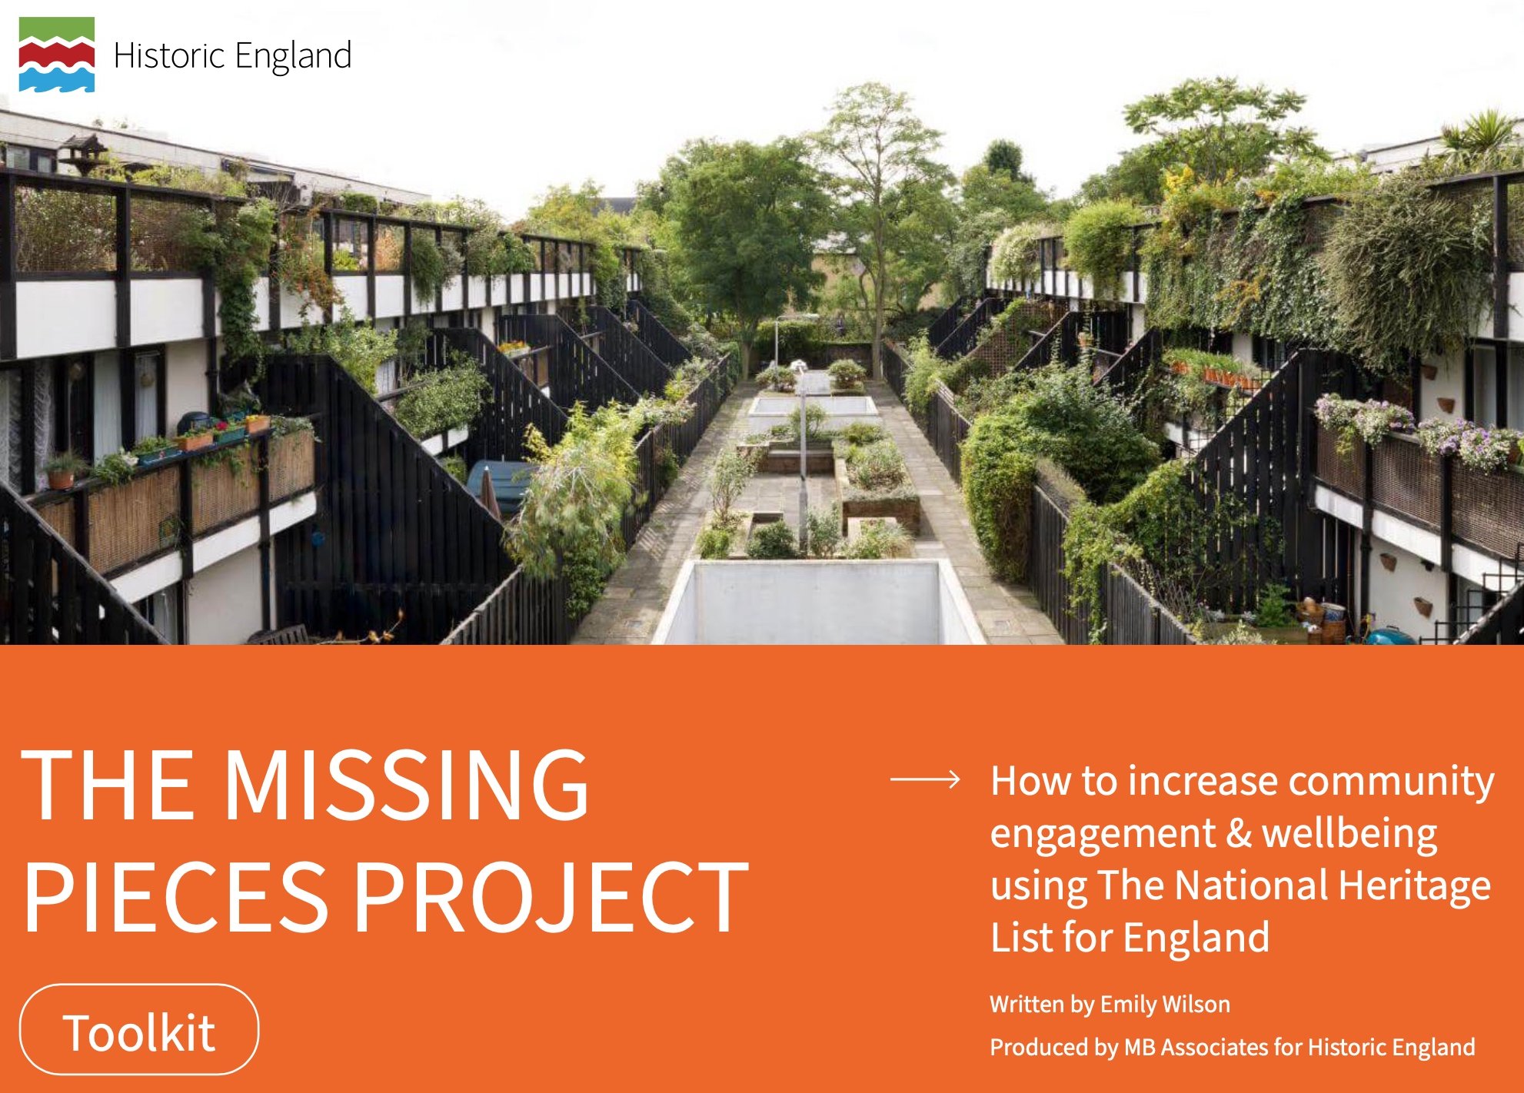
Third lesson learnt: have a legacy
Image: Harwood’s Scenery of Great Britain (1840).
Public domain.
Image: Historic England website.
Notes:
Further activities - contacting more sites, updating map etc when book published
and a Missing Pieces project?

Slide 19
What was the most important outcome for the Friends?
Notes:
Asked by Frankie when preparing this.
More information, more stuff - the magazines, boards, benches - but real benefit is the increased PRIDE we all now feel in the Gardens and their creator.

Slide 20
Celebrating Marnock initiative
Image: Gardeners Chronicle 3:6 (1889). Public domain.
Three lessons learnt
Jill Sinclair, 15 July 2024
Notes:
Celebrating Marnock initiative:
Three lessons learnt

