Slide 1
AUDIENCE ENGAGEMENT PROGRAMME
Claire de Carle – Chair and Trustee

Slide 2
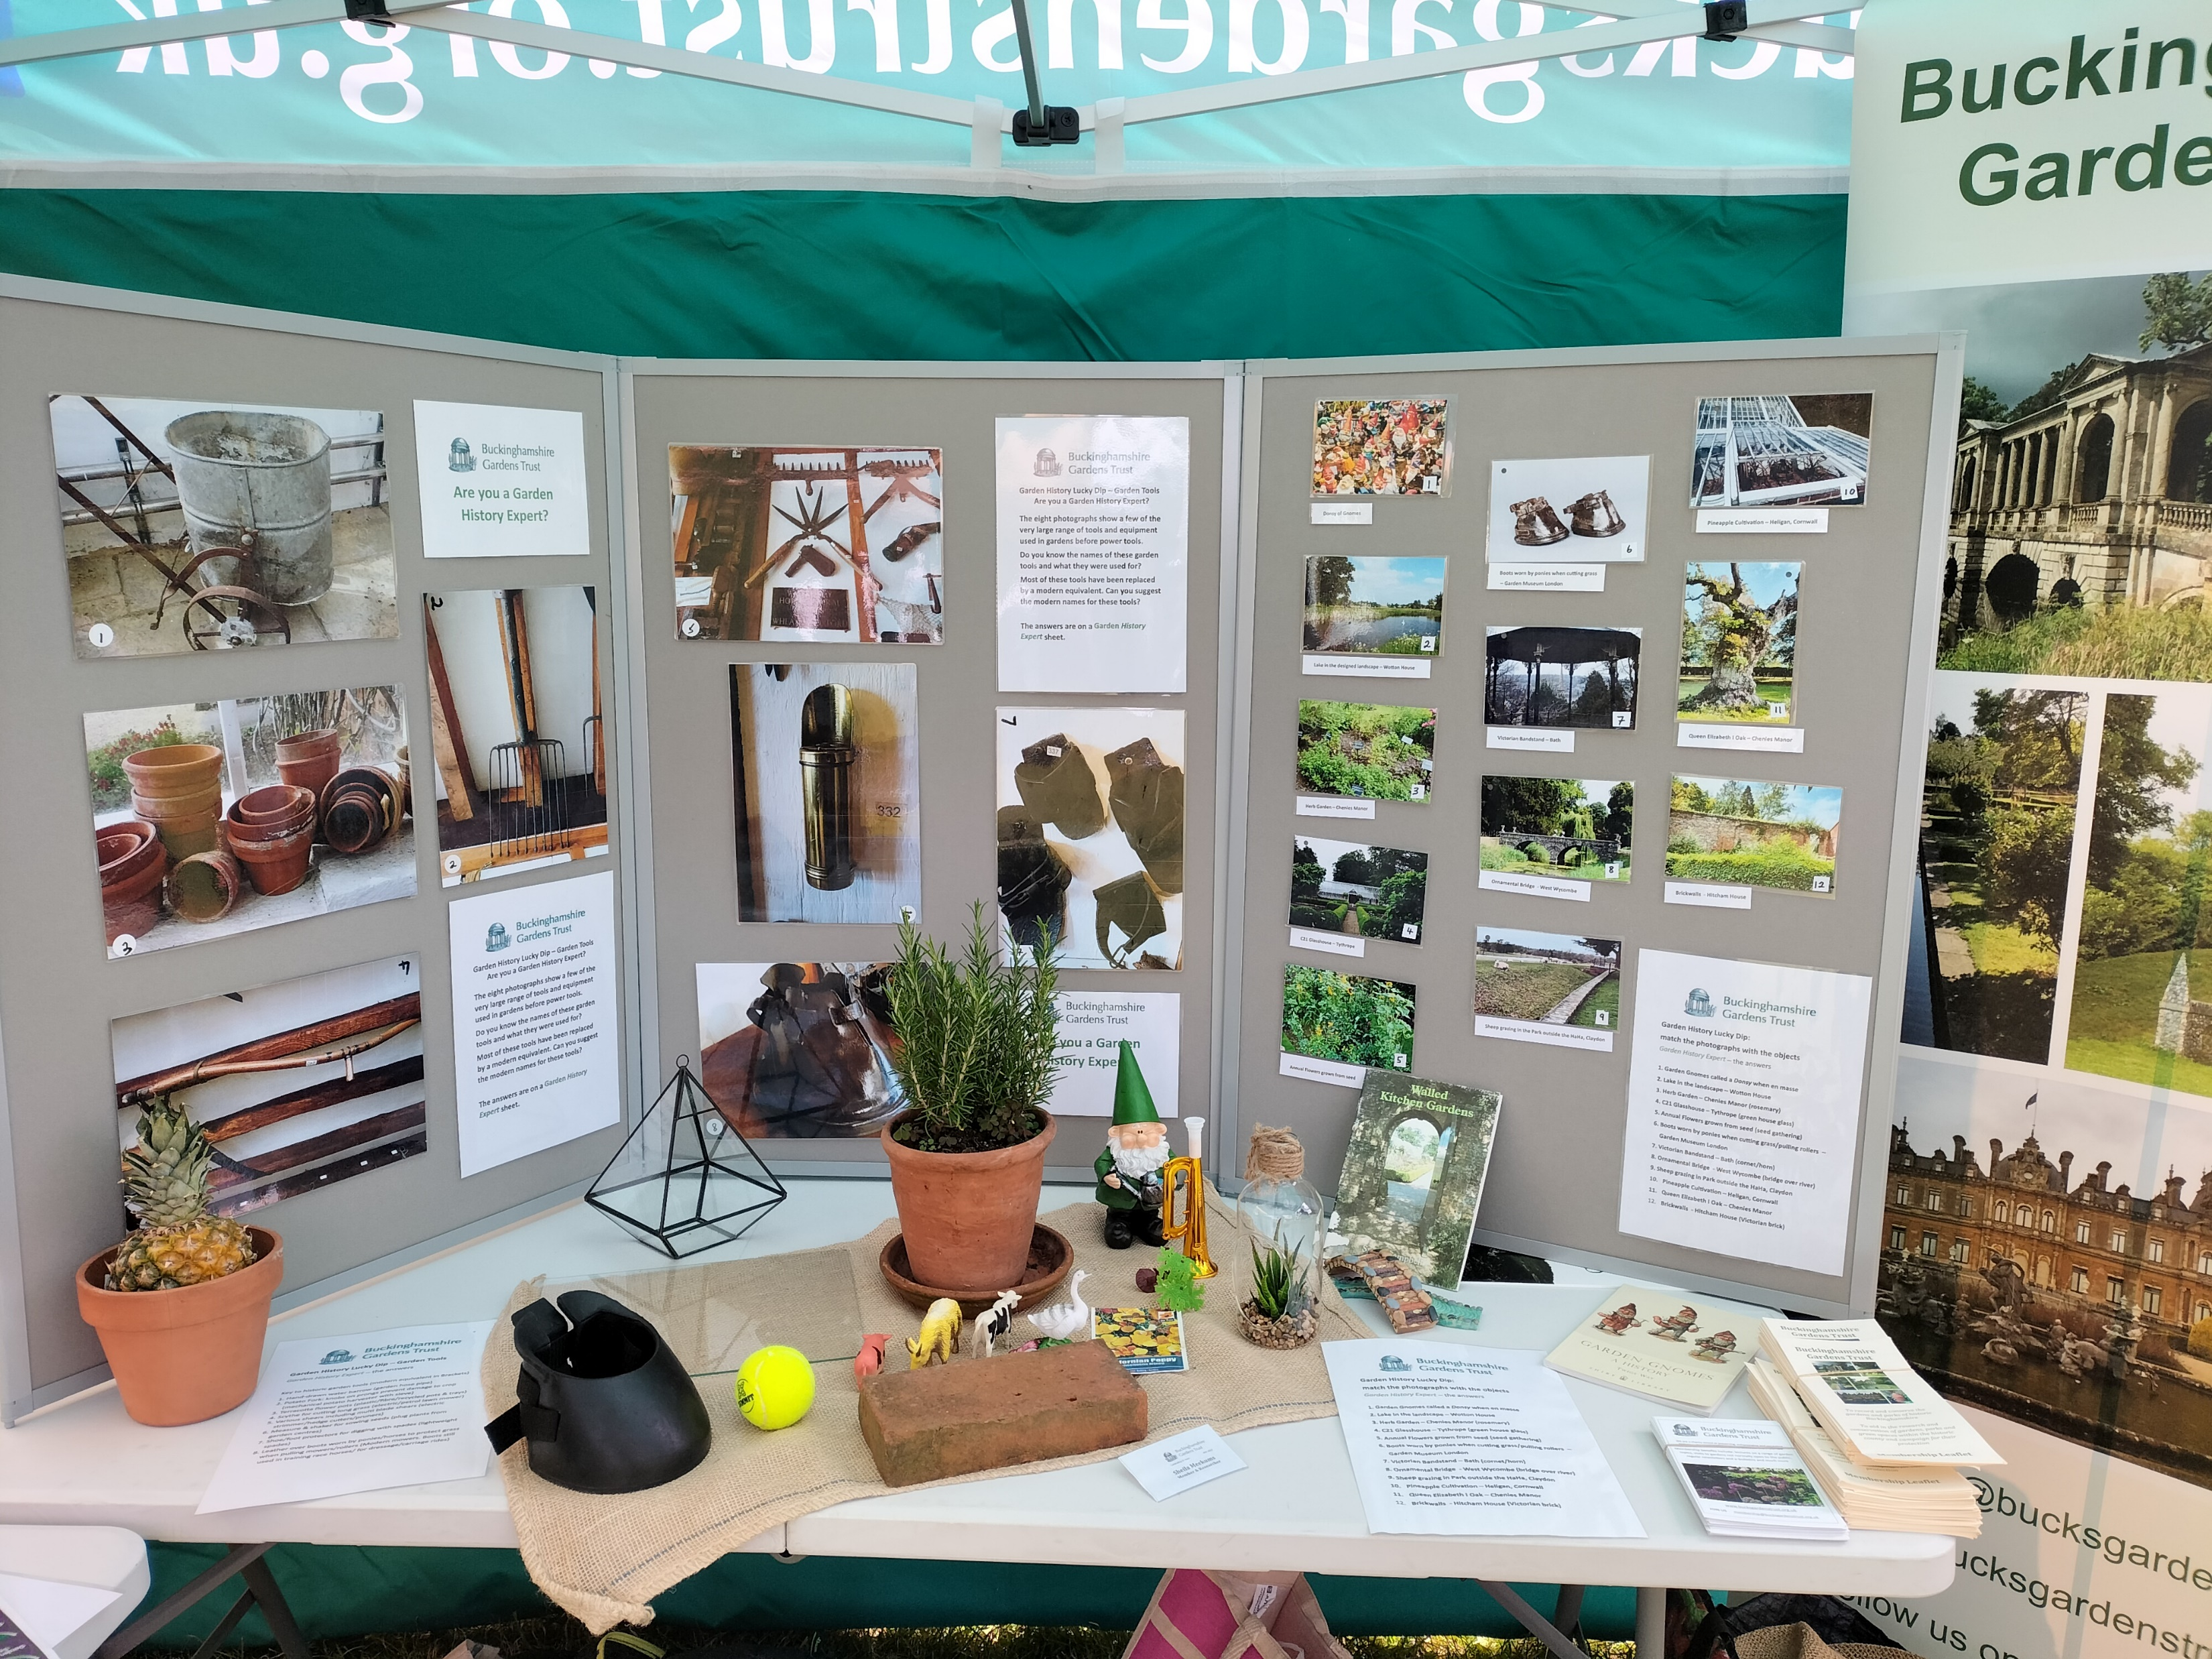
Funding the programme
The Gardens Trust Community Grant

Slide 3
Where can I hold an event?

Slide 4
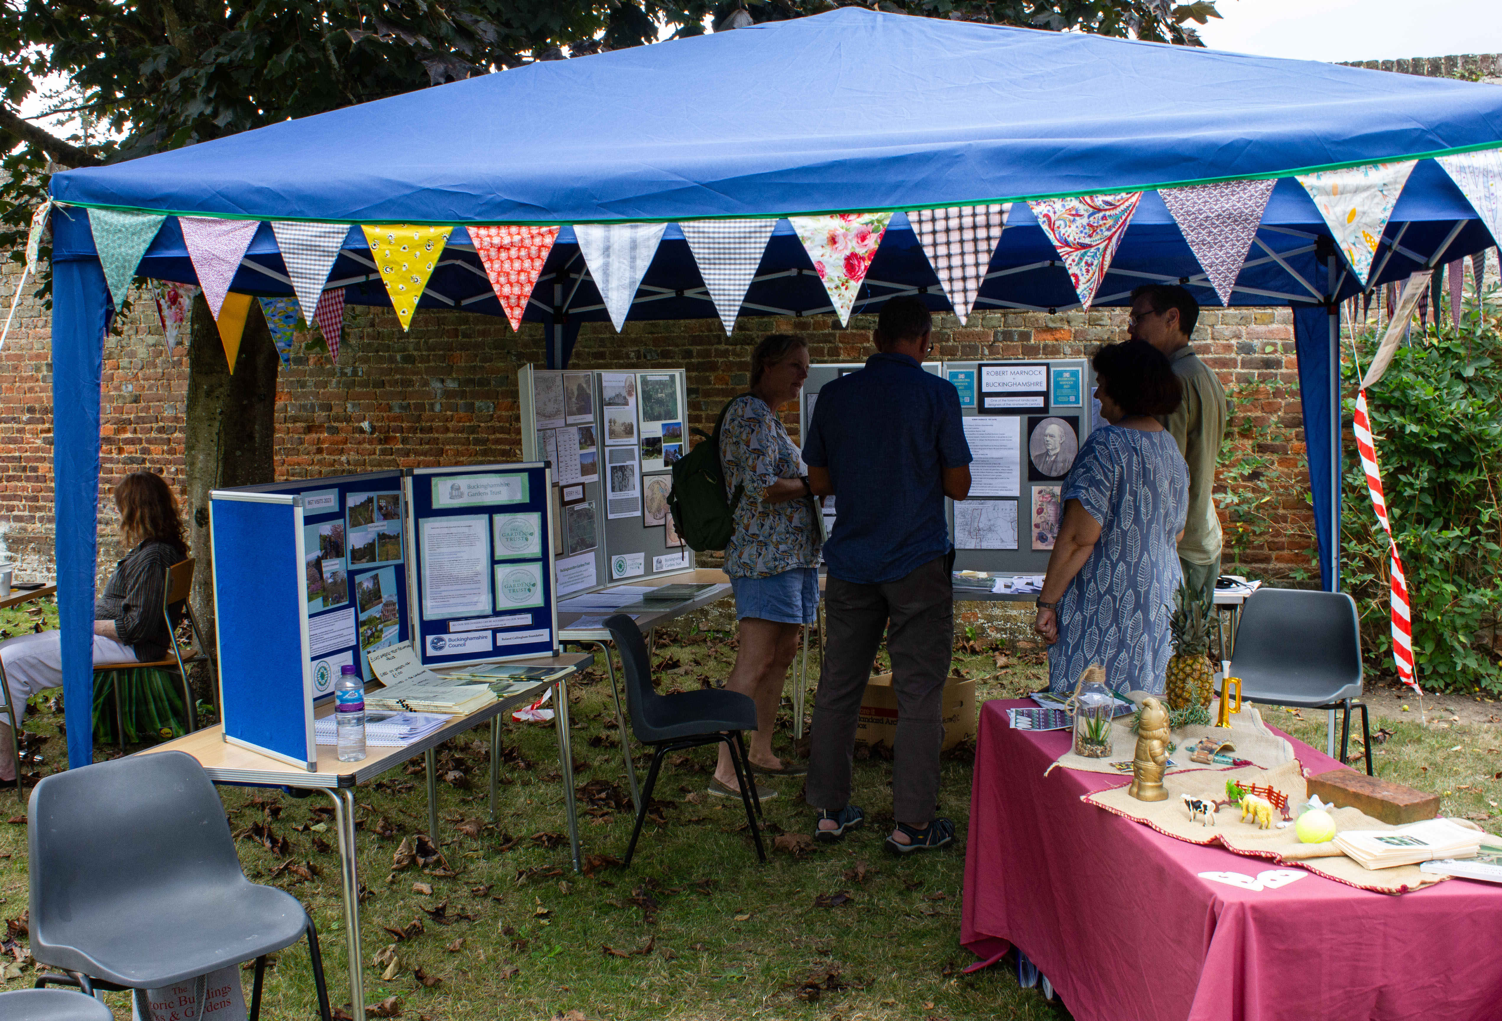
Setting up at an event

Slide 5
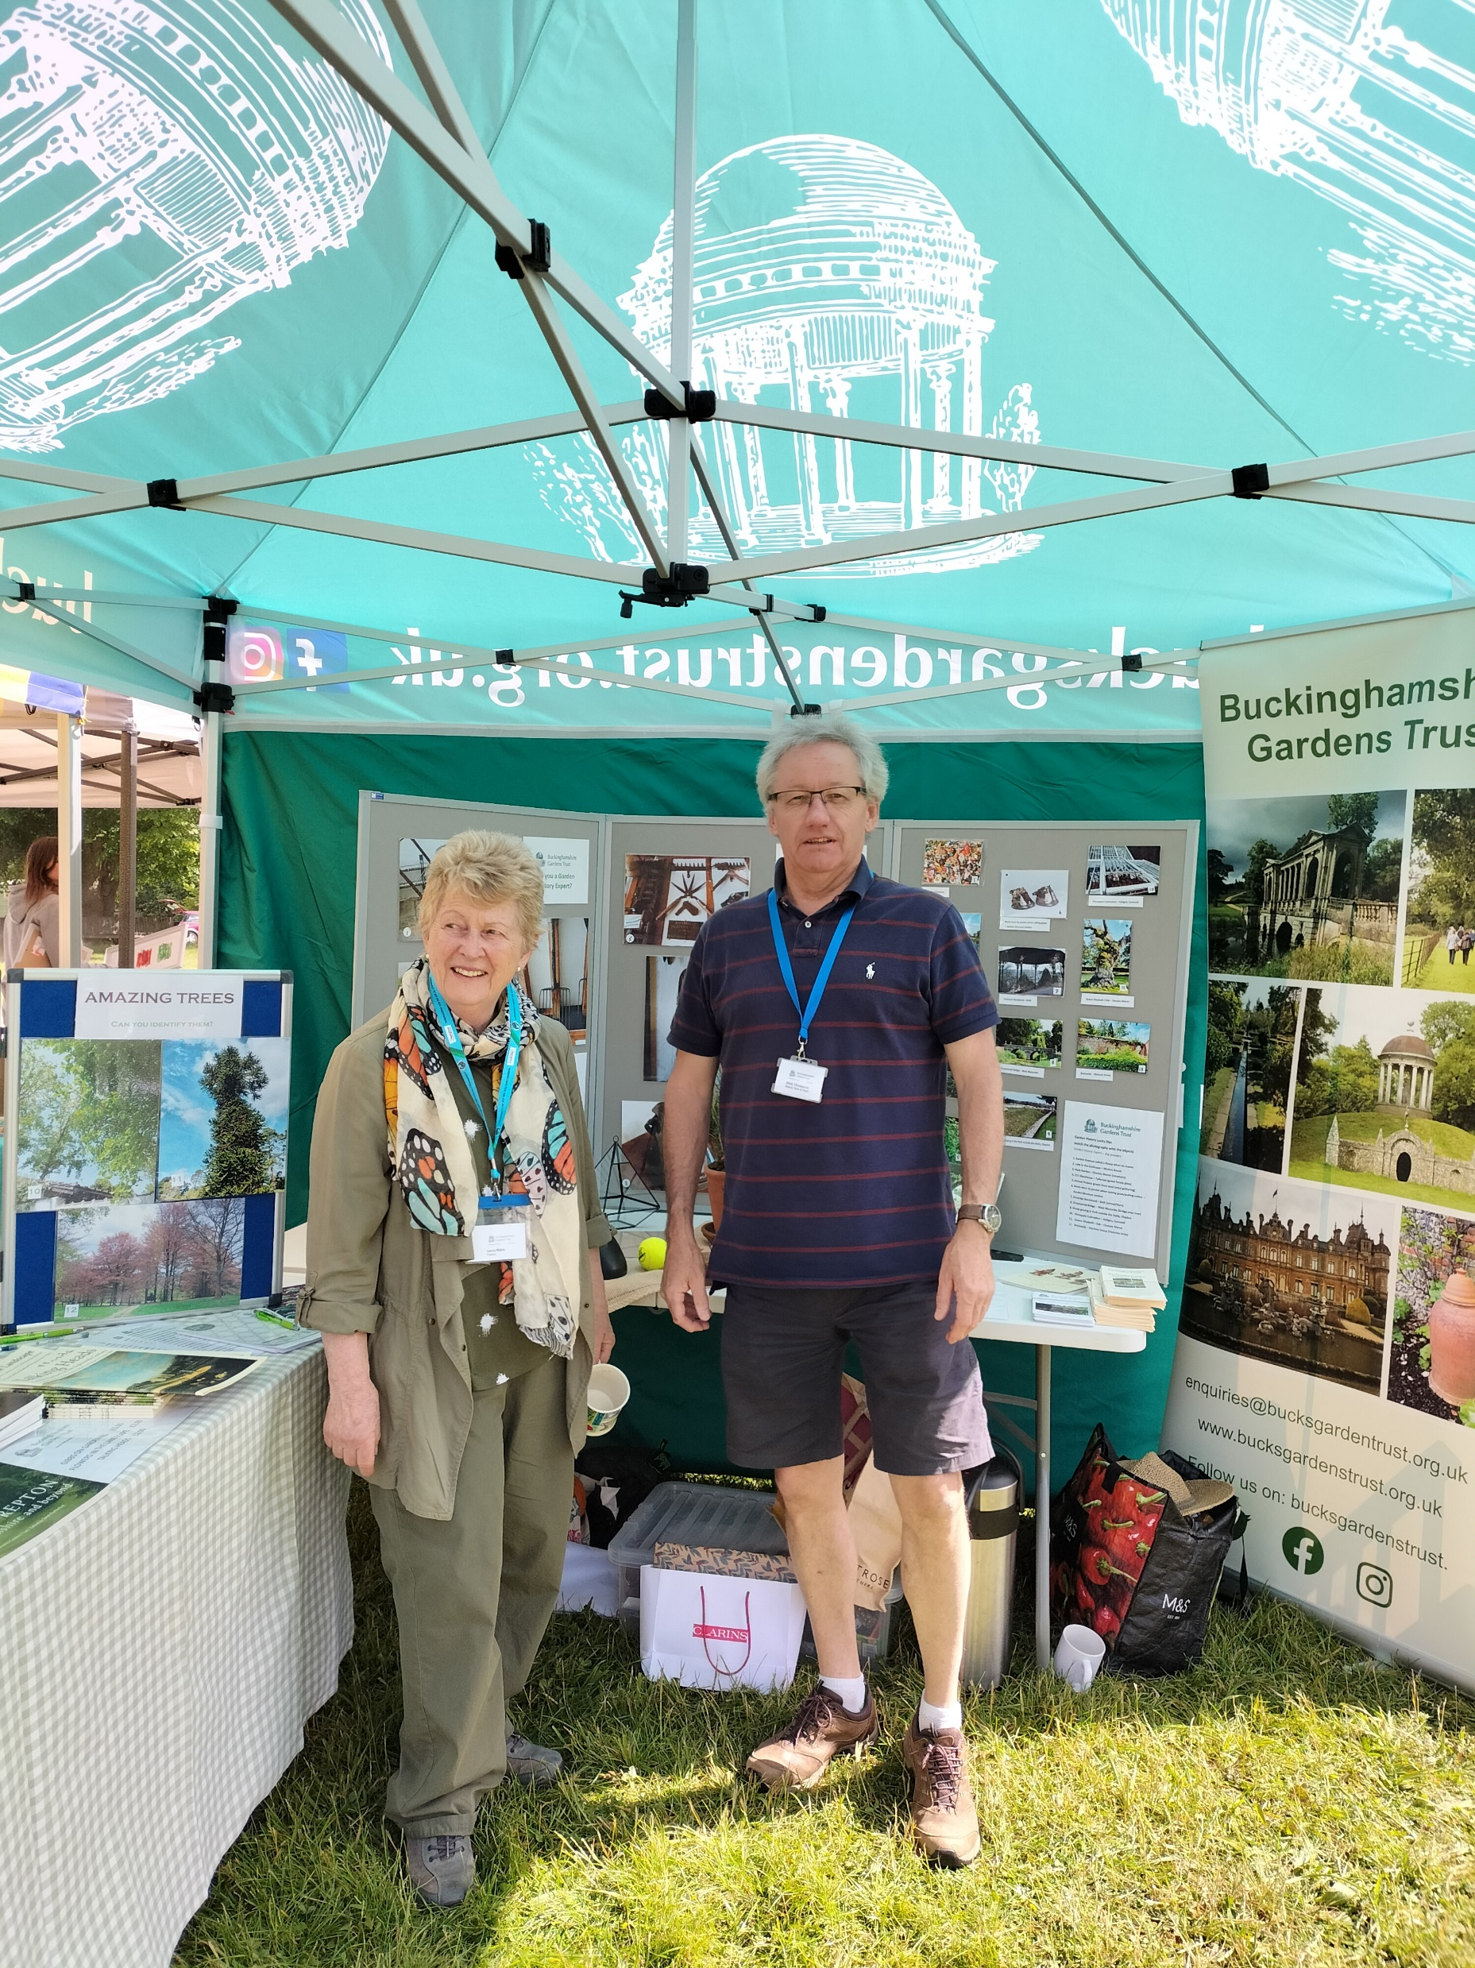
Recruiting Volunteers

Slide 6
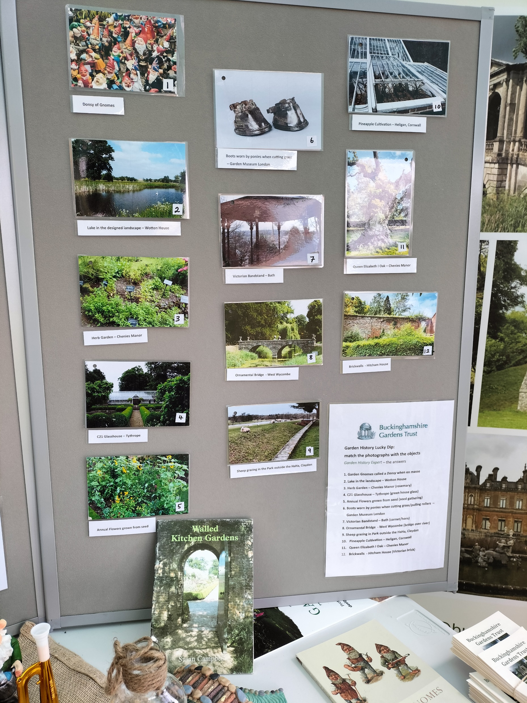
The Garden History - Lucky Dip
Are you a garden history expert?

Slide 7
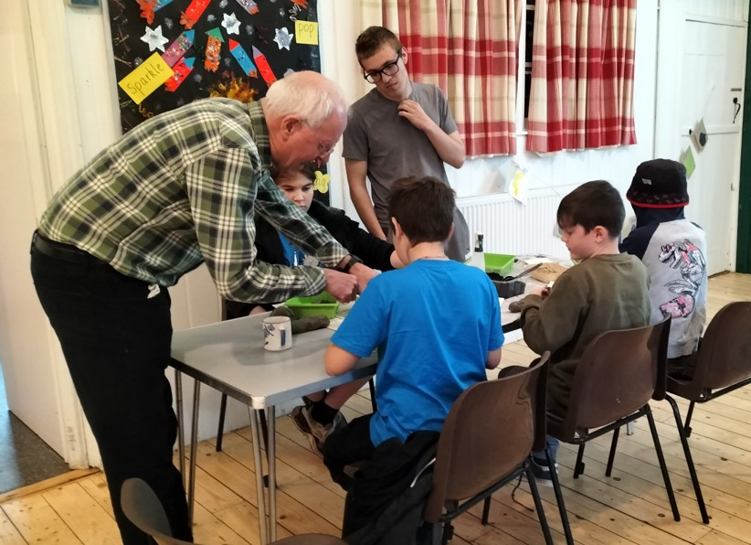
Outreach events with children’s clubs or school groups
Young Archaeologists making crop circles

Slide 8
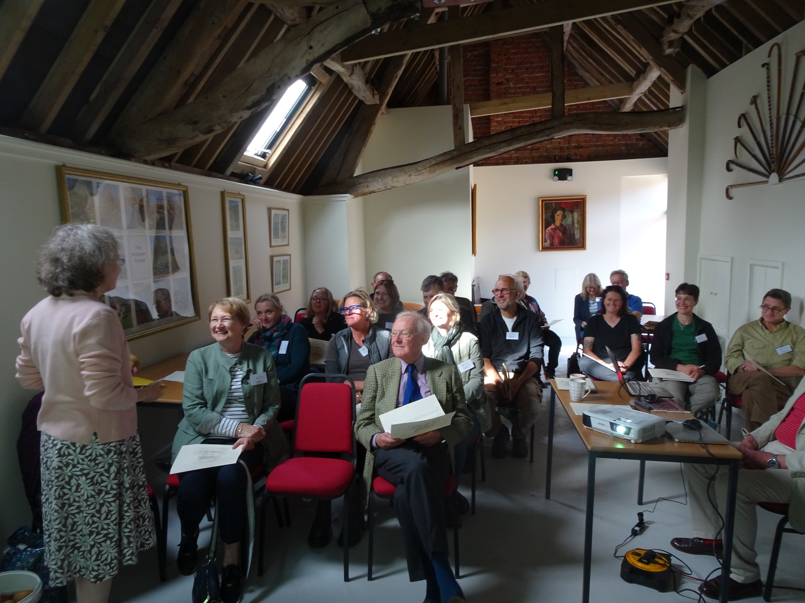
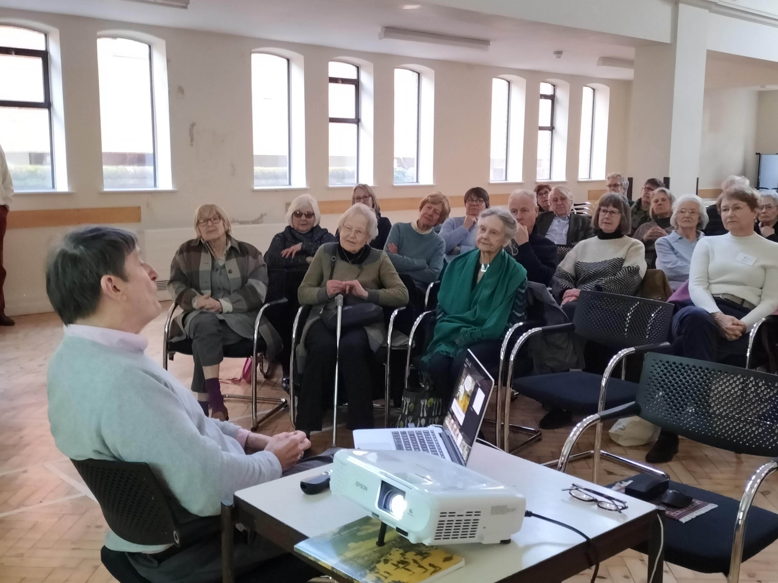
Outcomes
New members
Networking
Increased awareness of historic gardens
Fun activity for children
Future ideas
Funding

