Slide 1
Gardens Trusts
Historic Landscape Project
What’s the story?
Notes:
I’m going to give background to the movement that Devon GT is part of, explaining what CGTs are up to more broadly speaking, and how it all fits together into one splendid jigsaw. I know that many of you are new to this whilst others are already seasoned members of DGT, so I’m trying to tread a tightrope of addressing much of this to you, who maybe know very little about CGTs, whilst not boring longer-standing CGT members.
First of all, in case you’re wondering who I am: HLP began in 2010 as pilot project with funding from NE, then GHS, AGT, EH. Capacity building CGTs to play active conservation role (NB conservation includes research)
Mainly building networks and training - Responding to Planning Applications, Settings and Significance, Designation, Using Social Media, Managing Volunteers

Slide 2
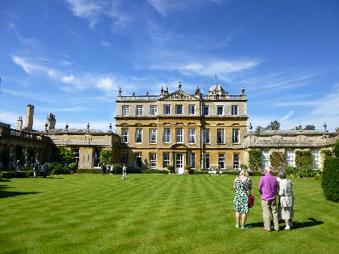
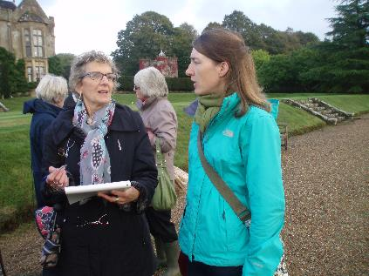
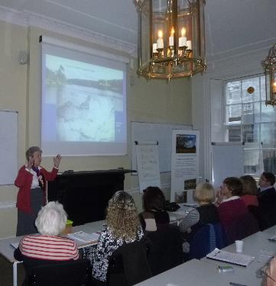
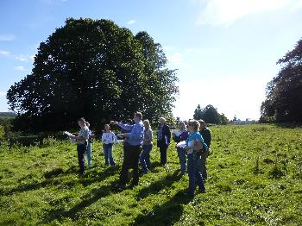
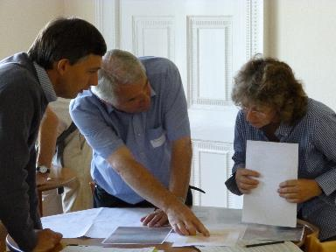
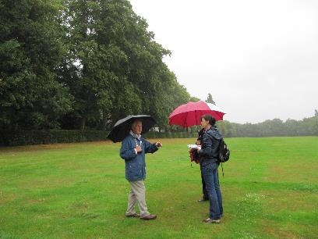
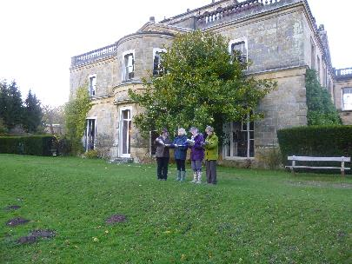
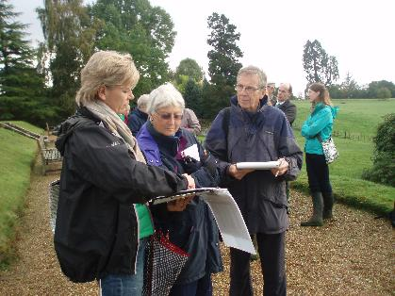
Notes:
What are CGTs? Well, here’s a gallery to give you an idea of the jolly things they’re up to. We’re talking about visiting landscapes, studying landscapes, recording, discussing with likeminded people, undertaking work in the planning system, raising the profile of landscapes, fighting the corner.

Slide 3
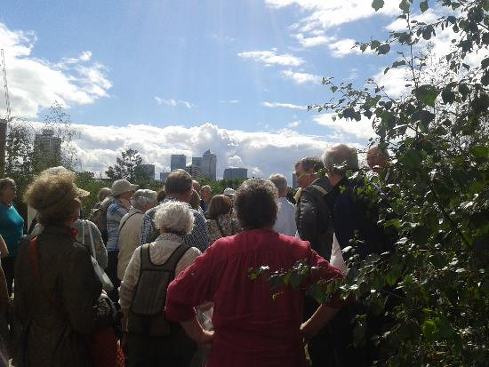
What are County Gardens Trusts?
35 County Gardens Trusts – CGTs
Association of Gardens Trusts (AGT) - Umbrella body
Autonomous charitable organisations
Membership 50 – 400+ per county
Members – volunteers – active and inactive…
Research & Recording Groups
Conservation Groups
Education initiatives
Garden visiting groups
Working Together … merger Garden History Society (GHS)
Notes:
So hopefully those pics have made you feel warm and fuzzy, but we do need some gritty details to explain what CGTs are:
35 County Gardens Trusts – CGTs
Association of Gardens Trusts (AGT) - Umbrella body
Autonomous charitable organisations
Membership 50 – 400+ per county
Members – volunteers – active and inactive…
Each has a committee of Trustees with sub groups such as Research and Recording groups, Conservation Groups
Research & Recording Groups
Conservation Groups
Education initiatives
Garden visiting groups
Working Together … merger – Garden History Society (GHS)

Slide 4
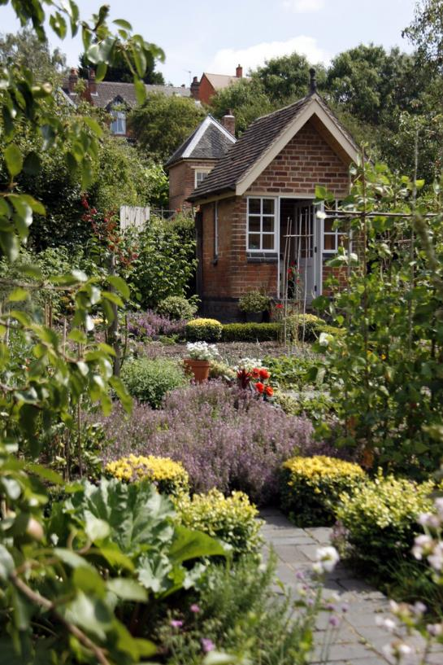
Gardens Trusts?
Or Historic Designed Landscape Trusts?
Notes:
Need to clarify the title…
Yes, we are interested in pretty gardens, such as these Hill Close Gardens in Warwickshire, but when we say ‘gardens’ we tend to be using it as a shorthand for the much wider reaching ‘historic designed landscapes’

Slide 5
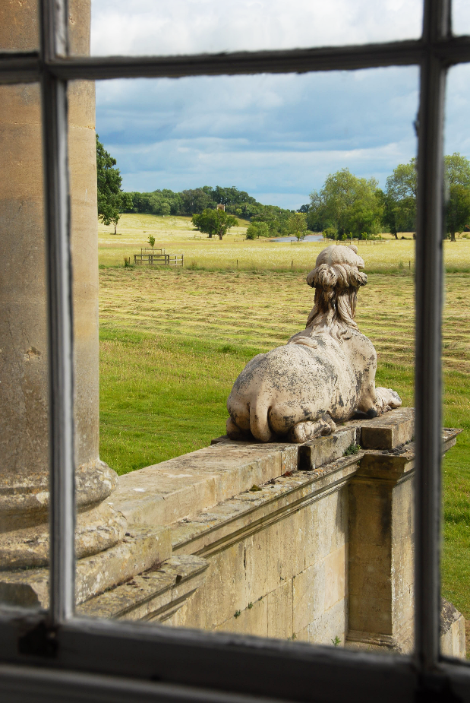
Notes:
We’re also talking about wider parkland such as Capability Brown one at Croome in Worcestershire
(Photo courtesy of Steffie Shields)

Slide 6
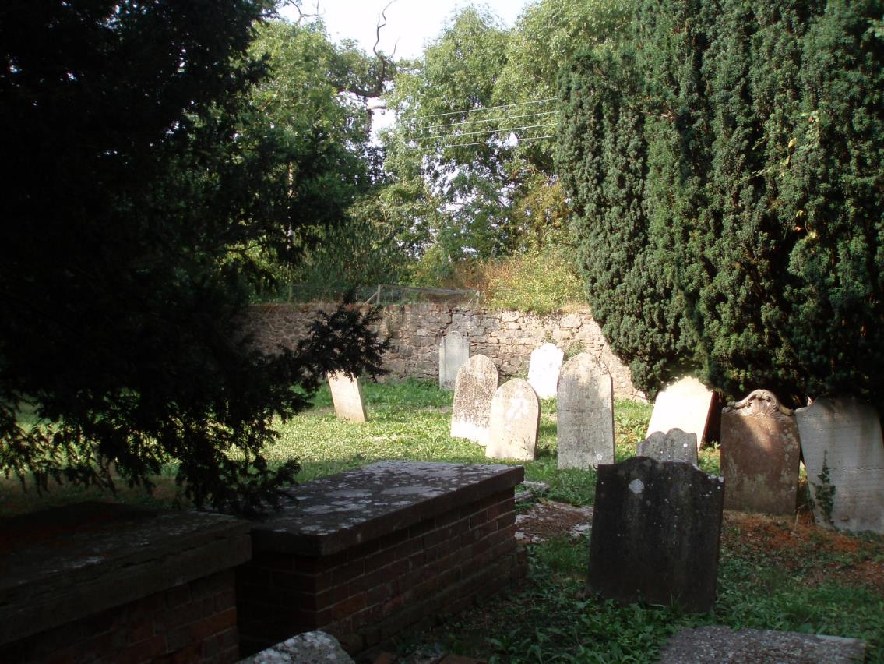
Notes:
And all manner of designed landscapes including urban public parks, garden squares, cemeteries, institutional landscapes such as hospitals. This is Gulliford Burial Ground, Lympstone [thanks to Carolyn Keep of DGT for pic]

Slide 7
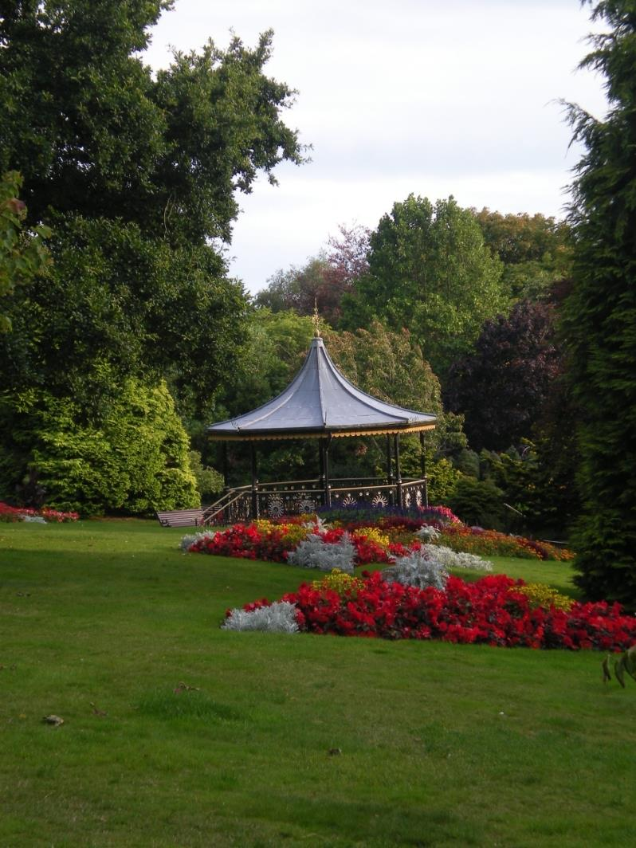
Notes:
Municipal parks too - Victoria Park, Truro, Cornwall (Unreg)

Slide 8
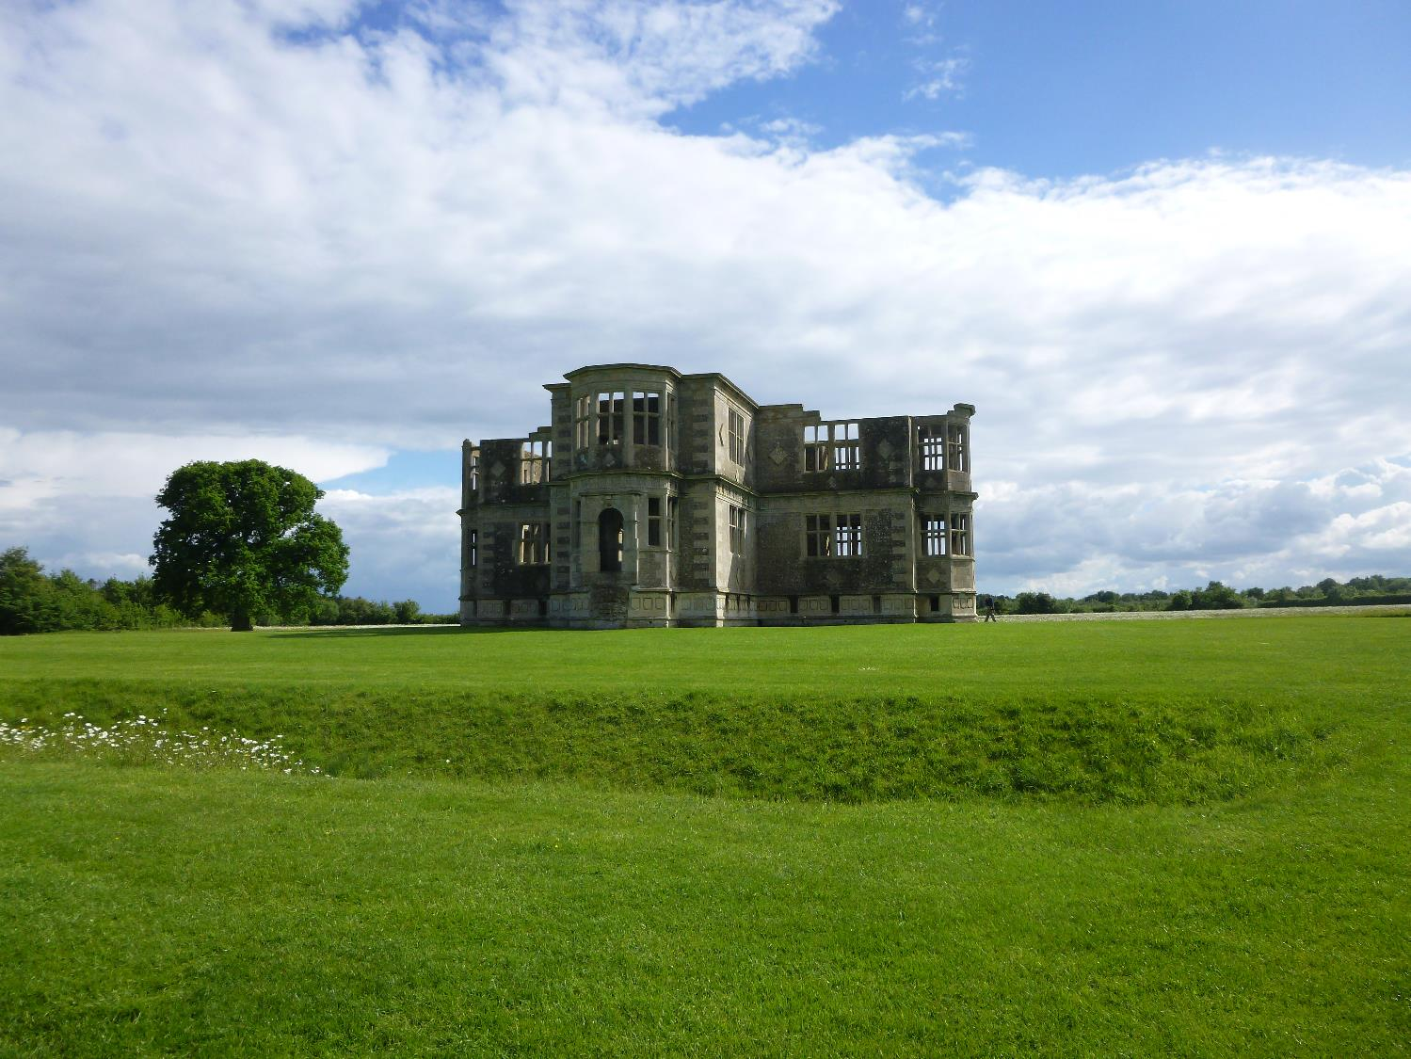
Historic Landscape Project
Notes:
Also very interested in Setting - that is the landscape around the actual park or garden that provides its backdrop, often very intentionally by design
Lyveden New Bield, Northants – wind farm proposal wasn’t in the actual garden but was in the views (setting) to and from Lyveden so would have had a massive impact

Slide 9
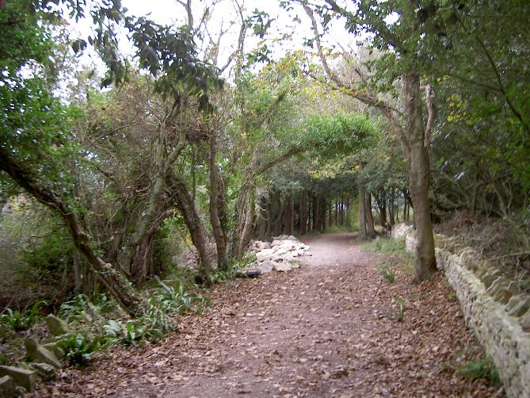
Protect and conserve landscapes
The kinds of things that can threaten landscapes are:
Neglect
Poor management
Lack of investment
Development
Change of use
Lack of natural/historical balance
Lack of understanding of significance
Notes:
Now here’s the bad news.
Our historic landscapes are massively under threat.
The kinds of things that can threaten landscapes are:
Neglect
Poor management
Lack of investment
Development
Change of use
Lack of natural/historical balance
Lack of understanding of significance
[Durlston Castle, Swanage, Dorset - key circulation route within Grade II RPG overgrown and key designed views obscured due to inhibition on appropriate tree management due to blanket TPO]
The good news is that CGTs are doing great things to conserve historic landscapes. The Historic Landscape Project is funded specifically to encourage this.

Slide 10
BY UNDERSTANDING
the historic environment
people value it
BY VALUING
it they will want to
care for it
BY CARING
for it they will help people enjoy it
FROM ENJOYING
the historic environment comes a thirst to understand it
Notes:
CGTs double interest in research and conservation makes them brilliantly placed to play a role in ‘modern conservation’, in which the two subjects are intrinsically linked.
This is a lovely diagram from English Heritage, now Historic England, demonstrating the value of understanding to the conservation cycle.
Research into the historic development of a garden is essential in order to understand what we have now, and therefore work out what is of value, of significance.
[Where research and recording is undertaken with local partners such as the county gardens trust or local archive centres, and, of course, owners themselves, the knowledge and significance of a site is both deepened and disseminated more widely and publicly, promoting a cycle of understanding, valuing, enjoying and protecting the designed, historic environment.]

Slide 11
Who are CGT members?
Professional and amateur skills
Wide knowledge and specialisms
Local (and national) knowledge
Local and national contacts
Notes:
I’m going to talk more about the great things CGTs are up to in a minute, but first, who are they?
Who are CGT members?
Members come from all kinds of professional and amateur backgrounds. Lots of retired planners!
Some just like visiting nice gardens but most have a wide knowledge and specialism, even those with amateur backgrounds.
Local (and national) knowledge – level of expertise often astounding – connections they can make between sites and themes
Many also have excellent local and national contacts of relevance, either pre-existing or ones that they’ve built up through their involvement in the CGT.

Slide 12
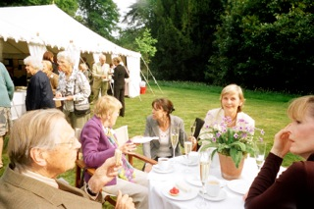
What do CGTs actually do?
Notes:
So what do CGTs actually do? Do they sit around all day drinking sparkling wine in nice gardens, like in this pic?
Well, of course they are great at organising lovely garden visits and interesting lectures – this is a given so I’m not even going to talk about it today.

Slide 13
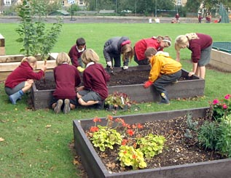
Education
Notes:
The other thing they do really well, that I’m not going to talk about today, is their Education work - their work with the wider public to encourage actual gardening or creating new gardens, especially with schools.

Slide 14
Research
Researching local landscapes
Site survey and recording
Understanding significance
Writing up concisely, consistently, professionally
Notes:
What I think we want to hear about today, is the serious and invaluable (and fun!) research work that they do.
By way of summary,
CGTs are busy researching local landscapes that would otherwise go unrecognized (as well as ones of national importance).
This work includes days in the archives, but also involves walking the ground with a site survey and recording and an appreciation and noting of what survives in the landscape today as well as finding the details of its past.
CGTs and their research work are also at the forefront of the conservation move to ensure an understanding of the significance of sites – I’ll talk more about this later on today.
And of course, what you’ll see about CGT research is that we are making sure that work is written up concisely, consistently, professionally.
Of course, CGTs do a huge amount of ongoing research work, but they also like to bundle things up into ‘projects’, as a great way of creating buzz and attracting volunteers. Currently lots are focusing on projects researching Capability Brown landscapes, for his Tercentenary festival in 2016, or 1WW gardening or memorial sites as part of the centenary. Walled Gardens are also attracting a lot of attention, with several, from Isle of Wight to Suffolk researching and publishing on walled gardens.

Slide 15
Oxfordshire Walled Gardens Project
Focused project
New members
Reinvigorate research
Increase knowledge and skills
Add to records
Raise profile
Contribute to conservation in county
Notes:
In April 2012 the OGT was awarded £50,000 by the Heritage Lottery Fund to research the walled kitchen gardens of Oxfordshire.
The funding enabled them to hire a project co-ordinator, who recruited an enthusiastic band of volunteers to undertake the research, survey work and recording of these sites. The project was completed in July 2014 and has led to a much better understanding and appreciation of these often-neglected gardens, with a book and information on the gardens being available via the OGT website.
The initial research involved looking at historical maps and other archives and data sources, including aerial photography. This identified the location of over 200 walled kitchen gardens in the county, which was followed up with site visits to 89 of them, where owners allowed access, so that they could undertake condition surveys.

Slide 16
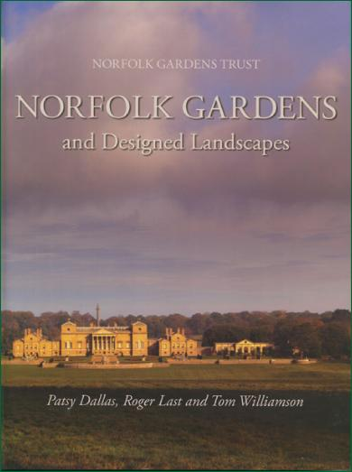
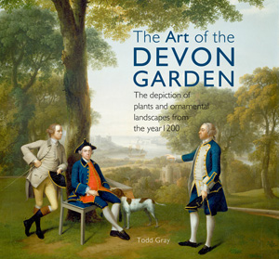
Publishing
*PK Stembridge Thomas Goldney’s Garden (1996) pp30 £3.50 ISBN0 9518290 2 5
Peggy Stembridge Thomas Goldney, Man of Property (1991) ISBN 0 9518290 1 7 *Stewart Harding and David Lambert Parks and Gardens of Avon (1994)
pp132 £7.95 p/b ISBN 0 7291 0230 0
*R Guilding Historic Public Parks: Bath (1997) with Bath and NE Somerset Council
pp76 p/b ISBN 0 9531013 0 4 £5.95
*D Lambert Historic Public Parks : Bristol (2000) with Bristol City Council
pp72 p/b £5.95 ISBN 0 9531013 2 0
D Lambert Historic Public Parks: Weston-Super-Mare (1998)
pp56 £5.95 ISBN 0 9531013 1 2
Journal
[Planning a gazetteer for 2010]
*[Caversham Court Gardens: A Heritage Guide Friends of Caversham Court 2012]
*Talking Heads: Garden Statuary in the Eighteenth Century (2007) 32pp A4
*Flowers in the Landscape (2008)
**The Gardens of Cambridgeshire: A Gazetteer (2002)ISBN 0 9538542-0-5
*John Drake Wood and Ingram A Huntingdonshire 1742-1950 (2008) 260pp pb
ISBN 978-0-9538542-1-9 £14.00
*Journal (2005 and 2008) annually since 1991
Sue Pring, Editor Glorious Gardens of Cornwall (1996) [gazetteer]
Occasional Papers Vol 1 (2002) *Steven Pugsley (Editor) Devon Gardens: An Historical Survey (1994) Alan Sutton in association with Devon Gardens Trust ISBN 0 7509 0055 5
Todd Gray The Garden History of Devon: An Illustrated Guide to the Sources University of Exeter Press in association with Devon Gardens Trust (1995)
ISBN 08598 9453 0
A Short History of he Devon Gardens Trust (1988-2008)
*Journal No 1 (2008)
* Journal No 2 (2010)
* Journal No 3
*Journal No 2 (January 2012)
*Journal No 3 (January 2013)
Fiona Cowell and G Green (Editors) Repton in Essex (2002)
*Angela Taigel Historic Designed Landscapes, Planning and Conservation Guidance (2003) A4 pp100 £17.50 ISBN 1 85281 238 9
EGT Epping Forest District: Inventory of Designed Landscapes (2004 – unpublished)
*Twigs Way (Editor) Paper Landscapes: Archive Based Studies on Historic Gardens and Landscapes in Essex (2005)
*Twigs Way Rooted in Essex EG Trust Archive Research Group (2006) A5 Paper Places
*Twigs Way (Editor) The Living Landscape: Animals in the Parks and Gardens of Essex (2009) A4 pp90 p/b £10.00 ISBN 978 0 9565198 0 1 (10 articles)
*Gill Hedley and Adrian Rance Pleasure Grounds: The Gardens and Landscapes of Hampshire Milestone Publications (1987) Catalogue of Exhibition at Southampton City Art Gallery in conjunction with Hampshire Gardens Trust ISBN 1 85265 104 0
*Journal 24 (2005), 25 (2006), 26 (2007)
*David Whitehead, Edited by Janet Patton A Survey of Historic Parks and Gardens in Herefordshire Hereford and Worcester GT (2001)
*Grant, Fiona and Patton, Jane (Editors) The Walled Gardens of Hereford with Logaston Press (2009) ISBN 978 1 906663 12 4
Richard Bisgrove Hertfordshire Gardens on Ermine Street (1996)
Patience Bagenal Hertingfordbury Park and its Links with the Bayfordbury Estate (2000)
*Hertfordshire GT and Tom Williamson The Parks and Gardens of West Hertfordshire
(2000) ISBN 0-9538417-1-5
Anne Rowe A History of Knebworth’s Parks (2005)
*Anne Rowe (Editor) Hertfordshire Garden History: A Miscellany University of Hertfordshire Press (2007) [Research work of Hertfordshire GT]
ISBN 978 1 905313 38 9
A Presentation of Parks: a Survey of Amenity Parks and Gardens in Kent (date?)
*Elisabeth Hall Garden of England: Evolution of Historic Gardens in Kent n.d.
ISBN 1 873010 591
Cemeteries and Churchyards (1996)
Funding London’s Heritage Landscapes (1997)
The Gardens of Canons (1997)
London’s Garden Suburbs (1998)
City Parks (1999)
The Gardens of Wanstead (1999)
London Views (2000)
Journal (annually since ?)
Gazetteer (2014)
Patsy Dallas, Roger last and TomWilliamson Norfolk Gardens and Designed Landscapes (2014)
*The Historic Deer Parks of Northamptonshire (2002) A3 folded leaflet
*The Walled Kitchen Gardens of Oxfordshire (2014)
Historic Parks and Gardens of Shropshire Paul Stamper (? CGT publication – check!)
* Lois Hall (Editor) Walled Kitchen Gardens (2003) ISBN 0 9536730 1 4
*‘Pastime of Pleasure’: A Celebration of Suffolk Gardens from the Seventeenth Century to the Present Day Exhibition with Manor House Museum (2000)
Guildford Borough Council for Surrey Gardens Trust Nature and Tradition: Arts and Crafts Architecture and Gardens in and around Guildford (1993)
*Joan Percy In Pursuit of the Picturesque: William Gilpin’s Surrey Expedition
(2001) ISBN 0 9540630 0 7
*Josey, Don and Saich, Dinah Broome Park, Betchworth; with a Bit about Ice-houses
(2005) ISBN 0 9540630 1 5
Mavis Batey (Editor) A Celebration of John Evelyn: Proceedings to Mark the Tercentenary of his Death (2007)
*Campden House (1994) 5pp A4
*Honington Hall (nd. 1995?) 7pp A4
*Radway Grange (2003) 7pp A4
*Wroxton Abbey (Oxon) (1997) 7pp A4
Journal (1997-2004,*2005,*2006,*2007)
The Obelisks of Warwickshire (2013) ISBN 978-1-85858-515-4 pb
Historic Gardens of the Vale of Glamorgan published by Welsh Historic Gardens Trust ISBN 978-9558021-0-2; 2007, Edited by Hilary M. Thomas.
*Journal (Nos 34 1996, 1997, 51 & 52 2005, 56 2007, 57 2008)
Helen Lazenby Plumpton Rocks, Knaresborough (1997)
*With Abundance and Variety: Yorkshire Gardens and Gardeners across Five Centuries
(2009) ISBN 978 0 9564347 0 8 pp188 pb £18.25 from publisher inc p&p (£16)
David Palmer Historic Parks and Gardens of Ceredigion (2004)
Notes:
As with the OGT Walled Garden project, many CGTs have been publishing their research on their websites and producing excellent books, such as these by Devon and Norfolk GTs.
Norfolk have just gone into second reprint of their new book on their county gardens.

Slide 17
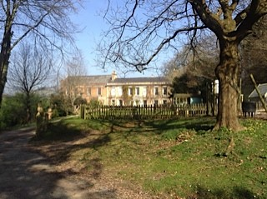
Designation
Great Ambrook Italian Garden
A triumph for Devon Gardens Trust in successfully adding it to the National Heritage List!
Notes:
[thanks to dgt for pic]
For many, their research is tied into an effort to put a site forward to be nationally designated as a heritage asset by going on to the English Heritage Register of Parks and Gardens of Special Historic Interest, the landscape equivalent of listing. Equally, commenting on EH’s (Historic England’s) proposals to designate something. These days the Register is available online at the Historic England website as part of the National Heritage List.
By way of background for any of you who don’t know, the Register in itself entails no additional statutory controls within planning protection. It is compiled with the aim of identifying important historic parks and gardens in order to increase awareness of the existence of these sites, and to encourage their protection and conservation. It entails no additional statutory controls in itself but the historic interest of a park or garden is established as a material planning consideration, and the Register provides the key means by which sites of special historic interest are identified. It draws attention to the fact that the sites included should receive special consideration if changes or proposals for development are being contemplated.
Local authorities are required to consult English Heritage over any planning applications they receive which may affect sites graded I or II* on the Register. They are also directed to consult the Garden History Society on applications which may affect any site on the Register regardless of grade (and as we will see later, consultation with the GHS these days effectively means consultation with the local CGT too). Additionally, the Register is used by many local planning authorities as the basis for relevant conservation policies in statutory development plans.
In 1999 there was a Review of the Register and, to give you an idea of the respect with which EH sees DGT, they were commissioned to carry out the Devon Review, via a desktop study. As a result, some additional public parks and cemeteries were added to the Register (that was the theme the EH was interested in at the time).
Generally speaking, it’s pretty tough to get a site onto the Register, and Historic England are clear that currently they are only really looking at those applications where the nominated site is under threat of development (or if it is a 1WW memorial park). This threat of development was the case at the Italian Garden of Great Ambrook, which DGT and others successfully saw onto the Register at Grade II recently after it was threatened I think with solar development.
The Italian Garden at Great Ambrook was laid out between 1909 and 1912 by T H Lyon for Arthur Graham.
Designated:
For the unusual design of the garden, reflecting the early-C20 fashion for Italian style in gardens, but taking a more informal, picturesque approach suited to the Devon landscape within which it is set;
as the only surviving garden created by T H Lyon, a local architect with a more far-reaching role as first Director of the Cambridge School of Architecture, whose eclectic tastes are well represented in the garden design;
Because the garden includes a number of buildings and structures of unusual design, which form an integral part of the layout and experience of the site;
Because despite decades of neglect, the garden remains remarkably close to its original design, as evidenced by contemporary documents and photographs;
Because a number of mature trees and plants survive from the original planting scheme;
for the socio-historical context in which the garden was produced, being commissioned, designed, and written about by men linked by homosexuality as well as by aesthetic interests;
And because of it’s Group value with Grade II-listed Great Ambrook House, to which Lyon added a music room extension (pic) contemporaneous with the garden.

Slide 18
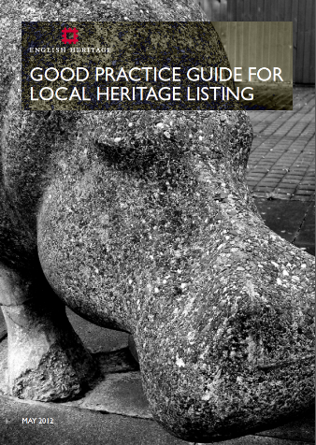
Local listing
Non-designated local sites identified with local community against agreed criteria
Local lists can be attached to the Local Plan
Non-statutory
Good way of achieving greater recognition for local heritage assets, albeit with potentially limited protection
Notes:
But the National Heritage List and Register aren’t the be all and end all, and CGTs really come into their own when it comes to local listing.
Local Listing involves Non-designated local sites that are identified with/by local community against agreed, published criteria
Local Lists are non-statutory with therefore potentially limited protection but on the otherhand they are a good way of achieving greater recognition for local heritage assets, and the Lists often form Supplementary Planning Guidance the Local Plan
Lots of CGTs have been channelling their research into Local Lists , through building relationships with their local authorities.

Slide 19
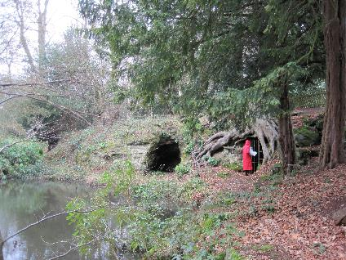
Kent Compendium Review Project
Notes:
Kent GT’s Compendium is always a good example, because their reports are fully compliant with the EH Local Listing guidance!
In the early 1990s, Kent Gardens Trust in association with Kent County Council produced a register of significant parks and gardens within the county (The Kent Gardens Compendium). This compendium has been of considerable benefit to the various planning departments in Kent in enabling them to identify sites which will need to be protected. This is common to many CGTs.
But KGT since felt that this register needed to be updated and formalised in greater detail, so embarked on the Kent Compendium Review Project. Since 2009, a group of volunteers have been trained to systematically research and record gardens identified as being of significant historical or social interest. Major gardens in the care of bodies such as the National Trust and English Heritage were excluded as they are already well documented, but all the reports are written up in an English Heritage approved format. I’ve got an example entry on display here.
Volunteers have now looked at parks and gardens in the areas covered by Tunbridge Wells Borough Council and Sevenoaks District Council and the reports have been presented to the two councils and should provide valuable source material to the respective planning departments. They have also done some reports for Thanet District Council and are now engaged in a major project for Medway Council. They are very grateful to all the councils we have worked with for their support.

Slide 20
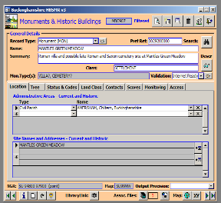
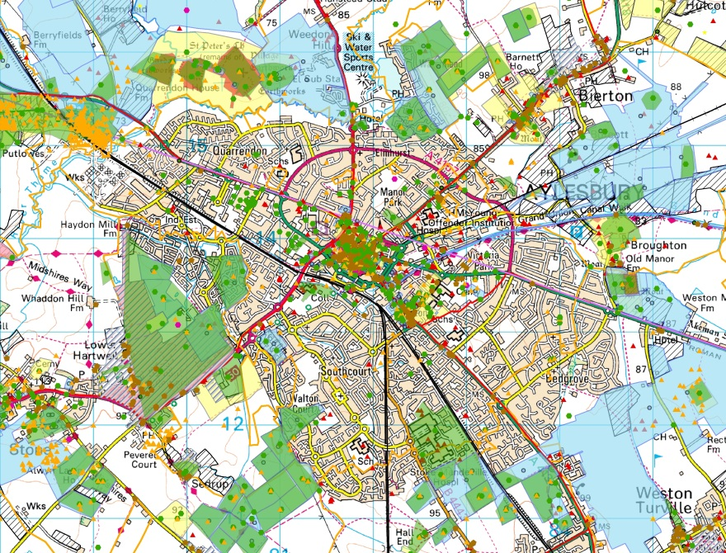
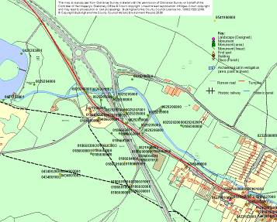
Historic Environment Records (HER)
Notes:
Increasingly though, CGTs are hearing our calls to make sure that their research is used to the benefit of conservation, by adding it the Historic Environment Records (HERs).
These are local authority run public access records of the whole historic environment of a county, district or unitary authority that can be linked to a specific spatial entity or location. Generally but not always available on internet.
HERs cover all kinds of sites:
Most records include:
Nationally designated sites (Scheduled Monuments, Registered Parks and Gardens, Listed Buildings)
Locally designated sites (Conservation Areas, Locally Listed Buildings)
all reported archaeological sites
historic buildings
historic landscapes
archaeological events (investigations, surveys etc)
A record for a particular site can comprise of
a computerised database linked to GIS mapping
reports
illustrations
aerial photographs
historic mapping
other backup material
library
online HER websites
On screen here is an example of the kind of hi-tech mapping, layering and interrogation that HERs can make possible by pooling together various pieces of research and record. Basically, they can take our research and give it wings!
Who uses HERs?
local residents and community groups
students and academics
schools
commercial contractors and consultants
government and other national agencies And the really exciting bit is:
local authority planning officers
conservation and historic building officers
You may or may not know that the government’s planning framework that local planning authorities have to work to (National Planning Policy Framework, NPPF) obliges planning applicants to consider the significance of a heritage asset in their application, and local authorities to again consider the significance of heritage assets in making a decision. In doing so NPPF obliges local authorities to maintain these Historic Environment Records as the place where this information will be found. So, you can see that if local authority officers consult the HER in order to decide whether an application will have an unacceptably detrimental effect on a heritage asset or not, it is huge power to CGTs’ elbow if we can have made sure that the information we want officers to see with regard to a site’s importance is on there!

Slide 21
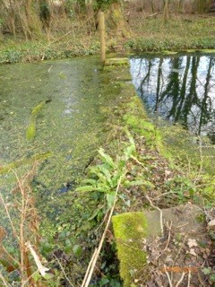
Avon’s Historic Environment Records
Regular meetings with HER officer
HER officer suggests sites to research
HER provides digital copies of historic maps
Gardens Trust research sent to be added to HERs
Notes:
I’ll just give you an example of a CGT that’s making great links with it’s HER at the moment – Avon.
There are four unitary authorities in Avon – North Somerset, South Gloucestershire, Bristol City and Bath & North East Somerset.
Avon GT has established particularly strong links with North Somerset and South Gloucestershire.
At North Somerset the HER officer is part-time and so welcomes any information the Trust can pass on. They have had several meetings with him over the last two years including one where the HER officer suggested certain sites relating to parks and gardens which he felt would benefit from further research by the Trust’s volunteer researchers.
South Gloucestershire – officer has two posts as he is the HER officer and Archaeological Officer. He will send AGT digital copies of historic maps for any site they are researching, and any new information is sent through to him. Under the Historic Environment section on the South Glos. website, there is a sub heading entitled Parks and Gardens
The HER officer for BANES is new and AGT have heard via their Conservation Officer that he is keen to arrange a meeting – what a great reputation the Trust obviously has!
.
This pic is of an intact Victorian Bathing Pond on what had once been part of the Tyntesfield Estate which is a registered Historic Park and Garden. The AGT team is currently researching this and will make sure it is added to the HER.

Slide 22
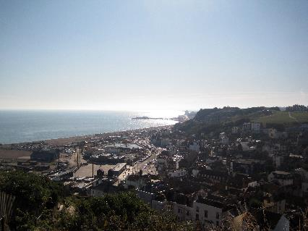
Hastings Local Listing Project
Contact made with East Sussex HER
Contact made with Hastings BC - took the bait! Timely approach
Used all available local contacts
Local archives training
New audiences
Notes:
Want to take a moment to talk about how research projects aren’t just for the benefit of our heritage, but also have great benefits for the Trusts and their mojo. Sussex GT decided to revitalise its researchers with a local listing project, based on Hastings.
They didn’t just shuffle along to their local archive and get on with it. Instead, along the way, they have engaged great numbers of new people.
First they met with the East Sussex County Archaeology and HER team to discuss whether this project was something their department could support. A new HER officer was to be appointed and the team agreed in principle that practical support such as the provision of maps and other archival information stored on the HER could be given. SGT say ‘The importance of having the County HER on board cannot be underestimated, not only to provide archival material in electronic form, particularly OS maps, but to become the main repository for the completed site reports.’
Then they met with Hastings Borough to set up working in partnership. They contacted the conservation officers in Hastings Borough and patience and persistence paid off eventually. Hastings BC responded positively, agreed to host our introductory meeting and as partners to comment on potential sites and local listing criteria. It subsequently transpired that HBC had just passed a council resolution to undertake local listing so (unknown to us at the time) so our offer of running a project was timely.
Then they used this as a brilliant opportunity to get in new volunteers, pulling in SGT members’ own local contacts. An author of a locally produced booklet on an historic site in Hastings led to contact with a number of individuals and press outlets with a potential interest in local listing. They prepared several adverts and articles to distribute.
Finally, through the first few people gained through the press and personal contacts, word spread through the local community – we think via at least 2 ’Friends of’ groups ( one from the town’s main HLF-restored park and the other the country park) the local Hastings Area Archaeological Group (HAARG), the Hastings On-Line Times.
This is now a thriving project, well underway.

Slide 23
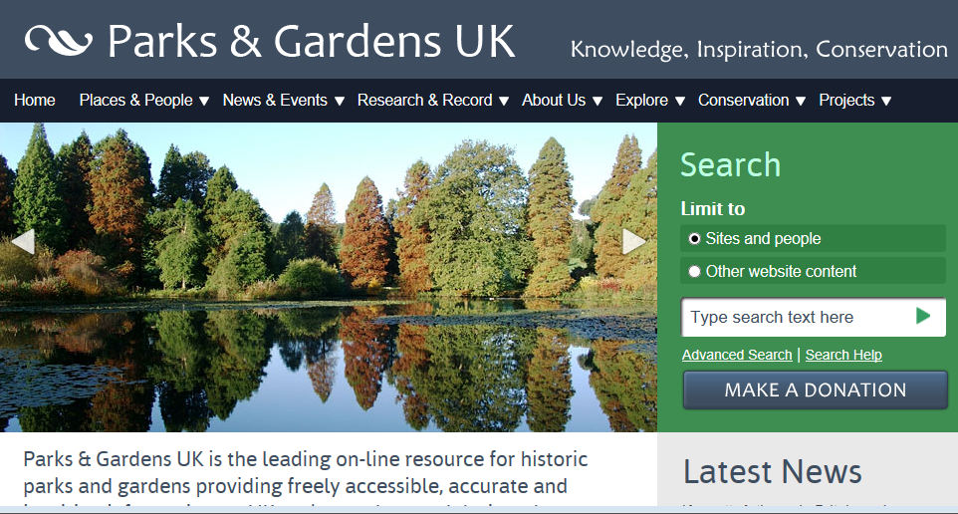
www.parkandgardens.org (PGUK)
Notes:
Quick note to mention our friends at PGUK, onto which many CGTs are putting their research.
Parks & Gardens UK is the leading on-line resource for historic parks and gardens providing freely accessible, accurate and inspiring information on UK parks, gardens and designed landscapes and all activities concerned with their promotion, conservation and management.
Additional information and new sites are added as information becomes available. This website has no statutory authority with regard to planning or other permissions.
Signed up to by AGT, GHS (supported by EH, HLF etc, although funding rather thin on the ground at the moment) – is the home for many of the projects being undertaken by theses organisations and we are encouraging CGTs to make sure that their research goes onto PGUK as well as HERs (indeed, many HERs pull their info off of PGUK)
Hampshire GT’s 1WW Gazetteer project.

Slide 24
Yorkshire’s East Riding and Selby projects
Training volunteers
Identifying sites of local interest
Desktop research
Site visits to record what is on the ground
Adding in Statements of Significance
Notes:
[NB SLIDE MST NOT BE REUSED IN OTHER CONTEXTS OR PUBLISHED ONLINE]
One of the best things about the research that CGTs are doing at the moment, is that much of it has picked up on the importance of ‘Significance’ in current planning systems. I won’t go into detail here, but EH’s Conservation Principles and the National Planning Policy Framework all put great emphasis on conservation being in terms of managing change to the ‘Significance’ of a heritage asset, rather than necessarily preserving the actual fabric entirely in aspic regardless of which bits are and are not of value.
Following on from this, HERs need material submitted with a Statement of Significance, so that planners, developers and others can readily understand the Sigificance of a site that they need to protect.
So gone are the days when a researcher could devote 10 years of their life to researching one site, then at the end deposit 6 box files of material or 10,000 words on every planting detail of a garden.
What we need now is something to accompany that which assesses the material and reaches some conclusions, in only a few hundred words, as to what is actually Significant with value. (Moderately complicated concept, we have devoted entire training days to this.)
We have been delighted recently to hear of a brilliant project from Yorkshire GT, in which they have revisited a project in the East Riding which identified sites of local importance and then researched them using desktop tools. In the revisit, they have now gone back to those sites and actually visited them to record what survices on the ground and, very excitingly, have been completing Statements of Significance, having first carried out training workshops for their volunteers.(This is a pic of one of their volunteers examining the ice house at Grimston Garth)
This has been a great success so they are now about to embark on a similar project in the Selby District.

Slide 25
Planning applications
Commenting on Planning Applications affecting parks and gardens
Now doing this in close liaison with the Garden History Society, who are a statutory consultee
Volunteers or paid staff
Notes:
Commenting on Planning Applications affecting parks and gardens
Now doing this in close liaison with the Garden History Society, who are a statutory consultee
Volunteers or paid staff – Devon has excellent John Clark, LPGT recruiting for cons officer who will be hub of local groups

Slide 26
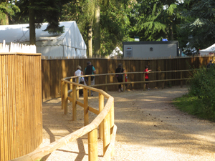
Planning applications: Warwick Castle
Warwick Castle , Grade I Registered
Huge ‘glamping’ proposal
Warwickshire GT working with The Garden History Society, the Warwick District Council Conservation Advisory Forum and local objectors, including the Tree Wardens.
Ongoing…
www.warwickshiregardenstrust.org.uk
Notes:
This is Warwick Castle - SAM, Grade I Listed building surrounded by a Grade I RPG. Warwick GT has been fighting a planning application for a mega glamping site in the castle’s landscape, working with The Garden History Society, the Warwick District Council Conservation Advisory Forum and local objectors, including the Tree Wardens.
So, Warwick Castle Park is a Grade I registered landscape, one of only 142 in all of England, created between 1743 and 1803 by two Earls of Warwick, with assistance from Capability Brown. The registered landscape is in divided ownership with Merlin Entertainment Group owning the Castle gardens and a small part of the Park. The rest is privately owned.
In 2013, Merlin initiated “glamping” in Foxes’ Study, without planning permission. (Foxes’ Study was planted in the Picturesque style in the late eighteenth century. It forms the transition between the gardens and the park and would have been a mixed plantation of trees with an understorey of shrubs, interlaced with winding paths.) In 2014 they obtained a temporary permission for 42 tents.
Then, before any evaluation of the impact of the initial glamping could be made, they put in an application for permanent summer use of the 41 tents, together with 20 pairs of semi-detached lodges, and 5 tree houses. This was refused, but was swiftly followed by a new one for 40 standard (round) tents, 3 premium (oval) tents, 9 trailers of loos (and one disabled) and three of showers, in addition to four large service tents for reception, dining and cooking and a generator. This for the next three seasons. They claim there will be 14,000 overnight visitors per year during the five month opening of the site.
National planning policy declares that significant damage to Grade I landscapes (and other heritage assets of this grade) and their settings should be “wholly exceptional” but the Castle’s planning advisers are already claiming that the permissions for 2013 and 2014 have established the acceptability of glamping in this location.
Clearly, this is very worrying for the historic landscape of Warwick Castle, but above all it would be a precedent which would put other historic parks at risk.
Warwick Gardens Trust’s volunteers robustly fought this application through letters to the local authority but far too often these stories don’t end well or us and in February the application was granted.
The Trust will fight on however, determined not the let the resubmission of the lodge application be approved – wish them luck, please, and go to Warwick GT’s website for details on how you can add your support to their battle.

Slide 27
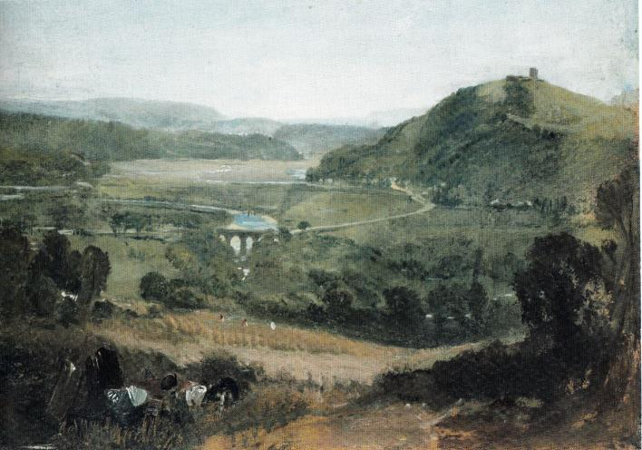
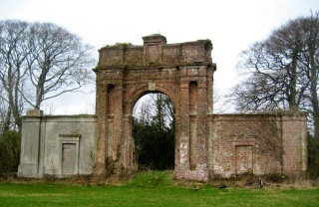
Planning applications: Boringdon Arch
Wind with a 50m hub height, 77m tip height with associated infrastructure and formation of access track
Refused!
Harm to historic interests – Saltram and Boringdon
Unacceptable landscape and visual impacts
The significant harm to historic interests and landscape character, visual impacts and harm to neighbours are considered to outweigh the benefits of the production of renewable energy
Notes:
But thankfully, CGTs are also having great successes in looking after the interests of landscapes in the planning system! Especially in Devon under the careful hand of John Clark, Cons Officer.
This is Boringdon Park, which is now a golf course, who recently put in a planning application for a Wind Turbine (estimated output of 500kw) with a 50m hub height, 77m tip height with associated infrastructure and formation of access track. It is within a local landscape, but the proposal would be in the setting of Grade II* Saltram.
DGT objected, along with EH and the NT (who specifically said that they agreed with DGT’s view).
DGT’s research skill and knowledge was invaluable, as they were able to explain the connection between the Boringdon Arch and Saltram. The Arch was built for Lord Boringdon in 1783 to a design by Robert Adam and both served as an “eye catcher” from Saltram House and, provided a sudden and dramatic view of Saltram when approached from the north, via a former drive from Boringdon House – this is crucial because the wind turbine would be slightly below the ridge and a little to the east of the Boringdon Arch so therefore would be a visual competitor in the views of the Arch from Saltram and vice versa. This pic is a painting of the view out from Boringdon, painted by Turner in the early 19th century. The Trust has also corrected an error contained within Environmental Appraisal Report, which asserts that Saltram landscape addresses the House and the estuary. In actual fact, the Boringdon Arch was the focal point of the overall landscape design, linking the new seat at Saltram with the ancestral seat of the Parkers at Boringdon.
We have just heard that permission has been refused, due partly to harm to historic interests and unacceptable landscape and visual impacts, with DGT’s comments being quoted in the report. In this case, the significant harm to historic interests and landscape character, visual impacts and harm to neighbours are considered to outweigh the benefits of the production of renewable energy.

Slide 28
Conservation & Research working together
Indio House, Bovey Tracey
Notes:
Final example, I always show this across the country to demonstrate the link between conservation and research, which gives great power to CGTs’ elbow, and can be absolutely invaluable. (Thanks to John Clark, DGT, for pic)
It’s a Devon example, of course! This is Indio House , where there was an application to build over 100 new houses in its parkland. The lpa asked Devon GT researchers to add it to the Devon Gazetteer – so at Local List level - which it did, and then DGT’s conservation hat put in an objection – consequently the application was refused. Perfect triangle between research, conservation, and great relationships with lpas.
[Indio House is an important historic country house, listed grade II, in a mature historic designed landscape. The parkland and paddocks surrounding the house and the historic trackways, lodge, carriage drive and planting belts form part of the historic landscape associated with the house and are important to the appreciation of its setting. Indio House replaced an earlier house on this site and was designed in 1850 by the Exeter architect, David Mackintosh for Charles Aldenburg Bentinck, Lord of the Manor of Bovey Tracey. The house remained in the ownership of the Bentinck family until 1939, when it was sold with 1.5miles of trout fishing and 400 acres. Shelter belt planting screens the property from the main road. The entrance is marked by a lodge and gates with brick/stone piers and cast iron railings, in the manor of a country house of some distinction. The impressive tree lined carriage drive with parkland railings runs from the lodge on Newton Road, through Heathfield Plantation. It continues past the gardener's cottage, walled garden and converted stables, which were once part of the estate. To the north of the drive lies parkland and paddocks with mature individual and perimeter trees. A tree lined historic trackway forms the north boundary and links to trackways to the north of the house and east of the parkland. The drive terminates at an open entrance area on the south side of the house. The principal rooms of the house face predominately south east with open views across parkland towards woods and the Devon countryside beyond. The property retains some 25 acres of the 400 acre original estate, made up of ancient English woodland, grazing paddocks, an orchard, a third of an acre totally enclosed walled garden and formal gardens adjacent to the house surrounded by shelter belt woods. East of the house is an attractive rose parterre garden with six listed granite columns standing amidst circular and crescent flowerbeds in the Victorian style; open areas of terraced lawn with evidence of further flower beds, a pleasure garden with decorative specimen mature trees including Oak, Beech and Monkey Puzzle; the formal water garden has seen better days. Beyond the parkland railings to the east, is level pasture with a large mature Oak. To the south lies further pasture or parkland bounded by perimeter trees and including an orchard area. To the north lies an orchard with a number of historic orchard trees. The previous Indio House was associated with the Indio Pottery (1750 -1836) which lay to the east of the house. An adit or leat c. 1810-11 connected it to Pond Garden Pottery and the associated Indio Pond or Lakes, now in separate ownership. The Devon Gardens Trust works in partnership with The Garden History Society in responding to consultations and advises that development which adversely impacts upon the historic environment should not be permitted. In our opinion, the proposed development of 122 houses would seriously affect the character and appearance of the heritage asset of Indio House. In conclusion, we are concerned about the adverse visual impact of the proposed development which would cause substantial harm to the significance of Indio House and its setting. We recommend that your authority should refuse consent for this proposal as it clearly conflicts with national planning policy with regard to the conservation of the historic environment. ]

Slide 29
Joining Up
Garden History Society
English Heritage
Natural England
Parks & Gardens UK
Local Authorities
National Amenity Societies
Local History Groups!
Notes:
Just to wrap up, this is such an exciting initiative from Devon GT – I have been telling CGTs across the country about it in the hope that they will copy! It’s fabulous to see you all here, and to see the interest and working partnerships that you all represent.
For me, this is the icing on the cake of some hard graft in which we have all been working hard to make links, friendships, working partnerships wherever possible as there is strength in numbers and in unity.
CGTs now work closely with
GHS – working together on planning, merger
EH: WW1 – Commemorative Landscapes; Designations
Landscapes At Risk
Specific small research and survey projects
Support for owners
We’re starting to work much more closely with Natural England
Designed landscapes can be a target for NE funding especially with water bodies or SSSIs
P&GUK – national database of parks and gardens - building up info through receiving research reports
Local Authorities:
Need information on their HER
Support for local listing programmes
Planning
And speaking of planning – we also have the NAS such as Vic Soc and Georgian Group, SPAB – want and need to work with those that know about landscapes – often the setting for their key targets
And now you all – welcome! We are so pleased to have you here, and are looking forward to working together. I hope this will be a long relationship and together you will do great things for Devon’s historic landscapes!

Slide 30
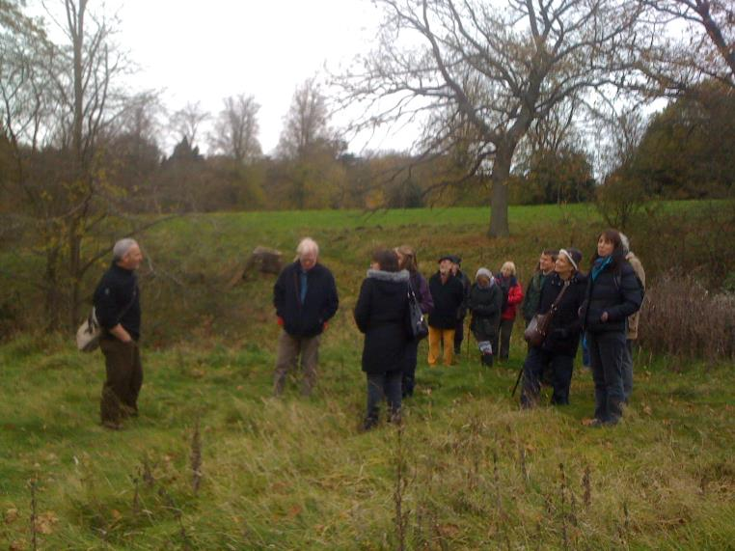
@leapthehaha
www.facebook.com/historiclandscapeproject
www.gardenstrusts.org.uk/hlp.html

